Slide 1


Year 2 Starters
Autumn Term
Test I
Play through the slides, giving children as much time as you think they need to answer each question. Most questions have a written answer; sometimes children may show a number of fingers.
Answers are given at the end of the test.
This is not a class competition! Can children beat their own personal best each week?
Which ride do they get to enjoy at the end?

Slide 2
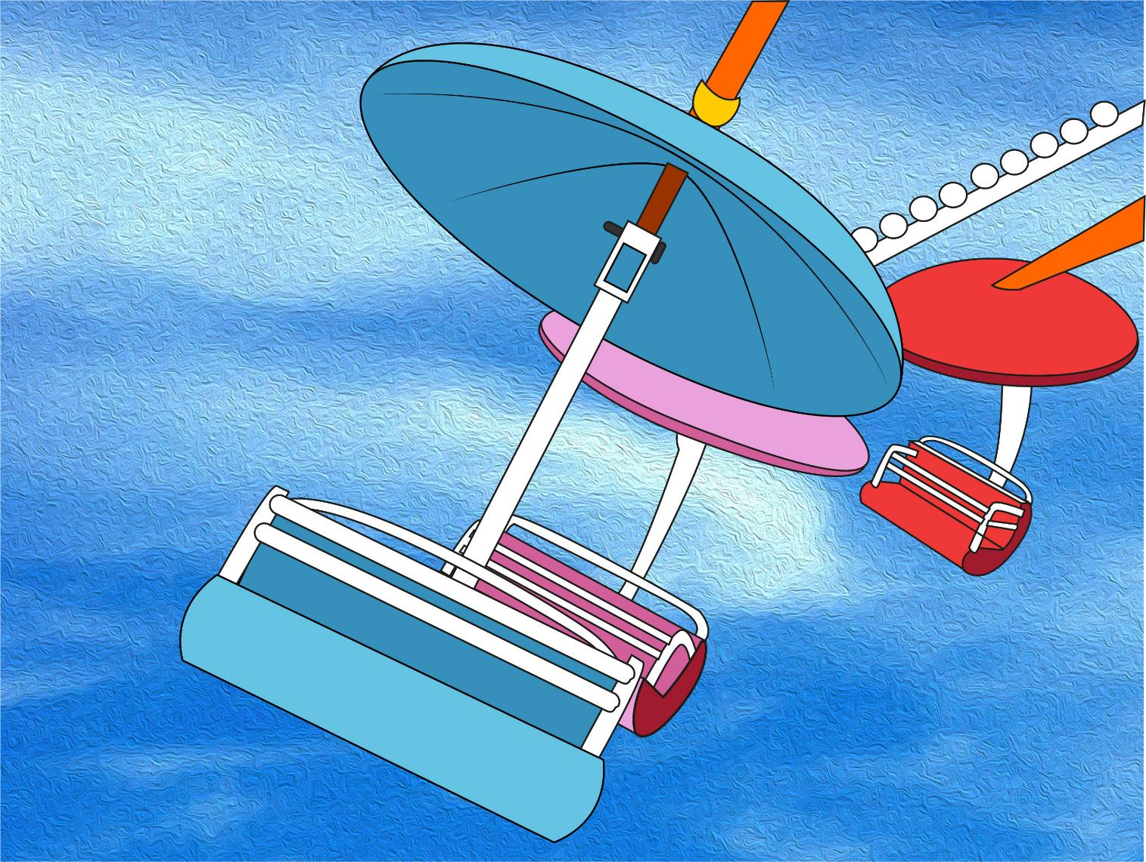
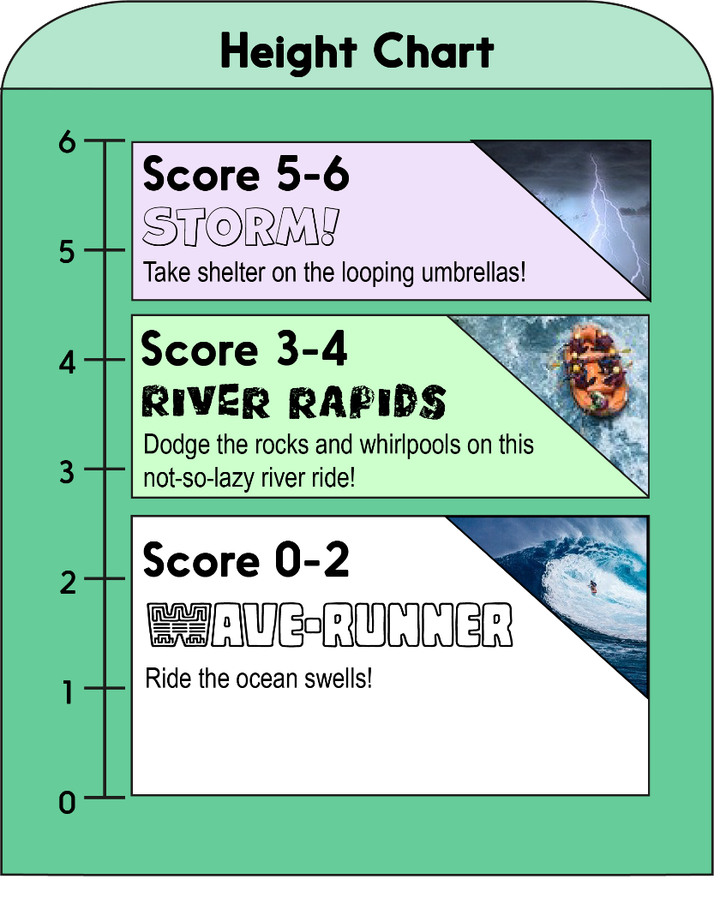


Score a mark on the chart for each correct answer on the test.
Which ride will you measure up for?!

Slide 3
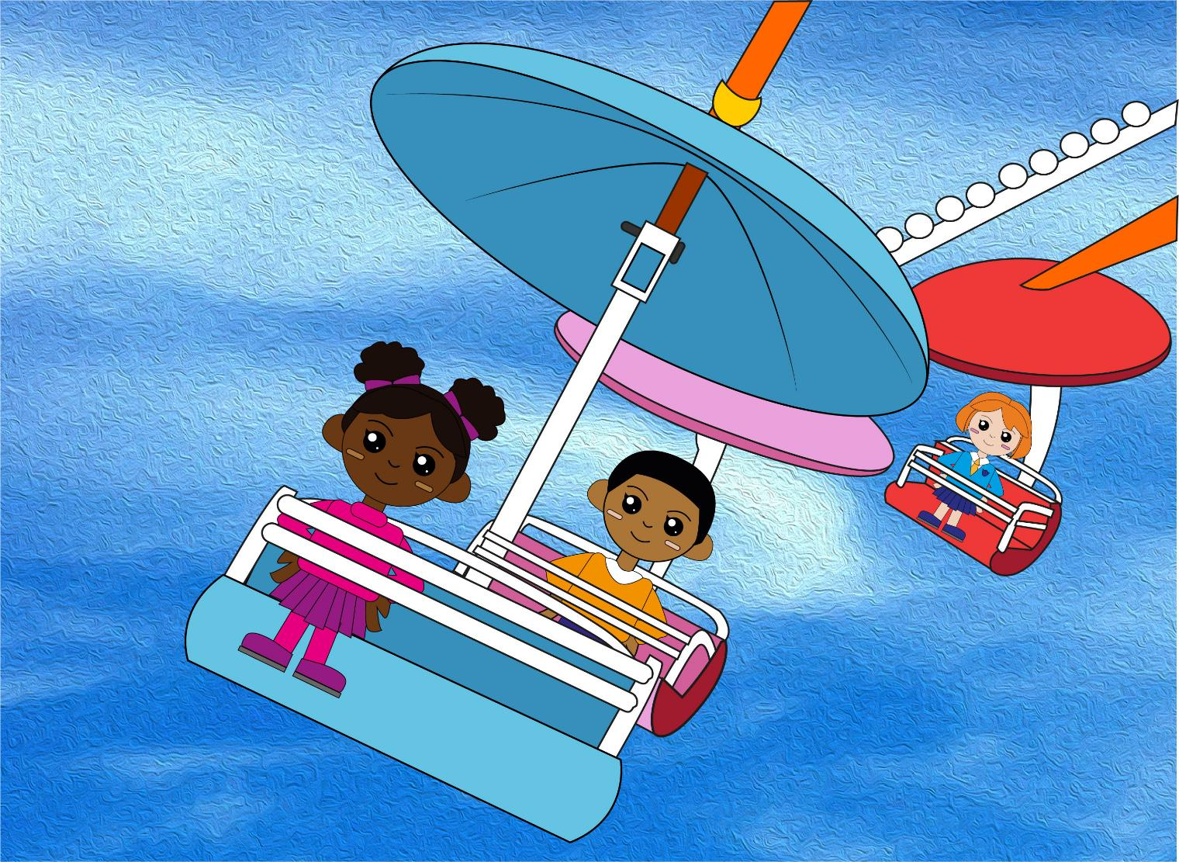

Question 1
Count back in 3s to find the next three numbers.
21, 18, 15, 12, __, __, __
Write the three numbers.

Slide 4
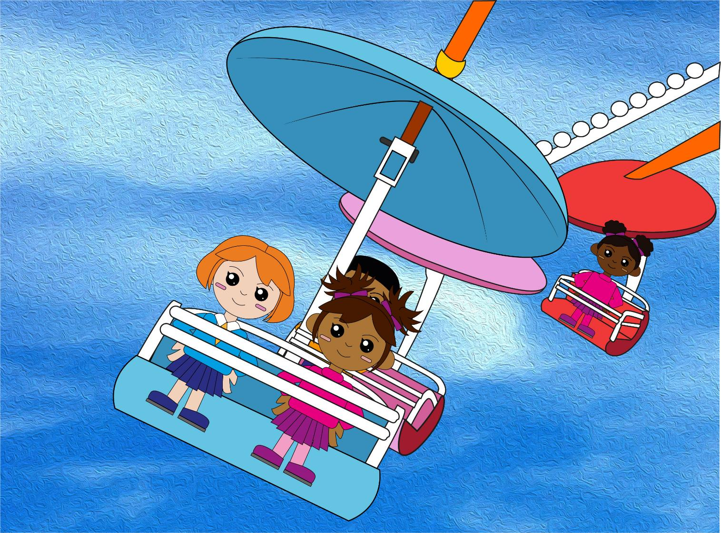
Question 2
Count in 3s to find the next three numbers.
7, 10, 13, 16, __, __, __
text
Write the three numbers.

Slide 5
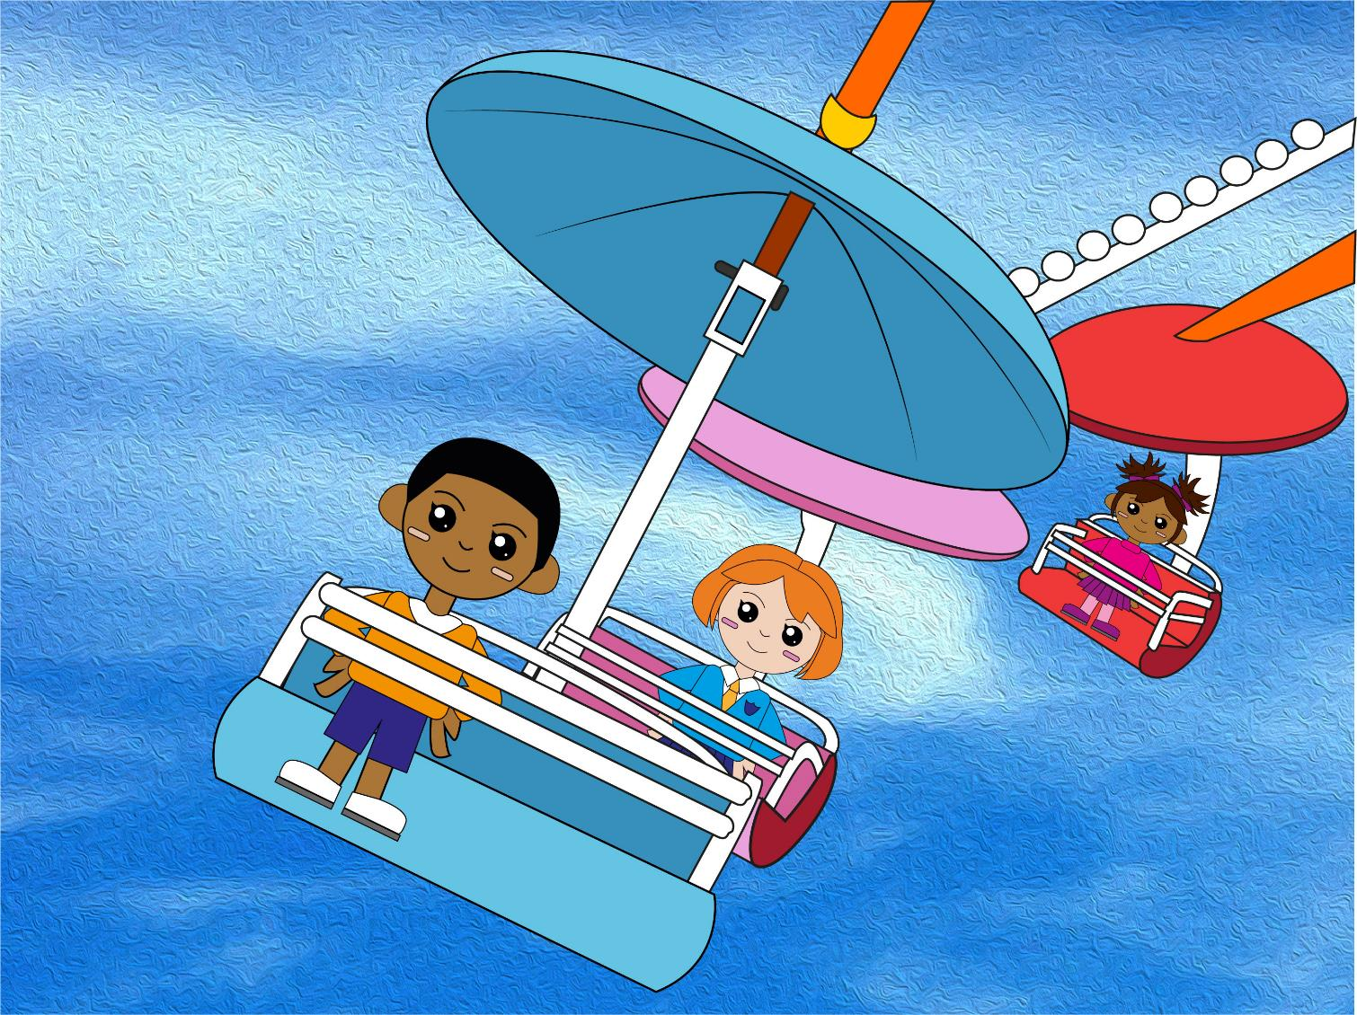
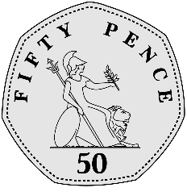
Question 3
Is this coin worth
5p, 20p, 50p or £1?
Write your answer.

Slide 6
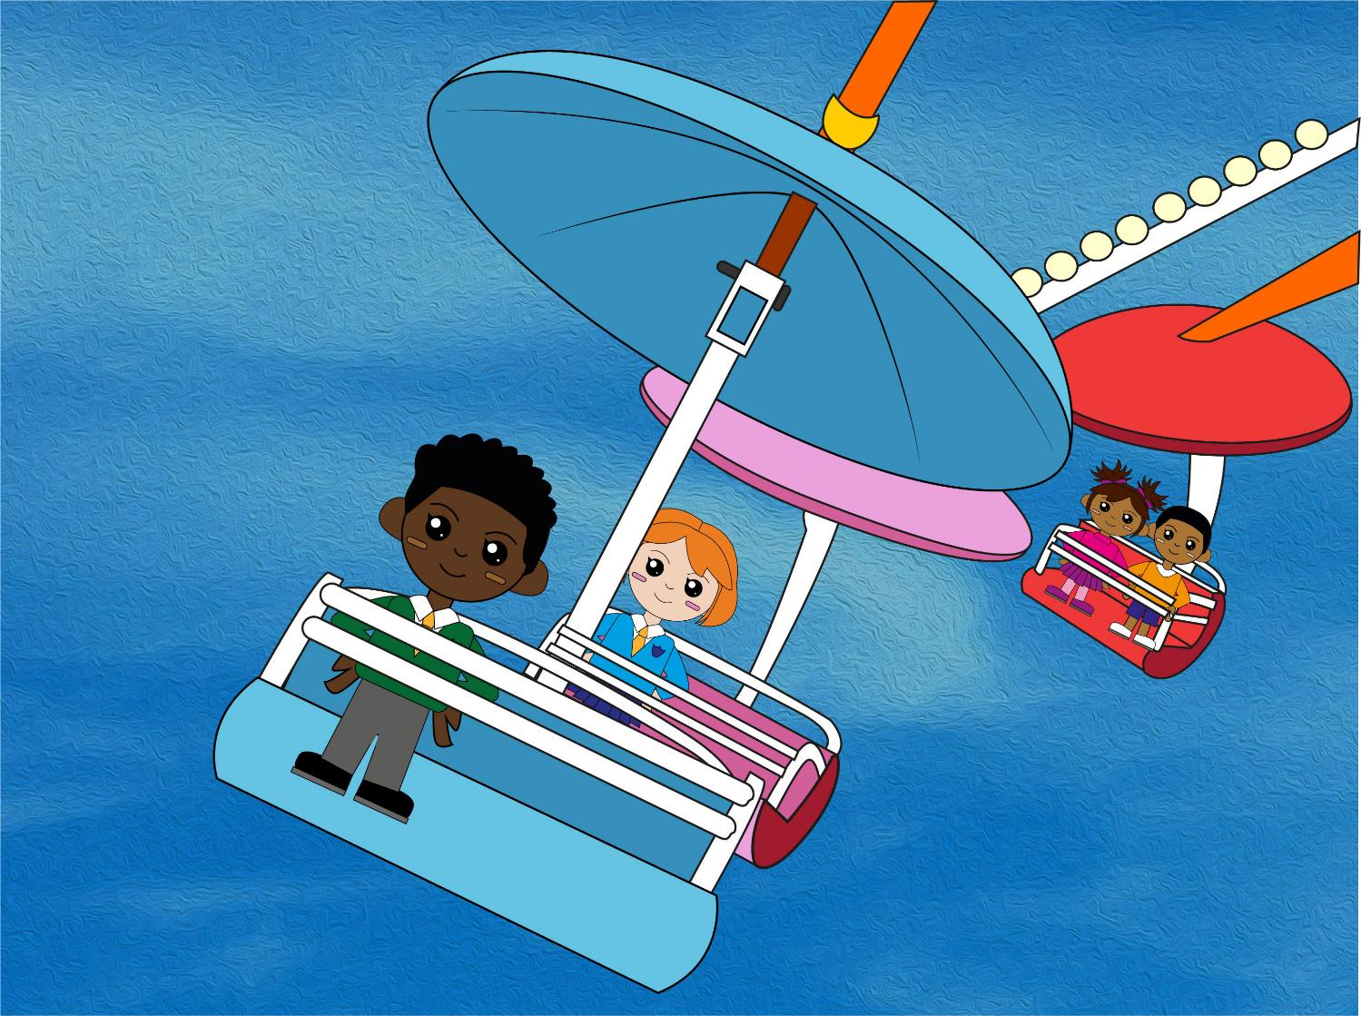

Question 4
Is this coin worth
5p, 20p, 50p or £1?
text
Write your answer.

Slide 7
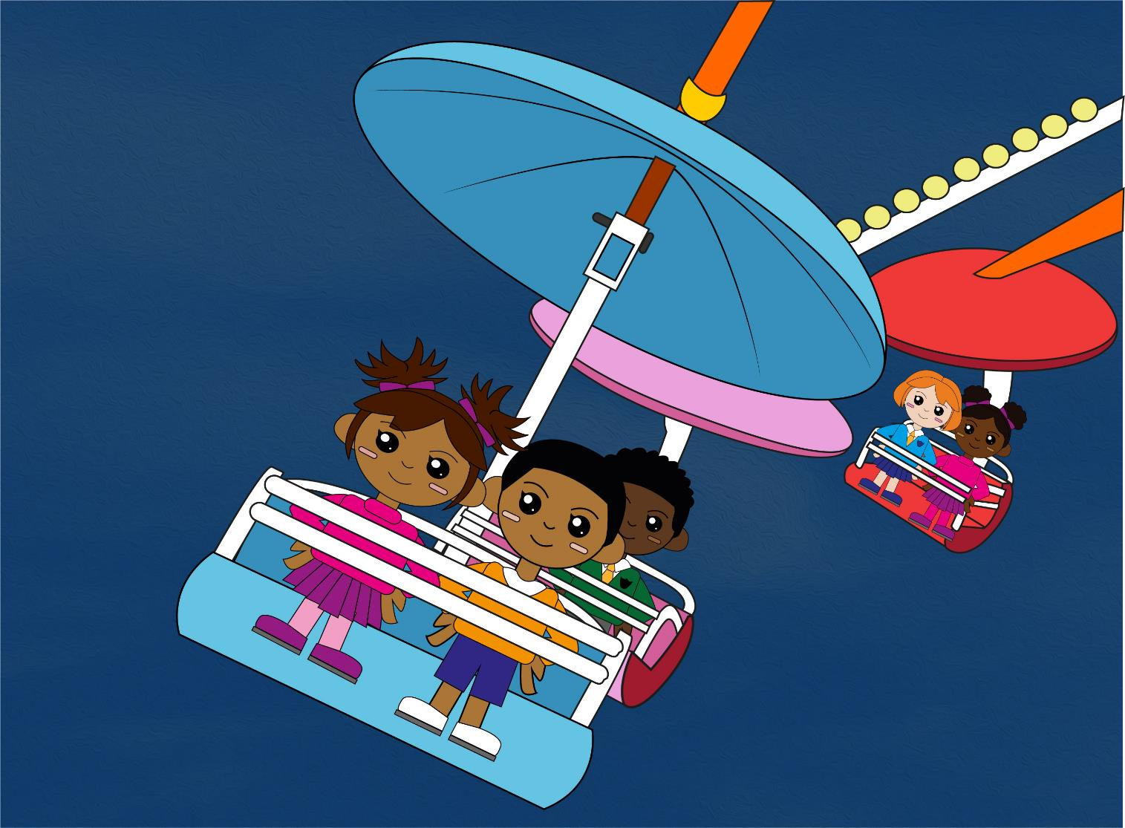
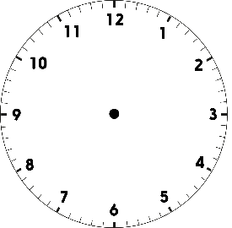
Question 5
Does this clock show 1 o'clock,
3 o'clock or 12 o'clock?
Write your answer.

Slide 8
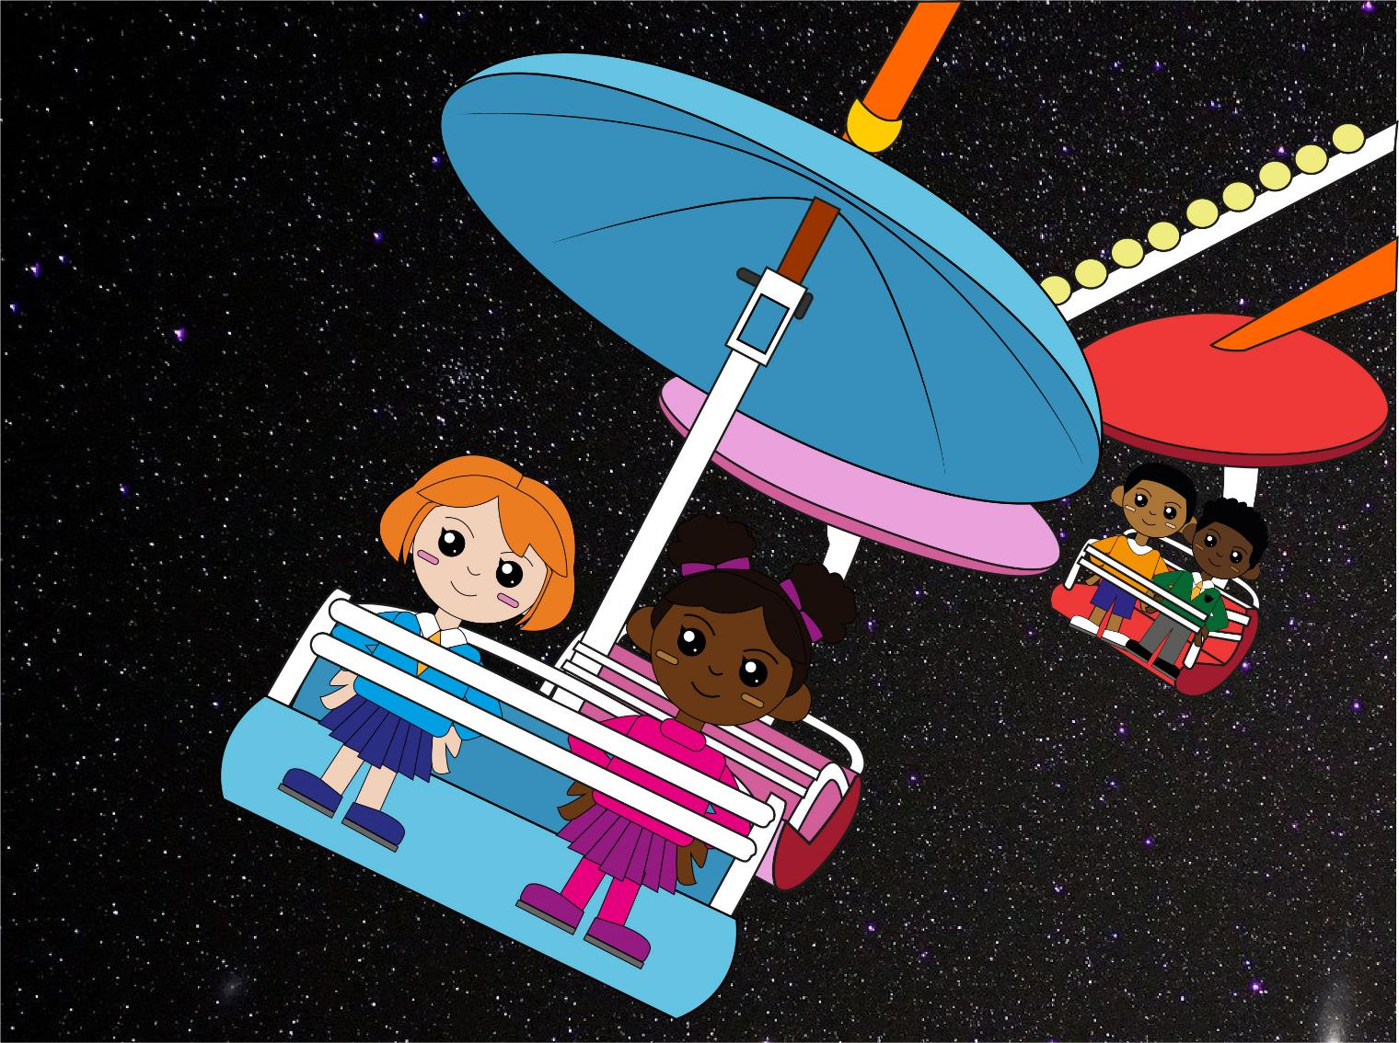
Question 6
Does this clock show 6 o'clock,
half past 8 or half past 6?
Write your answer.

Slide 9

Q1
21, 18, 15, 12, 9, 6, 3
Q2
7, 10, 13, 16, 19, 22, 25
Q3
50p
Q4
£1
Q5
3 o’clock
Q6
half past 8
The answers!

Slide 10
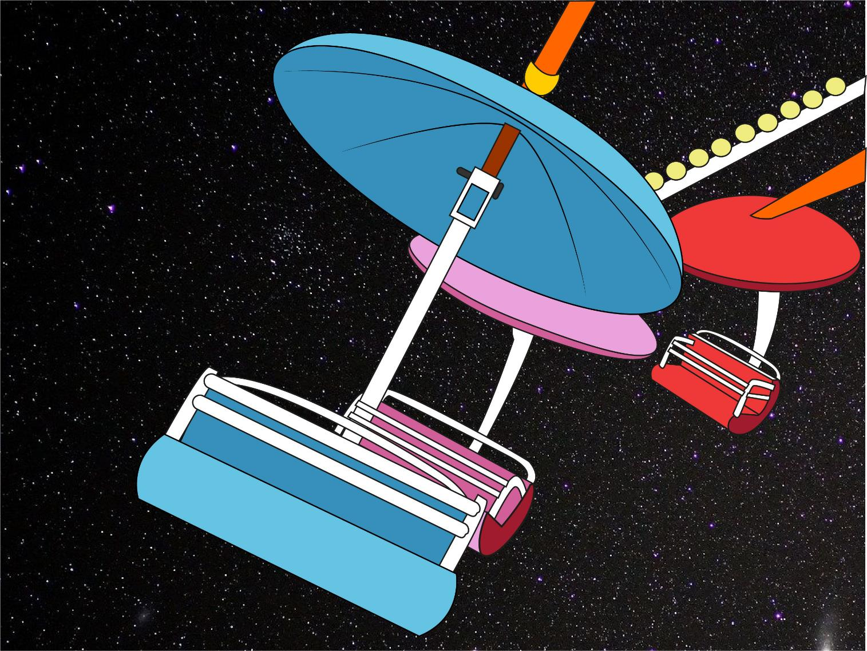
So, which ride do YOU measure up for?!
Did you beat YOUR personal best?

