Slide 1
Multiplication and Division
Begin to understand multiplication as sets and recognise patterns
Objectives
Day 1
Count in 10s and 2s. Recognise and describe patterns.
Day 2
Count in 10s. Begin to understand multiplication as repeated addition.
Notes:
Before teaching, be aware that:
On Day 1 you can also use Number grid ITP to model the patterns.

Slide 2
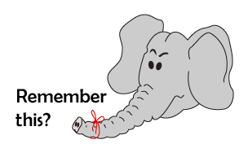
Multiplication and Division
Begin to understand multiplication as sets and recognise patterns
Starter
Count in 10s
Notes:
Simmering skills – to use this starter, drag this slide to the start of Day 2
Throw a soft ball to a child and say 10! They throw the ball to another child and say 20! That child throws to another child and says 30! Continue until you reach at least 100. Repeat, starting with a different child each time, ensuring all children have at least two turns.

Slide 3
Multiplication and Division
Begin to understand multiplication as sets and recognise patterns
Objectives
Day 2
Count in 10s. Begin to understand multiplication as repeated addition.

Slide 4



Day 2: Count in 10s; Begin to understand multiplication as repeated addition.
How much money is here? How can I find out?
We can count the coins in 10s!
10, 20, 30, 40, 50, 60, 70
10p + 10p + 10p + 10p + 10p + 10p + 10p = 70p
Or write a number sentence…
A quicker way to write it is 7 × 10p = 70p
That’s 7 lots of 10p, or 7 times 10.

Slide 5
Day 2: Count in 10s; Begin to understand multiplication as repeated addition.
How much money is here this time? How can I find out?
We can count the coins in 10s!
10, 20, 30, 40, 50, 60, 70, 80.
Or write a number sentence…
10p + 10p + 10p + 10p + 10p + 10p + 10p + 10p = 80p
A quicker way to write it is 8 × 10p = 80p
That’s 8 lots of 10p, or 8 times 10.

Slide 6

Day 2: Count in 10s; Begin to understand multiplication as repeated addition.
How much money do I have now? How can I find out?
We can count the coins in 2s!
2, 4, 6, 8, 10
Or write a number sentence…
2p + 2p + 2p + 2p + 2p
= 10p
A quicker way to write it is 5 × 2p = 10p
That’s 5 lots of 2p,
or 5 times 2.

Slide 7
Day 2: Count in 10s; Begin to understand multiplication as repeated addition.
How much money do I have now? How can I find out?
We can count the coins in 2s!
2, 4, 6, 8, 10, 12, 14.
2p + 2p + 2p + 2p + 2p +
2p + 2p = 14p
Or write a number sentence…
A quicker way to write it is 7 × 2p = 14p
That’s 7 lots of 2p,
or 7 times 2.

Slide 8
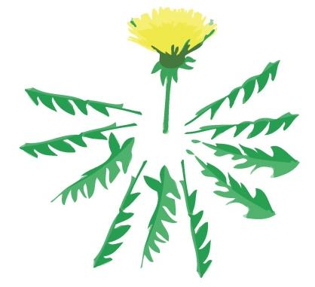

Day 2: Count in 10s; Begin to understand multiplication as repeated addition.
At the rescue centre they give each cage of rabbits 10 dandelion leaves. If there are 5 cages, how many dandelion leaves will they need?
We can write this as:
10 + 10 + 10 + 10 + 10 =
Or as
5 × 10 =
We can count in 10s to find the number needed, but try to remember what five 10s are, just like we know what 6 add 4 is. This will be quicker than adding 10 lots of times!
Notes:
Children can now go on to do differentiated GROUP ACTIVITIES. You can find Hamilton’s group activities in this unit’s TEACHING AND GROUP ACTIVITIES download.
WT/ARE/GD: Collecting 10ps and 2ps and beginning to record using multiplication sign.

Slide 9
Task 1 – Pair/Group Work
Children each roll a 1–10 dice and take that number of 10p coins.
They count the total and write a sentence, e.g. 7 lots of 10p = 70p.
Repeat the same activity with 2p coins.
.

Slide 10
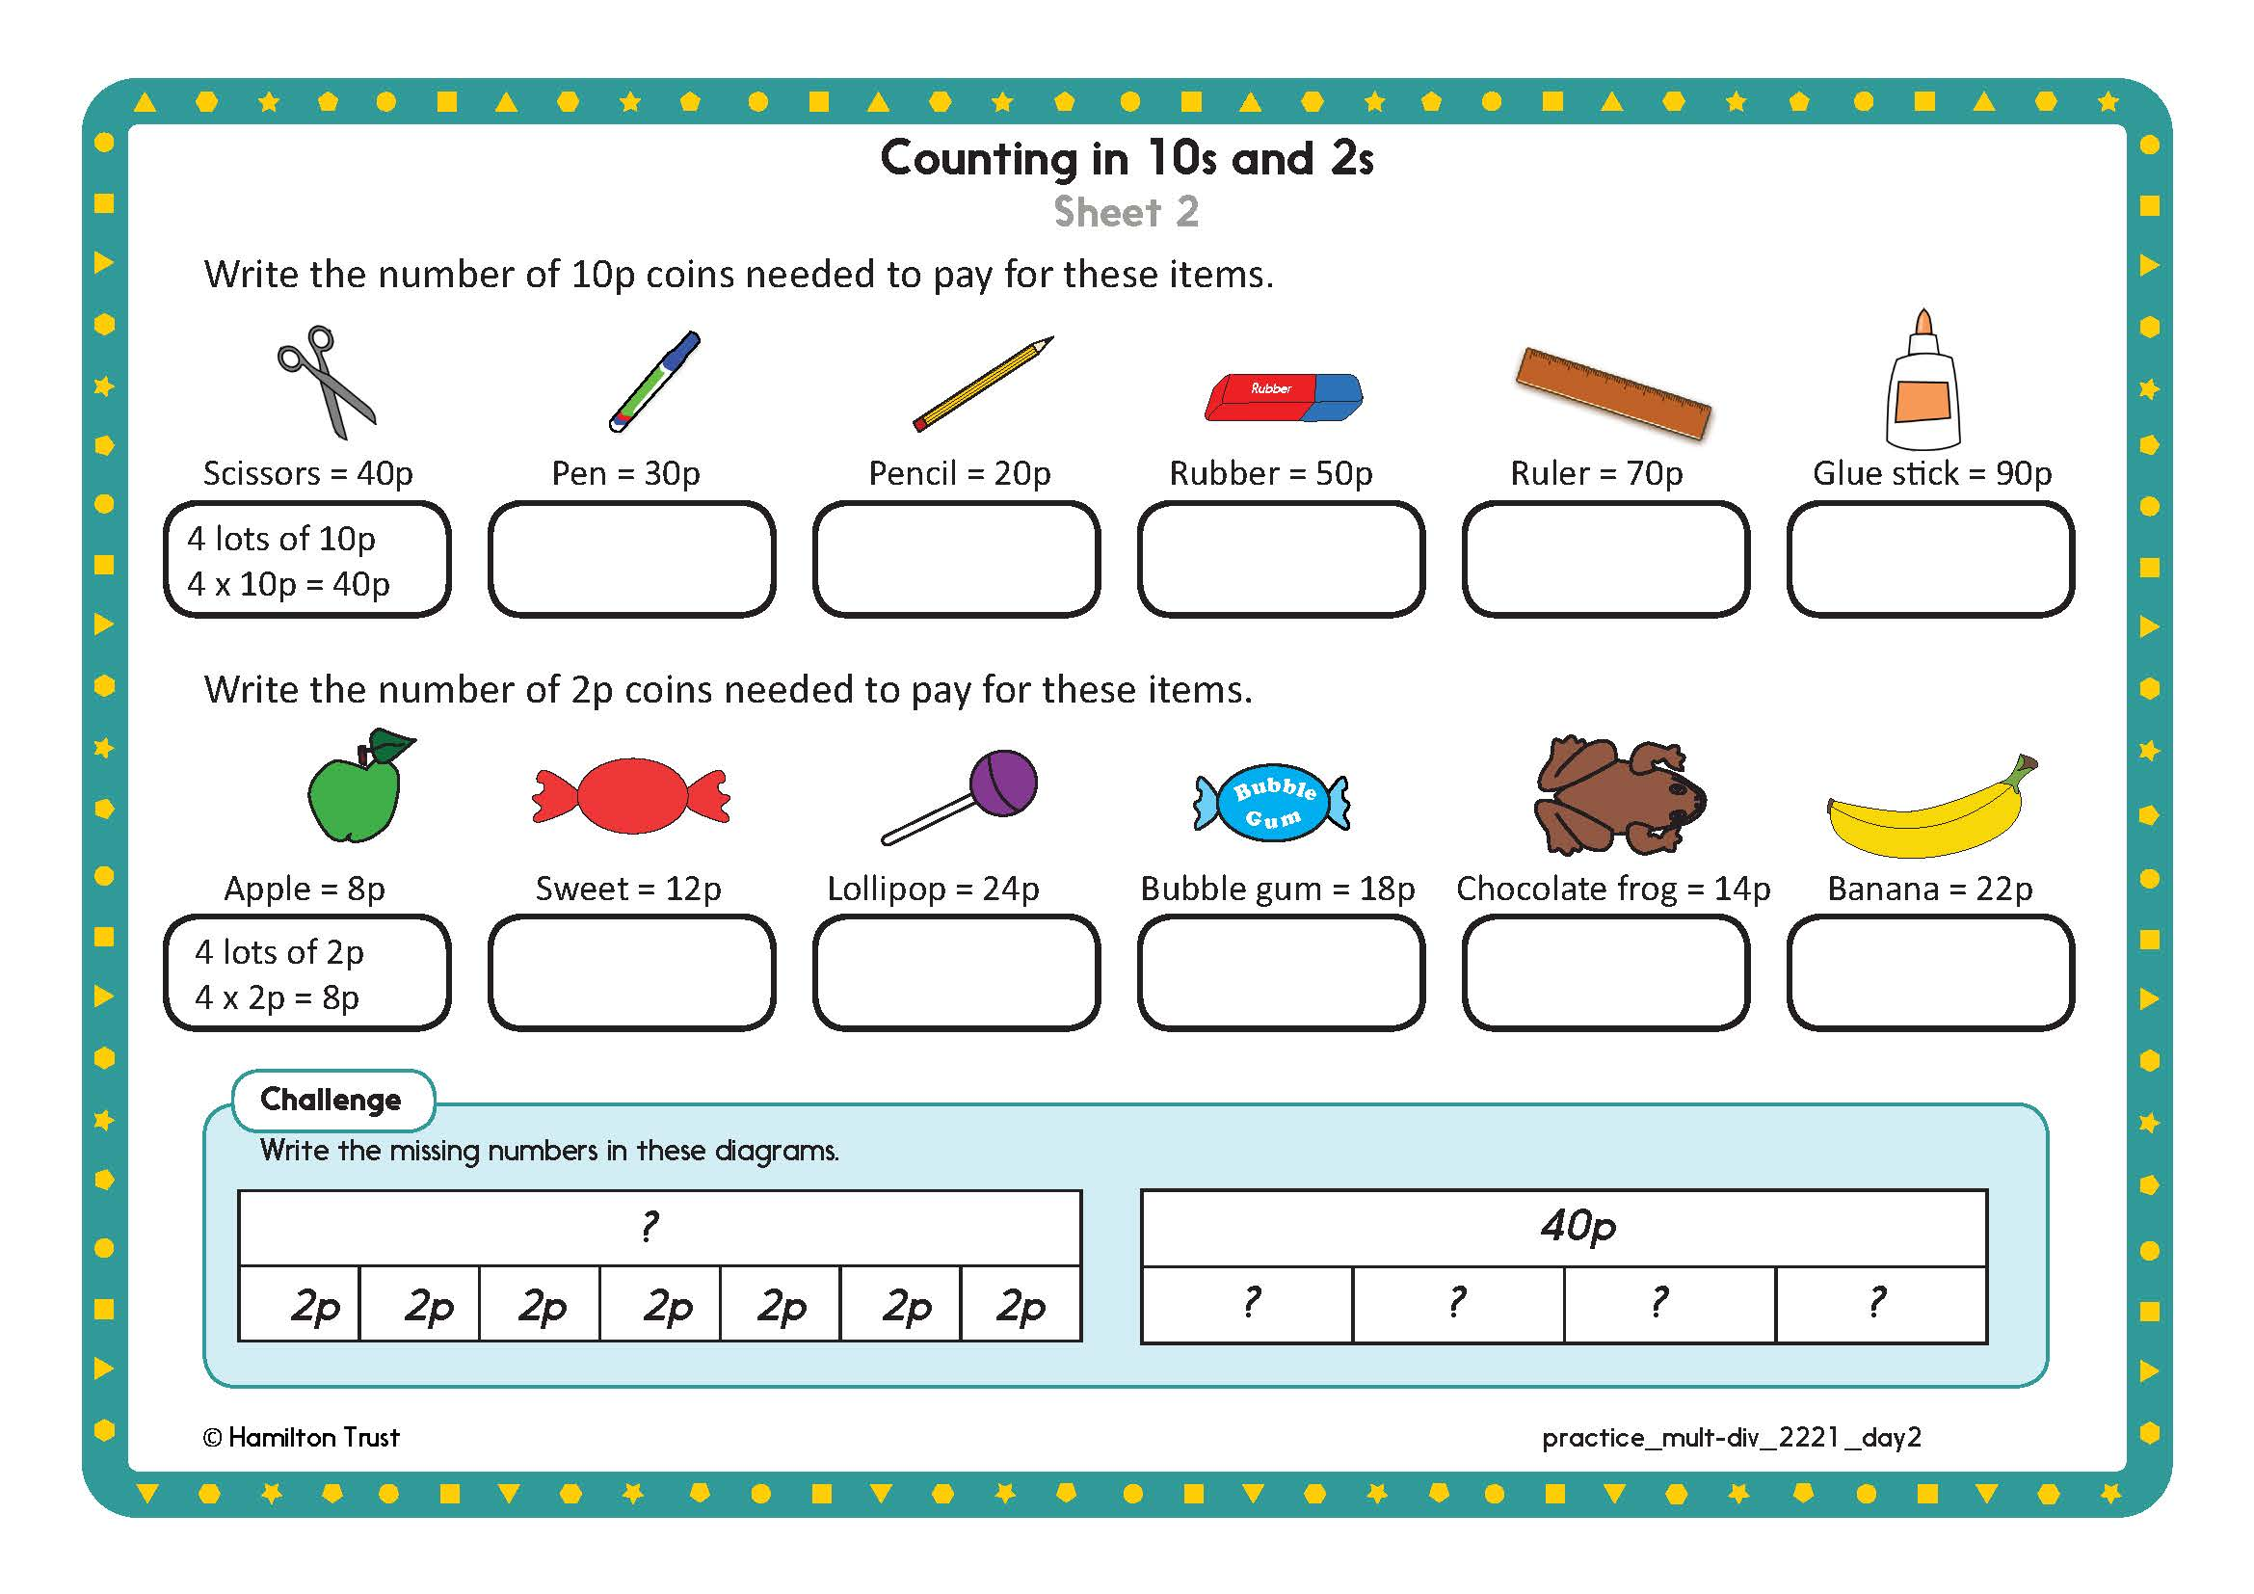

Task 2 – Independent Work
Challenge
Notes:
The Practice Sheet on this slide is suitable for most children.
Differentiated PRACTICE WORKSHEETS are available on Hamilton’s website in this unit’s PROCEDURAL FLUENCY box.
WT: Counting in 10s and 2s Sheet 1a an 1b.
ARE: Counting in 10s and 2s Sheet 2 - allow to draw the coins needed.
GD: Counting in 10s and 2s Sheet 2 - write as in the guided activity (4 x 10p = 40p).

Slide 11
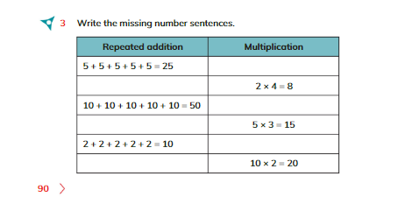
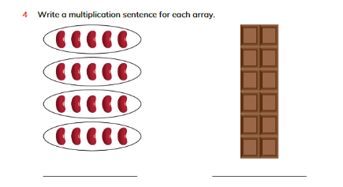
Plenary
Solve Q3 and Q4 on page 90 and 91, Learners book

Slide 12
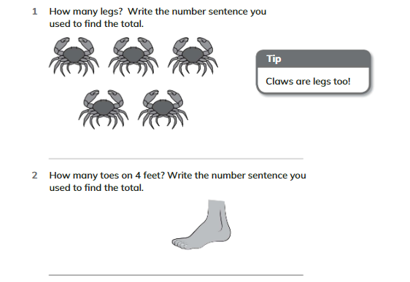
Homework
Solve Q1 and Q2 on page 95, Workbook.

