Slide 1
Science - Year 3
Forces and Magnets – Block 3FM
Amazing Magnets
Session 1
Investigation PowerPoint
© Original resource copyright Hamilton Trust, who give permission for it to be adapted as wished by individual users.
We refer you to our warning, at the foot of the block overview, about links to other websites.

Slide 2
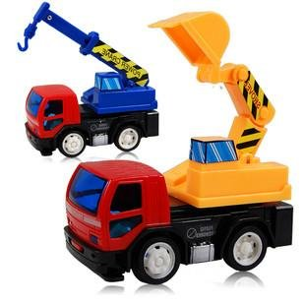
Forces
in
Action

Slide 3
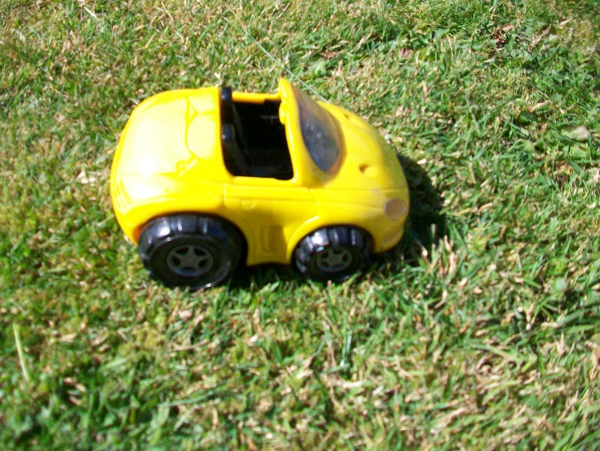
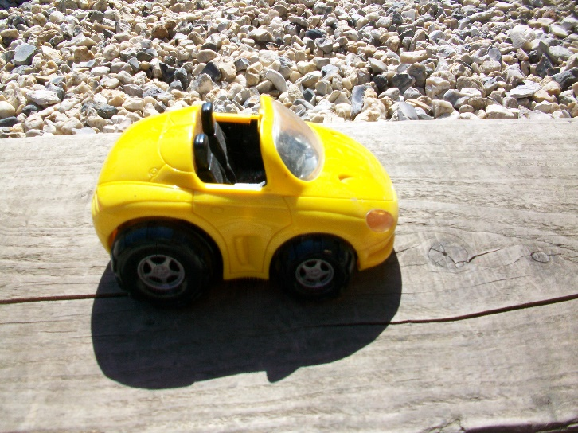
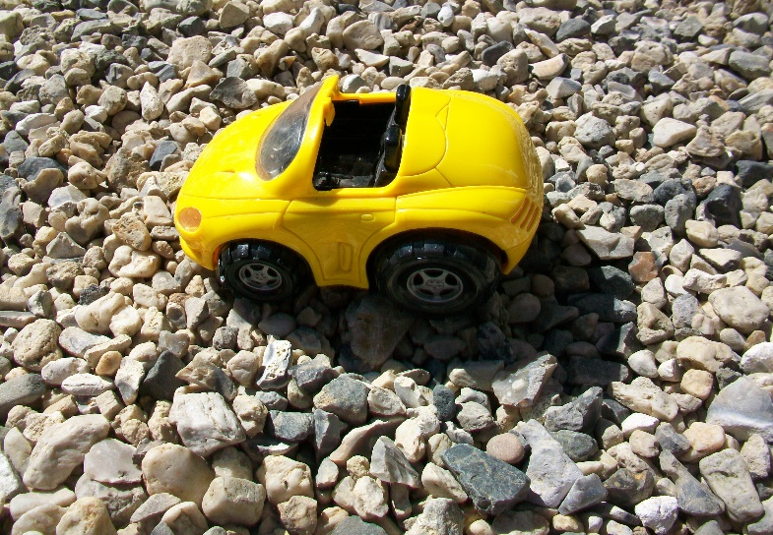
Which car will need the greatest force (push) to start moving?
Why do you think that?

Slide 4
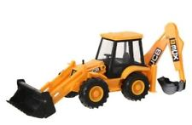
When scientists have an idea or theory about something, they always want to test it out!
What is your theory?
It is probably something like -
I think it takes more force to make a vehicle start moving on rough surfaces than smooth ones.

Slide 5
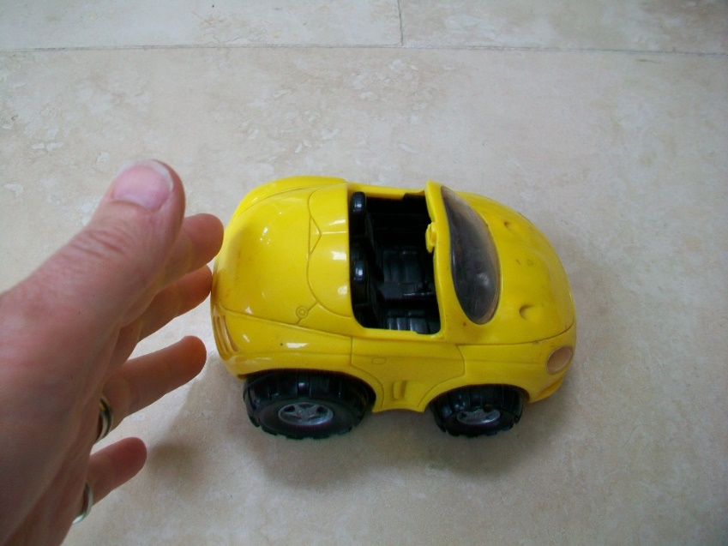
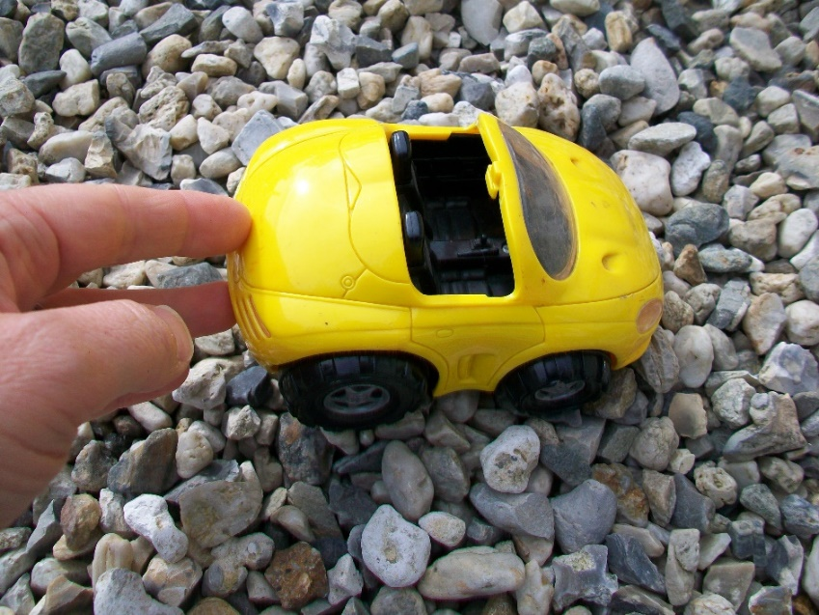
How can you test out your theory?
You will need to compare the amount of force it takes to move the car on different surfaces. But how?
You could just compare them by pushing with your hand.
Would that be a fair test?

Slide 6
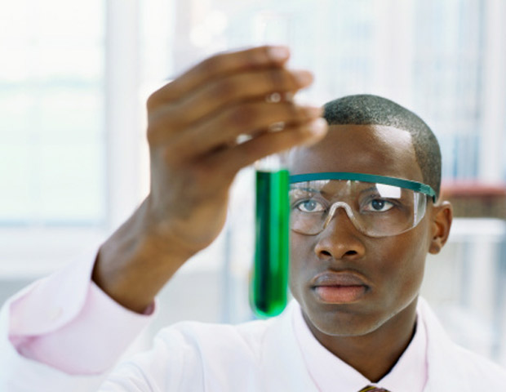
Remember scientists are like teachers, because they always want their tests to be fair!

Slide 7
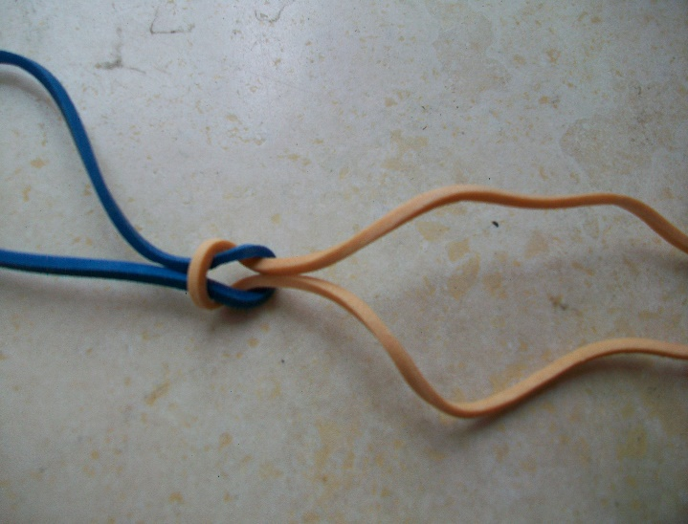
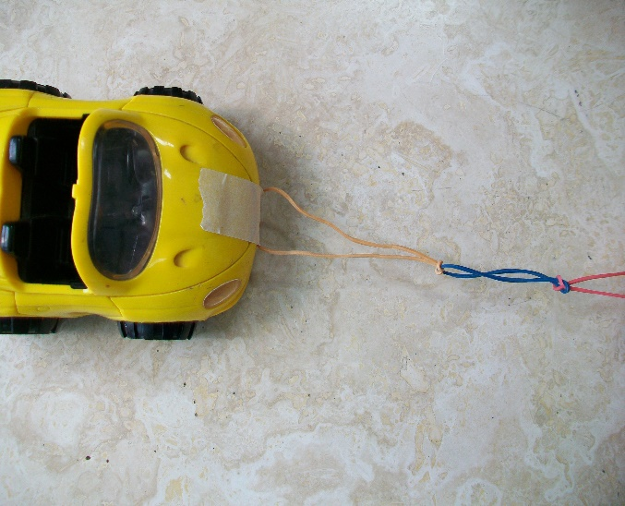
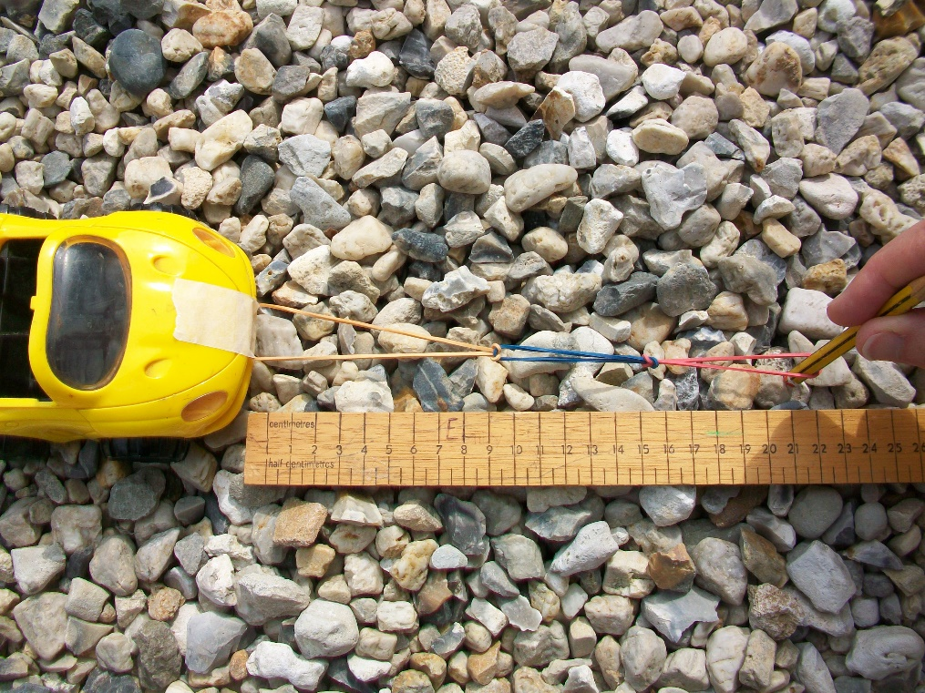
Try measuring pull by looping 3 thin rubber bands together into a chain and attaching one end to the front of a toy vehicle with some tape.
You can then gently pull out the rubber band chain along a ruler and measure how far the chain stretches before the vehicle begins to move. It is easier to measure if you use a pencil to stretch it out.
You may have simple force meters you can use.

Slide 8
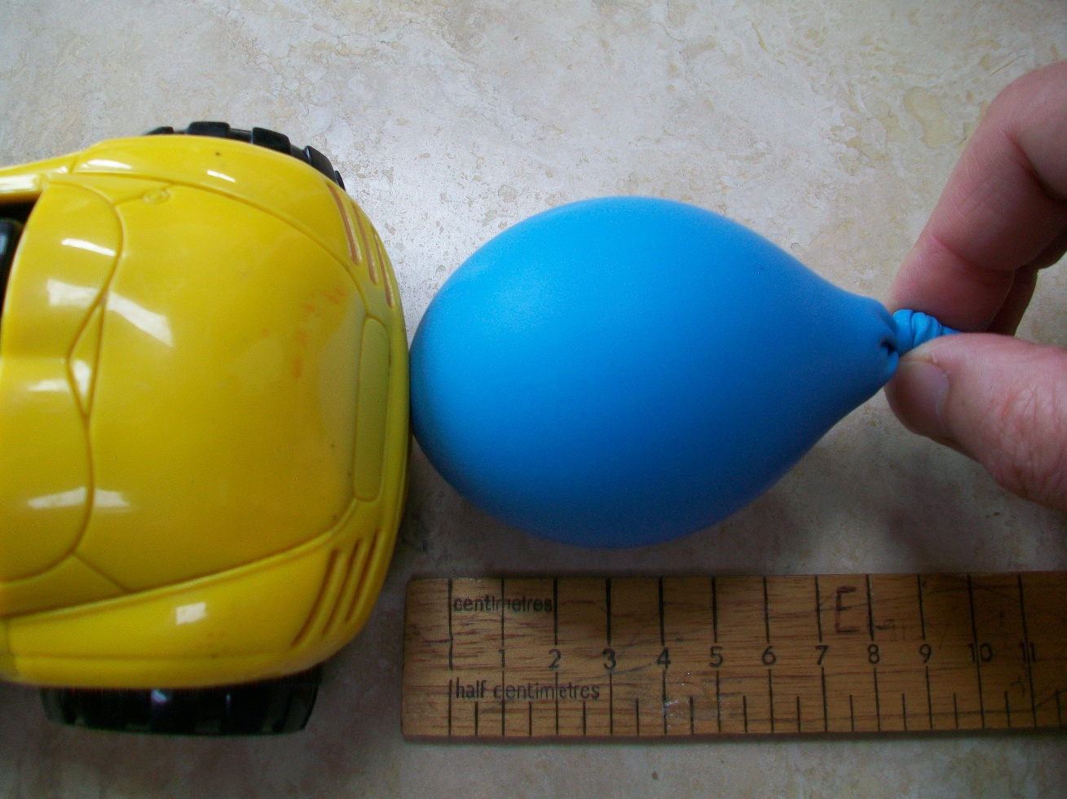
Or, you could try measuring push with a balloon.
It works best if your balloon is quite over stretched and squashy and it doesn’t have much air in it, e.g. one that has been blown up for a few days and gone small and flabby.

Slide 9
Your task is to test out your theory and make it a fair test!
You will need to decide:
What theory you are testing
Whether to test push or pull
Which different surfaces to test
How you will make it fair
What you think will happen (your prediction)

