Slide 1
Revision Day 2
Objectives
Count in 10s and 2s.
Recognise and describe patterns.
Begin to understand multiplication as repeated addition.
Notes:
Before teaching, be aware that:
On Day 1 children will need 100-bead strings. You may prefer to use a real 100-bead bar.

Slide 2
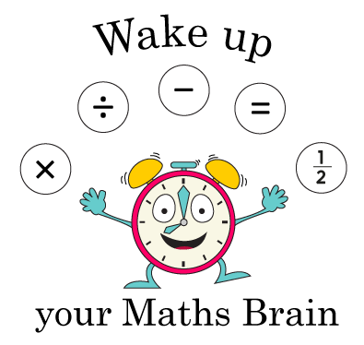
Starter
Find totals up to 20p
Notes:
Pre-requisite skills – to use this starter, drag this slide to the start of Day 1
Hold a 1p and 2p coin behind your back.
I’ve got 2 coins which total 3p. What are the coins?
Continue to hide coins and then reveal to check answers.
I’ve got 3 coins that total 6p. What are the coins?
I’ve got 2 coins that total 6p; what are they?
I’ve got 2 coins that total 20p; what are they?
I’ve got 3 coins that total 15p; what are they?
Continue to practise further examples.
Increase the level of this activity by asking open ended questions.
I’m holding some coins that total 15p. None of them are 1p coins. What could they be?
I’m holding some coins that total 20p. None of them are bronze coins. What could they be?

Slide 3
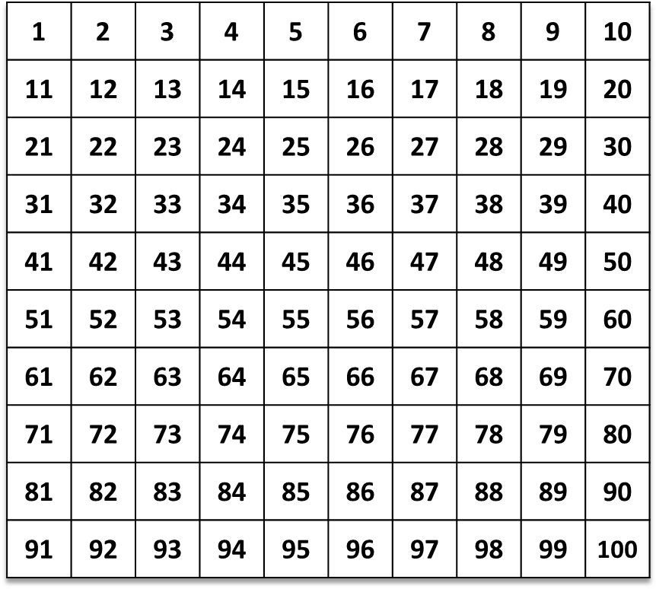
Station 1: Count in 10s and 2s; Recognise and describe patterns.
Can you predict the number I’m going to click on next? What’s my pattern?
Write the next 3 numbers in the sequence on your
whiteboards.
Let’s check…

Slide 4
Station 1: Count in 10s and 2s; Recognise and describe patterns.
If I can carry on, will I get to 57? 82? Explain…
Let’s check…

Slide 5
Count in 10s and 2s; Recognise and describe patterns.
How can you describe this counting pattern? Which three numbers will be next?
What do you notice about all the numbers in the pattern?
If we continue will 21 and 38 be highlighted? How do you know?
Let’s check…
They are all odd numbers!
Let’s check…
Notes:
Today would be a great day to use a problem-solving investigation – Clapping Times – as the group activity, which you can find in this unit’s IN-DEPTH INVESTIGATION box on Hamilton’s website.
Alternatively, children can now go on to do differentiated GROUP ACTIVITIES. You can find Hamilton’s group activities in this unit’s TEACHING AND GROUP ACTIVITIES download.
WT/ ARE: Continue number patterns, using knowledge and understanding of counting in 2s and 10s.
GD: Investigating statement about multiples.

Slide 6
Station 2: Count in 10s; Begin to understand multiplication as repeated addition.
How much money is here? How can I find out?
We can count the coins in 10s!
10, 20, 30, 40, 50, 60, 70
10p + 10p + 10p + 10p + 10p + 10p + 10p = 70p
Or write a number sentence…
A quicker way to write it is 7 × 10p = 70p
That’s 7 lots of 10p, or 7 times 10.

Slide 7
Station 2: Count in 10s; Begin to understand multiplication as repeated addition.
How much money is here this time? How can I find out?
We can count the coins in 10s!
10, 20, 30, 40, 50, 60, 70, 80.
Or write a number sentence…
10p + 10p + 10p + 10p + 10p + 10p + 10p + 10p = 80p
A quicker way to write it is 8 × 10p = 80p
That’s 8 lots of 10p, or 8 times 10.

Slide 8
Count in 10s; Begin to understand multiplication as repeated addition.
How much money do I have now? How can I find out?
We can count the coins in 2s!
2, 4, 6, 8, 10
Or write a number sentence…
2p + 2p + 2p + 2p + 2p
= 10p
A quicker way to write it is 5 × 2p = 10p
That’s 5 lots of 2p,
or 5 times 2.

Slide 9
Count in 10s; Begin to understand multiplication as repeated addition.
How much money do I have now? How can I find out?
We can count the coins in 2s!
2, 4, 6, 8, 10, 12, 14.
2p + 2p + 2p + 2p + 2p +
2p + 2p = 14p
Or write a number sentence…
A quicker way to write it is 7 × 2p = 14p
That’s 7 lots of 2p,
or 7 times 2.

Slide 10
Station 3: Find doubles to double 20.
15
15
Let’s find double 15…
Double 10 is …
20.
Double 5 is …
10.
Double 15 is 30.

Slide 11
Station 3: Find doubles to double 20.
17
17
Let’s find double 17…
Double 10 is …
20.
Double 7 is …
14.
We can partition to add 20 + 14...
20 + 14 = 20 + 10 + 4
= 34.
Double 17 is 34!

Slide 12
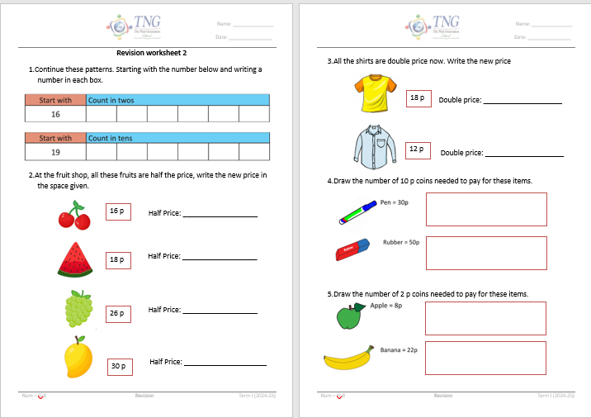
Independent Work

Slide 13
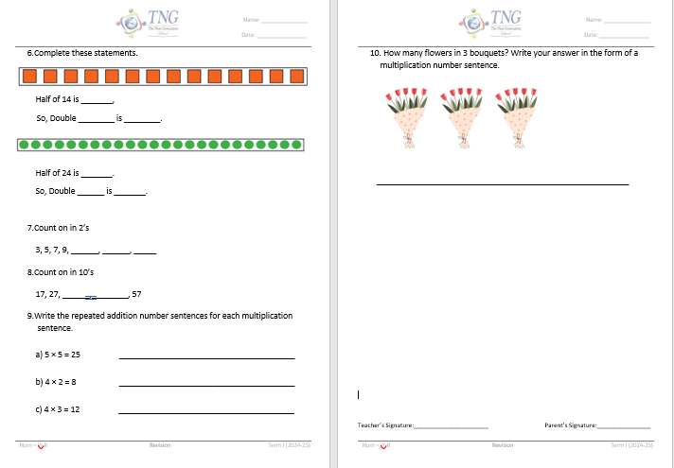

Slide 14
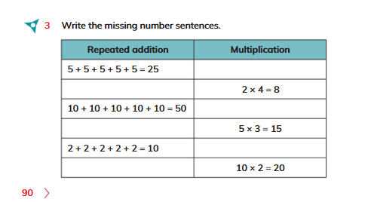
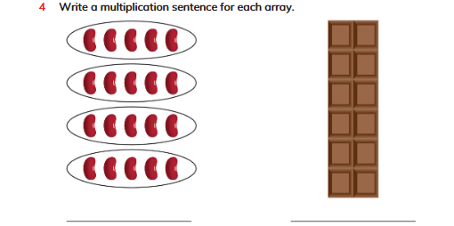
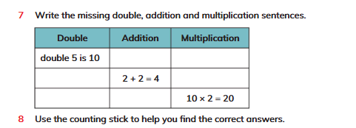
Book pages

Slide 15
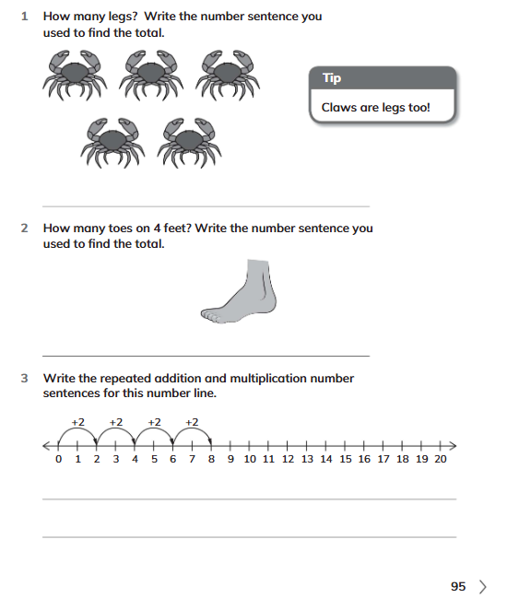

Slide 16
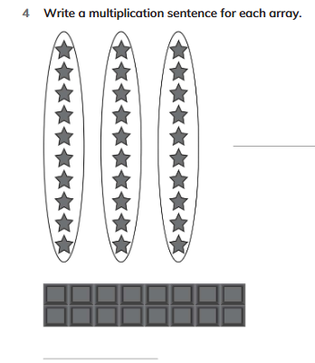
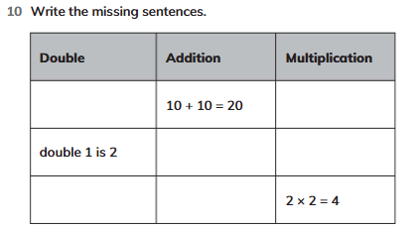

Slide 17
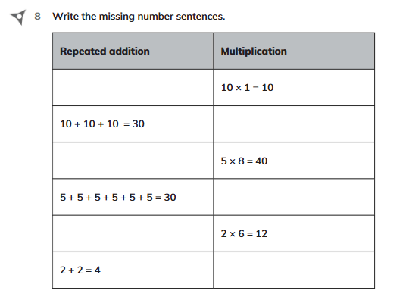
Homework
Solve Q8 on page 98, in workbook

