Slide 1

PHYSICS – Electrical quantities (1) - Supplement

Slide 2
LEARNING OBJECTIVES
Core •State that there are positive and negative charges • State that unlike charges attract and that like charges repel • Describe simple experiments to show the production and detection of electrostatic charges • State that charging a body involves the addition or removal of electrons Distinguish between electrical conductors and insulators and give typical examples State that current is related to the flow of charge • Use and describe the use of an ammeter, both analogue and digital • State that current in metals is due to a flow of electrons | Supplement State that charge is measured in coulombs • State that the direction of an electric field at a point is the direction of the force on a positive charge at that point • Describe an electric field as a region in which an electric charge experiences a force • Describe simple field patterns, including the field around a point charge, the field around a charged conducting sphere and the field between two parallel plates (not including end effects) • Give an account of charging • Recall and use a simple electron model to distinguish between conductors and insulators Show understanding that a current is a rate of flow of charge and recall and use the equation I = Q / t • Distinguish between the direction of flow of electrons and conventional current

Slide 3

State that charge is measured in coulombs
Charge is measured in coulombs

Slide 4


State that charge is measured in coulombs
Charge is measured in coulombs
The unit of charge is the coulomb (C).
Charge is often more conveniently measured in microcoulombs (µC)
1 microcoulomb = 10⁻⁶C

Slide 5
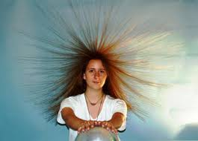

Electric fields and forces
Why does hair stand on end?
http://www.physics.upenn.edu/undergraduate/undergraduate-physics-labs/experiments/electric-charge-and-static-electricity

Slide 6
Electric fields and forces
Why does hair stand on end?
http://www.physics.upenn.edu/undergraduate/undergraduate-physics-labs/experiments/electric-charge-and-static-electricity
An electric charge has been passed from the Van de Graaff generator to the hair.

Slide 7
Electric fields and forces
Why does hair stand on end?
http://www.physics.upenn.edu/undergraduate/undergraduate-physics-labs/experiments/electric-charge-and-static-electricity
An electric charge has been passed from the Van de Graaff generator to the hair.
The force of repulsion between the charged hairs is strong enough to make hair stand on end.

Slide 8
Electric fields and forces
Why does hair stand on end?
http://www.physics.upenn.edu/undergraduate/undergraduate-physics-labs/experiments/electric-charge-and-static-electricity
An electric charge has been passed from the Van de Graaff generator to the hair.
The force of repulsion between the charged hairs is strong enough to make hair stand on end.
There is now an electric field around the dome and the girl.

Slide 9

Electric fields and forces
All electrically charged objects have an electric field around them

Slide 10

Electric fields and forces
In an electric field a charged particle or object (+ or -) experiences a force.
All electrically charged objects have an electric field around them

Slide 11
Electric fields and forces
In an electric field a charged particle or object (+ or -) experiences a force.
All electrically charged objects have an electric field around them
If two objects with the same charge are brought towards each other the force produced will be repulsive, it will push them apart.

Slide 12
Electric fields and forces
In an electric field a charged particle or object (+ or -) experiences a force.
All electrically charged objects have an electric field around them
If two objects with the same charge are brought towards each other the force produced will be repulsive, it will push them apart.
If two objects with opposite charge are brought towards each other the force produced will be attractive, it will pull them together.

Slide 13
Electric fields and forces
Lines of force will show how charged particles will move in an electric field.

Slide 14
Electric fields and forces
Lines of force will show how charged particles will move in an electric field.
Arrows will show the direction in which the force on a positive (+) charge would act. Field lines always point away from positive charge towards negative charge.

Slide 15
Electric fields and forces
Lines of force will show how charged particles will move in an electric field.
Arrows will show the direction in which the force on a positive (+) charge would act. Field lines always point away from positive charge towards negative charge.
-
Electric field close to a negatively charged sphere. The field around a Van de Graaff generator dome would be similar to this.
-
-
-
-
-
-
-
The direction of the arrow shows the direction a positively charged particle will move.

Slide 16
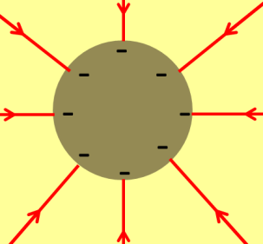
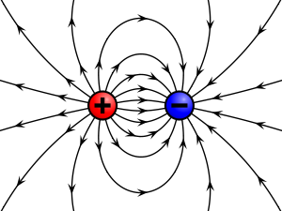
Electric fields and forces
Lines of force will show how charged particles will move in an electric field.
Arrows will show the direction in which the force on a positive (+) charge would act. Field lines always point away from positive charge towards negative charge.
Electric field between a positive and a negative point charge.

Slide 17
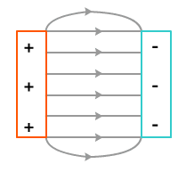
Electric fields and forces
Lines of force will show how charged particles will move in an electric field.
Arrows will show the direction in which the force on a positive (+) charge would act. Field lines always point away from positive charge towards negative charge.
Electric field between a positive and a negative point charge.
Electric field between two parallel plates with opposite charges on them

Slide 18
Electric fields and forces
Lines of force will show how charged particles will move in an electric field.
Arrows will show the direction in which the force on a positive (+) charge would act. Field lines always point away from positive charge towards negative charge.
Negatively charged particles, for example electrons, will move in the opposite direction to the arrow.
Electric field between a positive and a negative point charge.
Electric field between two parallel plates with opposite charges on them

Slide 19

-
+
+
-
Detecting and inducing charge
-
+
+
-
-
+

Slide 20
-
+
+
-
Detecting and inducing charge
-
+
+
-
-
+
Detection – using a gold leaf electroscope.
+
+
+
+
Charged rod
Insulator
-
-
-
-
Metal cap
+
+
+
+
Metal plate
Gold leaf

Slide 21
-
+
+
-
Detecting and inducing charge
-
+
+
-
-
+
Detection – using a gold leaf electroscope.
+
+
+
+
Charged rod
Insulator
-
-
-
-
Metal cap
As the charged rod is placed near the metal cap, charges are induced in the electroscope. Those in the gold leaf and metal plate repel, so the leaf rises.
+
+
+
+
Metal plate
Gold leaf

Slide 22
-
+
+
-
Detecting and inducing charge
-
+
+
-
-
+
Detection – using a gold leaf electroscope.
Inducing charge.
+
+
+
+
Charged rod
Insulator
-
-
-
-
Metal cap
As the charged rod is placed near the metal cap, charges are induced in the electroscope. Those in the gold leaf and metal plate repel, so the leaf rises.
+
+
+
+
+
+
+
+
More electrons than normal
-
-
-
-
-
-
-
-
+
+
Induced charge
+
+
+
+
+
+
+
+
+
Metal plate
+
Fewer electrons than normal
Metal sphere
Gold leaf

Slide 23

-
+
+
-
Detecting and inducing charge
-
+
+
-
-
+
Detection – using a gold leaf electroscope.
Inducing charge.
+
+
+
+
Charged rod
Insulator
-
-
-
-
Metal cap
As the charged rod is placed near the metal cap, charges are induced in the electroscope. Those in the gold leaf and metal plate repel, so the leaf rises.
+
+
+
+
+
+
+
+
More electrons than normal
-
-
-
Sphere earthed by finger
-
-
-
-
-
+
+
Induced charge
+
+
+
+
+
+
+
+
Metal plate
+
+
Fewer electrons than normal
Metal sphere
Gold leaf

Slide 24
-
+
+
-
Detecting and inducing charge
-
+
+
-
-
+
Detection – using a gold leaf electroscope.
Inducing charge.
+
+
+
+
Charged rod
The sphere ends up with an opposite charge to that on the rod, which never actually touches the sphere.
Insulator
-
-
-
-
Metal cap
As the charged rod is placed near the metal cap, charges are induced in the electroscope. Those in the gold leaf and metal plate repel, so the leaf rises.
+
+
+
+
+
+
+
+
More electrons than normal
-
-
-
Sphere earthed by finger
-
-
-
-
-
+
+
Induced charge
+
+
+
+
+
Electrons replace missing electrons
+
+
+
Metal plate
+
+
Fewer electrons than normal
Metal sphere
Gold leaf

Slide 25
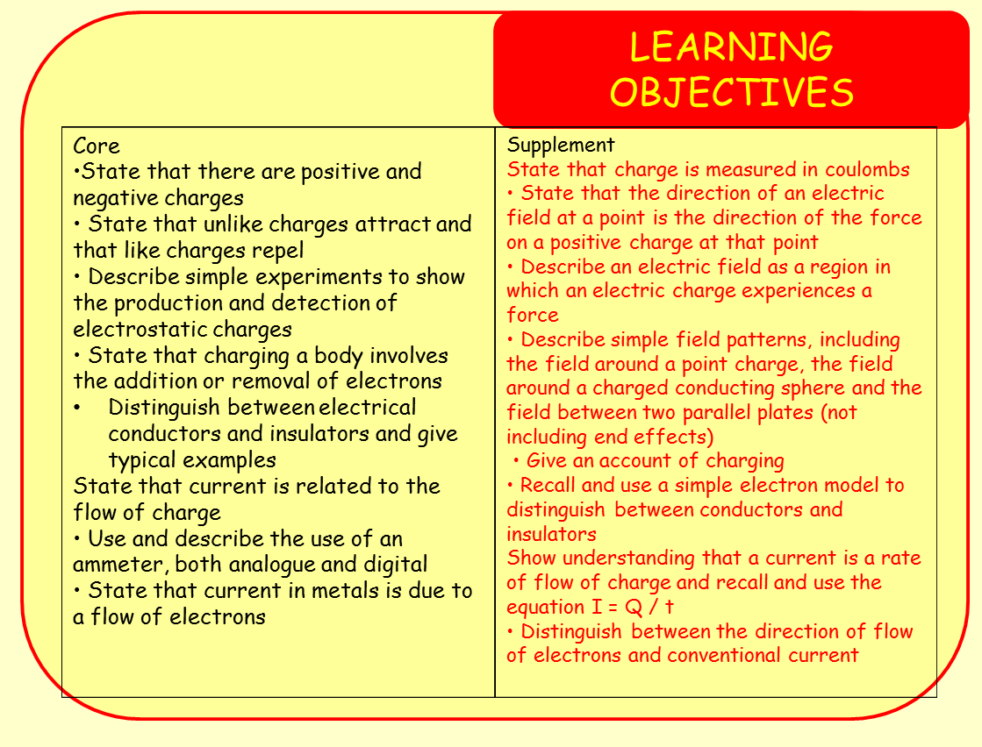
Conductors are made of materials that electricity can flow through easily. These materials are made up of atoms whose electrons can move away freely.

Slide 26
Conductors are made of materials that electricity can flow through easily. These materials are made up of atoms whose electrons can move away freely.
In insulators the electrons in the atoms are not easily freed and are stable, preventing or blocking the flow of electricity.

Slide 27
Conductors are made of materials that electricity can flow through easily. These materials are made up of atoms whose electrons can move away freely.
In insulators the electrons in the atoms are not easily freed and are stable, preventing or blocking the flow of electricity.
There is a link between current and charge:
If charge flows at 1 coulomb per second, then the current is 1 ampere.
If charge flows at 2 coulombs per second, then the current is 2 ampere.

Slide 28
Conductors are made of materials that electricity can flow through easily. These materials are made up of atoms whose electrons can move away freely.
In insulators the electrons in the atoms are not easily freed and are stable, preventing or blocking the flow of electricity.
There is a link between current and charge:
If charge flows at 1 coulomb per second, then the current is 1 ampere.
If charge flows at 2 coulombs per second, then the current is 2 ampere.
Current = Charge / time
I = Q / t

Slide 29
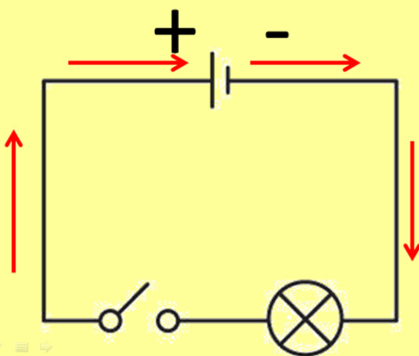
Conductors are made of materials that electricity can flow through easily. These materials are made up of atoms whose electrons can move away freely.
In insulators the electrons in the atoms are not easily freed and are stable, preventing or blocking the flow of electricity.
There is a link between current and charge:
If charge flows at 1 coulomb per second, then the current is 1 ampere.
Conventional current flow
Electron flow
If charge flows at 2 coulombs per second, then the current is 2 ampere.
Current = Charge / time
I = Q / t

Slide 30
LEARNING OBJECTIVES
Core •State that there are positive and negative charges • State that unlike charges attract and that like charges repel • Describe simple experiments to show the production and detection of electrostatic charges • State that charging a body involves the addition or removal of electrons Distinguish between electrical conductors and insulators and give typical examples State that current is related to the flow of charge • Use and describe the use of an ammeter, both analogue and digital • State that current in metals is due to a flow of electrons | Supplement State that charge is measured in coulombs • State that the direction of an electric field at a point is the direction of the force on a positive charge at that point • Describe an electric field as a region in which an electric charge experiences a force • Describe simple field patterns, including the field around a point charge, the field around a charged conducting sphere and the field between two parallel plates (not including end effects) • Give an account of charging • Recall and use a simple electron model to distinguish between conductors and insulators Show understanding that a current is a rate of flow of charge and recall and use the equation I = Q / t • Distinguish between the direction of flow of electrons and conventional current

Slide 31
PHYSICS – Electrical quantities (1) - Supplement

