Slide 1
Science - Year 3/4A Spring 1
Living Things and their Habitats
A World of Living Things
Session 3
Teaching PowerPoint
© Original resource copyright Hamilton Trust, who give permission for it to be adapted as wished by individual users.
We refer you to our warning, at the foot of the block overview, about links to other websites.

Slide 2
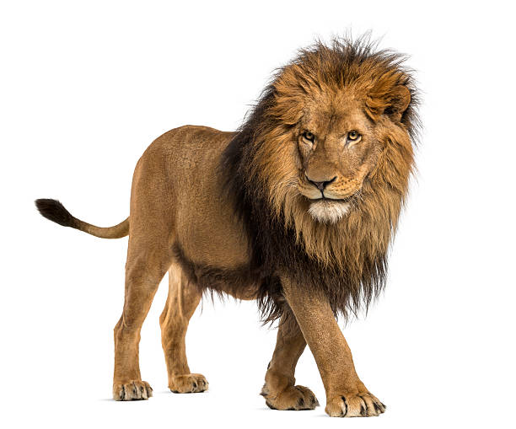
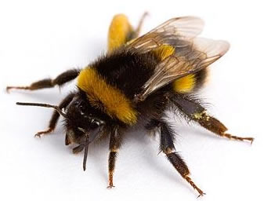
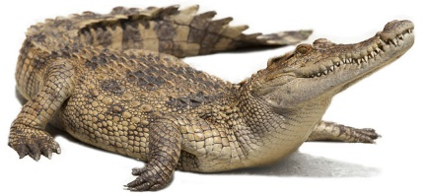
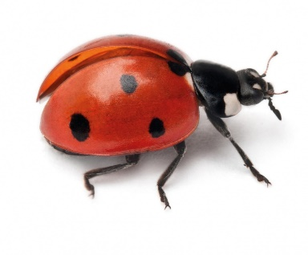
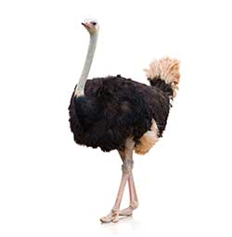
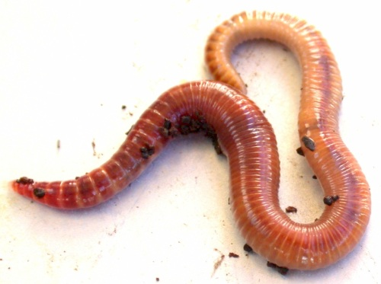
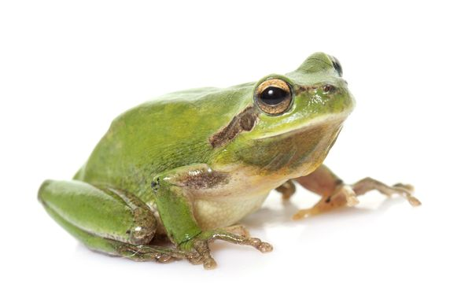
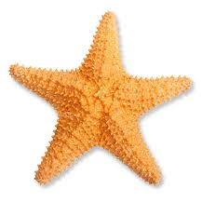
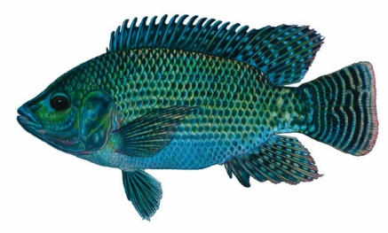
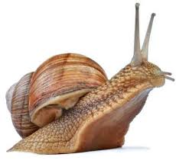
The Animal Kingdom
is divided into 2 groups
Animals with a backbone
Animals without a backbone
Vertebrates
Invertebrates

Slide 3
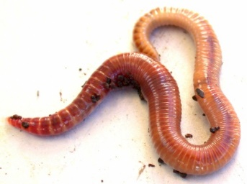
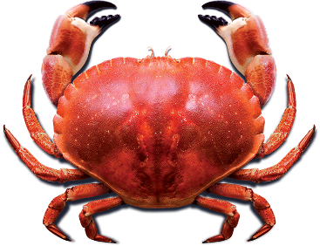
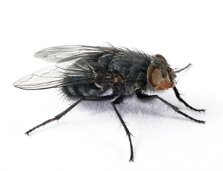
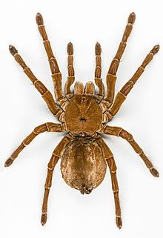
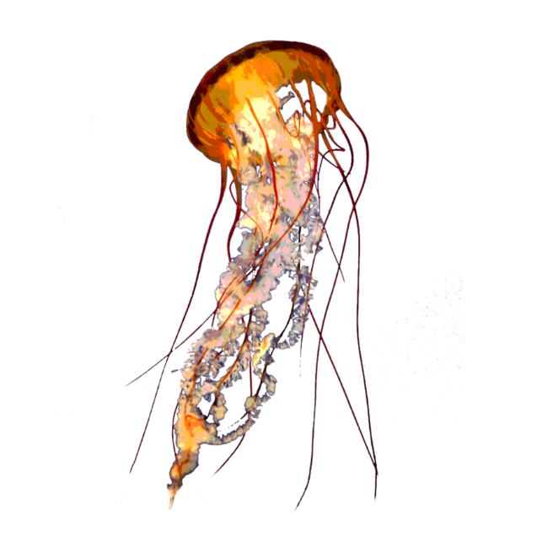
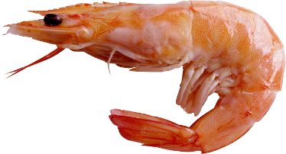
Today we are going to learn all about
Invertebrates
Here are some amazing invertebrate facts
Some are so tiny you can only see them with a microscope
They make up over 95% of all the animals on our planet
The largest invertebrate is the giant squid which can grow bigger than a bus
Many invertebrates have soft squishy bodies and they often have a hard shell to protect themselves
Some invertebrates have no head

Slide 4
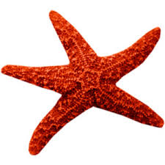
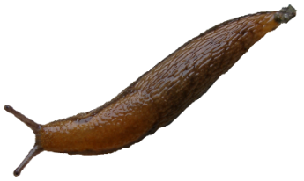
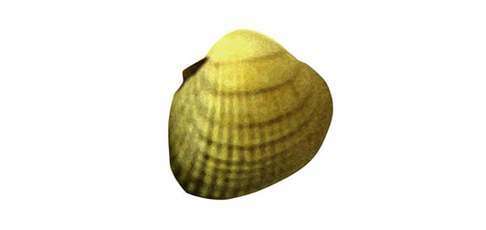
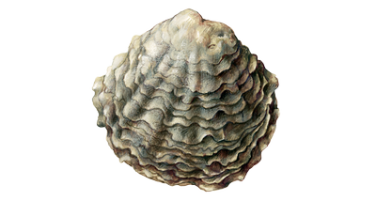
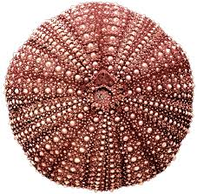
There are lots of different types of invertebrate
Some have strange scientific names but you will have seen many of them before.
Here are just some of them.
Annelids
Molluscs
We often call this group worms. They have no legs and a soft body made of lots of little sections called segments.
This group includes slugs and snails as well as shellfish.
Echinoderms
This is a group of sea creatures that are covered in a tough spiny skin. Their bodies are made of five identical parts. Starfish are in this group as well as sea urchins.
They have soft bodies that they need to keep moist to stay alive. Many molluscs have a hard shell to protect them.

Slide 5
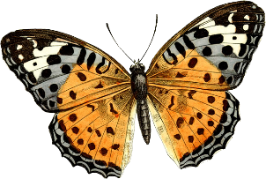
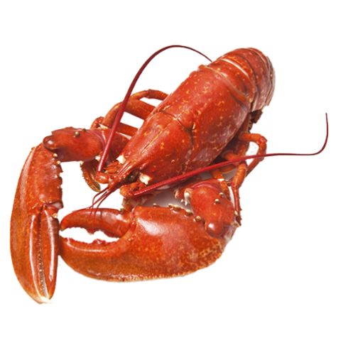
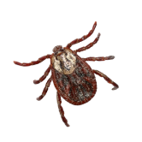
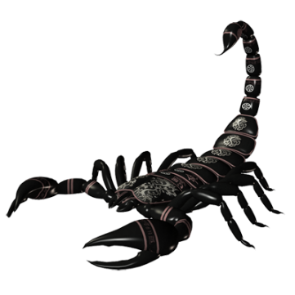
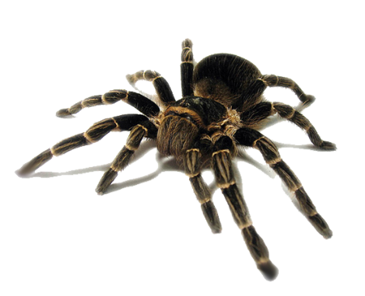
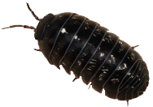
Arthropods
This is a big group of invertebrates that have a hard outer shell called an exoskeleton (which means outside skeleton). They also have jointed legs. There are lots of groups of arthropods that you already know.
Can you guess any of them?
Crustaceans
Insects
Arachnids
There are over a million different species and new ones are being discovered all the time. They hatch from eggs which develop into larvae before becoming adults. Adult insects have 6 legs. Many can fly.
This is the spider family. They have 8 legs and 2 sections to their bodies called a head and an abdomen. Many of them spin webs to catch prey.
This group have a hard shell and most of them live in the sea. Crabs, lobsters and shrimps are in this group.
Woodlice are a type of land living crustacean.
Tarantulas and scorpions are in this family.

Slide 6
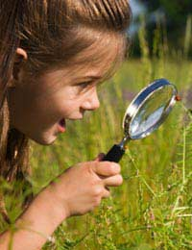
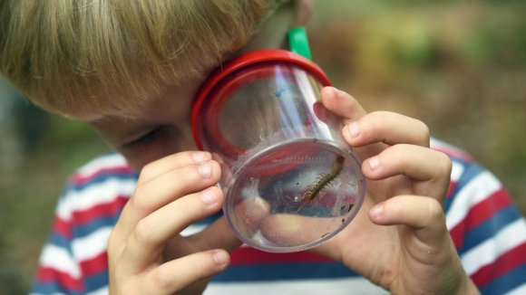
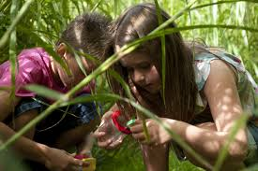
Scientists have classified all these creatures into their groups according to their similarities and differences. Now it’s your turn!
Your task is to go on a bug hunt!
Can you use their features to work out which type of creature you’ve found and what group it belongs to?
How many different types of invertebrate can you find?

Slide 7
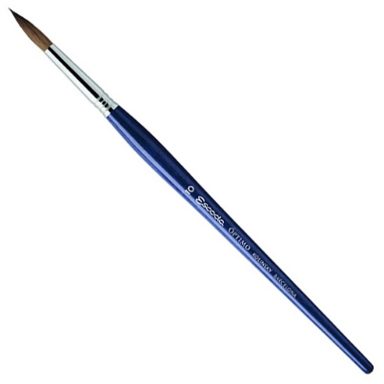
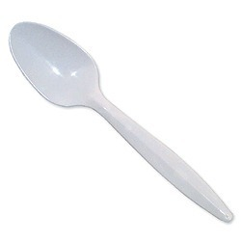
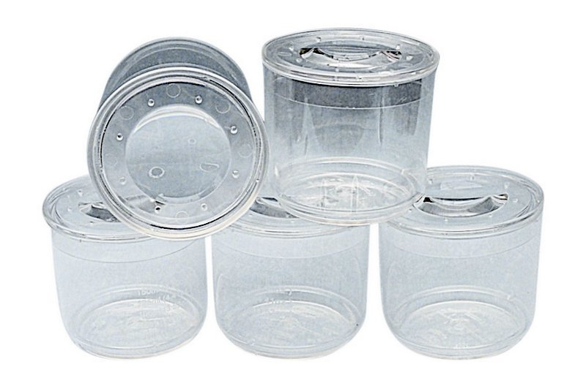
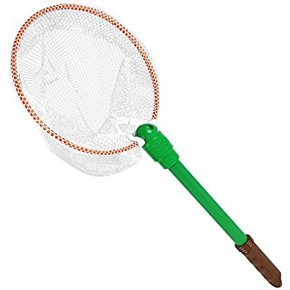
Here is some equipment that may help you
A paint brush or a plastic spoon is a good way to pick up creatures without hurting them
Pots with magnifying lids can be great for taking a close look at invertebrates. Empty yogurt pots can make good collecting pots too.
A net can be a handy way to trap flying creatures.

Slide 8
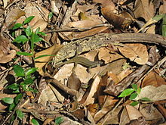
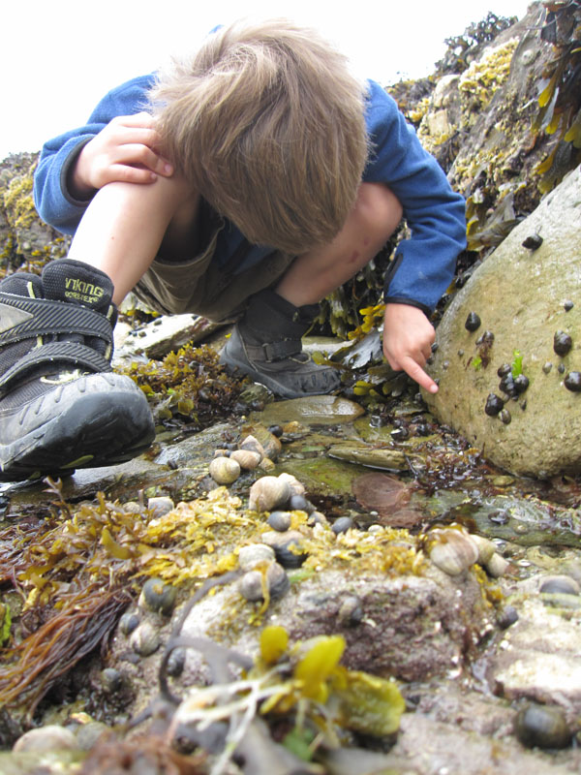
Hunt with a partner or a couple of friends. Try to find at least 3 different creatures.
Good places to look are:
In long grass
In amongst dead leaves
Under flowerpots or stones
In the soil
On flowers
On the bark of trees
Under trees and shrubs
In wood piles

Slide 9
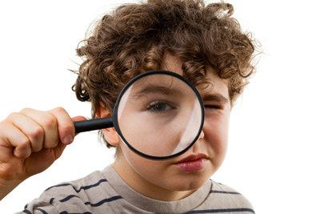
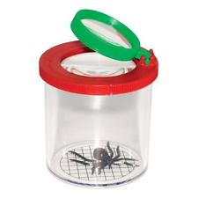
Always
Treat creatures gently and with respect –they are living things!
Remember where you found them – that place is their natural habitat (home)
Return them to their habitat later

Slide 10
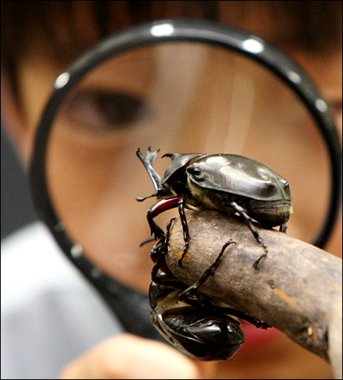
Bring your specimens back to the classroom. Then you can swap around and see what the other groups have found.
You will be able to use an invertebrate key like this one to identify your specimens.

Slide 11
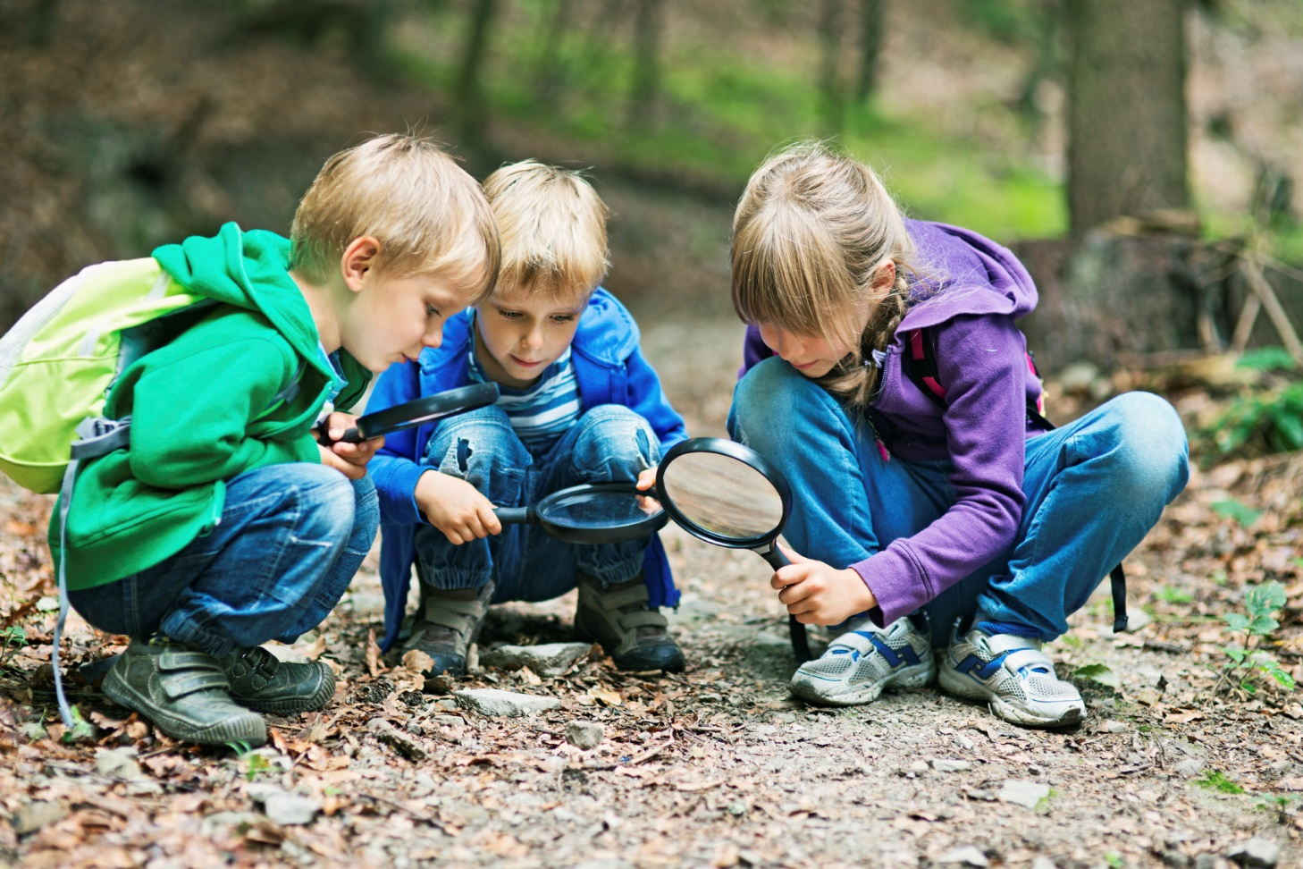
Good Hunting!

