Slide 1
Show Don’t Tell - Thinking About Emotions

Slide 2
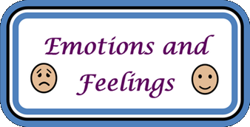
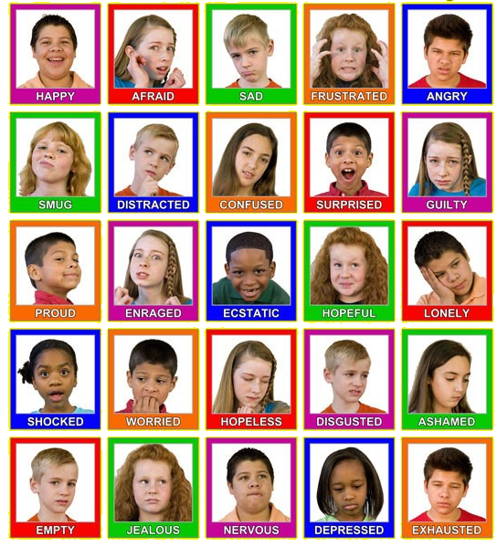
How do the emotions affect the face of these children?

Slide 3
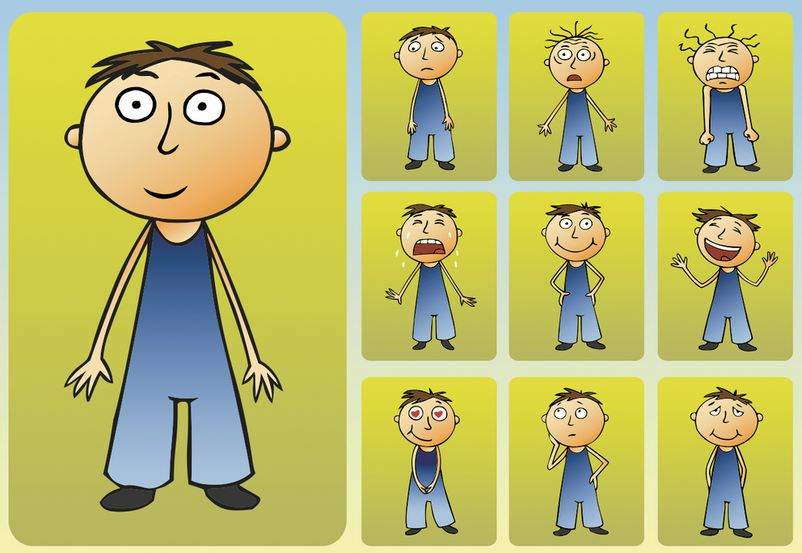
How do these emotions affect body language?

Slide 4
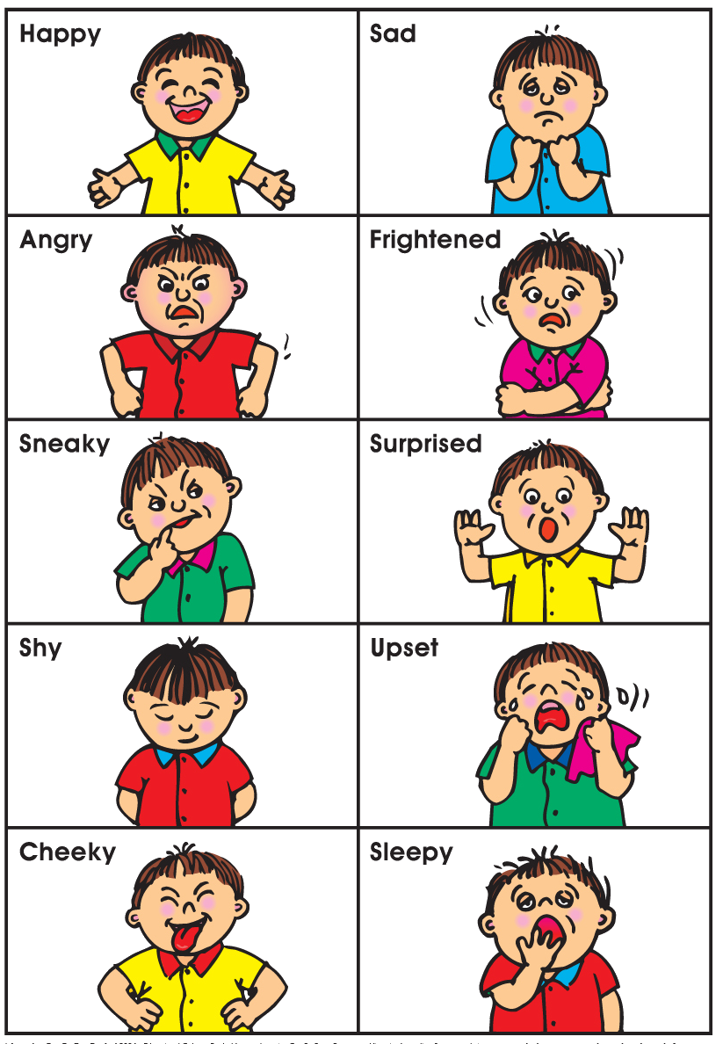
Our bodies change when we are displaying different emotions – our actions change?

Slide 5
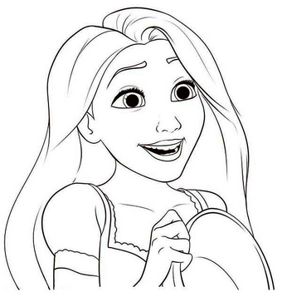
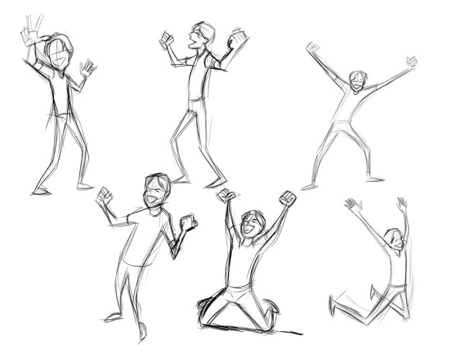
Excited for what’s to come
talkative,
pacing around,
rubbing hands,
eyes darting around,
big smiles,
hugging,
shaking hands,
punching someone on the arm,
giggles,
victory dance,
staring into the distance,
group feeling of joy.

Slide 6
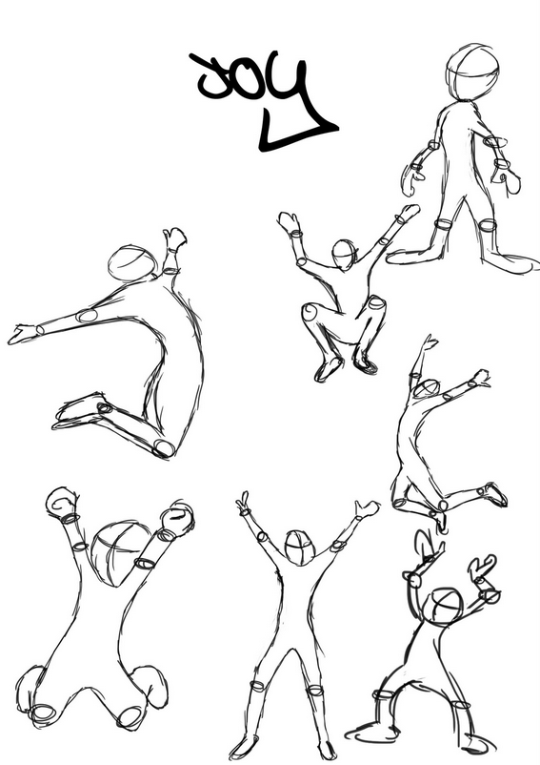
Amused
smiling,
eyes wide,
head up,
walking quickly,
friendly,
talkative,
using arms a lot,
throwing head back,
cupping the cheeks,
holding ribs,
holding hand up to stay stop,
covering the mouth,
trying to keep a straight face,
bouncing on toes,
breathlessness,
tapping with fingers.

Slide 7
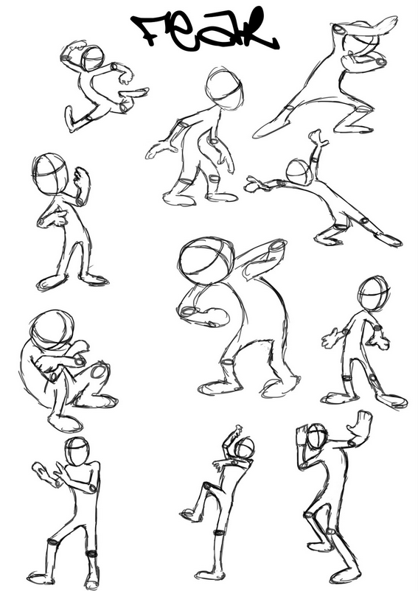
Fear
dry mouth,
biting lip,
wanting to run,
gasping for air,
cold sweat,
talking non stop,
dizziness,
shivery skin,
flinching at noises,
shaking,
shrill voice,
stuttering voice.
crouching
tip-toeing
hands up

Slide 8
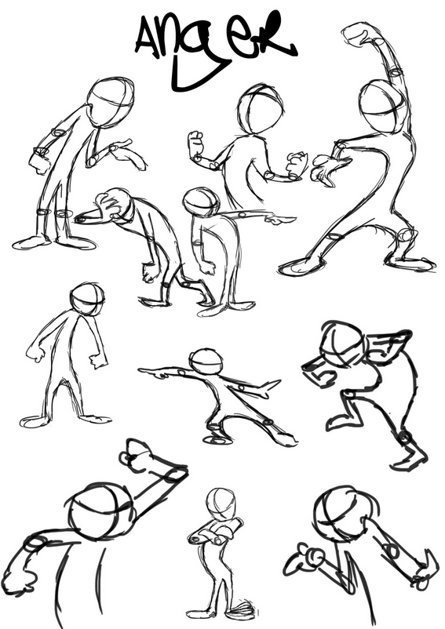
Anger
breathing deeply,
picking fights,
sarcasm,
pounding fists,
prodding finger,
deeper louder voice,
shoulders and head forward,
eyes wide and glaring,
hands forward in fists,
red face.

Slide 9
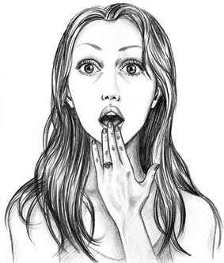
Shock
yelp or light scream,
stiffening posture,
sudden coldness,
eyes wide and water,
head darting left and right
hand against chest,
hand against throat,
shaky soft voice,
grabbing someone’s arm for comfort,
heavy feeling in the stomach,
tingling skin,
asking who, what, why questions.

Slide 10
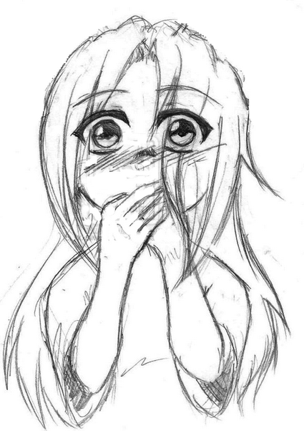
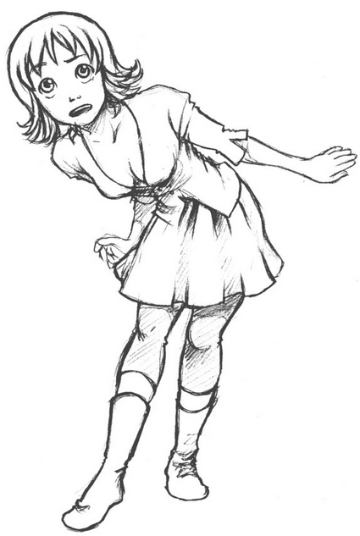
Curiosity
straining to see,
ears and head pointing to hear,
shushing others to be quiet,
head moving left and right,
wide eyes,
slower breaths,
lips parted slightly,
gasp of wonder,
small smile,
soft voice,
moving from left to right foot

Slide 11
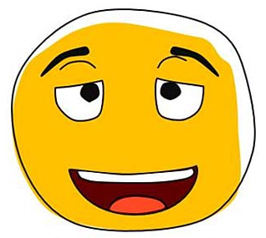
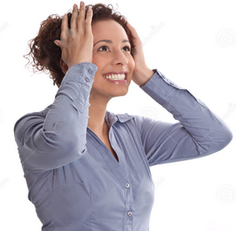
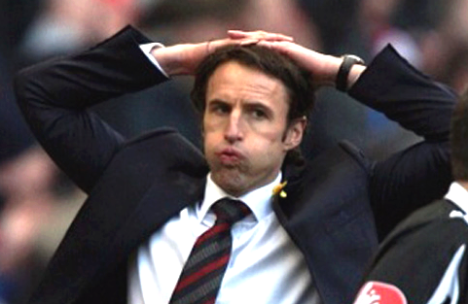
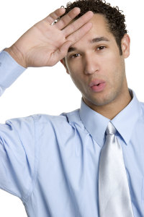
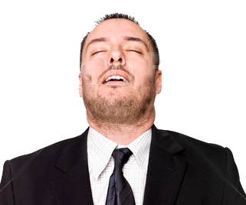
Relief
smiling
wide grinning eyes
eyes closed
hand holding brow
blowing air out of mouth
holding hair with both hands
mouth open, hands wide
shaking head, disbelief
laughter

Slide 12
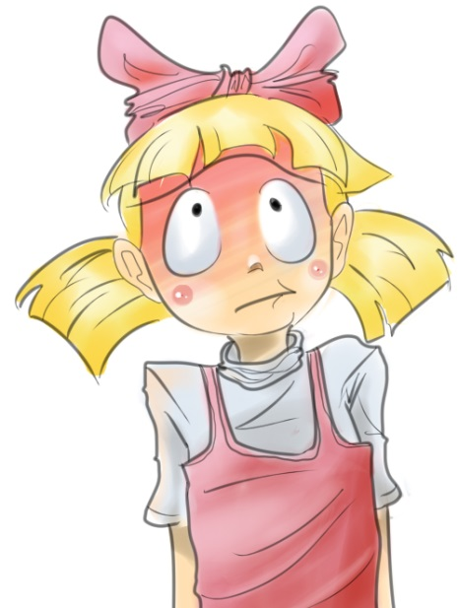
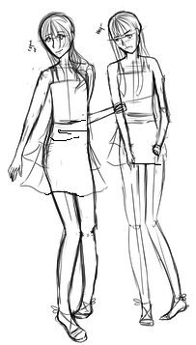
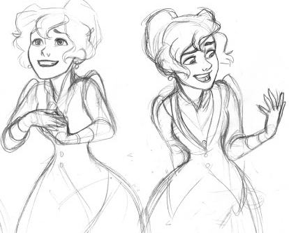
Embarrassment
looking down,
can’t look at other’s eyes,
hiding face with long hair,
walking quickly away,
grasping things against chest,
gritting teeth,
keep swallowing,
face goes red,
stammering,
panicky thoughts,
shoulders slumped,
glancing around anxiously for an exit.

Slide 13
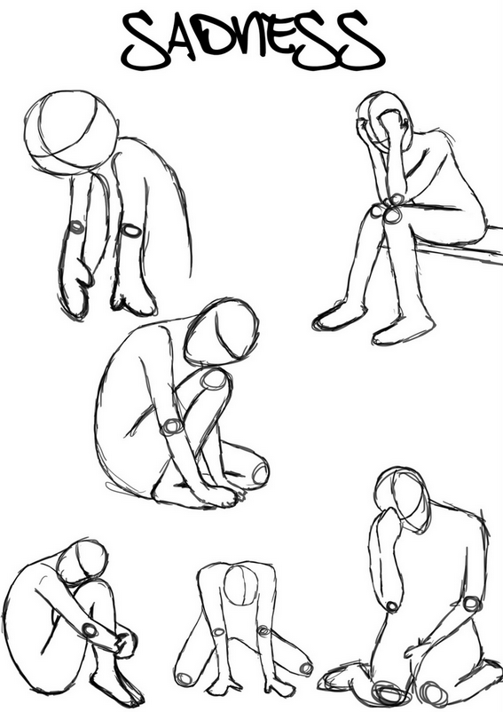
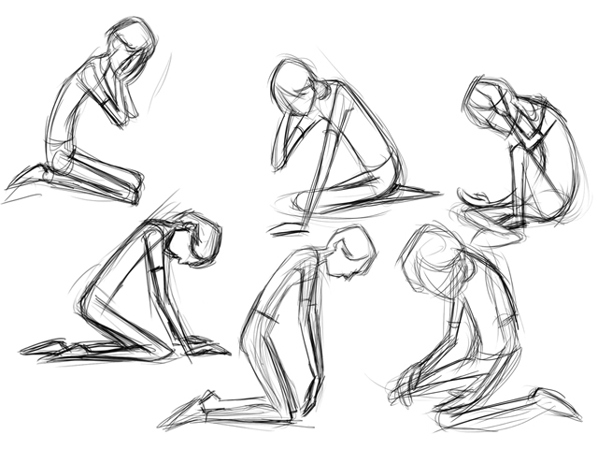
Sadness
downcast eyes,
red or watery eyes,
slow walk,
feeling sick,
crying, not wanting to talk,
jerky breathing,
shoulders slumped,
rubbing face,
rubbing hair,
downturned mouth,
avoiding other’s eyes.

Slide 14
A good writer shows emotions through ‘actions’ rather than using the emotional word.
Emotion | Actions
Amused | Smiling, eyes wide, head up, walking quickly, friendly, talkative, using arms a lot, throwing head back, cupping the cheeks, holding ribs, holding hand up to stay stop, covering the mouth, trying to keep a straight face, bouncing on toes, breathlessness, tapping with fingers.
Fear | Dry mouth, biting lip, wanting to run, gasping for air, cold sweat, talking non stop, dizziness, shivery skin, flinching at noises, shaking, shrill voice, stuttering voice.
Anger | Breathing deeply, picking fights, sarcasm, pounding fists, deeper louder voice, shoulders and head forward, eyes wide and glaring, hands forward in fists, red face.
Shock or Surprise | Yelp, stiffening posture, sudden coldness, eyes water, hand against chest, hand against throat, shaky soft voice, grabbing someone for comfort, heavy feeling in the stomach, tingling skin, asking who, what, why questions.
Curiosity | Straining to see, ears and head pointing to hear, shushing others to be quiet, wide eyes, slower breaths, lips parted slightly, gasp of wonder, small smile, soft voice
Excited for what’s to come | Talkative, pacing around, rubbing hands, eyes darting around, big smiles, hugging, shaking hands, punching someone in fun on the arm, giggles, victory dance, group feeling of joy.
Embarrassment | Looking down, can’t look at others eyes, hiding face with long hair, walking quickly away, grasping things against chest, gritting teeth, keep swallowing, stammering, panicked thoughts, shoulders slumped, glancing around anxiously for an exit.
Sadness | Downcast eyes, slow walk, feeling sick, crying, not wanting to talk, jerky breathing, shoulders slumped, rubbing face, avoiding others eyes.

