Slide 1
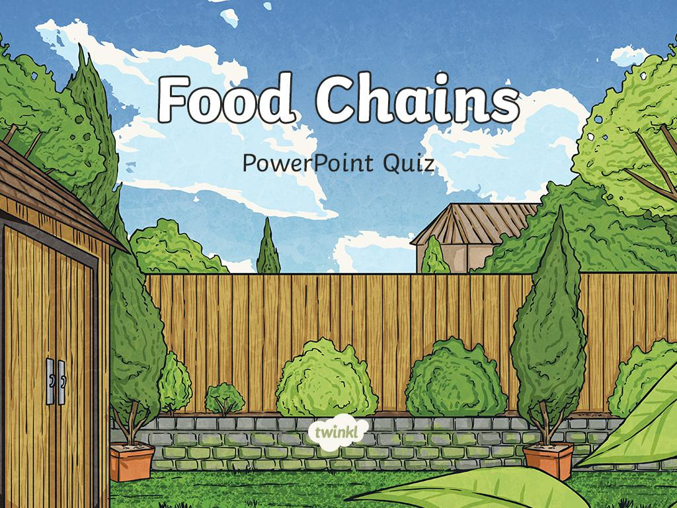

Slide 2
What is a food chain?
A
a recipe
B
a chain made of food
C
How animals depend on other plants and animals for their food and survival.

Slide 3
If an animal becomes extinct which part of the food chain is affected?
A
animals at the top of the food chain
B
the whole food chain
C
plants/animals at the bottom of the food chain

Slide 4
Which role do humans play in food chains?
A
consumer
B
producer
C
humans aren’t part of food chains

Slide 5
Which is an example of a consumer eating another consumer?
A
a deer eating bark
B
a lion eating a zebra
C
a bird eating berries

Slide 6
A producer uses the Sun’s energy to make food. Which of these is not a producer?
A
a sunflower
B
a rose bush
C
a pig

Slide 7
Consumers get their food by eating other organisms. Which of these is not a consumer?
A
A daisy
B
A horse
C
A tiger

Slide 8
What is always at the start of a food chain or web?
A
an insect
B
a big cat
C
a green plant

Slide 9
Why do food chains and webs always start with green plants?
A
green plants taste a lot nicer
B
green plants absorb the Sun’s energy to produce food
C
green plants look the best to eat

Slide 10
What is an animal called that hunts and eats other animals?
A
predator
B
prey
C
producer

Slide 11
A deer eats bark for food. A wolf eats deer for food. Which animal is the prey in this food chain?
A
Bark
B
Deer
C
Wolf

Slide 12
