Slide 1
Addition and Subtraction
Say one more and one less (numbers to 100)
Starter
Count back from 100
Notes:
Pre-requisite skills – to use this starter, drag this slide to the start of Day 2
Children count back from 100 as you point to numbers on a 1–100 grid, stressing 5s. Finish with blast off!

Slide 2
Addition and Subtraction
Say one more and one less (numbers to 100)
Objectives
Day 2
Find 1 more/1 less than any 2-digit number.

Slide 3
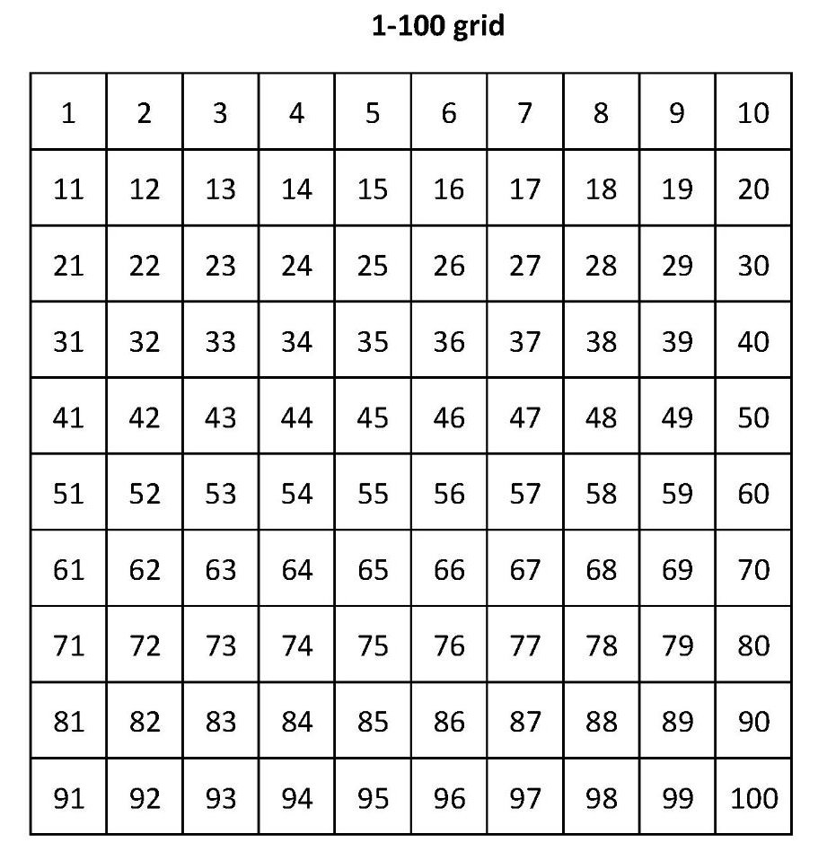
Day 2: Find 1 more/1 less than any 2-digit number.
Let’s count on in 10s.

Slide 4
Day 2: Find 1 more/1 less than any 2-digit number.
Let’s count from 30 to 45.
Notes:
Point to 40 and ask: What number came before 40? And after 40?

Slide 5
Day 2: Find 1 more/1 less than any 2-digit number.
Let’s count from 40 to 55.
Notes:
Point to 50 and ask: What number came before 50? And after 50?

Slide 6
Day 2: Find 1 more/1 less than any 2-digit number.
Let’s count from 50 to 65.
Notes:
Point to 50 and ask: What number came before 50? And after 50?

Slide 7
Day 2: Find 1 more/1 less than any 2-digit number.
Let’s count from 60 to 75.
Notes:
Point to 70 and ask: What number came before 70? And after 70?

Slide 8
Day 2: Find 1 more/1 less than any 2-digit number.
Let’s count from 70 to 85.
Notes:
Point to 80 and ask: What number came before 80? And after 80?

Slide 9
Day 2: Find 1 more/1 less than any 2-digit number.
Let’s count from 80 to 95.
Notes:
Point to 80 and ask: What number came before 80? And after 80?

Slide 10
Day 2: Find 1 more/1 less than any 2-digit number.
What is this number?
59

Slide 11
Day 2: Find 1 more/1 less than any 2-digit number.
What if I add 1 more?
59 + 1 = 60
What is the number after 59?

Slide 12
Day 2: Find 1 more/1 less than any 2-digit number.
What if I subtract 1?
59 – 1 = 58
What is the number before 59?
Notes:
Highlight other 2-digit numbers including 29, 39, 31 and 41 and repeat, in each case asking children to identify the number 1 more and then 1 less than each number.
Choose children to come up and write the corresponding number sentences for each.
Today would be a great day to use a problem-solving investigation – Next Domino – as the group activity, which you can find in this unit’s IN-DEPTH INVESTIGATION box on Hamilton’s website.
Alternatively, children can now go on to do differentiated GROUP ACTIVITIES. You can find Hamilton’s group activities in this unit’s TEACHING AND GROUP ACTIVITIES download.
WT: Make 2-digit numbers and write them on Post-it™ notes. Make a number line on a strip of paper and find 1 more/1 less than the numbers.
ARE/GD: Making 2 digit numbers from number cards. They find it on a number square and work out 1 more/1 less.

Slide 13
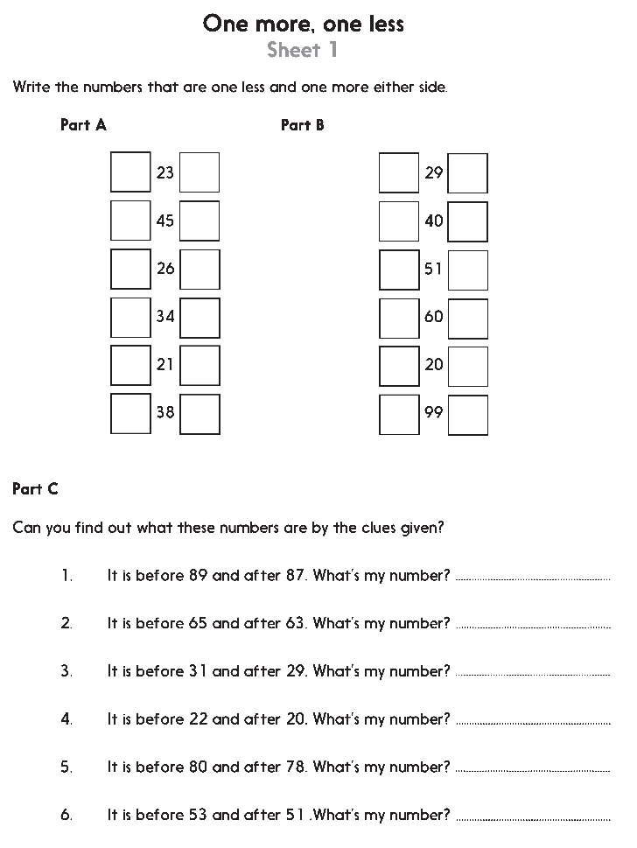
Challenge
Notes:
The Practice Sheet on this slide is suitable for most children.
Differentiated PRACTICE WORKSHEETS are available on Hamilton’s website in this unit’s PROCEDURAL FLUENCY box.
WT/ARE/GD: One more, one less Sheet 1

