Slide 1
ECOLOGY AND POPULATION SIZE

Slide 2
Ecology- Study of interaction between living organisms and their environment
Habitat- where organisms live
Niche-the way organisms live its life in an ecosystem
Population- group of species living in the same area at the same time
Community- different organisms living at the same habitat
Ecosystem- a unit containing all the organisms and their environment, interacting together, in a given area
e.g. lake or decomposing log

Slide 3
Producer- an organism that makes its own organic nutrients, usually using energy from sunlight, through photosynthesis
Consumer- an organism that gets its energy by feeding on other organisms
Decomposer- an organism that gets its energy from dead waste or waste organic matter
Herbivore- an animal that gets its energy by eating plants
Carnivore- an animal that gets its energy by eating other animals

Slide 4
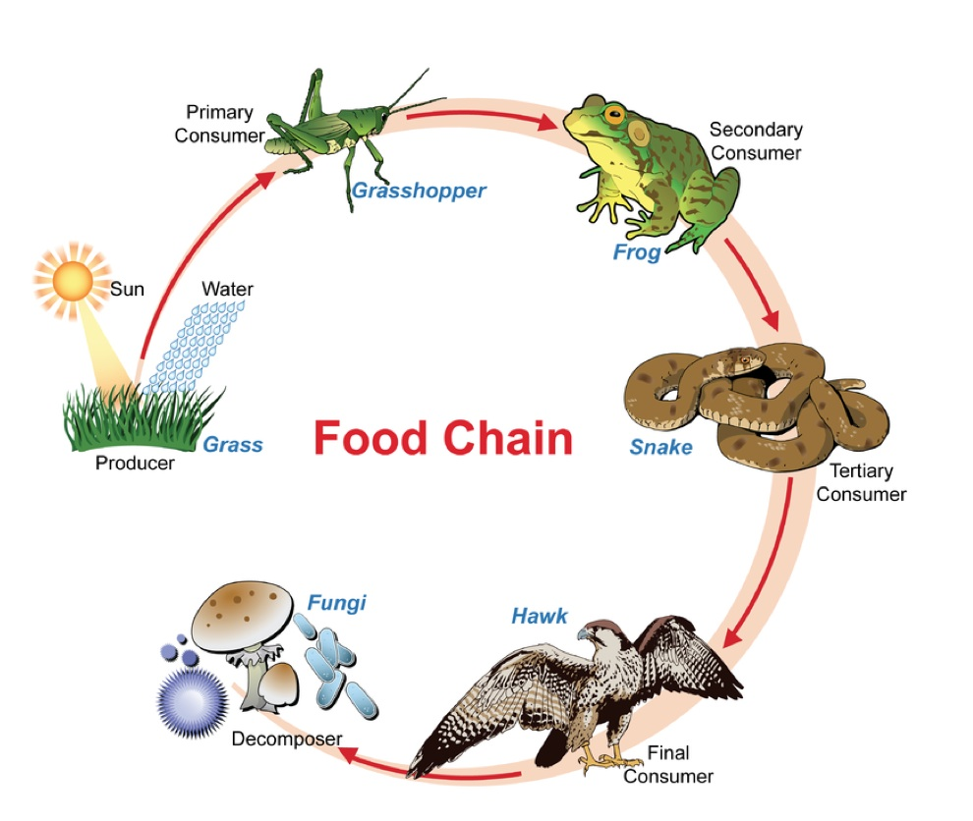
Food Chain
A chart showing the flow of energy from one organism to the next
https://www.tes.com/lessons/XhyMU0bGISIBYQ/copy-of-food-chain-food-web

Slide 5
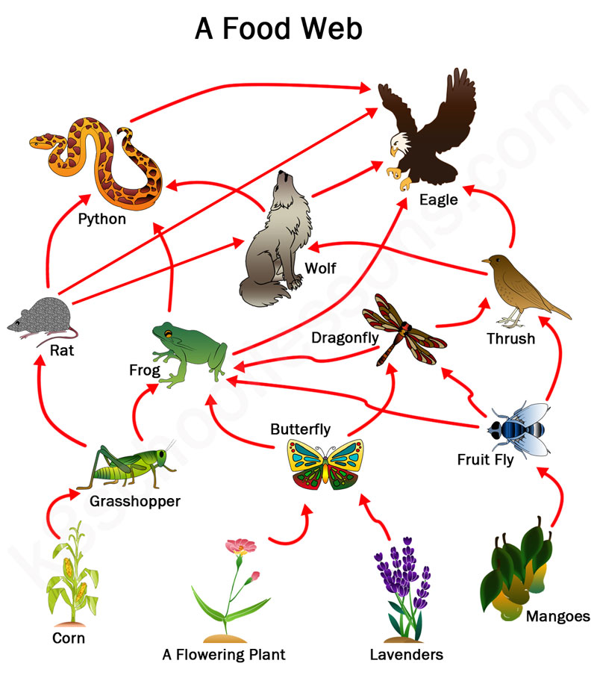
Food Web
A network of interconnected food chains showing the energy flow through part of an ecosystem
https://k8schoollessons.com/food-chains-food-webs/

Slide 6
Energy losses
Some of the energy released from the food is lost as heat energy to the environment
An organism rarely eats absolutely all of the other organism
Not all the food molecules are digested and absorbed, it will eventually be lost as faeces

Slide 7
Trophic Levels
The position of an organism in a food chain, food web or pyramid of numbers, biomass and energy
Producers
Primary consumer
Secondary consumer
Tertiary consumer

Slide 8
Pyramid of Numbers
https://worldofecologyais.weebly.com/energy-flow-in-the-ecosystem.html

Slide 9
Pyramid of Numbers, Biomass and Energy
https://sites.google.com/a/edubuzz.org/nat5biopl/unit-3-life-on-earth/2-energy-in-ecosystems

Slide 10
Population of Bacteria
http://biology-igcse.weebly.com/population-size.html

Slide 11
Environmental Factors
Food supply
Disease
Nest sites
Predators
Limiting factor- factor that stops the population from getting larger

Slide 12
Population sizes often oscillate
http://slideplayer.com/slide/5238724/

Slide 13
Age pyramids
http://www.visualcapitalist.com/animation-population-pyramids-10-biggest-countries/

Slide 14
Japan
https://www.financialsense.com/contributors/grant-williams/2012/07/30/things-that-make-you-go-hmmm

Slide 15
Human Population on Earth
http://depressinggraphs.com/post/63797947699/world-population-growth-through-history-source

Slide 16
Two Ways to control Human Population
Increasing the death rate
Decreasing the birth rate
Sources: Cambridge IGCSE Biology Coursebook 2nd ed.
Images from Google

