Slide 1
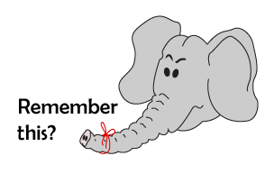
Addition and Subtraction
Adding by counting on (numbers to 20)
Starter
Count to 20
Notes:
Simmering skills – to use this starter, drag this slide to the start of Day 3
Count in 1s emphasising the 5s on the 20-bead bar, 1, 2, 3, 4, 5, 6, 7, 8, 9, 10… Show me 6. Can you do it the quick way? (Finding 5, adding one more bead to their bead strings.) Show me 7. Show me 5. Show me 4. Show me 10. Show me 9, the quick way! Show me 15. Show me 16. Show me 20. Show me 19. Repeat so that children get used to using the landmarks of 5, 10, 15 and 20.

Slide 2
Addition and Subtraction
Adding by counting on (numbers to 20)
Objectives
Day 3
Add 2, 3 or 4 by counting on.

Slide 3
Day 3: Add 2, 3 or 4 by counting on.
Make a tower of 5 cubes.
How many cubes now?

Slide 4
Day 2: Find 2 more/less than any number up to 20, recording the hops on a beaded line.
+ 3
8
What number sentence can we write?
Where is this number on the beaded line?
5 + 3 = 8

Slide 5
Day 3: Add 2, 3 or 4 by counting on.
12
We’re going to calculate 12 + 3.
12 + 3 =

Slide 6
Day 3: Add 2, 3 or 4 by counting on.
Make a tower of 12 cubes and add three more. Count as you add the cubes.
How many cubes now?
13
, 14
, 15

Slide 7
Day 3: Add 2, 3 or 4 by counting on.
Where is 15 on the beaded line?

Slide 8
Day 2: Find 2 more/less than any number up to 20, recording the hops on a beaded line.
+ 3
12
What number sentence can we write?
12 + 3 = 15

Slide 9
Day 3: Add 2, 3 or 4 by counting on.
Notes:
Repeat with other numbers up to 20, adding 3 or 4, making sure you include counting on from 7, 8 or 9 so that you show crossing 10.
Keep the 1st 10 cubes in one colour and the next group in another colour.
Today would be a great day to use a problem-solving investigation – Red or Blue – as the group activity, which you can find in this unit’s IN-DEPTH INVESTIGATION box on Hamilton’s website.
Alternatively, children can now go on to do differentiated GROUP ACTIVITIES. You can find Hamilton’s group activities in this unit’s TEACHING AND GROUP ACTIVITIES download.
WT: Add small numbers by counting on using a bead string.
ARE/GD: Add 2 sets of numbers together using a beaded line.

Slide 10
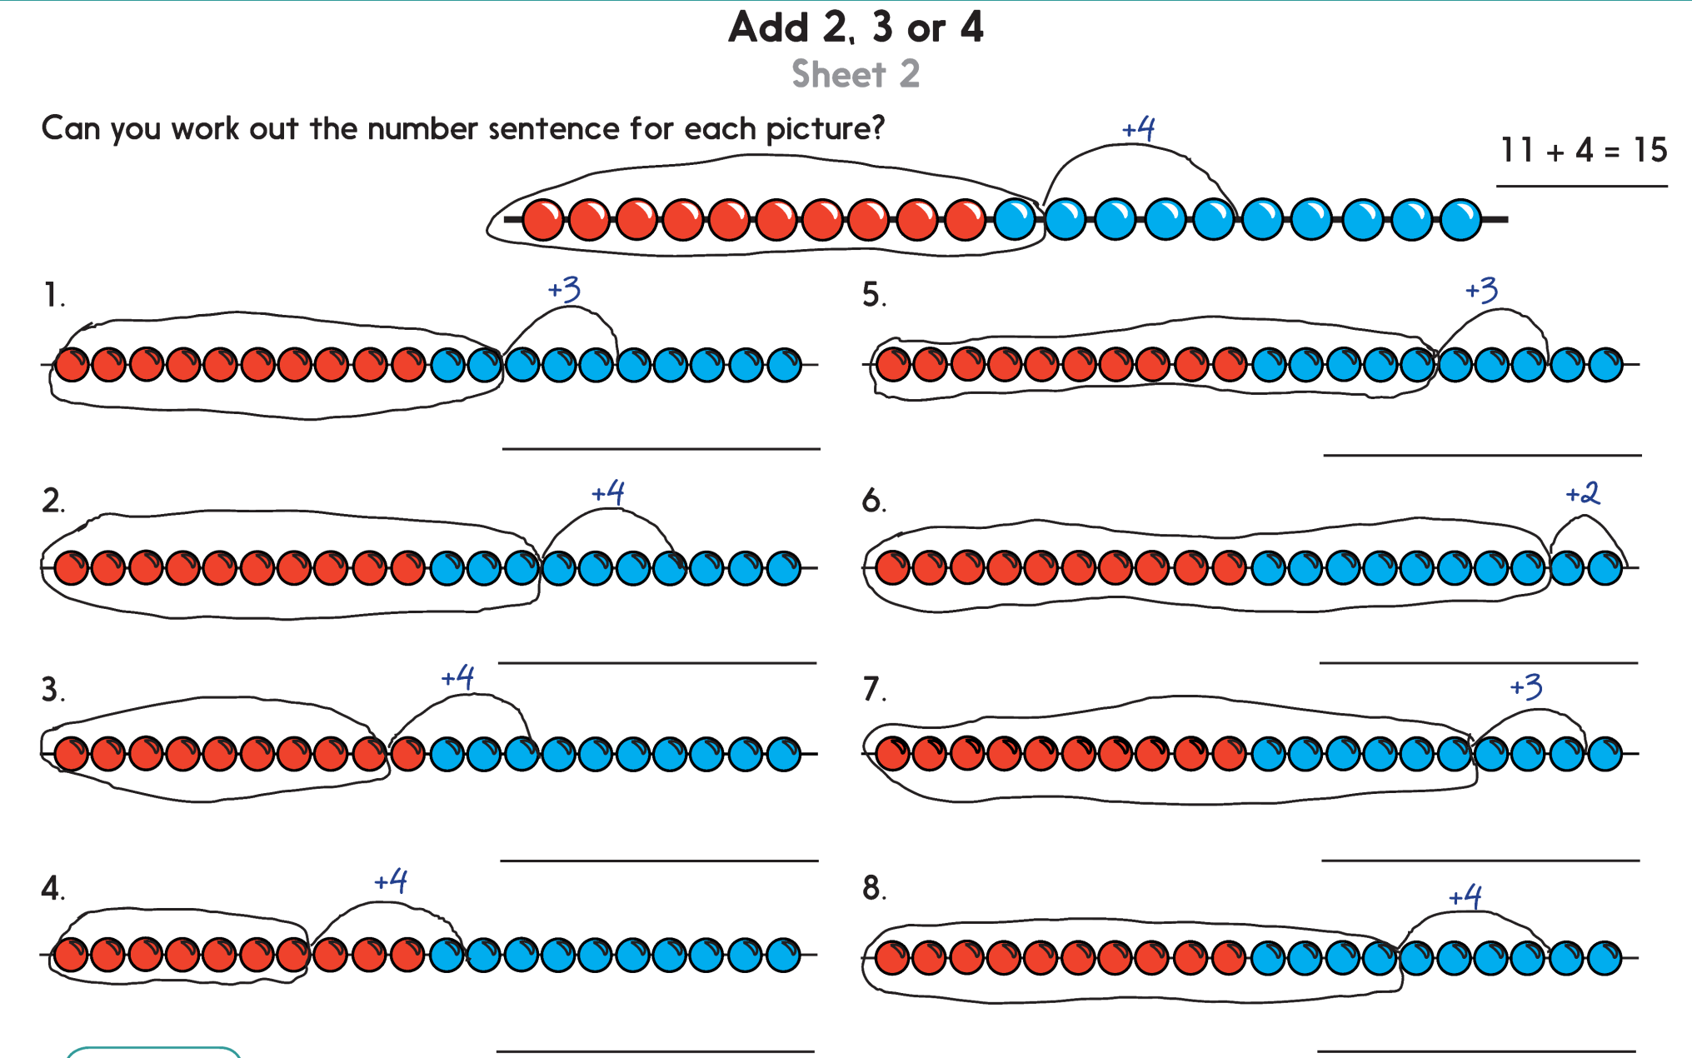
Challenge
Notes:
The Practice Sheet on this slide is suitable for most children.
Differentiated PRACTICE WORKSHEETS are available on Hamilton’s website in this unit’s PROCEDURAL FLUENCY box.
WT: Add 2, 3 or 4 Sheet 1
ARE/GD: Add 2, 3 or 4 Sheet 1

Slide 11
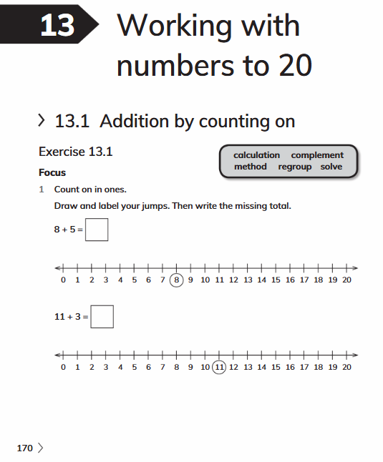
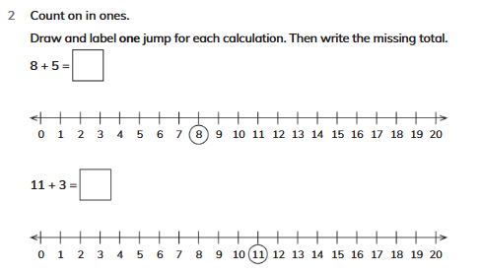
Book Exit
Complete Workbook page 170-171 nos. 1 and 2

