Slide 1
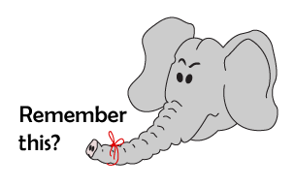
Addition and Subtraction
Number bonds to 10
Starter
One more/less
Notes:
Simmering skills – to use this starter, drag this slide to the start of Day 2
Working in pairs, ask children to divide their whiteboards into 3 parts. On the left hand side column they write 1 less and on the right hand column 1 more. Model how to do this. Show children a 1–100 grid on the IWB, e.g. the Number Grid ITP, starting with lower numbers, and highlight it. Children write this number in the middle column and then discuss and work out what is 1 more and 1 less than that number and record in the corresponding column. Check by showing the pattern on the grid and choose a new number to highlight.

Slide 2
Addition and Subtraction
Number bonds to 10
Objectives
Know number bonds to 10. Write addition sentences.

Slide 3
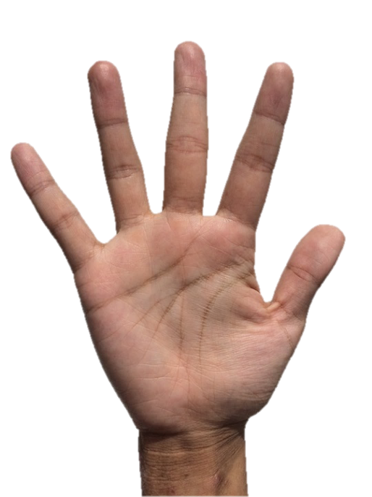
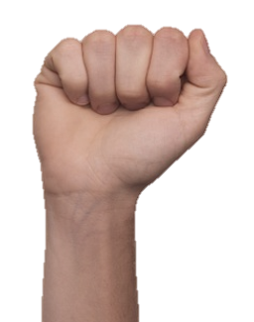
Day 2: Know number bonds to 10; Write addition sentences.
How many fingers are standing up?
5
5 + 5 = 10
3
Year 1
Notes:
Ask children how many fingers would have to be put up to make 10 again?
Remind children that these 2 numbers are special because they are partners that when added together make 10.

Slide 4
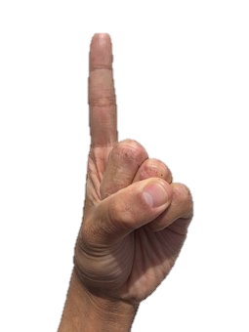
Day 2: Know number bonds to 10; Write addition sentences.
6 + 4 = 10
Notes:
Ask children how many fingers would have to go back up to make 10 again?
Ask a child to come up and write the number bond on the flipchart.

Slide 5
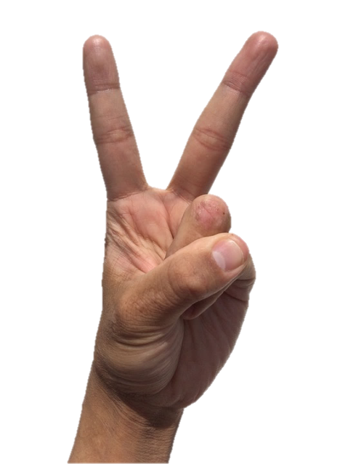
Day 2: Know number bonds to 10; Write addition sentences.
7 + 3 = 10
Notes:
Ask children how many fingers would have to go back up to make 10 again?
Ask a child to come up and write the number bond on the flipchart.

Slide 6
Day 2: Know number bonds to 10; Write addition sentences.
8 + 2 = 10
Notes:
Ask children how many fingers would have to go back up to make 10 again?
Ask a child to come up and write the number bond on the flipchart.

Slide 7
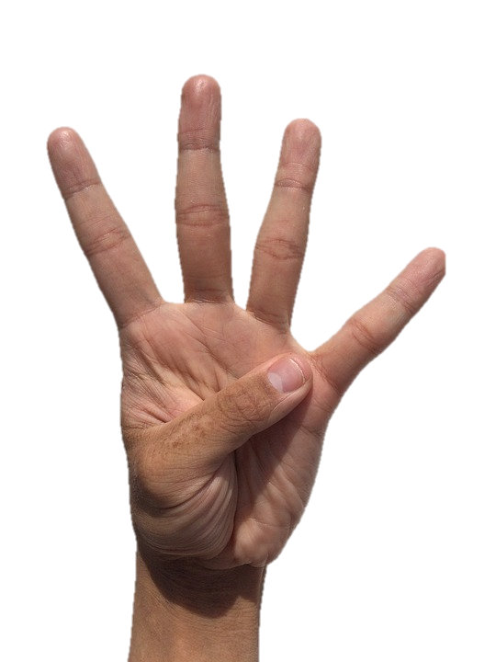
Day 2: Know number bonds to 10; Write addition sentences.
9 + 1 = 10
Notes:
Ask children how many fingers would have to go back up to make 10 again?
Ask a child to come up and write the number bond on the flipchart.

Slide 8
Day 2: Know number bonds to 10; Write addition sentences.
Talk to your partner.
How many fingers to make 10 again?
0 + 10 = 10
Notes:
Ask children how many fingers would have to go back up to make 10 again?
Ask a child to come up and write the number bond on the flipchart.

Slide 9
Day 2: Know number bonds to 10; Write addition sentences.
1 + 9 = 10
2 + 8 = 10
Talk to your partner.
Can you spot a pattern?
3 + 7 = 10
4 + 6 = 10
5 + 5 = 10
6 + 4 = 10
7 + 3 = 10
8 + 2 = 10
9 + 1 = 10
Notes:
Children discuss with a talk partner the fact that as 1 number gets bigger the other number gets smaller.
Children can now go on to do differentiated GROUP ACTIVITIES. You can find Hamilton’s group activities in this unit’s TEACHING AND GROUP ACTIVITIES download.
WT: Use cubes to make the complement to 10 for the number shown.
ARE/GD: Number bond snap.

Slide 10
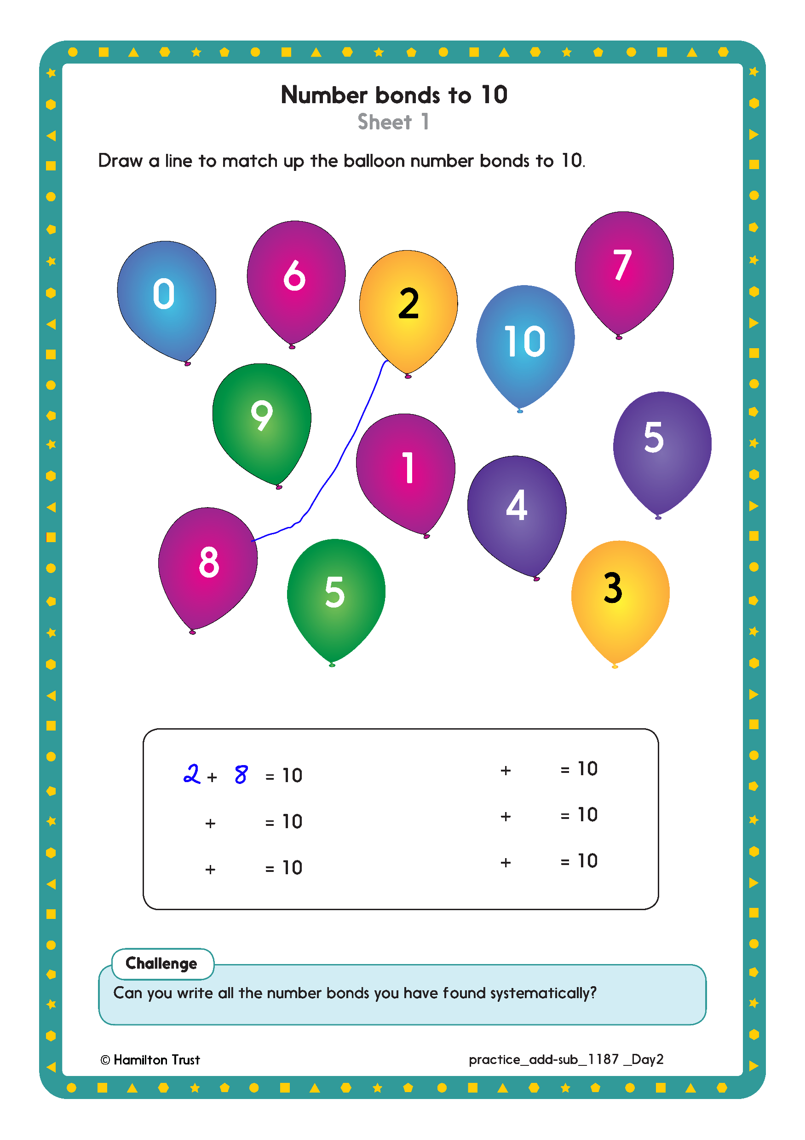
Challenge
Notes:
The Practice Sheet on this slide is suitable for most children.
Differentiated PRACTICE WORKSHEETS are available on Hamilton’s website in this unit’s PROCEDURAL FLUENCY box.
WT/ARE: Number bonds to 10 Sheet 1
GD: Number bonds to 20 Sheet 2

Slide 11
Show me – Mini Board Time
The teacher will write a number on the board, and students will write the number that pairs with it to make 10 on their mini boards.

