Slide 1
Noun Phrases
Describing
Nouns
Adverbs
Imagining
Adjectives
Being specific
Creating a picture
Notes:
All these slides are based on the teaching outlined in the document ‘Teaching_1_Pronouns’ available from Hamilton.
It is essential to read the teaching before using this powerpoint presentation.

Slide 2
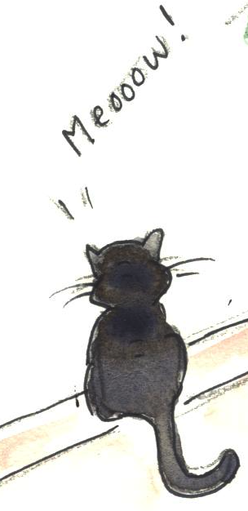
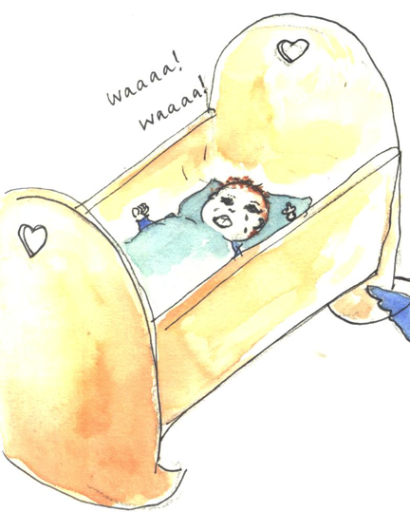
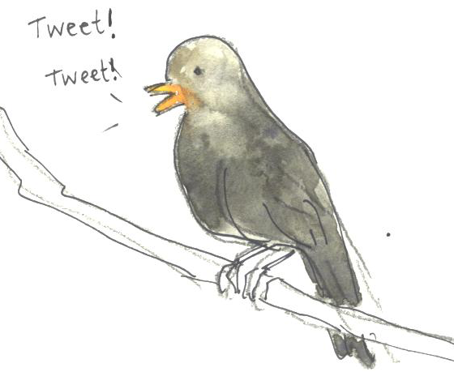
Nouns
A noun names a person, place, idea, thing or feeling.
In front of a noun, we often have one of ...
a
an
the
A baby lay in his cradle.
The bird sang an awesome song.
The cat had a fear of being left behind.

Slide 3
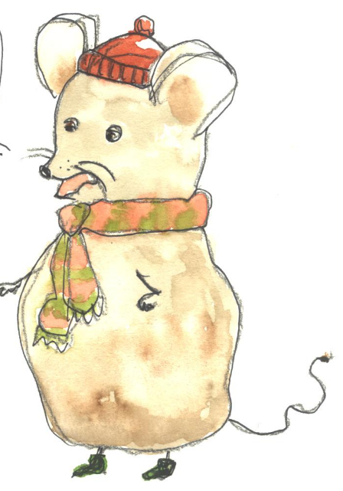
Identify the nouns
Hint!
Try putting ‘the’, ‘a’ or ‘an’ in front of the word. Does it make sense?
imagination
cats
Write the nouns on this page.
party
described
upsetting
they
mouse
home
very
Hint!
There are five.
Have you found them all?
Notes:
All these slides are based on the teaching outlined in the document ‘Teaching_1_Pronouns’ available from Hamilton.
It is essential to read the teaching before using this powerpoint presentation.

Slide 4
Identify the nouns
Hint!
Try putting ‘the’, ‘a’ or ‘an’ in front of the word. Does it make sense?
imagination
cats
Write the nouns on this page.
party
described
upsetting
they
mouse
home
very
Hint!
There are five.
Have you found them all?
Notes:
All these slides are based on the teaching outlined in the document ‘Teaching_1_Pronouns’ available from Hamilton.
It is essential to read the teaching before using this powerpoint presentation.

Slide 5
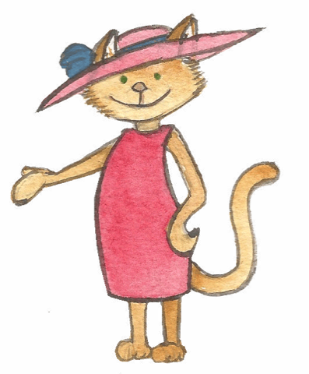
Adjectives
A adjective describes a noun.
Adjectives can come beside the noun
or they can complete a sentence.
The
cool, elegant
cat
loves
parties.
The
cat
appeared to be
smart and happy.
You can have several adjectives together…
But then you need a comma.
The cool, elegant cat…

Slide 6
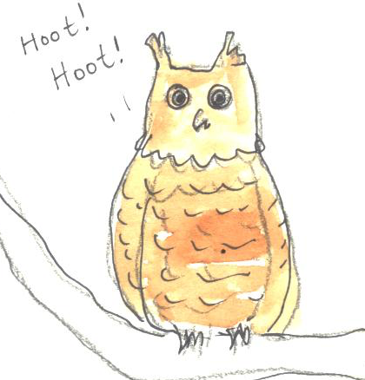
Adjectives
Adjectives describe nouns.
Adjectives can complete a sentence.
Adjectives can come beside the noun
An owl
What sort of owl?
A frightened, brown owl
Go on…
A frightened, brown owl felt
How did the owl feel?
A frightened, brown owl felt alone and sad.
Can you spot the adjectives?
A frightened, brown owl felt alone and sad.

Slide 7
Using adjectives
scary
comforting
lovely
cat
Use two adjectives to describe each noun.
feeling
hot
night
surprising
strange
birthday party
gorgeous
Don’t forget your comma!
cool
Hint!
What type of thing is it?
Think about your description.
usual
Notes:
All these slides are based on the teaching outlined in the document ‘Teaching_1_Pronouns’ available from Hamilton.
It is essential to read the teaching before using this powerpoint presentation.

Slide 8
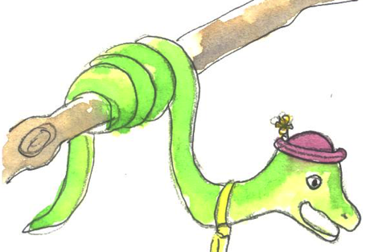
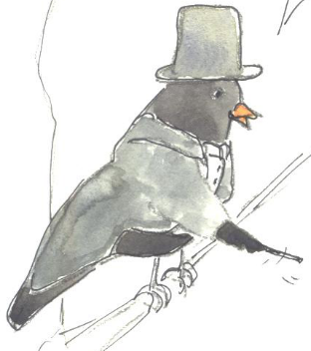
Adverbs
Adverbs add to adjectives – they tell us more about the description.
The friendly snake...
The weird bird …
How friendly is the snake?
How weird is the bird?
We can choose an adverb.
really
unsurprisingly
strangely
extremely
quite
unusually
Now try it yourself!
The really weird bird also came from the zoo.
Now we can finish the sentence.
The unusually friendly snake came from the zoo.

Slide 9
Using adverbs
Hint!
Try your adverb out in the description. Does it make sense?
A_______ elegant cat
An awfully
An _________ awful day
absolutely
Add an adverb to tell us more about each description.
quite
The ____ excited feeling
extremely
An _________ unusual party
Notes:
All these slides are based on the teaching outlined in the document ‘Teaching_1_Pronouns’ available from Hamilton.
It is essential to read the teaching before using this powerpoint presentation.

Slide 10
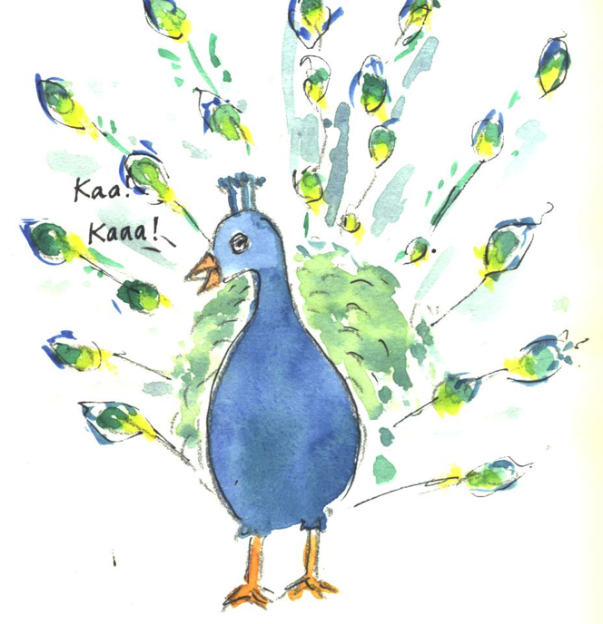
Creating good descriptions
Adjectives tell us more about nouns.
Tell me more about the peacock
Don’t forget the comma!
The peacock
The shimmering, shiny peacock
Finish the sentence
The shimmering, shiny peacock at the party…
The shimmering, shiny peacock at the party was the first thing we saw.

Slide 11
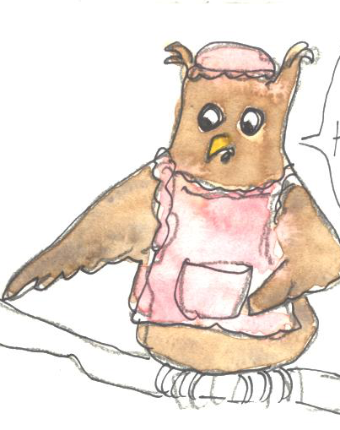
Highlight the adjective
Highlight the adverb
Noun phrases
Noun phrase = the words giving more detail about a noun
What is the noun being described?
Which bird?
bird
A bird
Where?
bird
A bird on the branch
A bird on the branch next to my window
bird
Tell me more about the bird
dressed
A dressed bird on the branch next to my window
bird
Dressed?!
strangely
There was a strangely dressed bird on the branch next to my window.
dressed
bird

Slide 12
Noun phrase
Now you have a go…
A cat
Start with a noun.
A cat at the door
Add description about what, where or when.
A very weird cat in a pink dress at the door
Add adjectives and adverbs.
Hint!
Think of something really good to describe
Notes:
All these slides are based on the teaching outlined in the document ‘Teaching_1_Pronouns’ available from Hamilton.
It is essential to read the teaching before using this powerpoint presentation.

Slide 13
END
Describing
Nouns
Adverbs
Imagining
Adjectives
Being specific
Creating a picture
Notes:
All these slides are based on the teaching outlined in the document ‘Teaching_1_Pronouns’ available from Hamilton.
It is essential to read the teaching before using this powerpoint presentation.

