Slide 1
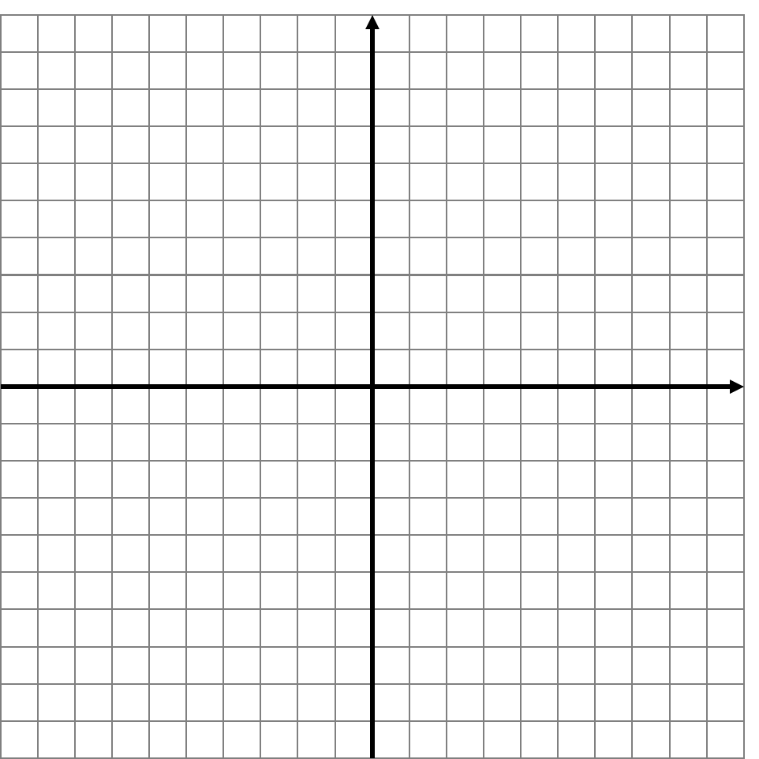
Starter
What is the equation of this line?
10
$$y$$
8
6
4
2
$$x$$
-10
-8
-6
-4
-2
0
2
4
6
8
10
-2
-4
-6
-8
-10

Slide 2
Describing Regions
Grade B/A
14/11/2023
Learning Objectives:
Able to find the equation of a line
Able to describe the region shaded for
y = a and x = b lines
Able to describe the region shaded for
y = mx + c lines

Slide 3
Describing Regions
This is the opposite of shading a region
You will be given some lines and a shaded region and have to describe the region that is shaded using inequalities

Slide 4
Describing Regions
To describe a region
Work out the equation of the line
Choose a point in the region and substitute it into the equation
Check if the left hand side of the equation is less than or greater than the right hand side
Check if the line is dashed or solid to see if it could be less/greater than or equal to

Slide 5
Identify the region that is shaded
y
$$x=5$$
5
4
1. Determine the equation of the line
2. Are the values of $x$ in the shaded region less than or greater than 5?
3. Is the line dashed or solid?
3
$x$ > 5
2
1
$$x$$
-7
-6
-5
-4
-3
-2
-1
0
1
2
3
4
5
6
7
-1
-2
-3
-4
-5

Slide 6
Identify the region that is shaded
y
5
4
1. Determine the equation of the line
2. Are the values of y in the shaded region less than or greater than -1?
3. Is the line dashed or solid?
3
$y$ ≥ -1
2
1
$$x$$
-7
-6
-5
-4
-3
-2
-1
0
1
2
3
4
5
6
7
-1
$$y=−1$$
-2
-3
-4
-5

Slide 7
Identify the region that is shaded
y
$$y=x−2$$
5
4
1. Determine the equation of the line
2. Are the values of $y$ in the shaded region less than or greater $x – 2$?
3. Is the line dashed or solid?
3
2
(5, 1)
1
(2, 0)
$$x$$
-7
-6
-5
-4
-3
-2
-1
0
1
2
3
4
5
6
7
-1
$$y=x−2$$
$$m=\frac{0−−2}{2−0}$$
$$m=1$$
$$c=−2$$
(0, -2)
<
-2
$$1 5−2$$
$$y≤x−2$$
$$1<3$$
-3
-4
-5

Slide 8
Identify the region that is shaded
y
5
4
1. Determine the equation of the lines
2. Choose a co-ordinate in the shaded region and test each equation to see if the LHS is less than or equal to the RHS
3. Is the line dashed or solid?
3
2
(0, 1)
$$y=1$$
1
(5, 0)
$$x$$
-7
-6
-5
-4
-3
-2
-1
0
1
2
3
4
5
6
7
-1
(1, -1)
$$y=−2x+1$$
$$y<1 and$$
$$y≥−2x+1$$
$$m=\frac{1−−1}{0−1}$$
$$m=−2$$
$$c=1$$
>
-2
$$0 −10+1$$
$$0>−9$$
-3
-4
-5
$$y=−2x+1$$

Slide 9
Your turn
Identify the regions labelled on the worksheet

