Slide 1
Journal Writing –Introduction
Paper 1 – Question 3

Slide 2
HOOK ACTIVITY
Write a paragraph sharing their thoughts and feeling regarding the winter break. Do incorporate the following while answering -
Places they visited (within and outside Doha)
Time Spend with the family
Preparation for upcoming IGCSE exams

Slide 4
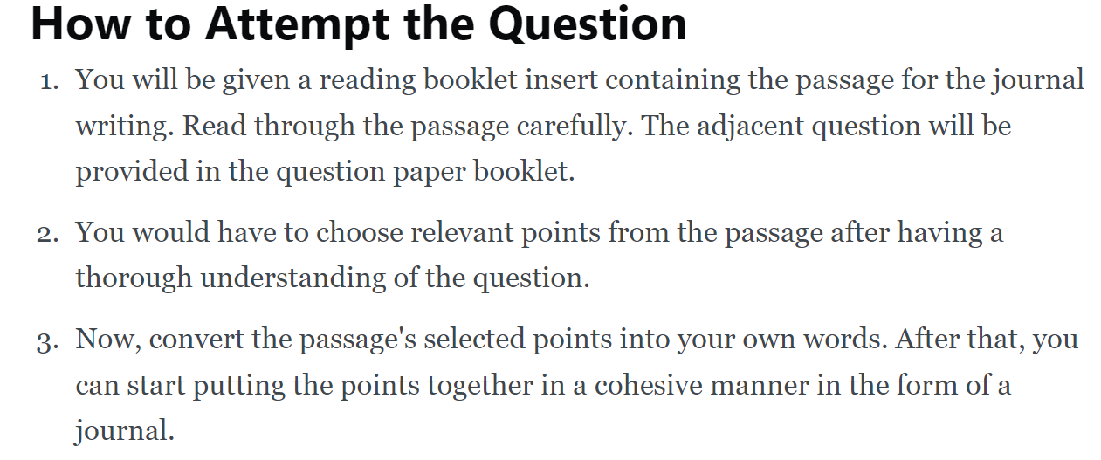

Slide 5
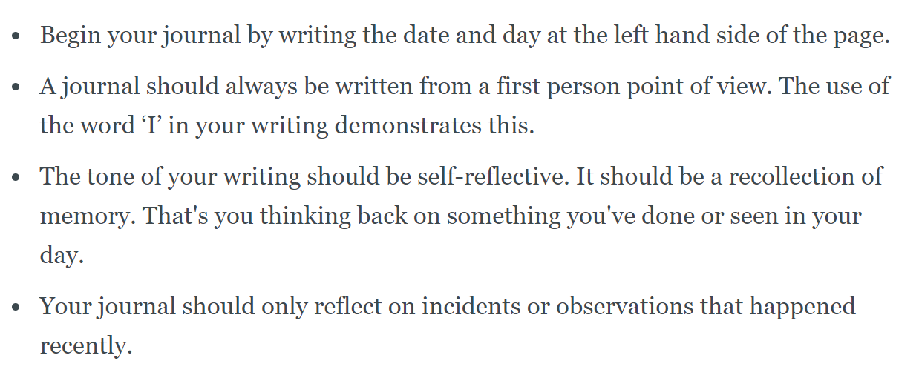

Slide 6
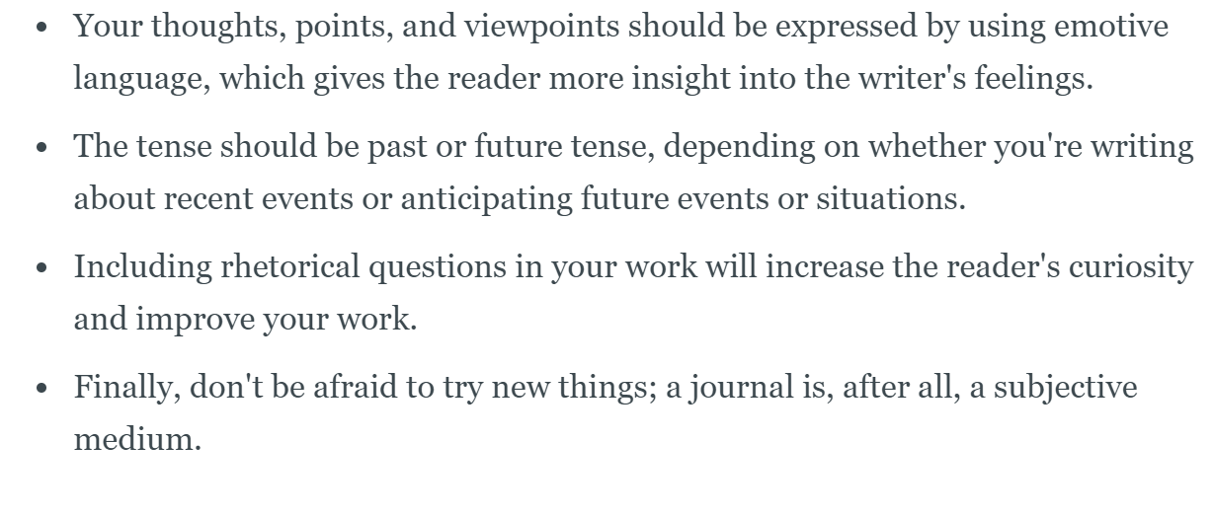

Slide 7
Reflect ….
What are the benefits of Journaling your everyday life in today's world?

