Slide 1
To p i c
Secondary Storage
C O M P U T E R S C I E N C E
Y E A R 8

Slide 3
Key Vocabulary:
Secondary Memory: Storage devices used to store data permanently or temporarily.
Hard Disk: A traditional magnetic storage device consisting of spinning disks.
SSD (Solid State Drive): A newer storage technology that uses flash memory chips.
Storage Capacity: The amount of data a storage device can hold.

Slide 4
Introduction
What types of devices do you use to store data apart from your computer's internal memory?
Can you name some common types of secondary memory?
What do you know about hard disks and SSDs?

Slide 8
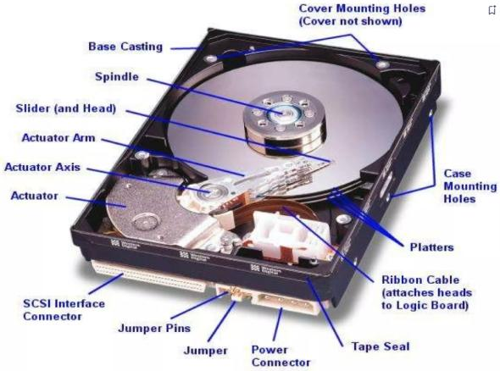

Slide 10
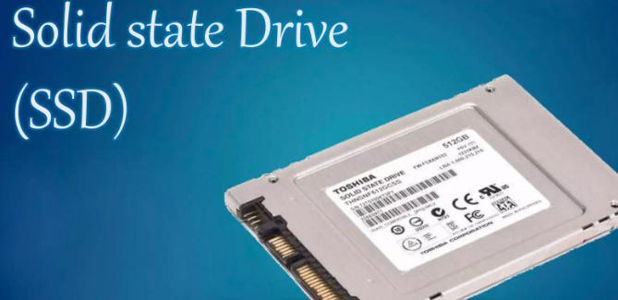

Slide 15
Differentiated Activities
Group A
Students will write down the basic functions of hard disks and SSDs.
Group B
Students will compare hard disks and SSDs in terms of speed, durability, and cost.
Group C
Students will explore and write advanced features and applications of SSDs.

Slide 16
Thank You!

