Slide 1
Unit5 - Multimedia
Year 4 Week 22 Day 1

Slide 2
Learning objective
By the end of the lesson students will be able to analyse and understand the following; 1) How to setup a new document? 2) How to format the text with format feature and headings in MS Word? After completing the class discussion and the activities.

Slide 3
Key Vocabulary
Paper size, Left alignment, Right alignment, Justify, Center, Subheadings, Formatting

Slide 4
Big Question
What options are available for formatting bulleted or numbered lists?
What options are available for changing the text size in Word?
How can I make text bold, italic, or underline in Word?

Slide 5
Hook Activity – Group (10 mins)
10 mins- Visual Aid
Watch the video on formatting and alignment in MS Word, they are invited to participate in the learning process. Throughout the video, questions will be posed, and students can provide their responses using either sticky notes or option cards.
.
https://app.nearpod.com/?pin=ZXEPS

Slide 6
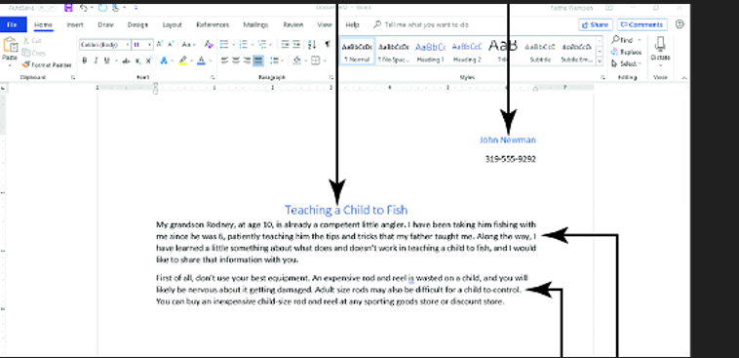
Main Activity Discussion–
15 mins-Class discussion
Identify the alignments and formatting tools in the displayed image of word. Teacher will jot down the responses of the students on the smartboard.

Slide 7
Main Activity Discussion–
Note-6-8 mins each station.
Learning station 1- Label the alignments
Students will discuss with their group and complete the activity sheet 4.
Learning station 2- Match it.
Students will discuss with their group and complete the activity sheet 5.
Learning station 3-Individual work/Teacher lead
Students will complete the Worksheet 3.

Slide 8
Enrichment task
Enrichment task
write down the answers for the big questions in the barcoded sheet.
What options are available for formatting bulleted or numbered lists?
What options are available for changing the text size in Word?
How can I make text bold, italic, or underline in Word?

Slide 9
Plenary
https://quizizz.com/admin/quiz/65a6ae5fec116e77a12c1e05?source=quiz_share

Slide 10
Homework
Read and revise the unit and create a poster on MS Word for the different threats and share with the teacher via ClassDojo.

