Slide 1
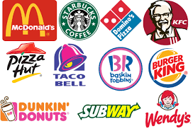
What is common in all these organisations?

Slide 2
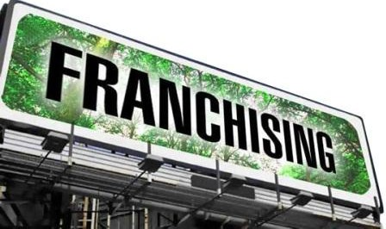

The franchisor is a business with a product or a service idea that it does not want to sell to consumers directly.
Use the idea or product and to sell it to consumers.

Slide 3

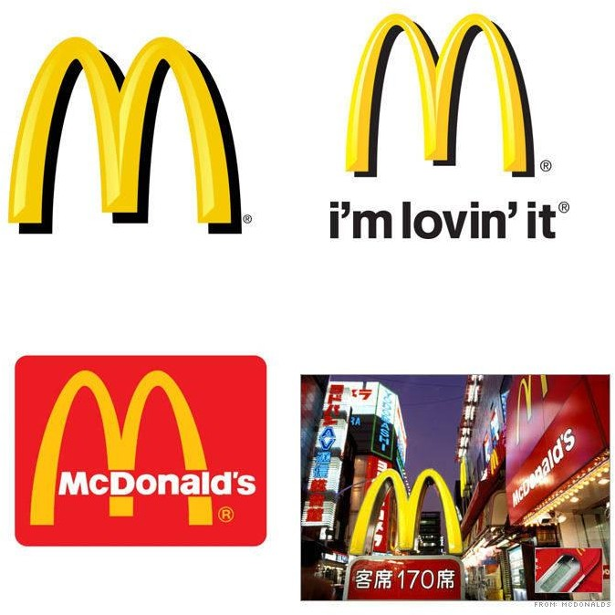
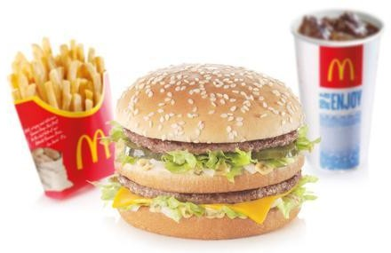
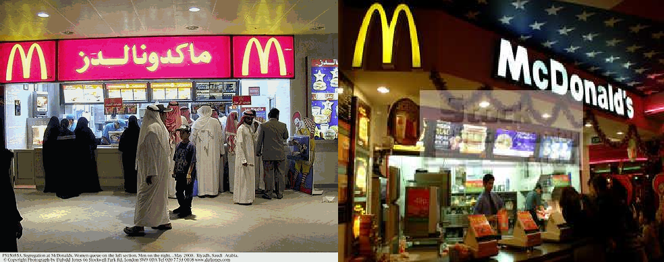

Slide 4

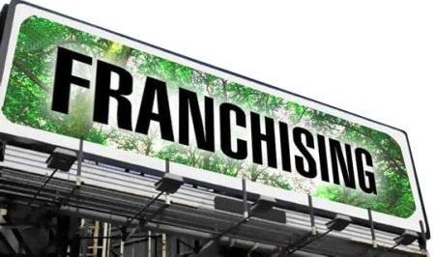



Advantages
Disadvantages
1. The franchisee buys a licence
1. Poor management of one franchised outlet could lead to a bad reputation for the
from the franchisor to use the brand name.
whole business.
business is much faster than
if the franchisor had to
2. The franchisee keeps profit
finance all new outlets
from the outlet.
The management of the outlets is the responsibility of the franchisee.
All products sold must be obtained from the franchisor.

Slide 5



Disadvantages
Advantages
1. The chances of business
failure are much reduced
1. Less independence than with operating a non-franchised
because a well-known product
is being sold.
business.
2. The franchisor pays for
3.
All supplies are obtained from
2. May be unable to make
a central source – the
decisions that would suit the
franchisor.
4. There are fewer decisions to
local area – e.g. new products that are not part of the range offered by the franchisor.
3. Licence fee must be paid to the franchisor and possibly a percentage of the annual turnover.
make than with an
independent business – prices,
store layout and range of
products will have been
decided by the franchisor.
5. Training for staff and
management is provided by
the franchisor.
6. Banks are often willing to lend
to franchisees due to relatively
low risk.

Slide 6


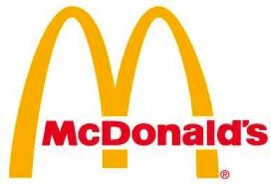



















Slide 7


A joint venture is when two or more businesses agree to start a new project together, sharing the capital, the risks and the profits.
Many European companies have set up joint ventures in China with Chinese businesses, as the local managers will have good knowledge
of market needs and consumer tastes.

Slide 8




Advantages
Disadvantages
Profits have to be shared
Disagreements
Sharing of costs
Local knowledge
Risks are shared
different cultures.

Slide 9
private sector. This means that they are owned
So far.. All organizations discussed were in the
by private individuals in the economy. These
include
Sole traders
Partnerships
Private Limited Companies
Public Limited Companies
Joint ventures
Franchising
However, there is still a very important part of the economy that we haven’t tackled.. The public sector, businesses owned by the government.

