Slide 1
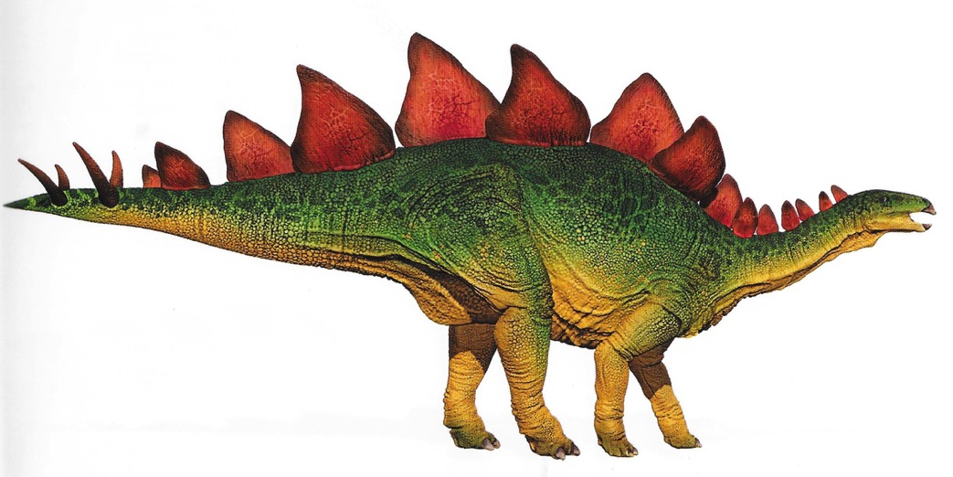
Nouns and Adjectives

Slide 2
Nouns
There are several different sorts of noun.
The two sorts of noun that we are going to look at are…
Common nouns
Proper nouns

Slide 3
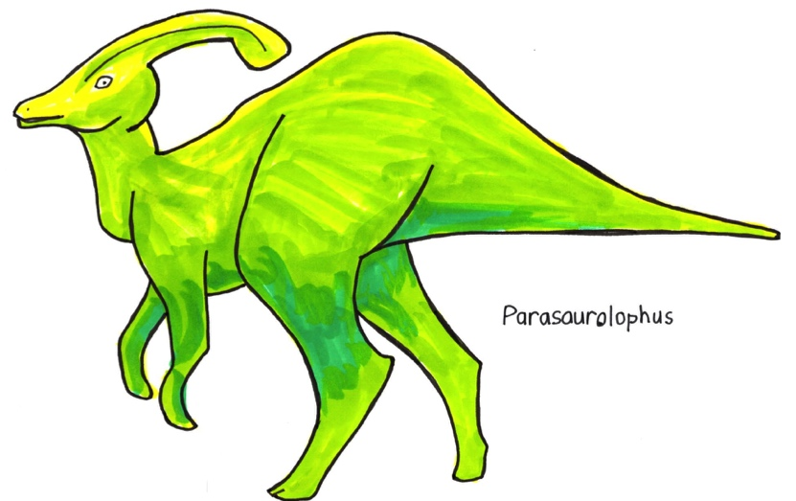
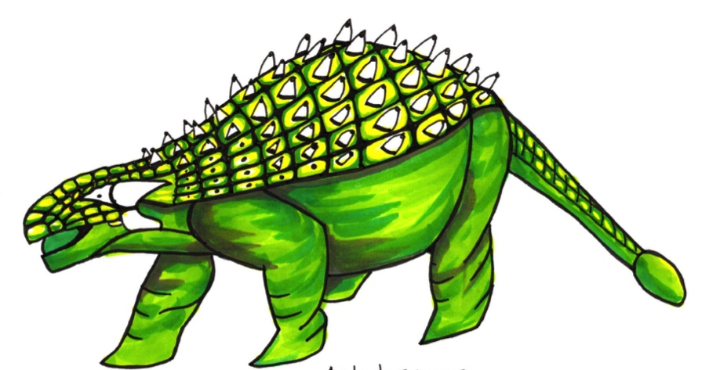
Common Nouns
Common nouns are names of creatures, things and feelings or ideas.
dinosaur
eye
plan
They often have the words the, a or an just before them.
a dinosaur
an eye
the plan
They don’t need to begin with a capital letter unless they are at the start of a sentence.

Slide 4
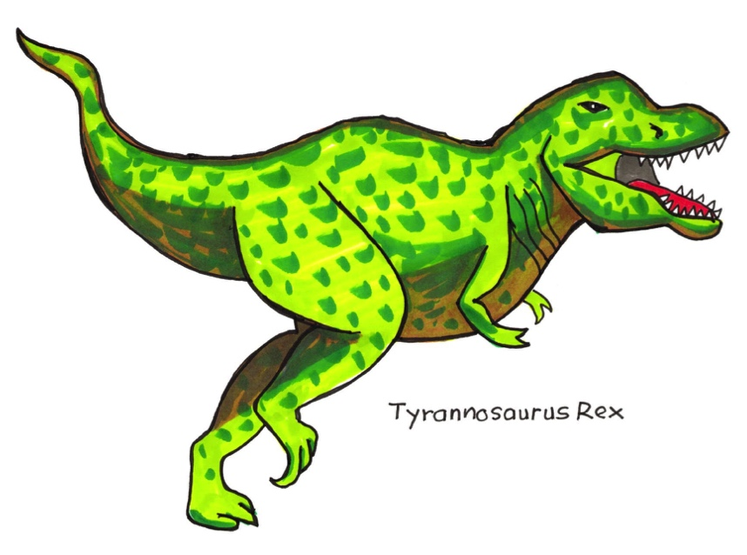
Proper nouns
Proper nouns are the names of individual people and places.
Oli London
Sunitha Shaun the sheep
They are also the names of days of the week, months of the year and different ages in history.
Monday January
The Cretaceous Era
They are the names of types of dinosaurs.
Apatosaurus
Stegosaur
T Rex
Proper nouns always begin with a capital letter, even when they are in the middle of a sentence.

Slide 5
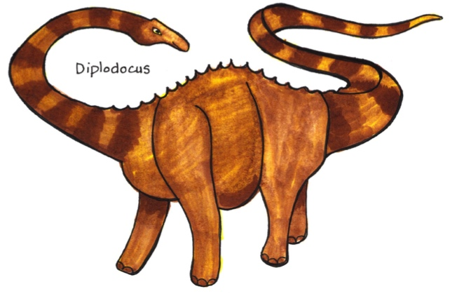
Which is Which?
Read each word and say whether it is a common noun or a proper noun:
Diplodocus
claw
a tooth
England
bones
the Triassic Era

Slide 6
Which type of noun?
Read the sentences. Say which words in the sentences are common nouns and which words are proper nouns:
The skull of a Stegosaurus has been found in Europe. These dinosaurs ate plants. They lived in forests in the Jurassic Era.

Slide 7
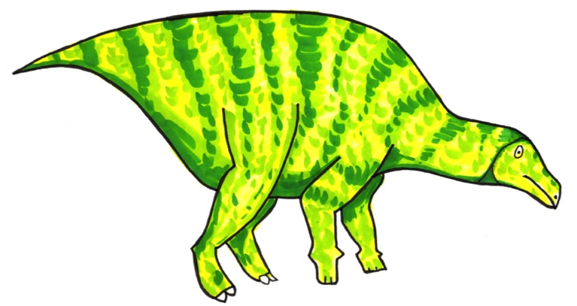
Adjectives
Adjectives are words that give more information about nouns – they describe nouns.
They often come immediately before the noun:
The heavy dinosaur
The small bones
Sometimes they come in different places in the sentence:
The dinosaur was heavy.
The bones were actually very small.
You can have more than one adjective describing a noun:
The heavy, green dinosaur
The bones were small and delicate.
A noun and an adjective together are called a noun phrase.

Slide 8
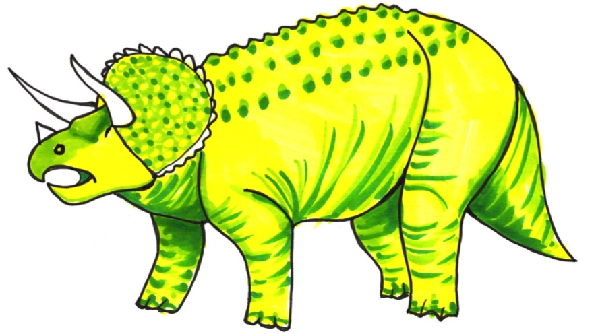
Adjectives
The adjectives used to describe a noun help us to understand the noun better.
Both these phrases are about this dinosaur, but the adjectives describe it very differently!
The huge, scary dinosaur
The small, blue dinosaur
Which adjectives are right for this dinosaur?

Slide 9
Find the Adjectives
Read the lines below. Which words are the adjectives?
A hungry dinosaur
The Diplodocus was huge.
Some long, sharp teeth
The dinosaur’s skin was bright and colourful.

Slide 10
Complete these lines
Think of adjectives to complete these lines:
The _________________
Tyrannosaurus Rex.
The Pterodactyl was __________________ .
The ______________ , _____________ dinosaur hunter.

Slide 11
Adverbs
Adverbs are words that can tell us more about adjectives.
They help us write really good descriptions.
The heavy dinosaur.
The really heavy dinosaur.
The T Rex was hungry.
The T Rex was extremely hungry.
Common examples of qualifying adverbs include:
slightly, quite, very, really, extremely, completely

Slide 12
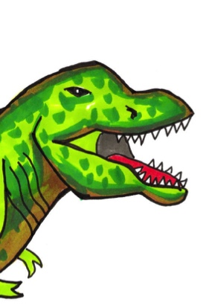
Where are the Adverbs?
Read the sentences. Find the adverbs. They say more about the adjectives.
The dinosaur had extremely large teeth
. The Iguanodon’s thumb was very sharp.
The quite slow Stegosaurus had really thick skin.

Slide 13
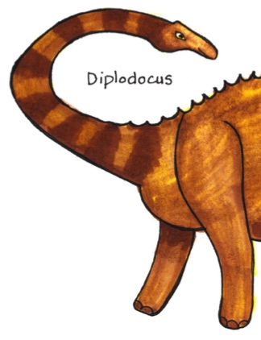
Which Adverb could we use?
Select an adverb from the group to say more about the adjective:
slightly quite very extremely really
The ____________ sharp claws.
The _____________ funny face.
The dinosaur with the ______________ long neck.

Slide 14
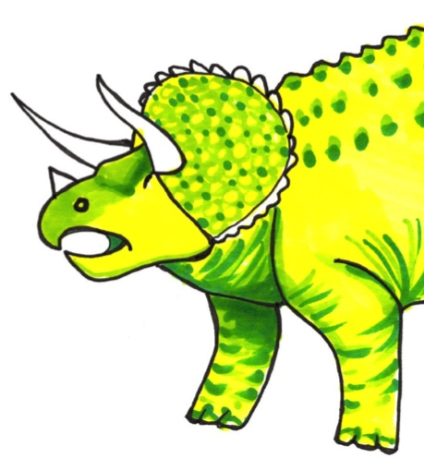
Descriptive Comparisons
We can describe a noun by comparing it to another noun.
The Hadrosaur was heavy.
The Hadrosaur was as heavy as a car.
The T Rex’s teeth were sharp.
They were as sharp as needles.

Slide 15
Complete these Comparisons
What nouns could you use to complete these comparisons?
The Apatosaurus was as tall as ……
The Ankylosaurus was as slow as…
The Pterodactyl could fly as high as…

Slide 16
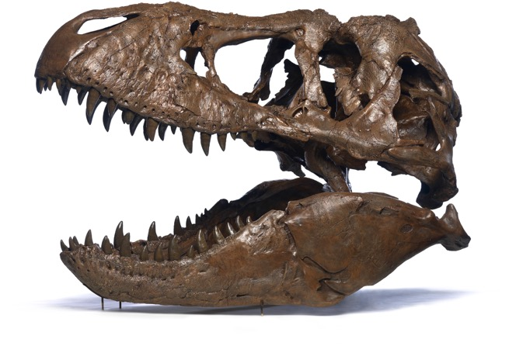
End!

