Slide 1
Science - Year 3/4B Autumn 1
Rocks
This Planet Rocks
Session 6
Task PowerPoint
© Original resource copyright Hamilton Trust, who give permission for it to be adapted as wished by individual users.
We refer you to our warning, at the foot of the block overview, about links to other websites.

Slide 2
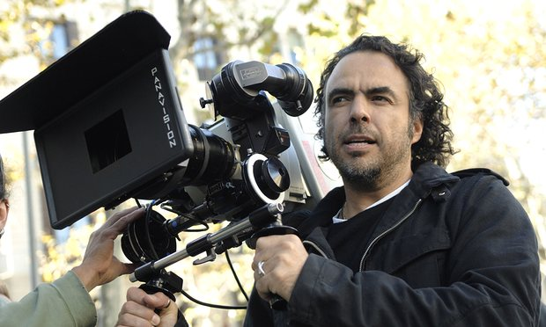
Message from Jeremy Crag
Head of Children’s Programming at Highcliff Television Studios

Slide 3
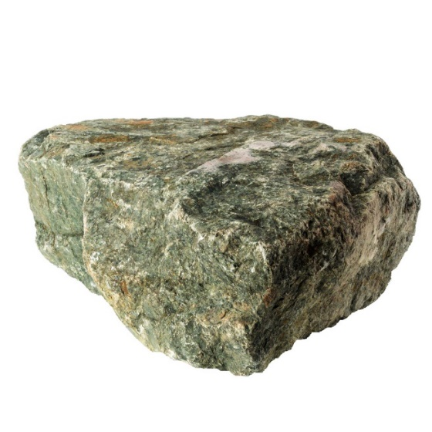
Thank you everyone for your hard work on this project. You have all become amazing rock and fossil experts
Today your task will be to become TV presenters. You will need to prepare and practise some presentations for camera.

Slide 4
There will be 4 programmes in the series:
Programme 1 – Understanding Rocks
Programme 2 – Rock around the Town
Programme 3 – Fantastic Fossils
Let’s look at these in more detail
Programme 4 – Super Soil

Slide 5
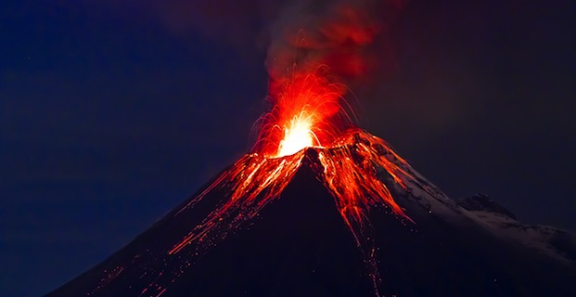
Programme 1 – Understanding Rocks
This will include :
An introduction to rocks – I think some of you may have already filmed this
Looking at, and naming 6 common rocks – you may have already filmed this too
Explaining the 3 different ways that rocks are formed – using pictures to help
Explaining how you can get clues about how a rock was formed by looking at it very closely – e.g. looking for crystals or layers
Showing how to test rocks – a water test, a hardness test and a permeability test

Slide 6
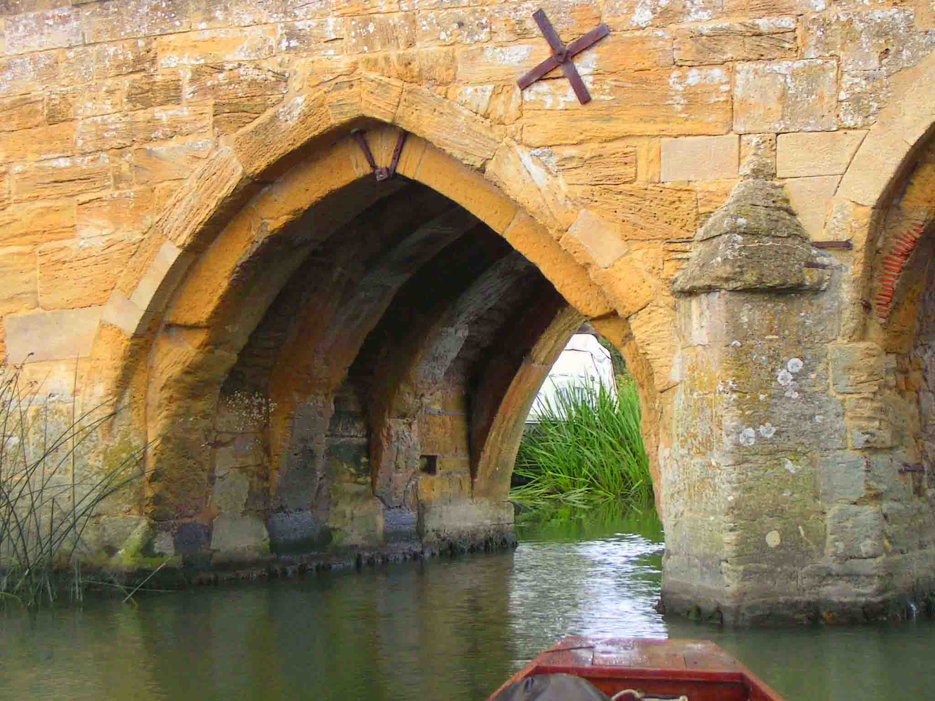
Programme 2 – Rock around the Town
This programme will teach the viewers all about how different types of rock are used in the local environment.
They will learn how to look for the bedrock in their area
They will learn how different rocks are suited to different jobs and how manmade rocks are used too.
I think you may have filmed this already

Slide 7
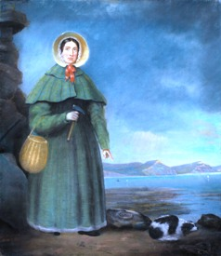
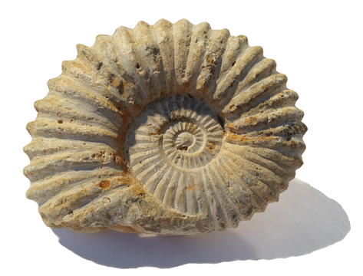
Programme 3 – Fantastic Fossils
This programme will include:
Explaining how fossils are formed
Showing viewers how to make a plaster cast fossil
Telling the story of Mary Anning – you could dress up and pretend to be Mary and her brother Joseph to make it more interesting if you wanted to

Slide 8
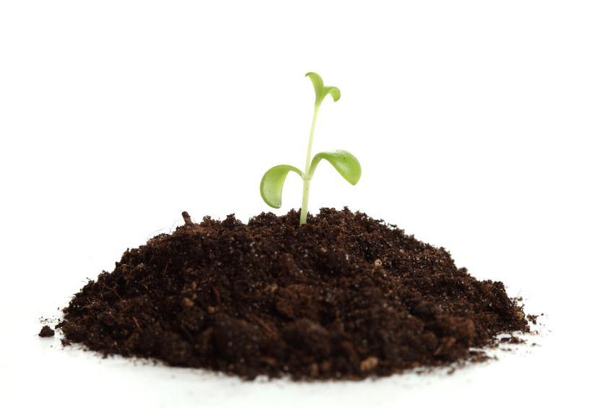
Programme 4 – Super Soil
This programme will include:
A presentation to explain what soil is made of, its amazing qualities and how important it is for life on Planet Earth
A demonstration of how viewers can investigate whether different soils are good drainers or soakers
A demonstration of how different soils can be compared by shaking them up in a jar with water to separate all the different sized particles

Slide 9
Tips on how to be a good presenter
Do not read your script, instead practise explaining in your own words a few times until you are confident
Look at the camera as you speak and don’t forget to smile. Try to show excitement and enthusiasm for what you are talking about – that way the viewers will find it exciting too
Use props (real items like rocks, magnifiers, soil samples etc. to help you). Hold them up to show the viewers as you explain
Think about the presenters of your favourite TV shows and try to copy their confidence and style

Slide 10
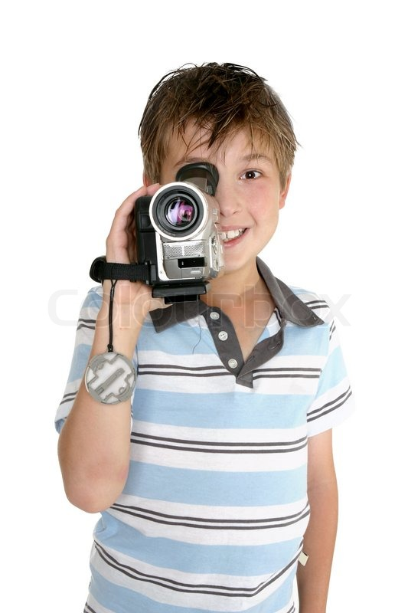
Tips on how to be a good camera operator
Try to keep the camera steady as you film, if this is hard, try standing against a wall or table or you could try propping your elbows on the top of some furniture.
If the presenter goes wrong, don’t delete everything you have filmed because the film can be edited (cut and joined together in a different way). Just film that bit again.
After you have filmed the presenter, take a few close ups of what they were explaining – these are called “cut aways” and they can be edited into the film later by Mr Crag.

Slide 11
The Director
It’s your job to decide what to film and how to film it. You are in charge of how it looks and how it sounds!
The Producer
Think about the shots you want, where the presenter and camera operator should go and what they will show
You are the organiser. It’s your job to get everything ready for the shots including the props, and the space you will film in.
If your group needs any signs, labels or pictures to help explain, it’s your job to get these ready
Check the set (the space where you are filming) is clear of clutter
Take turns to be different roles

Slide 12
As you will see, there is quite a lot to do, so with the help of your teacher, divide into teams and share out the tasks.
Don’t worry if you do not have enough cameras for every group. You will need to practise your presentation a few times to get it right, so you can keep busy while you wait for your turn.
Good luck everyone!

