Slide 1
Science - Year 3/4B Autumn 1
Rocks
This Planet Rocks
Session 6
Answers PowerPoint
© Original resource copyright Hamilton Trust, who give permission for it to be adapted as wished by individual users.
We refer you to our warning, at the foot of the block overview, about links to other websites.

Slide 2
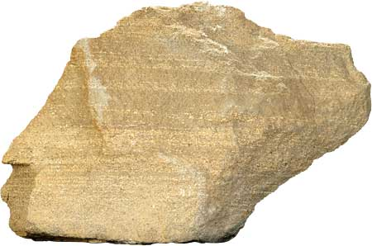
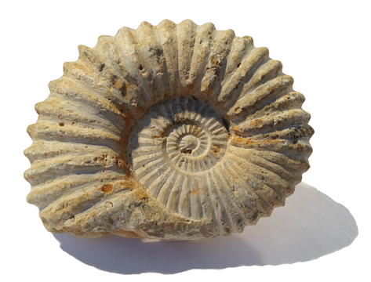
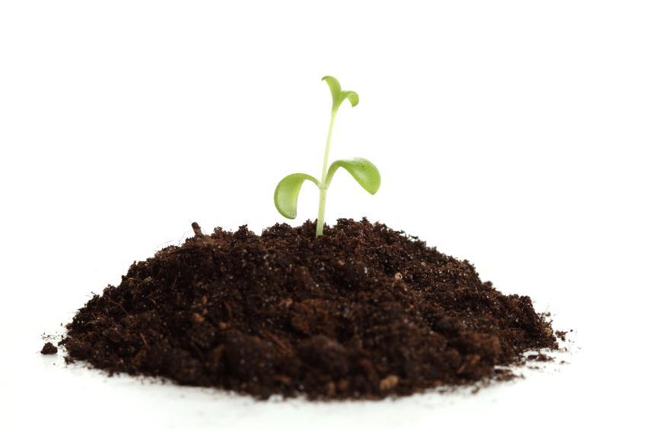
Answers
for
Quiz on Rocks, Fossils and Soil

Slide 3
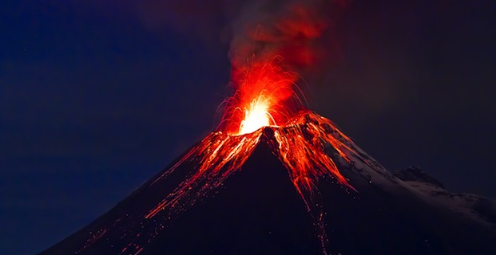
1. When magma from the Earth’s core cools down, it turns into rock. This type of rock is called …
A
Igneous Rock
B
Metamorphic Rock
C
Sedimentary Rock

Slide 4
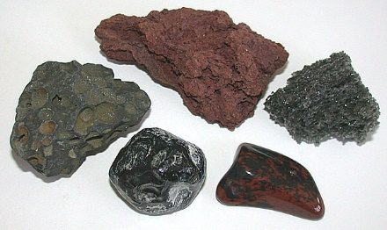
2. Rocks made in this way are usually …
A
Soft and crumbly
B
Hard and strong
C
Made of layers

Slide 5
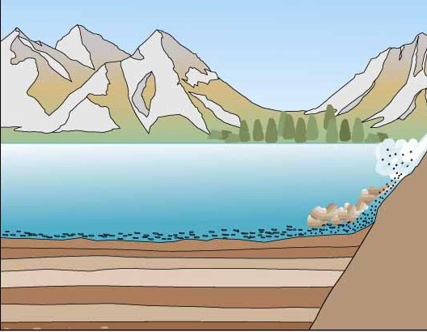
3. A different type of rock is made when layers of mud and dead creatures sink to the bottom of the sea and build up over millions of years. This type of rock is called …
A
Igneous Rock
B
Metamorphic Rock
C
Sedimentary Rock

Slide 6
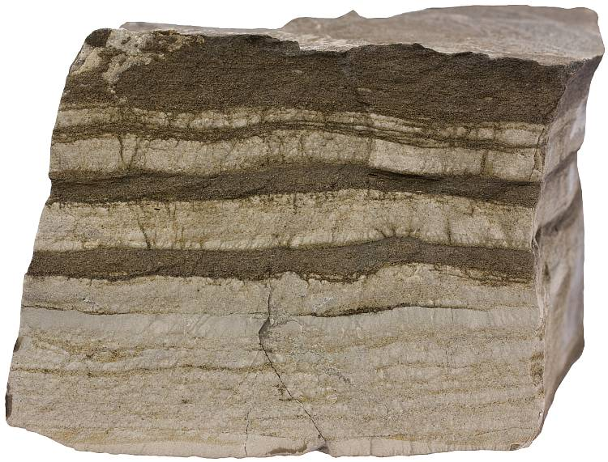
4. Rocks made in this way sometimes contain …
A
Large crystals
B
Fossils
C
Diamonds

Slide 7
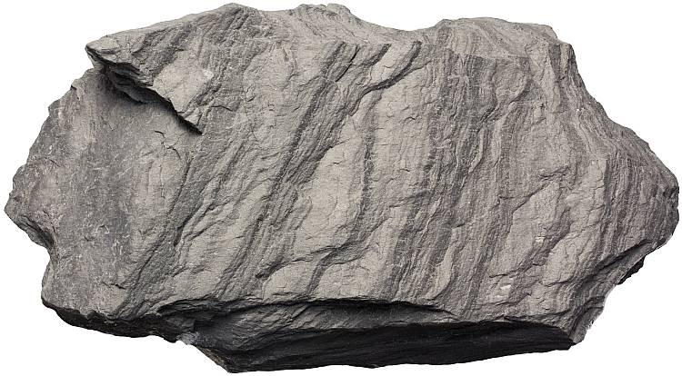
5. A third type of rock is made when extreme heat and pressure from the Earth changes existing rock of other types. This rock is known as …
A
Igneous Rock
B
Metamorphic Rock
C
Sedimentary Rock

Slide 8
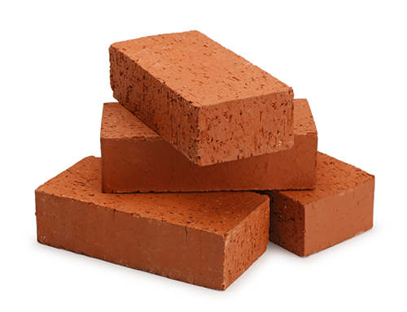
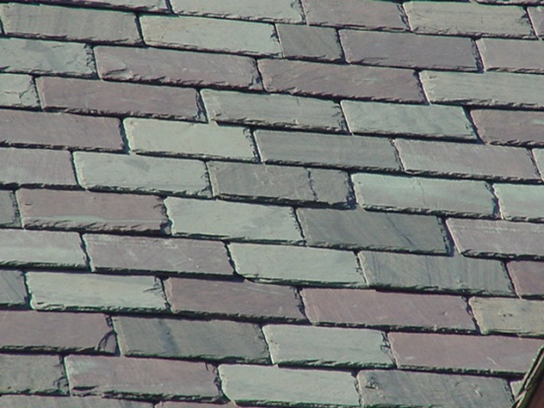
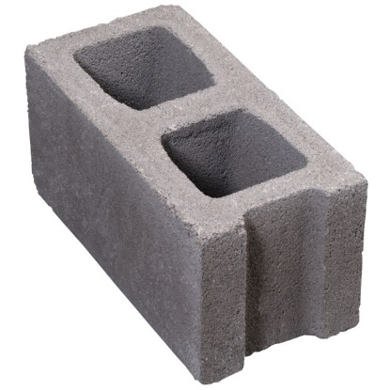
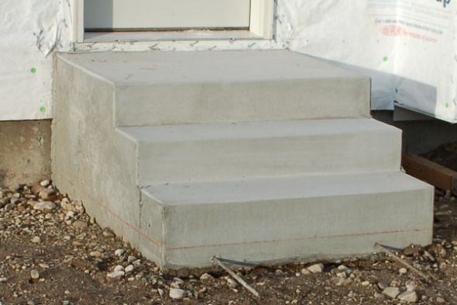
6. Many old buildings are made of natural rocks but often newer buildings are constructed of man-made materials.
Three of these are man-made materials. Which is made of natural rock?
D
Breeze Blocks
A
Bricks
B
Concrete steps
C
Slate tiles

Slide 9
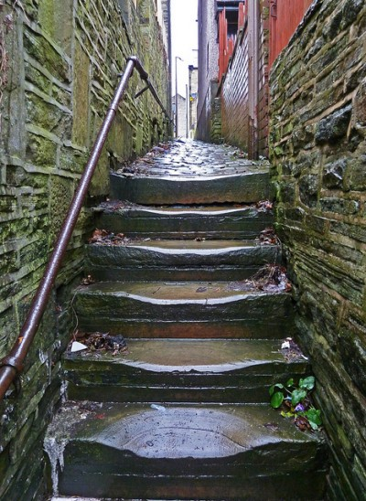
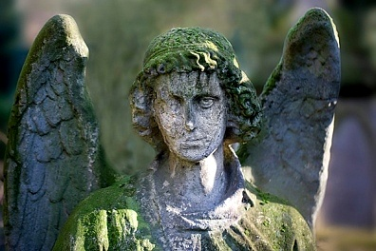
7. Sometimes rocks can be worn away by hundreds of years of use or by weather (e.g. frost, wind and rain).
This wearing away
Is called …
A
Explosion
B
Erosion
C
Exclusion

Slide 10
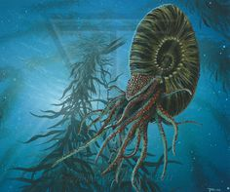
8. Sometimes a plant or animal that lived long ago sinks to the bottom of the sea and is buried in …
A
Concrete
B
A cave
C
Sediment

Slide 11
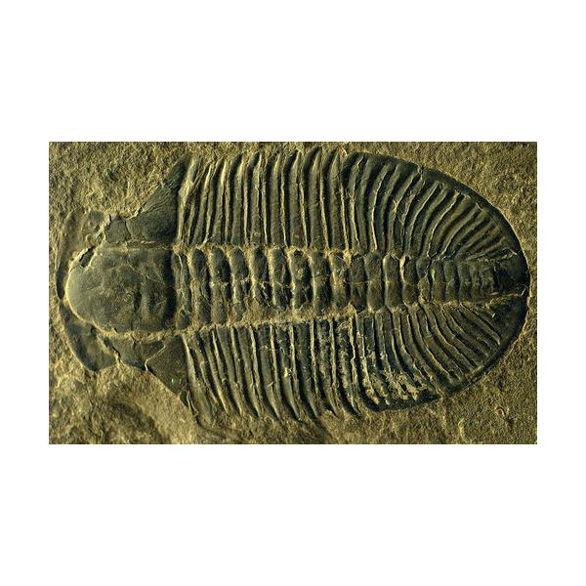
9. Usually the soft parts are eaten by other creatures or they rot away and only hard parts are left behind like the shell or the …
A
Toe nails
B
Skeleton
C
Brain

Slide 12
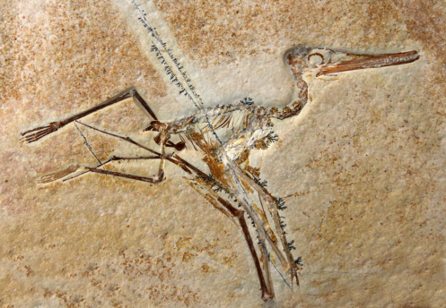
10. Gradually more and more layers build up over millions of years and the sediment turns to …
A
Rock
B
Soil
C
Magma

Slide 13
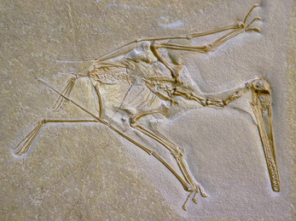
11. Water trickles through the rock and gradually the skeleton is washed away leaving an empty space the same shape as the skeleton. This is called a …
A
Mould
B
Stone
C
A curiosity

Slide 14
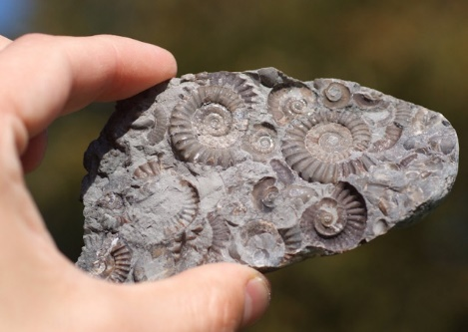
12. Later, minerals from the water collect inside the space and these gradually become rock. This rock is the same size and shape as the creature that made the mould. It is now a …
A
Pebble
B
Mineral
C
Fossil

Slide 15
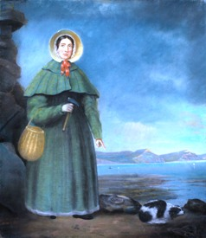
13. In the 1800s scientists became interested in these curious rocks but they did not really understand what they were. People began to collect them and study them. One of the greatest fossil hunters was a woman called Mary…
A
Armstrong
B
Anning
C
Atkins

Slide 16
14. Soil is made of a lot of different ingredients but a large part of it is small pieces of worn down rock for example small stones, grit and…
A
Sand
C
Glass
B
Brick dust

Slide 17
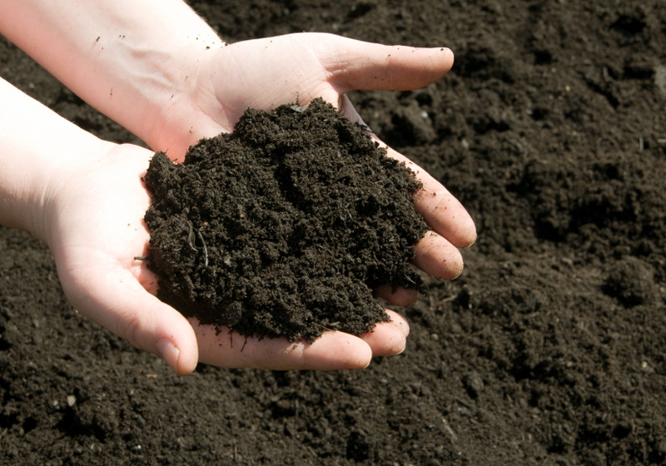
15. As well as worn down bits of rock, soil also contains millions of micro-organisms. They have a very important job in the soil as they …
C
Break down bits of dead plants and animals
A
Make soil soft
B
Give the soil its brown colour

Slide 18
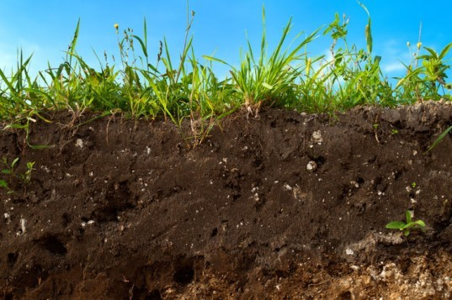
16. Soil is also home to a large number of living creatures. Which one of these does not live in soil?
A
worms
B
honey bees
C
moles
D
ants
E
woodlice

Slide 19
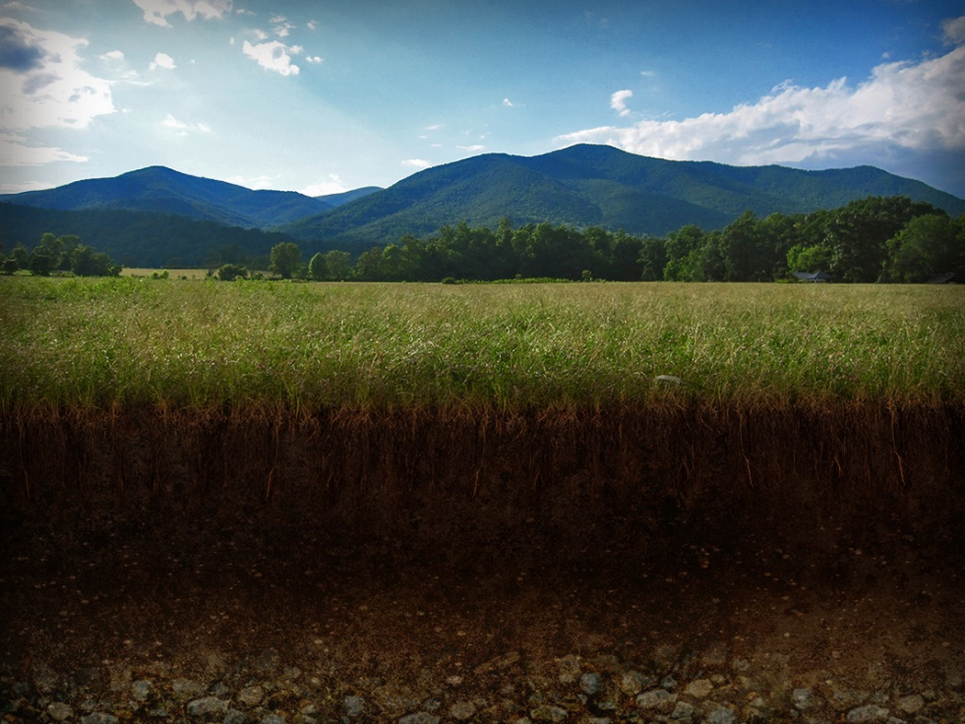
17. How long does it take to make 2cm of soil?
A
500 years
B
50 years
C
5 years

Slide 20
18. Without soil there would be…
A
A shortage of fruit and vegetables
B
High prices for food in shops
C
No life on Earth

