Slide 1
BIOTECHNOLOGY

Slide 2
Key Terms
Biotechnology- using living organisms to carry out processes that makes substances useful to humans
Bacteria
Yeast
Genetic Modification- changing the genetic material of an organism by removing, changing or inserting individual genes

Slide 3
Genetic Modification
Making human proteins
Making herbicide- resistant crop plants
Making pest- resistant crop plants
Improving nutritional qualities of crop plants

Slide 4
KEY TERMS
Recombinant plasmid- DNA found in the bacterial chromosome and much smaller circular pieces of DNA
Restriction enzymes- cut DNA molecules at specific points
DNA Ligase- are enzymes that join the cut ends of DNA
Sticky ends- length of unpaired bases on one strand of a DNA molecule

Slide 5
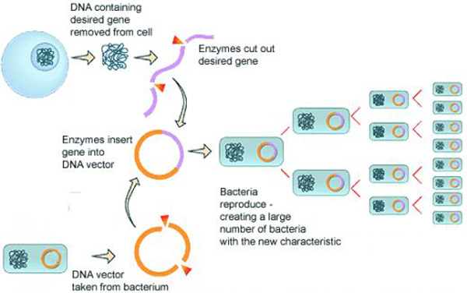
Genetically Modified Bacteria
http://www.erewise.com/current-affairs/what-is-genetic-engineering_art531079bc2e5d1.html

Slide 6
GM plants provide
Increased resistance to a range of pests and pathogens
Increased heat and drought tolerance
Increased salt tolerance
A better tolerance of proteins, carbohydrates, lipids, vitamins and minerals

Slide 7
Advantages of Genetic Engineering
Improved growth rates of plants and animals
Genetically modified crops (GM crops) usually have bigger yields
Crops can grow well in dry, hot or cold parts of the world
Crops can be engineered to produce plants that made their own pesticides or resistant to herbicides
Great deal of work done on the lungs of people with cystic fibrosis
Human insulin

Slide 8
Concerns about Genetic Engineering
Insects may become pesticide-resistant since they are on a constant diet of pesticide-producing plants
Effect of GM crops on human health
Genes from genetically modified plants and animals might spread into the wildlife of the countryside
Manipulation of genes of future generation

Slide 9
Sources
IGCSE Combined Sciences Biology (Oxford Int. AQA Examinations)
Images from Google
Edexcel IGCSE Biology (Pearson)
Cambridge IGCSE Biology 3rd ed.
Biology for Cambridge IGCSE Coursebook 4th ed.

