Slide 1
SEXUALLY TRANSMITTED INFECTIONS

Slide 2
Key Words
sexually transmitted infection (STI): a disease caused by pathogens that are transmitted during sexual contact
AIDS: acquired immune deficiency syndrome; a disease caused by HIV, which destroys white blood cells and therefore reduces the ability of the immune system to defend against other pathogens
HIV: the human immunodeficiency virus

Slide 3
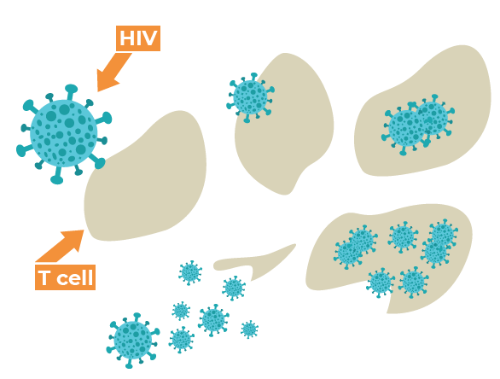
HOW HIV WORKS

Slide 4
Preventing HIV transmission
Through sexual contact
Through blood contact
Through breast feeding

Slide 5
Sources: Biology for Cambridge IGCSE Coursebook
Images from Google

