Slide 1
Be a Storyteller
T2 Wk 2 D1

Slide 2
Lesson Objective
By the end of the lesson, learners will be able to To change code to get the right result.

Slide 3
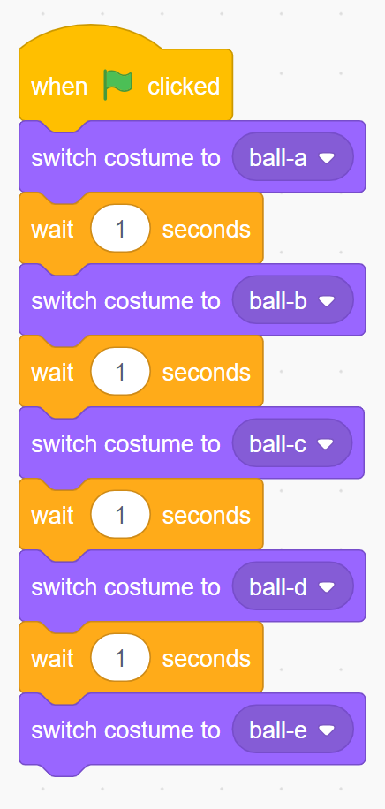
Hook Activity – Group Activity (10 mins)
What can be done to make the colour change faster.
What can be done to make the colour change slower.
Can you make other suggestions that will change the output of the program.

Slide 4
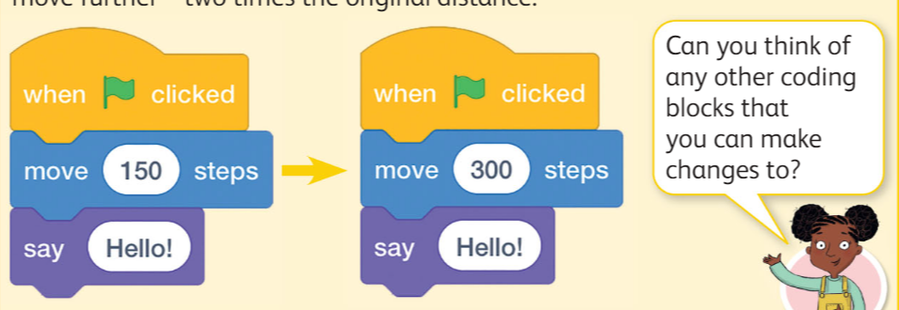
Discussion Time

Slide 5
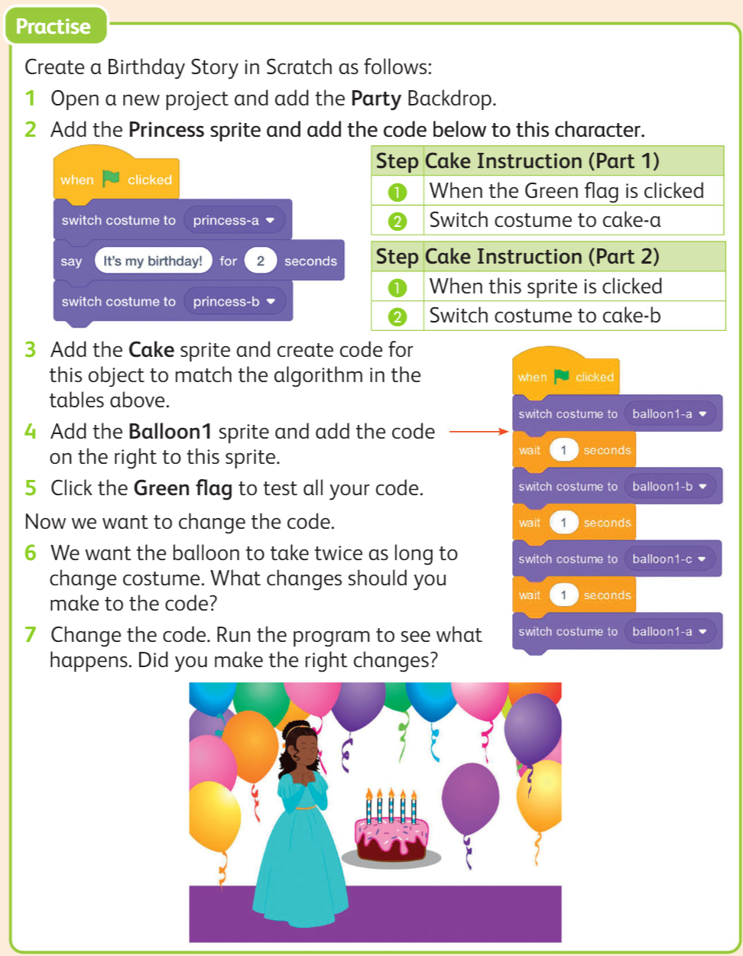
Main Activity– Pair Work (20 mins)
Work in pairs to complete the activity on book pg 100 using scratch software
Extension task:
Create your own program that show changes.

Slide 6
Exit Ticket
Give example of any 3 blocks that make change in the program.

