Slide 1
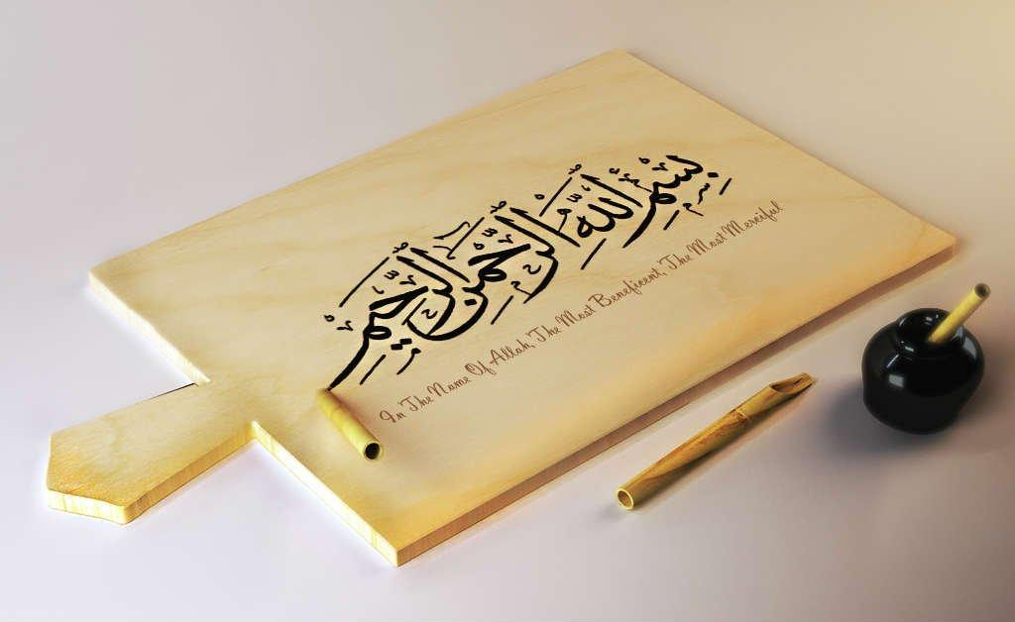
https://youtu.be/Sta_p-oB_d4?si=PSzflbzQ7wHiQ1tU

Slide 2
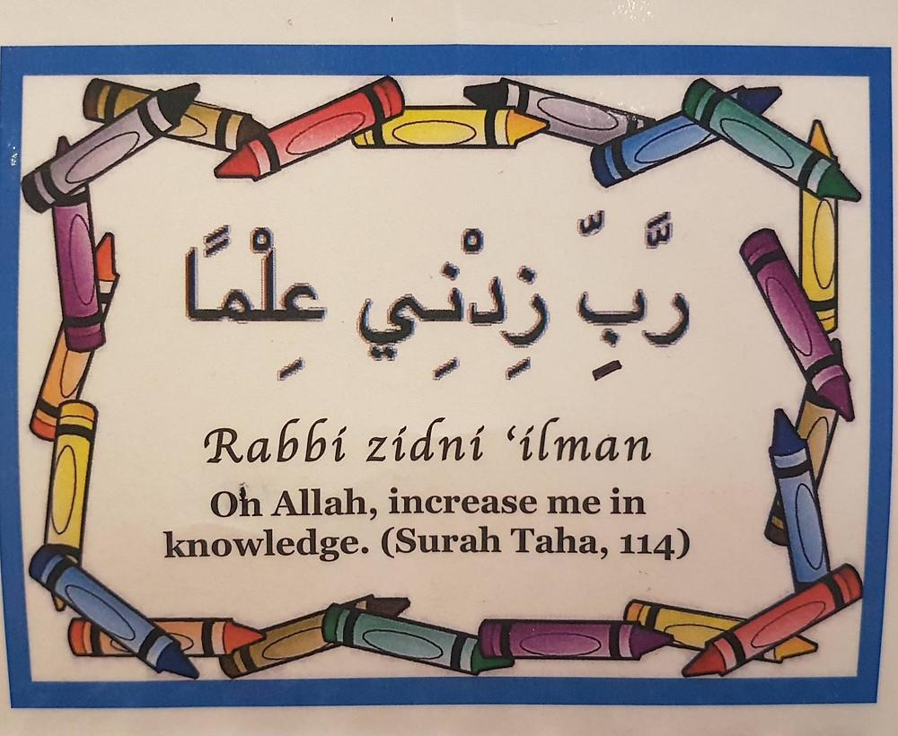
https://youtu.be/Sn3ElZG_WwQ?si=XDsPu9P89Av1dU5L

Slide 3
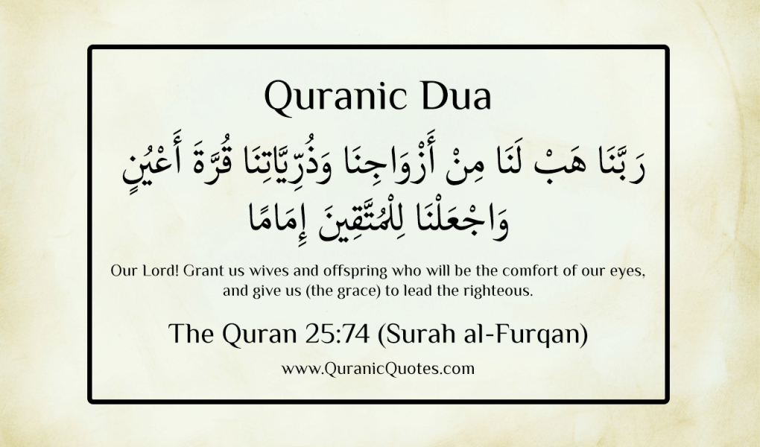
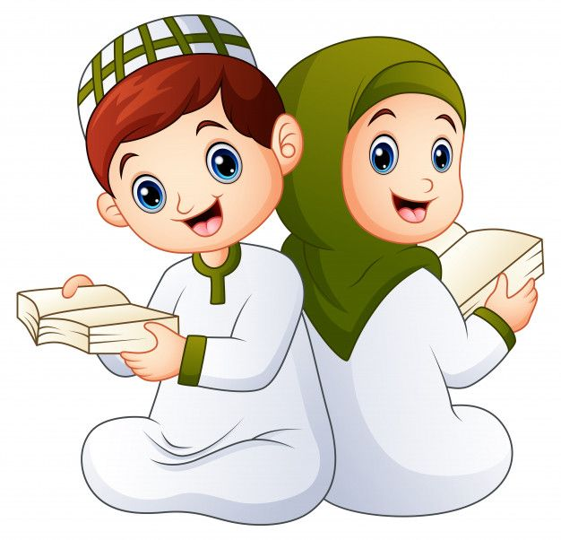

Slide 4
QUR'AN CLASS RULES
Please maintain silence and Respect Qur'an (speech of Allah)

Slide 6
OBJECTIVE At the end of the lesson students will be able to: Understand the significance of Rabbana Dua through clas discussion and analyzing the meaning. Analyze the learning of surah Al Qariah through formal formative. . .

Slide 7
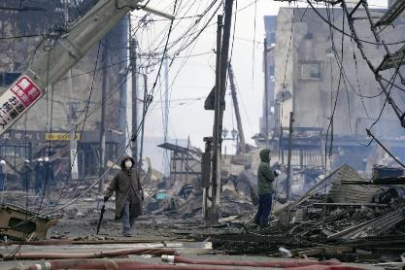
QATAR IDENTITY

Slide 8
KEY VOCABULARIES
Al-Qariah -The Striking Disaster, an event of great magnitude.
Haqqah- (The Truth, another term that signifies a day of reality or truth.
Mizan - Scale, referring to the scale of deeds.
Thaqeel - Heavy, indicating weighty or good deeds.
Khafif - Light, indicating lacking or insufficient deeds.
Na’ar - Fire, used here to symbolize the consequences of one’s deeds.

Slide 9
BIG QUESTION
What do you think “Al-Qariah” refers to, and why is it so significant in this Surah?

Slide 10
HOOK ACTIVITY
What does “Subhanallah” mean, and why do we say it in this dua?
What does “Al-Azeem” mean, and how does it describe Allah in this dua?
Why do we praise Allah with “wa bihamdihi” in this dua?

Slide 12
REPEATITION TIME
https://www.youtube.com/watch?v=jldIY3-PBM0

Slide 13
https://alquran.islam.gov.qa/droos/Dr3.shtml

Slide 14
Home work
Memorise the Rabbana Dua 7

Slide 15
END……. ANY QUESTIONS OR DOUBTS????

