Slide 1
Multiplication and division
Grid method and short multiplication
Objectives
Day 1
Revise using grid multiplication to multiply 3-digit numbers by single-digit numbers.
Day 2
Use short multiplication to multiply 3-digit numbers by single-digit numbers.
Day 3
Use short multiplication to multiply 3-digit numbers by single-digit numbers.
Day 4
Use short multiplication to multiply 3-digit numbers by single-digit numbers including amounts of money.
Notes:
Before teaching, be aware that:
On Day 1 - 4 children will need mini-whiteboards and pens.

Slide 2
Multiplication and division
Grid method and short multiplication
Starters
Day 1
6, 60, 7 and 70 times tables (pre-requisite skills)
Day 2
Times tables (pre-requisite skills)
Day 3
Factors and multiples (simmering skills)
Day 4
Find the time later using 24-hour clock (simmering skills)
Or
Multiply by multiples of 10 (e.g. 24 x 30) (simmering skills)
Notes:
Choose starters that suit your class by dragging and dropping the relevant slide or slides below to the start of the teaching for each day.

Slide 3
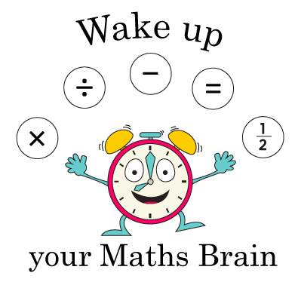
Multiplication and division
Grid method and short multiplication
Starter
6, 60, 7 and 70 times tables
Notes:
Pre-requisite skills – to use this starter, drag this slide to the start of Day 1
Use the ITP Number dials https://player.hamilton-trust.org.uk/itp_display.php?cid=779 to practise facts for the 6 and 60 times tables, then the 7 and 70 times tables.

Slide 4
Multiplication and division
Grid method and short multiplication
Starter
Times tables
Notes:
Pre-requisite skills – to use this starter, drag this slide to the start of Day 2
Pairs of chn shake their hands as they say flippy, floppy fingers, then each show any number of fingers. The first to say the product earns a point. After 5 minutes, the winner is the person with most points. Did anyone score more than 30 points?

Slide 5
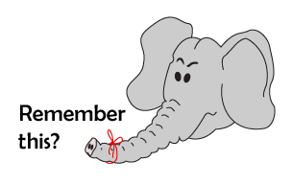
Multiplication and division
Grid method and short multiplication
Starter
Factors and multiples
Click here
⇩
NUMBER
GENERATOR
Notes:
Simmering skills – to use this starter, drag this slide to the start of Day 3
Ask children to each choose two numbers between 1 and 10. They write them on their w/b. Use a random number generator such as at https://www.mathgoodies.com/calculators/random_no_custom to generate numbers between 0 and 100. Children hold up their board if one of their numbers is a factor of the number generated. Repeat.

Slide 6
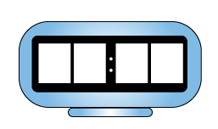
Multiplication and division
Grid method and short multiplication
Starter
Find the time later using 24-hour clock
Click here
⇩
Notes:
Simmering skills – to use this starter, drag this slide to the start of Day 4 – or use the next slide
Use the link on screen to access online activity. Scroll down and click ‘View the Item’. Choose 24-hour clock and click on Clock face button to change the time. You can also click on night/day, which might help children to know when each time of day is. By clicking add/remove make the clocks show 12:10. Ask children to write the time 30 mins later, click 30 mins to check. Keep adding 30 mins until you reach 14:10, then add 45 mins repeatedly. Finally show 22:30 and ask children to write the time 30 mins later until you pass midnight.

Slide 7
Multiplication and division
Grid method and short multiplication
Starter
Multiply by multiples of 10 (e.g. 24 x 30)
Notes:
Simmering skills – to use this starter, drag this slide to the start of Day 4 – or use the previous slide
What is 10 × 24? How could you work out 20 × 24? 30 × 24? Ask chn to work in pairs to work out 10 × 24, 30 × 24… 100 × 24, writing the answers in a list. They swap with another pair to check.

Slide 8
Multiplication and division
Grid method and short multiplication
Objectives
Day 1
Revise using grid multiplication to multiply 3-digit numbers by single-digit numbers.

Slide 9



Day 1: Revise using grid multiplication to multiply 3-digit numbers by single-digit numbers.
Discuss with your partner how you might work out 234 × 6.
We could use the grid method…
× | 200 | 30 | 4
6 | 1200 | 180 | 24 | 1404
What if it was 234 × 8?
Work in pairs to use the grid method to find the answer.
× | 200 | 30 | 4
8 | 1600 | 240 | 32 | 1872
Now work out 276 × 6 and 358 × 7

Slide 10

Day 1: Revise using grid multiplication to multiply 3-digit numbers by single-digit numbers.
Which of these do you think will have the biggest answer?
Use rounding to estimate the answer to each.
8 x 376 345 x 7 6 x 482 410 × 9
8 x 400 300 x 7 6 x 500 400 x 9
= 3200 = 2100 = 3000 = 3600
Will the exact answer be more or less than 3200?
How do you know?
Did you need to use the grid method to work out the answer to this one?
Work out the exact answers to each.
Compare the answers with your approximations.
Note that our estimates are usually more ’out’ when multiplying
than when adding or subtracting.

Slide 11
Day 1: Revise using grid multiplication to multiply 3-digit numbers by single-digit numbers.
Whole class investigation
Use these cards to make a 3-digit by single-digit multiplication. Try to make it so everyone in your group has a different multiplication. Compare your answers.
Which multiplication gave the biggest answer? Any surprises? Has anyone got an even bigger answer?
Work together to find the smallest possible answer and the largest possible answer.
5
6
6
7
Notes:
Children can now go on to do differentiated GROUP ACTIVITIES. You can find Hamilton’s group activities in this unit’s TEACHING AND GROUP ACTIVITIES download.
Take feedback. Children may be surprised that 654 × 7 gives a much bigger answer than 765 × 4, because they thought that the largest digit should be put in the 100s place. Having a bigger multiplier means every digit is multiplied by the biggest digit possible.
WT: Work with this group to make sure they are really confident in using grid multiplication.
GD: Chn also try to find the answer closest to 3000 as possible (756 × 4 = 3024).

Slide 12
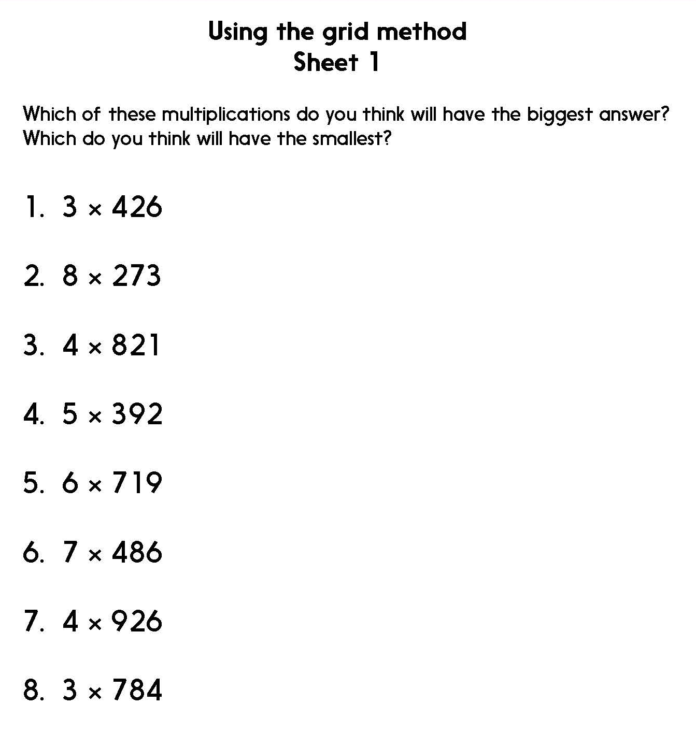
Notes:
The OPTIONAL Practice Sheet on this slide is suitable for most children.
Differentiated PRACTICE WORKSHEETS are available on Hamilton’s website in this unit’s PROCEDURAL FLUENCY box.
ARE: Using the grid method to multiply 3-digit numbers by 1-digit numbers.

Slide 13
Multiplication and division
Grid method and short multiplication
Objectives
Day 2
Use short multiplication to multiply 3-digit numbers by single-digit numbers.

Slide 14



Day 2: Use short multiplication to multiply 3-digit numbers by single-digit numbers.
Use the grid method to work out the answer to 3 × 326.
Today, we are going learn a new method of multiplication called short multiplication – it takes up less space than the grid method.
× | 300 | 20 | 6
3 | 900 | 60 | 18 | 978
Now we work out 3 × 20, 2 tens. That’s 6 tens, plus the 1 ten we had from multiplying the 1s, so that's 7 tens, so we write 7 in the 10s column.
Then we work out 3 × 300. That’s nine 100s and we write this in the 100s column.
3 times 6 is 18. We write the 8 in the 1s column and the 1 ten in the 10s column above the line like we do for addition.
And the 900?
Where is 60? We added the 10 at the same time!
Where is 18 in the short multiplication method?
3 2 6
x 3
1
8
9
7

Slide 15

Day 2: Use short multiplication to multiply 3-digit numbers by single-digit numbers.
Use the grid method to work out 3 x 263.
Now let’s use short multiplication to work out 3 x 263.
Now we work out 3 × 60. That’s 1 hundred and 8 tens. We write the 1 hundred in the 100s column above the line, like we do for addition, and the 8 in the 10s column.
Then we work out 3 × 200. That’s six 100s. We add the one 100 we made from multiplying the 10s, and write 7 in the 100s column.
3 times 3 is 9. We write the 9 in the 1s column.
x | 200 | 60 | 3
3 | 600 | 180 | 9 | 789
2 6 3
x 3
1
8
9
7
Work individually to use short multiplication to work out 4 × 217 and 5 × 261.
Choose one and explain how you worked it out to a partner.
Notes:
Children working towards ARE use the grid method to work out 4 × 217 and 5 × 261.
Agree the answer to each.
Children can now go on to do differentiated GROUP ACTIVITIES. You can find Hamilton’s group activities in this unit’s TEACHING AND GROUP ACTIVITIES download.
WT: Identify ranges of multiples of 100 for answers to grid multiplication, and say which multiple of 100 will be nearer.
ARE: Support children using the new method of short multiplication.

Slide 16
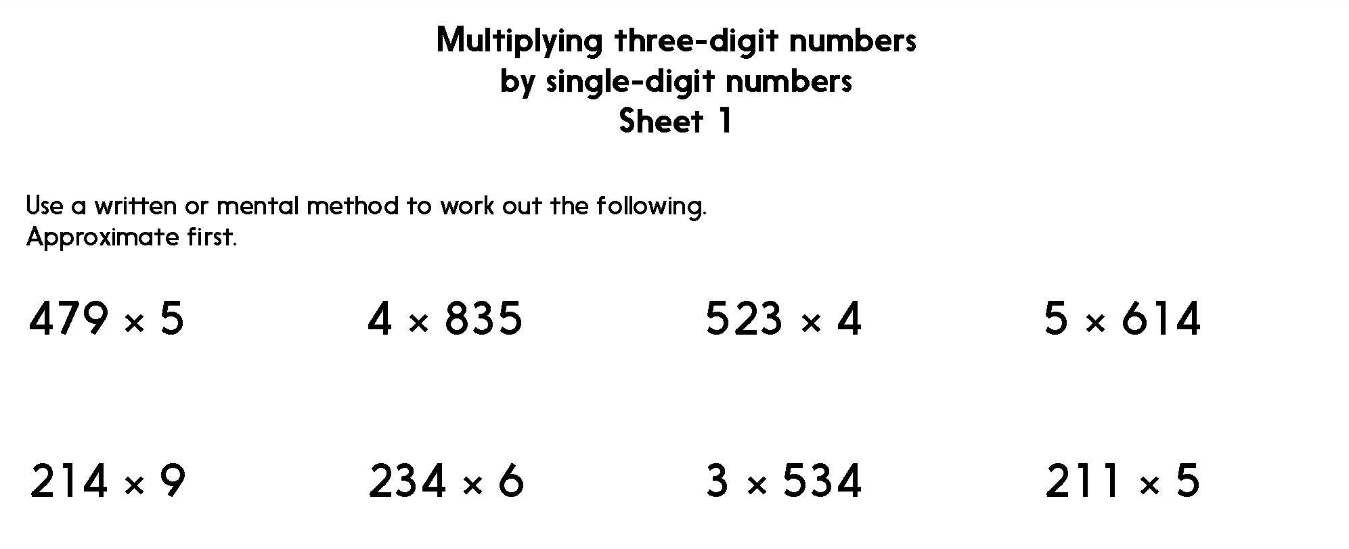
Notes:
The Practice Sheet on this slide is suitable for most children.
Differentiated PRACTICE WORKSHEETS are available on Hamilton’s website in this unit’s PROCEDURAL FLUENCY box.
WT/ARE: Multiply 3-digit numbers by 1-digit numbers (easier multipliers).
GD: Multiply 3-digit numbers by 1-digit numbers (harder multipliers).

Slide 17
Multiplication and division
Grid method and short multiplication
Objectives
Day 3
Use short multiplication to multiply 3-digit numbers by single-digit numbers.

Slide 18
Day 3: Use short multiplication to multiply 3-digit numbers by single-digit numbers.
How many meals do you think you might eat in a year?!
In most years there are 365 days and we mostly eat 3 meals a day. Let’s use short multiplication to work out the answer.
Some children are going to use the grid method to work out 3 × 365.
Now we work out 3 × 60. That’s 1 hundred and 8 tens, plus the 1 ten from multiplying the 1s. We write the 1 hundred in the 100s column above the line, and the 9 in the 10s column.
Then we work out 3 × 300. That’s nine 100s, plus the 1 hundred from multiplying the 10s. That’s ten 100s, 1000.
3 times 5 is 15. We write the 5 in the 1s column and the 1 ten in the 10s column above the line.
3 6 5
x 3
× | 300 | 60 | 5
3 | 900 | 180 | 15 | 1095
1
9
1
5
1 0
We get the same answer!
Notes:
Ask children working towards ARE to use the grid method, compare answers afterwards.

Slide 19
Day 3: Use short multiplication to multiply 3-digit numbers by single-digit numbers.
How many drinks do you think you might have in a year?
Work out the answer using short multiplication or grid method.
Work in pairs to work out how roughly how many meals you might have eaten in your life or how many drinks you have had.
Be ready to share your answer, and how you reached it.
Notes:
Together agree a number per day, e.g. 6 and ask children to work out the answer using short multiplication or grid method. Check they got the same answer.
Today would be a great day to use a problem-solving investigation – ? Title ? – as the group activity, which you can find in this unit’s IN-DEPTH INVESTIGATION box on Hamilton’s website.
? Alternatively, children
Children can now go on to do differentiated GROUP ACTIVITIES. You can find Hamilton’s group activities in this unit’s TEACHING AND GROUP ACTIVITIES download.
WT: Support children using the grid method for multiplying 3-digit by 1-digit numbers.
ARE: Support children using the new method of short multiplication.
GD: Begin to use short multiplication to multiply 4-digit number by 1-digit numbers.

Slide 20
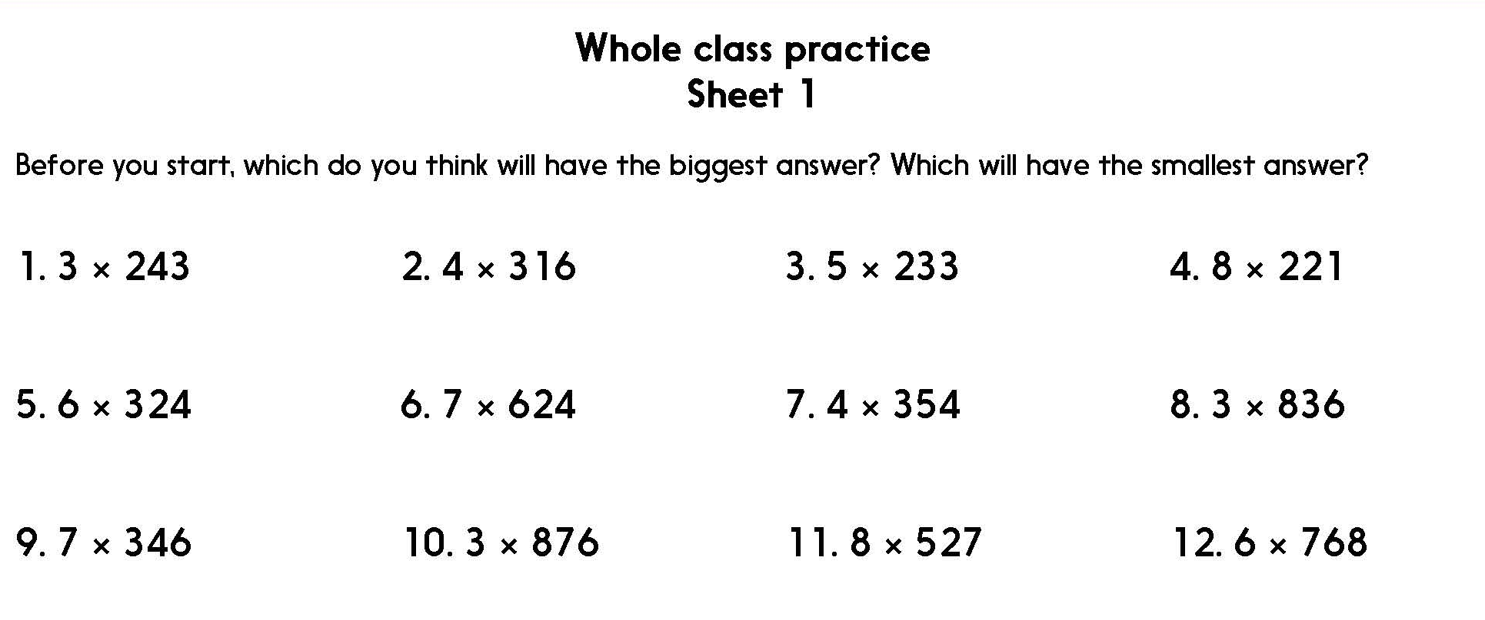
Notes:
The Practice Sheet on this slide is suitable for most children.
Downloadable PRACTICE WORKSHEETS are available on Hamilton’s website in this unit’s PROCEDURAL FLUENCY box.
Most children should be able to complete these calculations using the short multiplication method. Children Working towards ARE can use the grid method.

Slide 21
Multiplication and division
Grid method and short multiplication
Objectives
Day 4
Use short multiplication to multiply 3-digit numbers by single-digit numbers including amounts of money, e.g. 3 × £4.56.

Slide 22
Day 4: Use short multiplication to multiply 3-digit numbers by single-digit numbers including money.
We could use the grid method or jottings to record steps.
What do you think the answer is approximately?
6 × £5.24. How could we work this out? Talk to your partner.
Six lots of £5 is £30, so the answer will be a bit more than that.
We write £ and p by each product to be clear.
£ 5.2 4 × 6
× | £5 | 20p | 4p
6 | £30 | £1.20 | 24p | £31.44
£ 3 1 .
1
4
2
4
Add the pounds, and then the pence.
As six lots of 20p is greater than £1, we need to be careful how we record this, so that we add the products correctly.
6 x 20p + 20p = £1.40
Notes:
Talk through each method.

Slide 23
Day 4: Use short multiplication to multiply 3-digit numbers by single-digit numbers including money.
Use the grid method to start working out £5.45 × 7.
The addition is a bit more tricky this time.
If you find the addition difficult to do mentally, turn the grid round so you can use column addition to help...
x | 7
£5 | £35
40p | £ 2.80
5p | 35p
× | £5 | 40p | 5p
7 | £35 | £2. 80 | 35p
Now find the cost of 8 items at £6.79 each, choosing either the grid method or short multiplication.
1
£38.15
Notes:
Children can now go on to do differentiated GROUP ACTIVITIES. You can find Hamilton’s group activities in this unit’s TEACHING AND GROUP ACTIVITIES download.
WT: Support children using the grid method for multiplying amounts of money.
ARE: Support children using the new method of short multiplication for multiplying amounts of money.
GD: Use the new method of short multiplication for multiplying amounts of money.

Slide 24
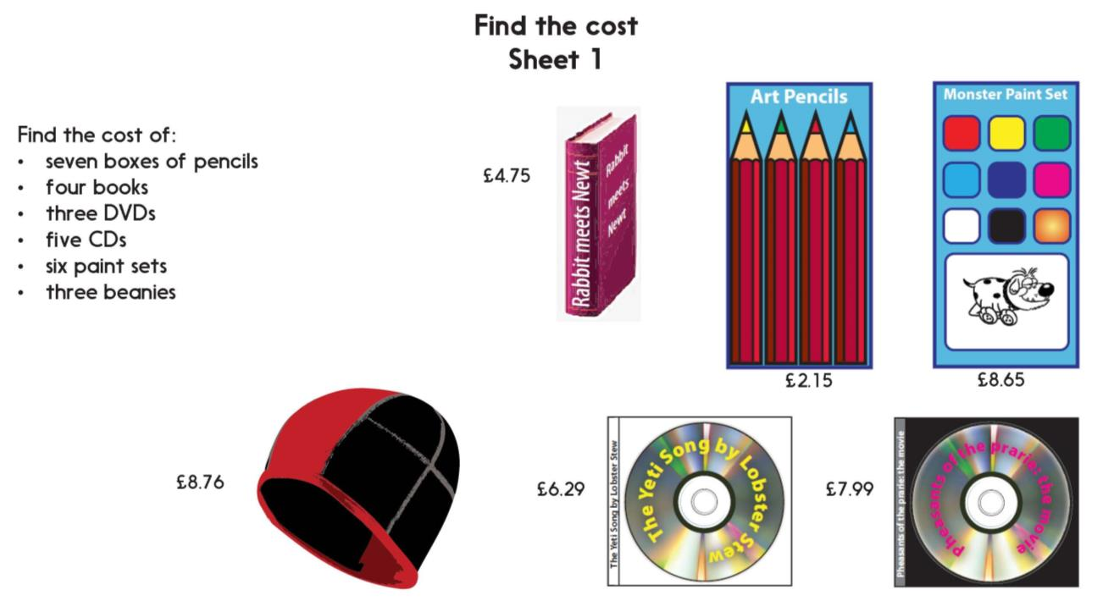
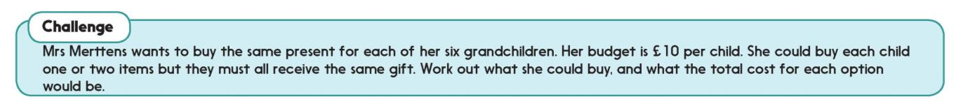

Challenge
Notes:
The Practice Sheet on this slide is suitable for most children.
Dowloadable PRACTICE WORKSHEETS are available on Hamilton’s website in this unit’s PROCEDURAL FLUENCY box.
Most children should be able to complete these calculations using the short multiplication method. Children Working towards ARE can use the grid method.

Slide 25

Multiplication and division
Grid method and short multiplication
Well Done! You’ve completed this unit.
Objectives
Day 1
Revise using grid multiplication to multiply 3-digit numbers by single-digit numbers.
Day 2
Use short multiplication to multiply 3-digit numbers by single-digit numbers.
Day 3
Use short multiplication to multiply 3-digit numbers by single-digit numbers.
Day 4
Use short multiplication to multiply 3-digit numbers by single-digit numbers including amounts of money.
Notes:
You can now use the Mastery: Reasoning and Problem-Solving questions to assess children’s success across this unit. Go to the next slide.

Slide 26
Multiplication and Division
Problem solving and reasoning questions
Find the product of 274 and 6 using two different methods. Do your answers agree?
Explain how you can work out 235 x 4 mentally. Now check your answer using short multiplication.
Fill in the missing digits:
8 4 ☐
x ☐
☐ ☐ 0 5
Write a multiplication of one 3-digit number by 6 where the last two digits of the product are consecutive (e.g. 5, 6).

Slide 27
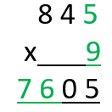
Problem solving and reasoning questions
Find the product of 274 and 6 using two different methods. Do your answers agree? 1644 The two methods are grid and short multiplication. Where children have found 2 different answers can they identify their error? With the grid method these are often with place value or with the final addition, with short multiplication the layout needs to be clear. In both methods mistakes may simply be due to insecure recall of times table facts.
Explain how you can work out 235 x 4 mentally. Now check your answer using short multiplication. 940. This can be found mentally by doubling twice.
Fill in the missing digits:
Write a multiplication of one 3-digit number by 6 where the last two digits of the product are consecutive (e.g. 5, 6). The following are all the solutions where the answer is less than 1000, they can be found by consecutively adding 6 to 600:
102 x 6 = 612 109 x 6 = 654 113 x 6 = 678 122 x 6 = 732
126 x 6 = 756 133 x 6 = 798 139 x 6 = 834 146 x 6 = 876
152 x 6 = 912 159 x 6 = 954 153 x 6 = 978

