Slide 1
TRANSPORT IN HUMANS
THE HEART

Slide 2
Circulatory system
Main transport system of all mammals is the blood system
Network of tubes with a pump and valves to ensure one-way blood flow

Slide 3
Double Circulatory System
Blood travels through the heart twice on one complete journey around the body

Slide 4
Heart
https://www.lorecentral.org/2017/10/13-parts-human-heart-functions.html

Slide 5
How does double circulatory system work?

Slide 6
https://blissbiology.wordpress.com/2015/04/22/circulatory-system/

Slide 7
Coronary arteries
Blood vessels on the outside of the heart that supply blood to the heart muscles

Slide 8
Coronary heart disease
Blockage of the coronary arteries
CAUSES:
-smoking cigarettes- ‘nicotine’
-high in salt and saturated fats diet
-long-term stress
-genes

Slide 9
Pacemaker
A patch of muscle on the right atrium that controls the rate of heart beat
Systole | Walls Contract | heart smaller | Blood out of the heart
Diastole | Walls Relax | Heart larger | Blood flow into the heart

Slide 10
Valves of the heart
Atrioventicular Valve | Semilunar Valve
Bicuspid valve or Mitral valve | Pulmonary valve
Tricuspid valve | Aortic Valve

Slide 11
How the heart pumps blood
Diastole-all muscles relaxed
Atrial Systole-the muscle of the atria contract, ventricles remain relaxed, blood force to the ventricle
Ventricular systole-the muscle of the atria relax, the ventricle contract, blood is forced out of the ventricles into the arteries

Slide 12
Heart Rate
Exercise | Angry or Afraid
Increase heart rate Muscle release more energy by aerobic respiration increase supply of oxygen Increase stroke volume | Increase heart rate Supply extra blood to the muscle releasing more energy by aerobic respiration Triggered by secretion of the adrenaline hormone Causing us to ‘fight or flight’

Slide 13
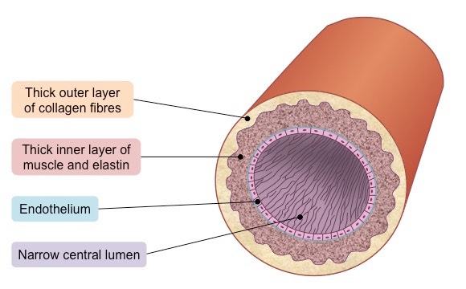
Arteries
carry blood from the heart to the organs of the body
Arterioles-small arteries
http://ib.bioninja.com.au/standard-level/topic-6-human-physiology/62-the-blood-system/arteries.html

Slide 14
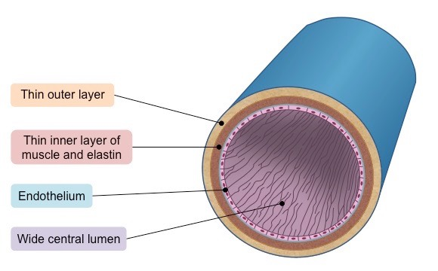
Veins
carry blood from organs back towards the heart
Venules-small veins
http://ib.bioninja.com.au/standard-level/topic-6-human-physiology/62-the-blood-system/veins.html

Slide 15
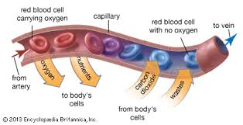
Capillaries
Carry blood through organs, bringing the blood close to every cell in the organ
One cell thick
https://www.britannica.com/science/capillary

Slide 16
http://www.flspinalcord.us/arteries-veins-and-capillaries/

Slide 17
Main Components of the Human Circulatory System

Slide 18
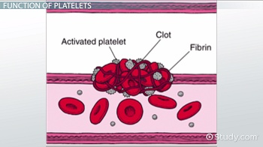
The Composition of the Blood
1) Plasma (liquid part)- carries the blood cells, nutrients, hormones, carbon dioxide and urea around the body
2) Platelets (smallest cells)- make blood clot
Fibrinogen Fibrin
https://study.com/academy/lesson/what-are-platelets-definition-function-normal-range.html

Slide 19
3) Red blood cells (erythrocytes)
Biconcave, disc-like cells with no nucleus
Contain mainly haemoglobin, which loads oxygen in the lungs and unloads it in other regions of the body
Haemoglobin + Oxygen Oxyhaemoglobin

Slide 20
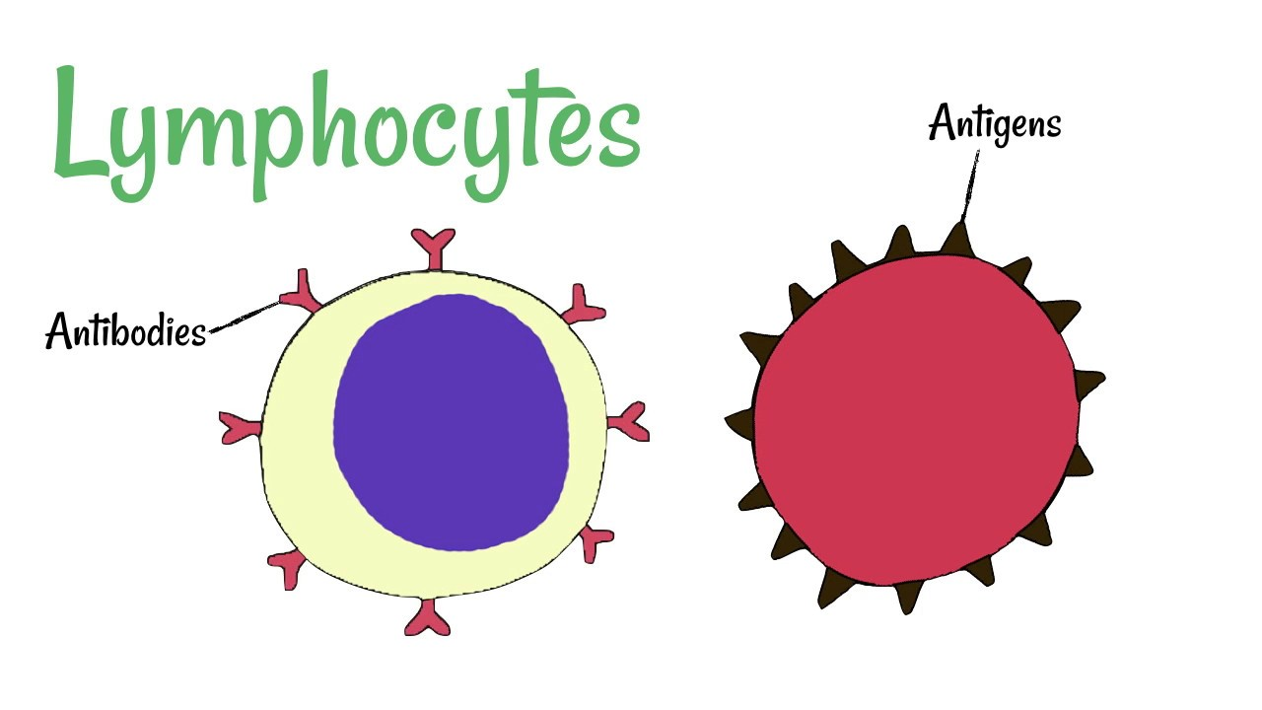
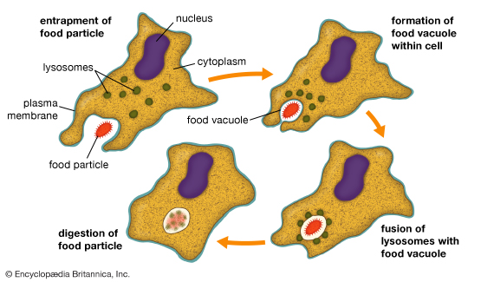
4) White Blood Cells
Lymphocytes-antibodies | Phagocytes-engulf bacteria
 | Phagocytosis:
https://www.youtube.com/watch?v=bGKsGEByr0w

Slide 21
Tissue Rejection
A condition when the recipient’s immune system will recognise the cells in the new kidney as ‘foreign,’ and will attack and destroy them.

Slide 22
Blood Cells in Microscope
https://www.quora.com/Is-it-possible-to-do-a-full-blood-count-with-only-a-microscope-up-to-X1000-and-slides

Slide 23
Tissue fluid
It surrounds the cells in the body
It supplies cells with all their requirements

Slide 24
Lymph
Fluid at the lymphatic capillaries
Formerly tissue fluid

Slide 25
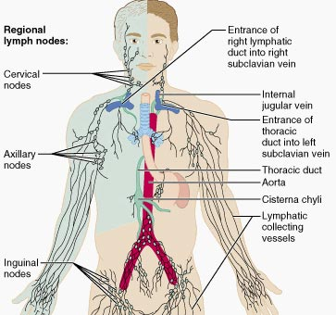
Lymph Nodes
Contain large number of white blood cells
http://www.daviddarling.info/encyclopedia/T/thoracic_duct.html

Slide 26
Sources: Edexcel GCSE Biology (Pearson); Cambridge IGCSE Biology Coursebook 2nd ed.
Images from google

