Slide 1
THE MENSTRUAL CYCLE

Slide 2
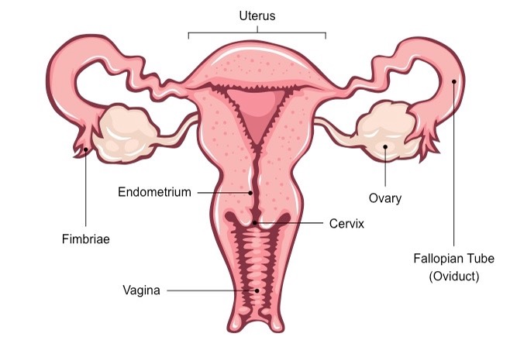
FEMALE REPRODUCTIVE SYSTEM
http://ib.bioninja.com.au/standard-level/topic-6-human-physiology/66-hormones-homeostasis-and/female-reproductive-system.html

Slide 3
Adolescence and Puberty
adolescence: the time when a person approaches sexual maturity
puberty: the time at which sexual maturity is reached

Slide 4
Secondary sexual characteristics
Testosterone: male sex hormone released at the testes
Oestrogen: female sex hormone from the ovary

Slide 5
Key Words
menstruation: the loss of the broken down uterus lining through the vagina
follicle: a structure within an ovary, in which an egg develops
pituitary gland: a small endocrine gland attached to the underside of the brain
corpus luteum: a structure that develops from the empty follicle after an egg has been released from an ovary; also known as a yellow body

Slide 6
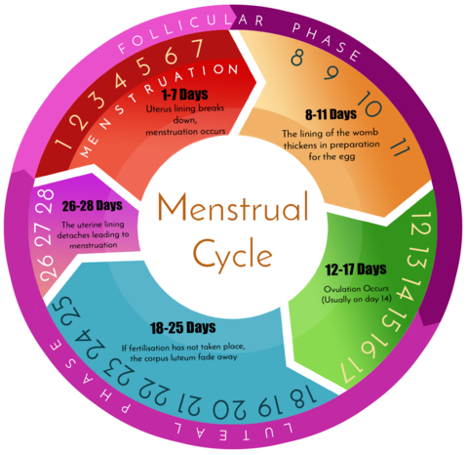
Menstrual Cycle
https://www.anigan.com/pages/all-about-menstruation

Slide 7
Hormones
FSH: follicle stimulating hormone, a hormone secreted by the pituitary gland which causes a follicle to develop in an ovary
LH: luteinising hormone, a hormone secreted by the pituitary gland that causes ovulation to happen

Slide 8
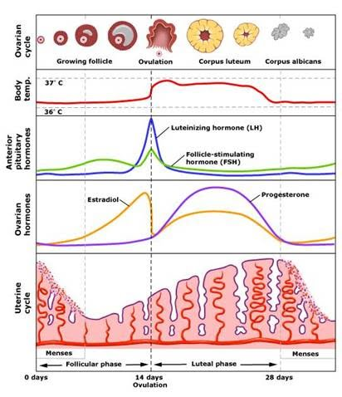
https://sites.google.com/site/medicnote/ob-gyn/menstrual-cycle

Slide 9
Sources: Biology for Cambridge IGCSE Coursebook
Edexcel IGCSE (9-1) Biology (Pearson)
Images from Google

