Slide 1
To p i c
Virtual memory & Cloud Storage
C O M P U T E R S C I E N C E
Y E A R 8

Slide 2
Key Vocabulary:
Virtual Memory
Cloud Storage
RAM
Cache
Paging
Cloud Computing.

Slide 3
Hookup Activity
Imagine you are working on a computer and suddenly you run out of memory space. What would you do?
Come on board and share your answer

Slide 4
Introduction
What is memory in a computer system?
Have you heard about virtual memory? What do you think it means?
What is cloud storage? How is it different from physical storage?

Slide 5
Objective
T explain the concepts of virtual memory and cloud storage,
differentiate between them and recognize their importance in modern computing after having explored real-world examples and scenarios using multimedia resources (presentation) and collaborative group work.

Slide 6
Virtual memory
One of the problems associated with memory management is the case when processes run out of RAM.
If the amount of available RAM is exceeded due to multiple programs running, it is likely to cause a system crash.
This can be solved by utilising the hard disk drive (or SSD) if we need more memory. This is the basis behind virtual memory.
Essentially RAM is the physical memory, while virtual memory is RAM + swap space on the hard disk or SSD.

Slide 7
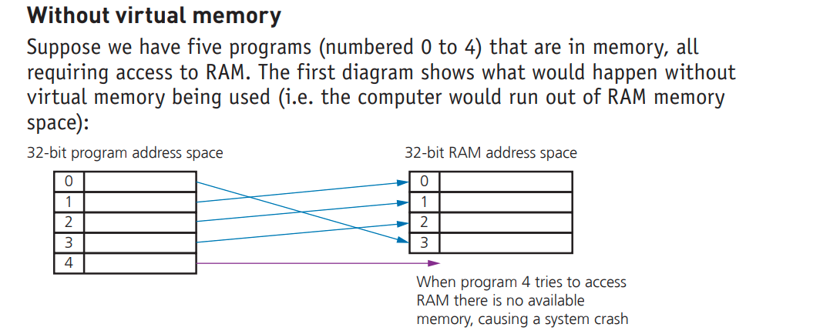

Slide 9
paging
is used by memory management to store
and retrieve data from HDD/SSD and copy it into RAM.
A page is a fixed-length
consecutive (or contiguous) block of data utilised in virtual memory systems.

Slide 10
Benefits of Virtual Memory
The main benefits of virtual memory are:
» programs can be larger than physical memory and still be executed
» there is no need to waste memory with data that isn’t being used (e.g. during
error handling)
» it reduces the need to buy and install more expensive RAM memory (although
as mentioned earlier there are limits to the value of doing this).

Slide 11
Disk thrashing (HDD)
a problem in a hard disk drive (HDD) caused by excessive swapping in and out of data
causing a high rate of head movements during virtual memory operations
Thrash point
the point at which the execution of a program comes to a halt because the system is so busy moving data in and out of memory rather than actually executing the program

Slide 12
Cloud storage
Cloud storage is a method of data storage where data is stored on remote servers.
There are three common systems:
» Public cloud – this is a storage environment where the customer/client and cloud storage provider are different companies
» Private cloud – this is storage provided by a dedicated environment behind a company firewall; customer/client and cloud storage provider are integrated and operate as a single entity
» Hybrid cloud – this is a combination of the two above environments; some data resides in the private cloud and less sensitive/less commercial data can be accessed from a public cloud storage provider.

Slide 13
Differentiated Activities
Group A
Students will create a poster where they explain the concept of virtual memory in simple terms.
Group B
Students will write the advantages and disadvantages of cloud storage.
Group C
Students will explore real-world examples of companies using cloud storage and their benefits.

Slide 14
Plenary

Slide 15
Thank You!

