Slide 1
UNIT 6: BE AN ANIMATOR
Muhammad Umair Khan

Slide 2
LEARNING OBJECTIVE:
create scratch program using selection statement.
After doing group activity.
followed by a Quiz.

Slide 3
KEY VOCABLARY:
BIG QUESTIONS:
How do selection statements help computers make decisions
Can you give real-life examples of decision-making
Why is it important to have conditions in decision-making
What happens if there are multiple conditions to consider
How might selection statements be used in creating games or stories

Slide 4
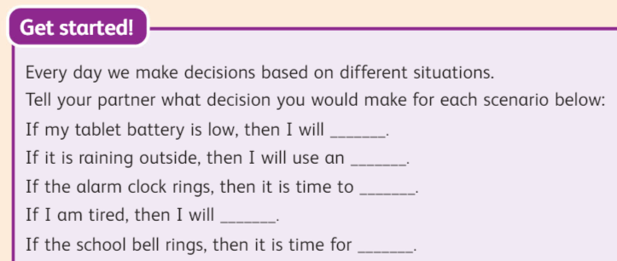
HOOK ACTIVITY: (PEER ACITIVTY) PAGE NUMBER 70

Slide 5
WHAT IF?? If the month of your birthday ends with a 'Y' or 'R', then raise your right hand.

Slide 6
WHAT IF?? If you can play a musical instrument, clap your hands three times.

Slide 7
WHAT IF?? If you have black hair, touch your head.

Slide 8
WHAT IF?? If the month of your birthday ends with a 'Y' or 'R', then raise your right hand.

Slide 9
WHAT IF?? If your name ends with an 'A' or 'E', say 'Yes!'

Slide 10
WHAT IF?? If you have a brother or sister, touch your toes.

Slide 11
WHAT IF?? If your favourite ice-cream flavour is vanilla, give a thumbs up.

Slide 13
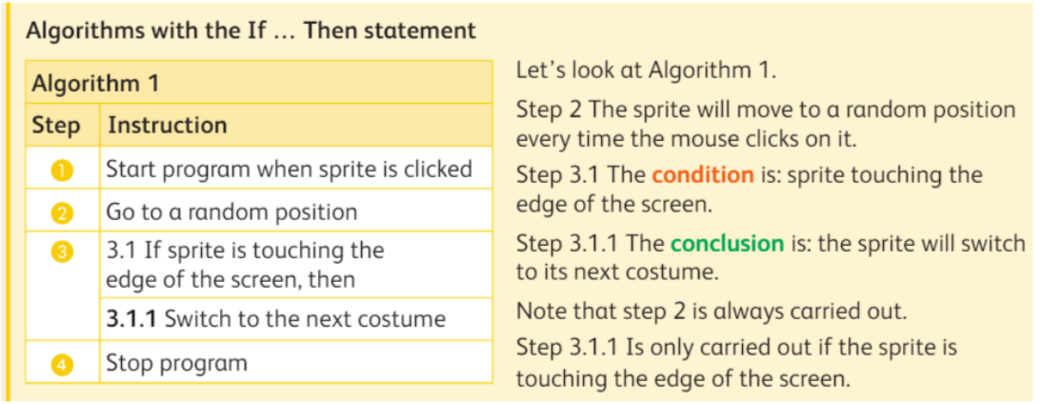
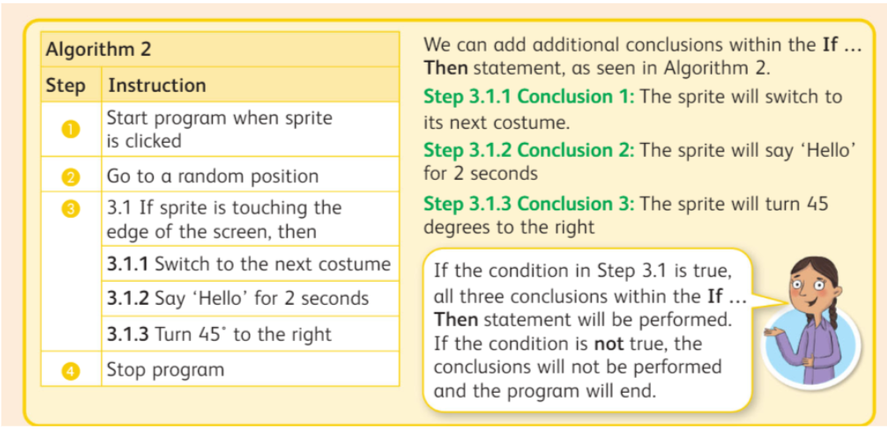
GROUP WORK:
Task for first group
Task for SECOND group

Slide 14
PLENARY
REFLECT ON YOUR ANSWERS

Slide 16
Add a Slide Title - 4

Slide 17
Add a Slide Title - 5

