Slide 1
Multiplication and Division
Understand doubling and halving (numbers to 20)
Objectives
Day 1
Find doubles to double 20.
Day 2
Find halves of even numbers using strips to help.
Day 3
Find doubles to double 20 and corresponding halves.
Notes:
Before teaching, be aware that:
On Day 1 you will need 2 bead strings; children will need mini-whiteboards and pens.
On Day 2 children will need paper strips cut from ‘Finding halves’ sheet (see resources).
On Day 3 children will need mini-whiteboards, paper, 10p and 1p coins.

Slide 2
Multiplication and Division
Understand doubling and halving (numbers to 20)
Starters
Day 1
Double 1–5 and halves (pre-requisite skills)
Day 2
Double 1–10 and halves (pre-requisite skills)
Day 3
Pairs to 6, 7, 8 and 9 (simmering skills)
Notes:
Choose starters that suit your class by dragging and dropping the relevant slide or slides below to the start of the teaching for each day.

Slide 3
Multiplication and Division
Understand doubling and halving (numbers to 20)
Starter
Double 1–5 and halves
Notes:
Pre-requisite skills – to use this starter, drag this slide to the start of Day 1
Children hold their thumbs together and say double 1 is 2. You say half of 2 is … and children reply 1! They hold their thumbs and forefingers together and say double 2 is 4. You say half of 4 is … and children reply 2! Repeat for double 3, 4 and 5. Call random doubles to double 5, children call out the total. Repeat for halves of even numbers less than 10.

Slide 4
Multiplication and Division
Understand doubling and halving (numbers to 20)
Starter
Double 1–10 and halves
Notes:
Pre-requisite skills – to use this starter, drag this slide to the start of Day 2
Slide the beads behind the whiteboard on a 20-bead frame. Slide 1 across on each bar to show double 1. You say double 1 is … and children reply 2! Show 2 on each bar. You say double 2 is ... and children reply 4! Repeat up to double 10. Repeat, this time saying half of 2 is… and children replying 1! Half of 4 is… children say 2!

Slide 5
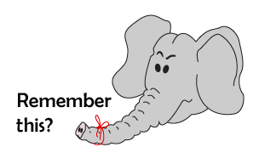
Multiplication and Division
Understand doubling and halving (numbers to 20)
Starter
Pairs to 6, 7, 8 and 9
Notes:
Simmering skills – to use this starter, drag this and following slide to the start of Day 3
Show bar model pictures of pairs to 6, 7, 8 and 9 with a missing number in each bar (see resources). Children put their hands behind their backs. Point to a question mark on the first bar. Children show number of fingers to make 6. Repeat for each bar model showing pairs to 6, 7, 8 or 9.
Play ‘Ping Pong’ for pairs to 6, 7, 8 and 9. Tell children you are looking for the pair to 7 and call out a number, e.g. 2. Children respond together: 5! Repeat with a different pair: 7… 0 etc. Build up the speed as recall allows.

Slide 6
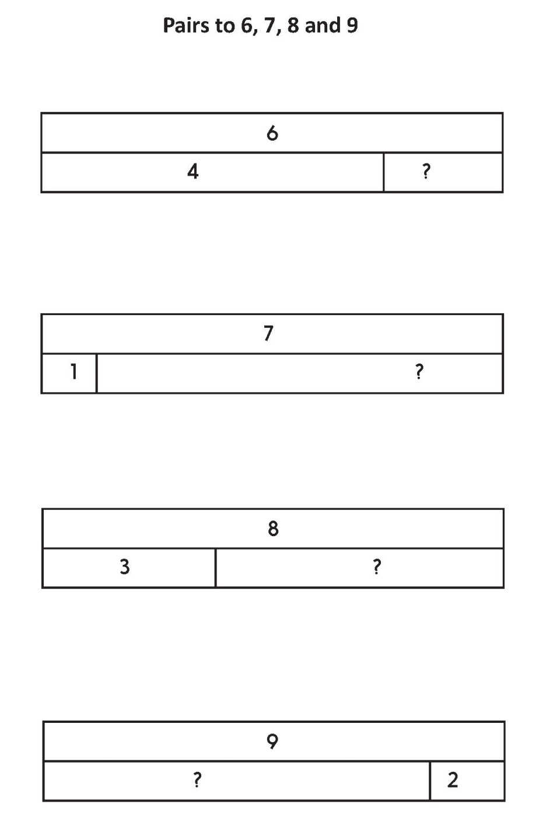

Slide 7
Multiplication and Division
Understand doubling and halving (numbers to 20)
Objectives
Day 1
Find doubles to double 20.

Slide 8
Day 1: Find doubles to double 20.
13
13
Let’s find double 13…
Double 10 is …
20.
Double 3 is …
6.
Double 13 is 26.

Slide 9
Day 1: Find doubles to double 20.
15
15
Let’s find double 15…
Double 10 is …
20.
Double 5 is …
10.
Double 15 is 30.

Slide 10
Day 1: Find doubles to double 20.
17
17
Let’s find double 17…
Double 10 is …
20.
Double 7 is …
14.
We can partition to add 20 + 14...
20 + 14 = 20 + 10 + 4
= 34.
Double 17 is 34!

Slide 11
Day 1: Find doubles to double 20.
Work in pairs to find double 12…
Who can explain that?
Work in pairs to find double 16…
Who can explain that?
Notes:
Children can now go on to do differentiated GROUP ACTIVITIES. You can find Hamilton’s group activities in this unit’s TEACHING AND GROUP ACTIVITIES download.
WT/ARE: Use bead strings to find doubles of numbers up to 20.
GD: ‘Doubles to 20’ card game.

Slide 12
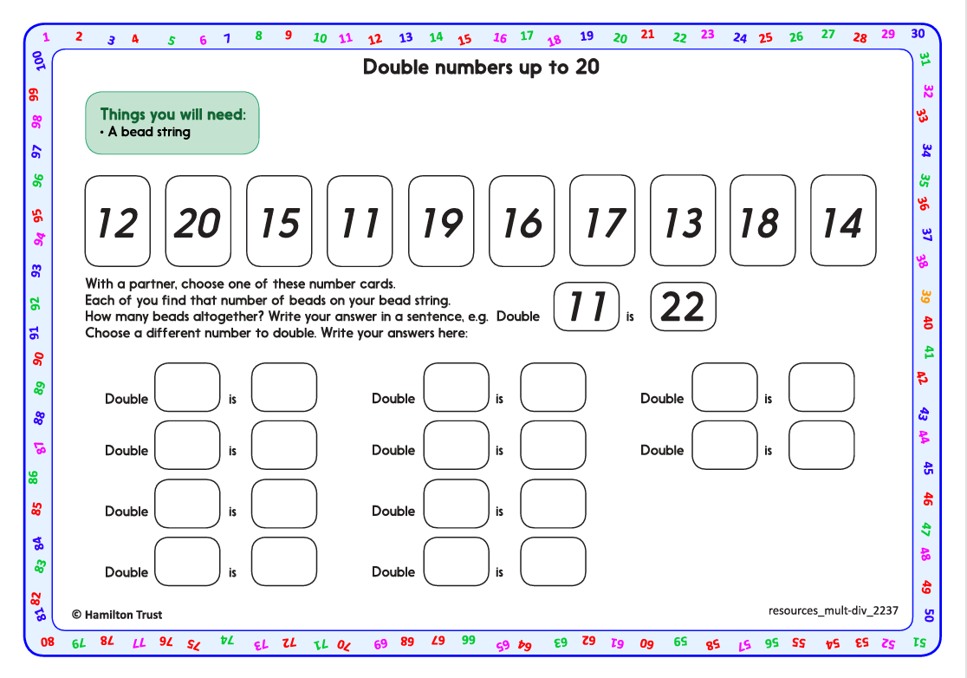
Work in pairs with 2 bead strings to find and record doubles of numbers from 11 to 20. Use the ‘Double numbers up to 20’ activity sheet (see resources) for an example of recording and to scaffold further recording.
Can you work through all the numbers?
Task 1 – Pair/Group Work

Slide 13
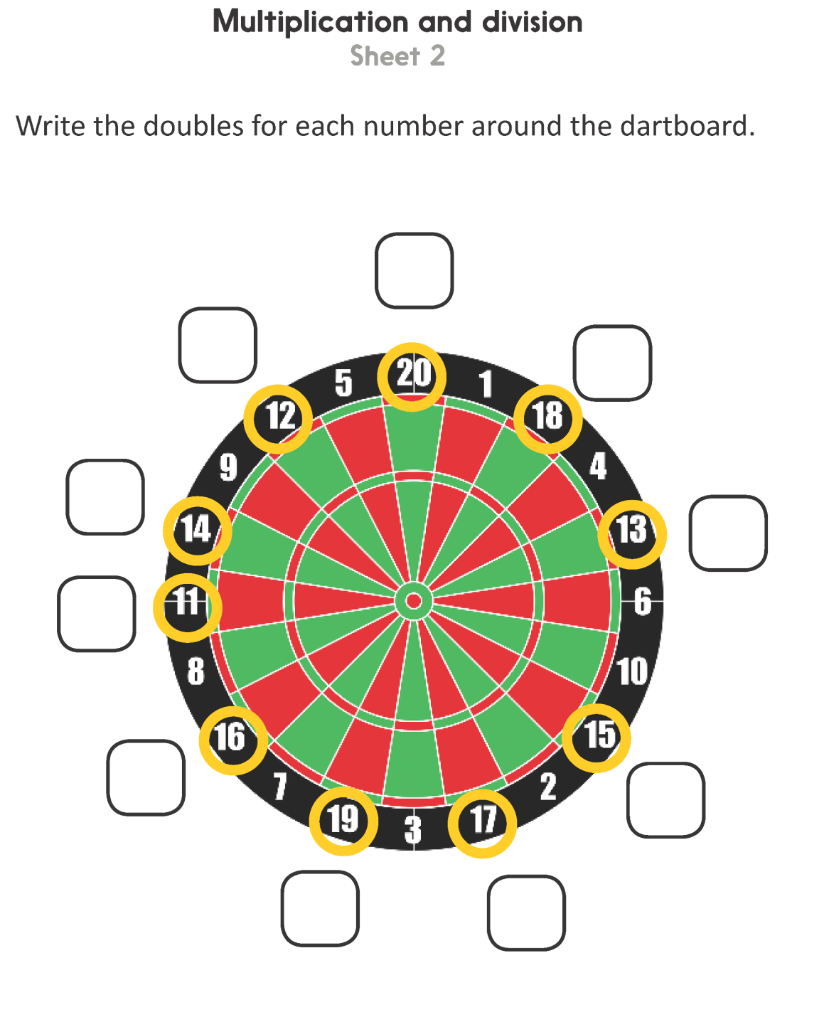
Task 2 – Independent Work
Challenge
Notes:
The Practice Sheet on this slide is suitable for most children.
Differentiated PRACTICE WORKSHEETS are available on Hamilton’s website in this unit’s PROCEDURAL FLUENCY box.
WT: Multiplication and Division Sheet 1.
ARE: Multiplication and Division Sheet 2.
GD: Multiplication and Division Sheet 3.

Slide 14
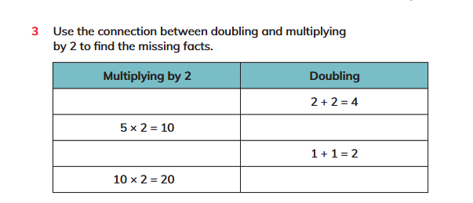
Plenary
Solve Q3 on page 161 and peer check the answers..

Slide 15
Homework
Solve Q6 on page 169 workbook.

