Slide 1
Measures
Begin to understand hours, minutes, seconds
Objectives
Day 2
Have a sense of the length of a minute.

Slide 2
Day 2: Have a sense of the length of a minute.
Show children a 1-minute sand timer and explain that we can use it to time how long something takes in minutes. Explain that they will take it in turns to stand up, turn around and sit down again. We’re going to time how long it takes to go around the whole class doing that!
Begin timing and keep time by calling ‘1 minute, 2 minutes, etc.’ each time you invert the sand timer. Look at the timer when the children have finished to see whether they think it has only just started or it is nearer the next minute, to give a time in whole minutes.
Repeat, this time asking children to take turns to touch their head, shoulders, knees and toes, shouting ‘head, shoulders, knees and toes’ as they do so. Did it take longer to go round the class doing this?
Notes:
Today would be a great day to use a problem-solving investigation – Order, Order! – as the group activity, which you can find in this unit’s IN-DEPTH INVESTIGATION box on Hamilton’s website.
Alternatively, children can now go on to do differentiated GROUP ACTIVITIES. You can find Hamilton’s group activities in this unit’s TEACHING AND GROUP ACTIVITIES download.
WT/ARE/GD: Seeing what can be done in one minute – repeated tasks e.g. writing first name, how many throws of 6 with a dice, etc.

Slide 3
QNID
Clock Tower in Qatar

Slide 4
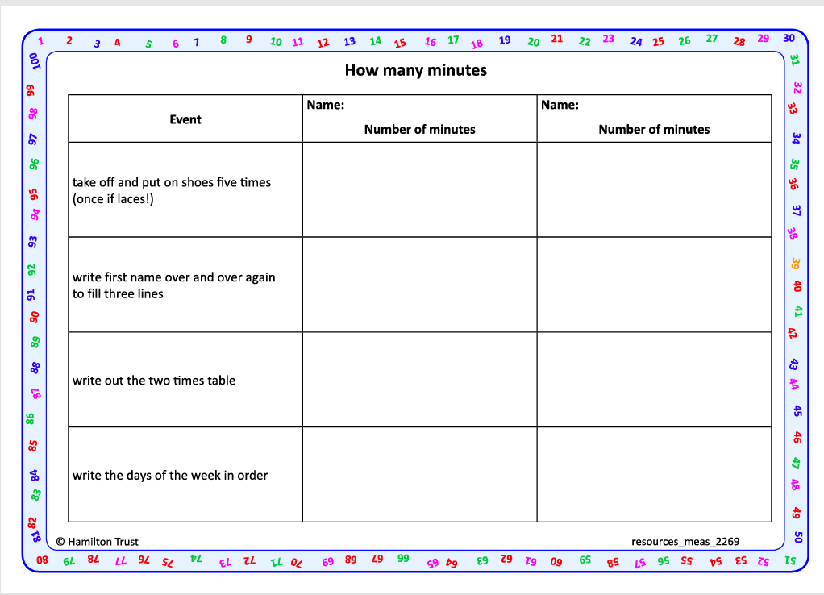
Task 1 – Pair/Group Work
•Take turns to use a 1-minute sand timer to time how long in minutes it takes your partner to:
Take off and put on their shoes five times (once if laces).
Write their first name over and over again to fill three lines.
Write the two times table.
Write the days of the week in order.
•Record results in your table.

Slide 5
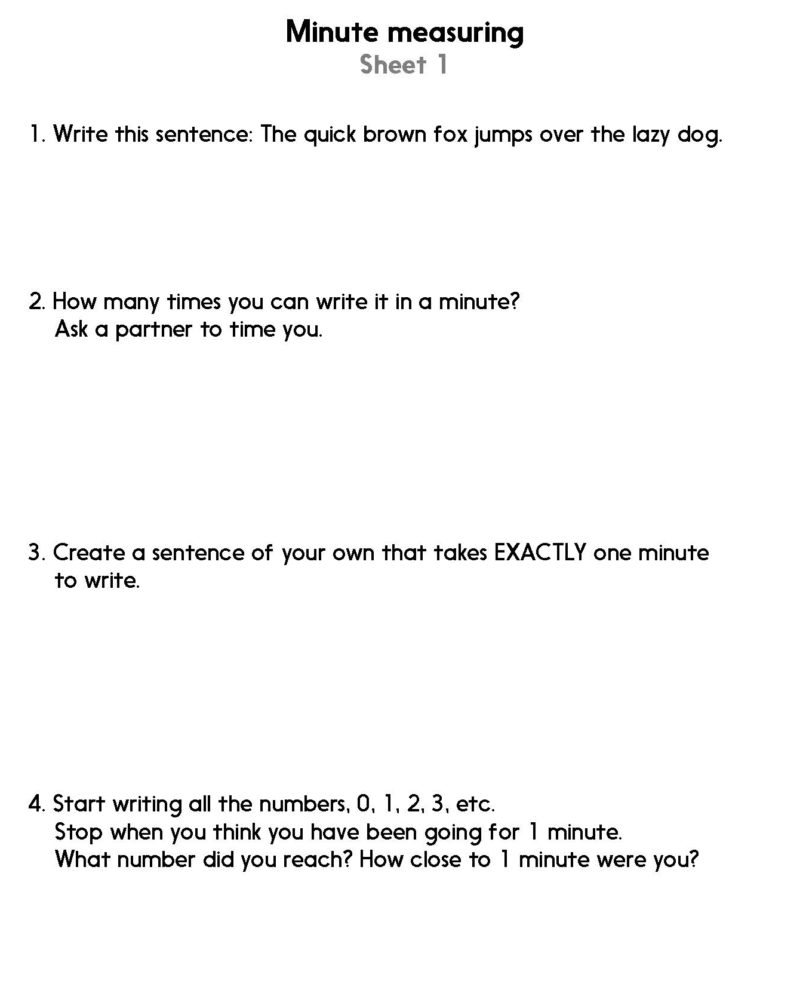
Task 2 – Independent Work
Notes:
The Practice Sheet on this slide is suitable for most children.
Differentiated PRACTICE WORKSHEETS are available on Hamilton’s website in this unit’s PROCEDURAL FLUENCY box.
WT/ARE/GD: Minute measuring Sheet 1
A practical practice activity for mixed-attainment pairs or 3s.

Slide 6
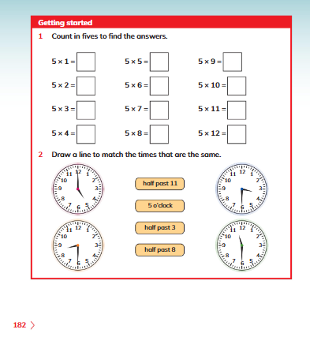
Plenary
Q1 and 2 on page 182, Learners book.

Slide 7
Homework
Go to this link and choose 15 or 30 seconds for chn to talk about different topics: https://wordwall.net/resource/10419939/english/thirty-seconds

