Slide 1


Year 2 Starters
Autumn Term
Test F
Play through the slides, giving children as much time as you think they need to answer each question. Most questions have a written answer; sometimes children may show a number of fingers.
Answers are given at the end of the test.
This is not a class competition! Can children beat their own personal best each week?
Which ride do they get to enjoy at the end?

Slide 2
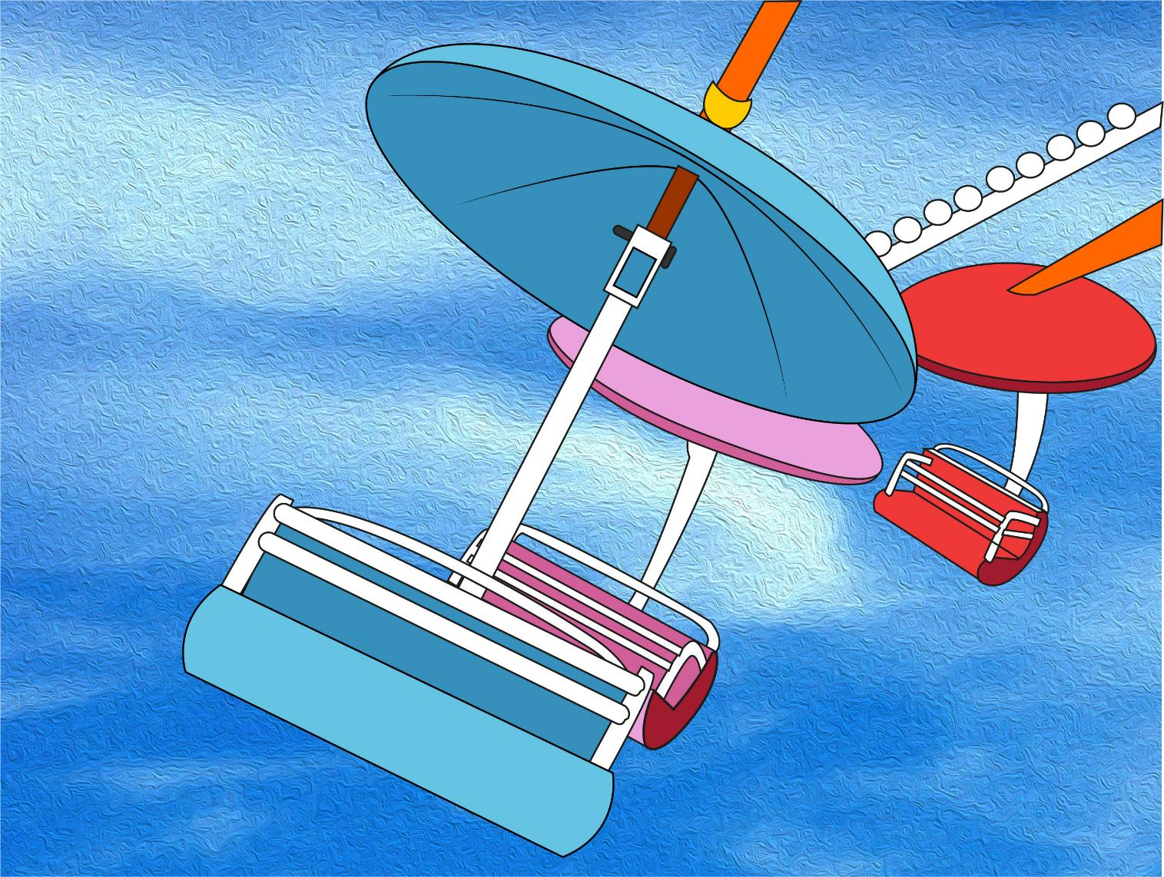
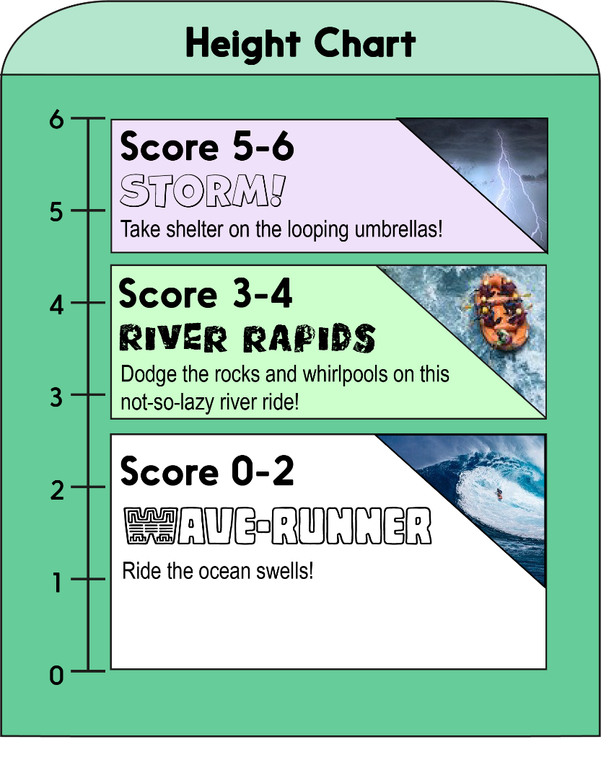


Score a mark on the chart for each correct answer on the test.
Which ride will you measure up for?!

Slide 3
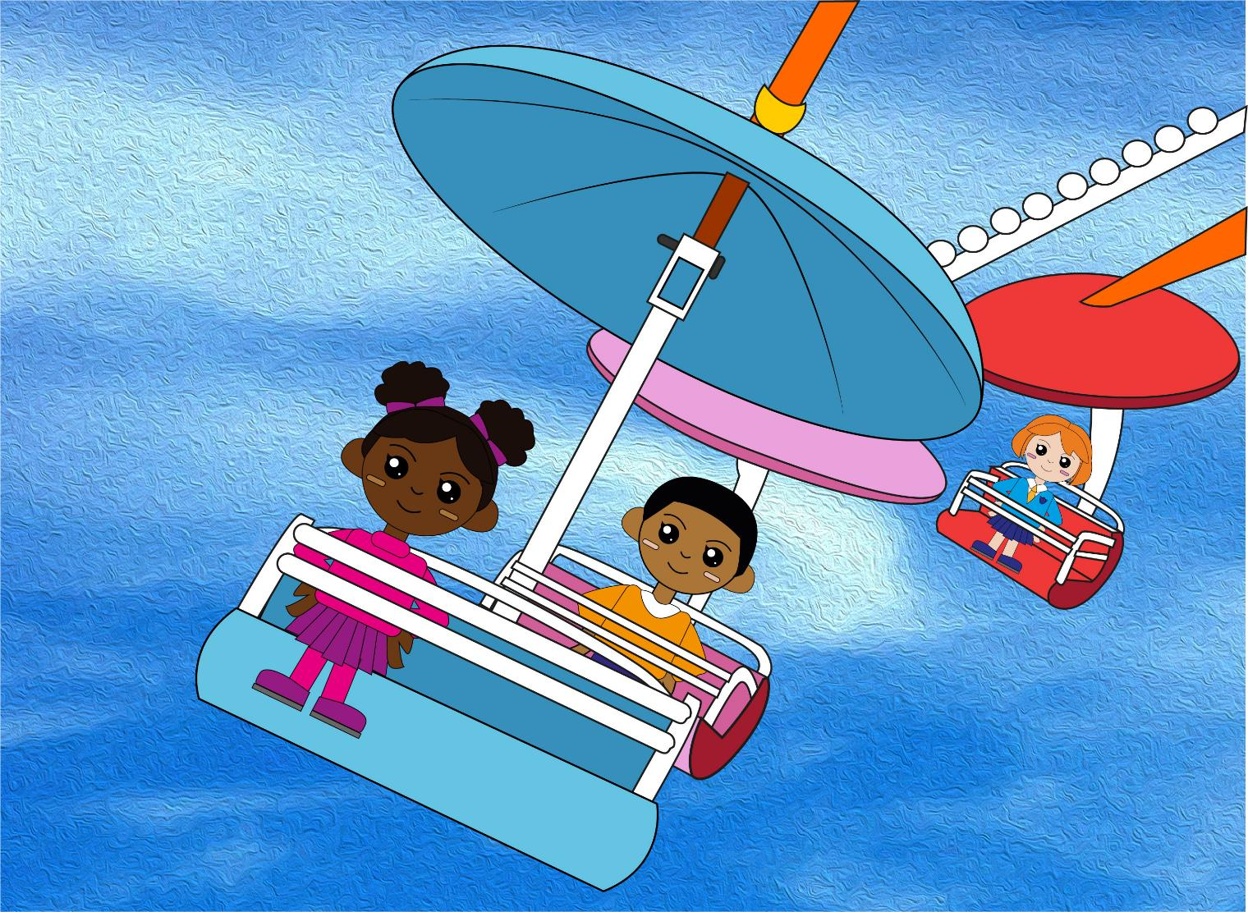

Question 1
Count in 3s to find the next three numbers.
3, 6, 9, 12, __, __, __
Write the three numbers.

Slide 4
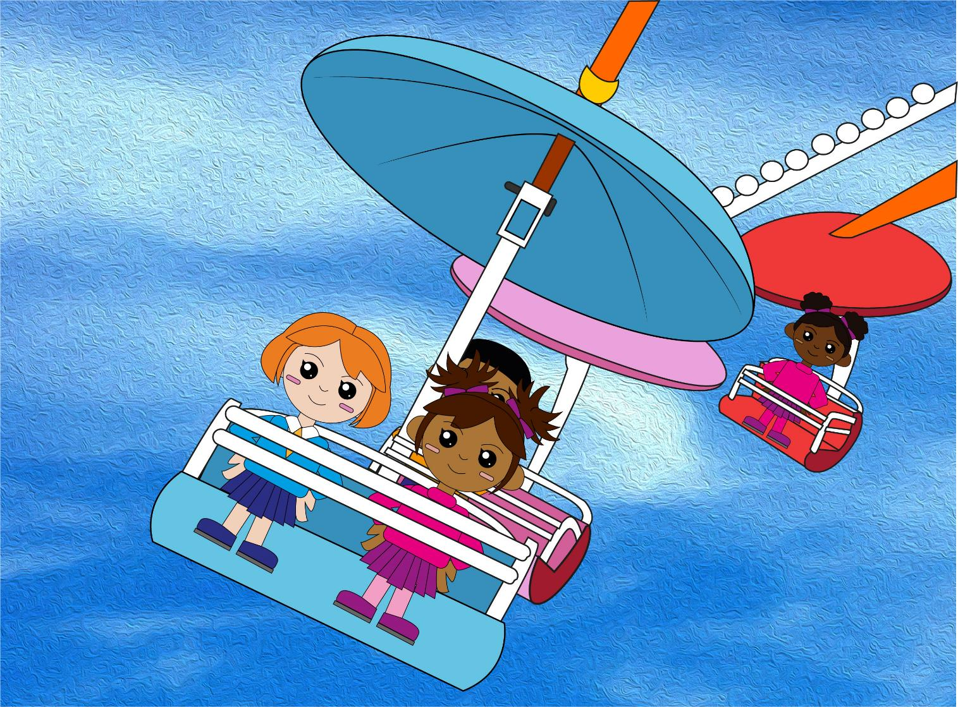
Question 2
Count back in 5s to find the next three numbers.
40, 35, 30, 25, __, __, __
text
Write the three numbers.

Slide 5
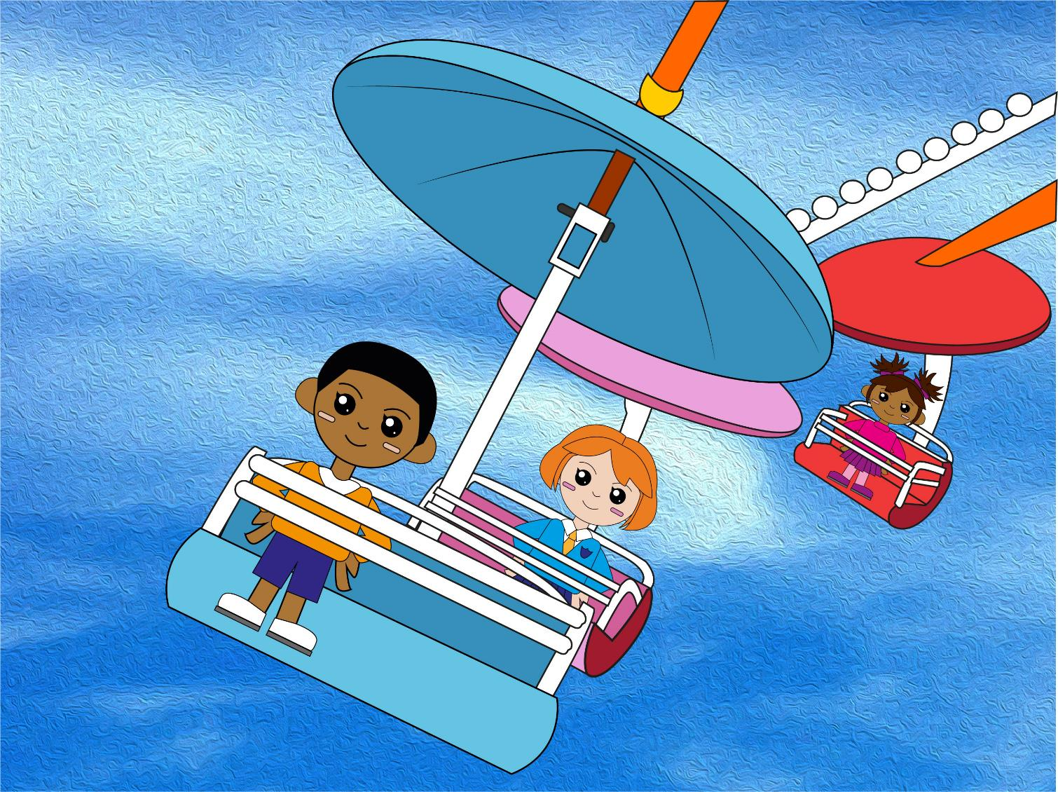
Question 3
Double 8 is?
Write your answer.

Slide 6
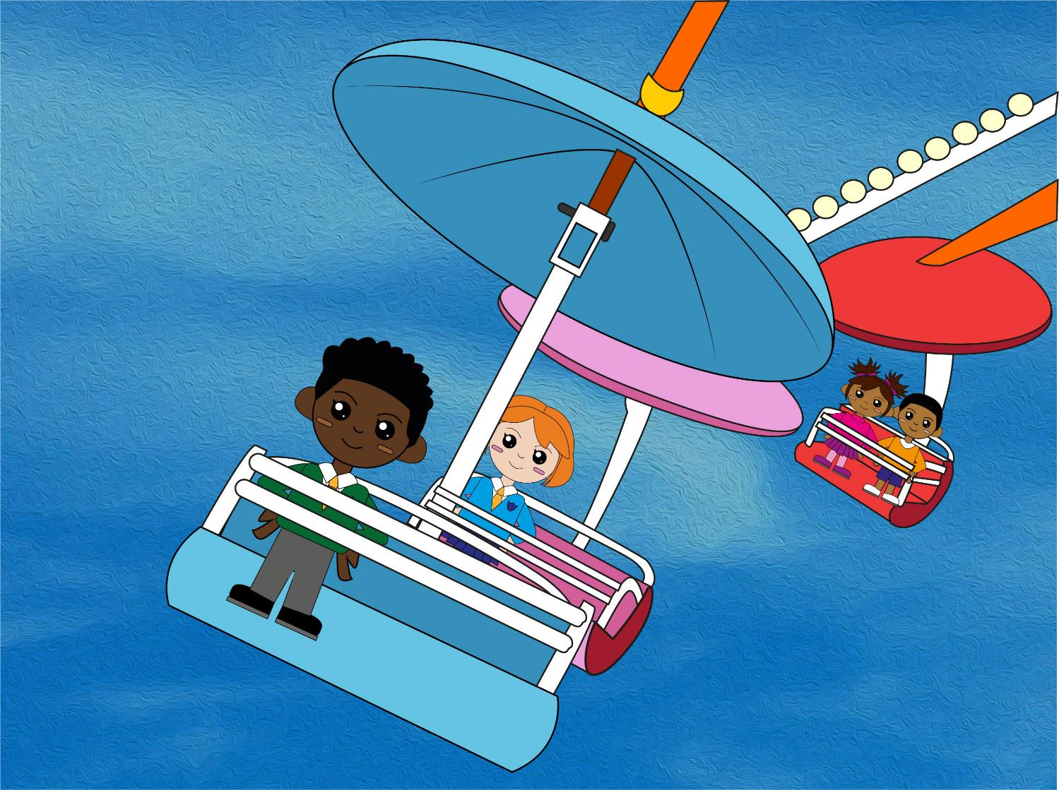
Question 4
Half of 12 is?
text
Write your answer.

Slide 7
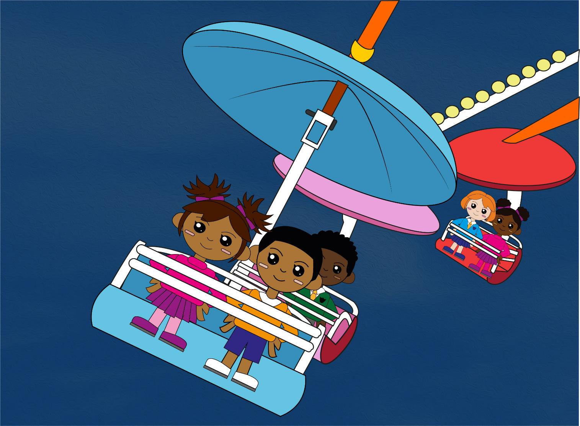
Question 5
4 x 5 = ?
Write your answer.

Slide 8
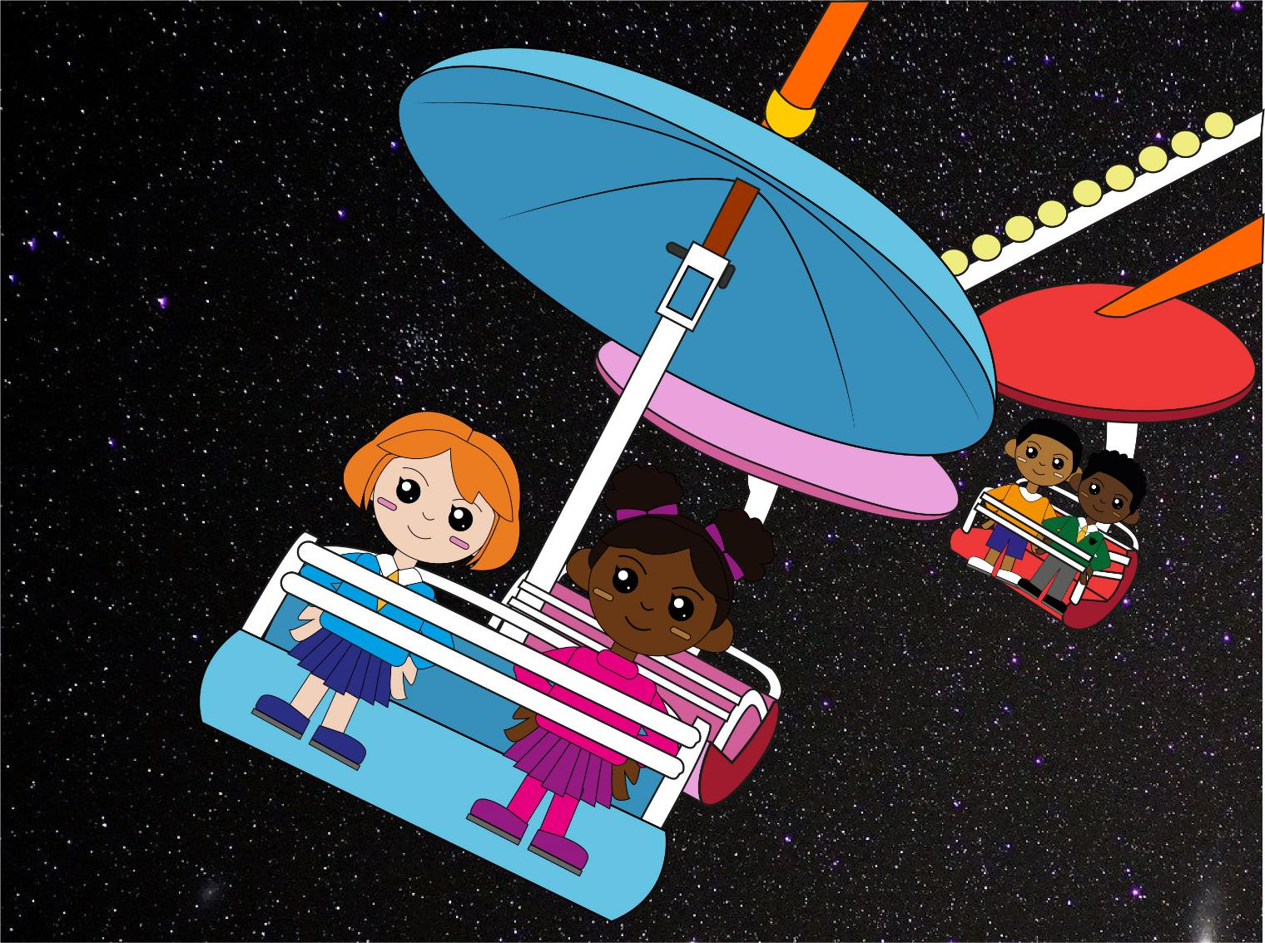
Question 6
7 x 5 = ?
Write your answer.

Slide 9

Q1
3, 6, 9, 12, 15, 18, 21
Q2
40, 35, 30, 25, 20, 15, 10
Q3
Double 8 is 16
Q4
Half of 12 is 6
Q5
4 x 5 = 20
Q6
7 x 5= 35
The answers!

Slide 10
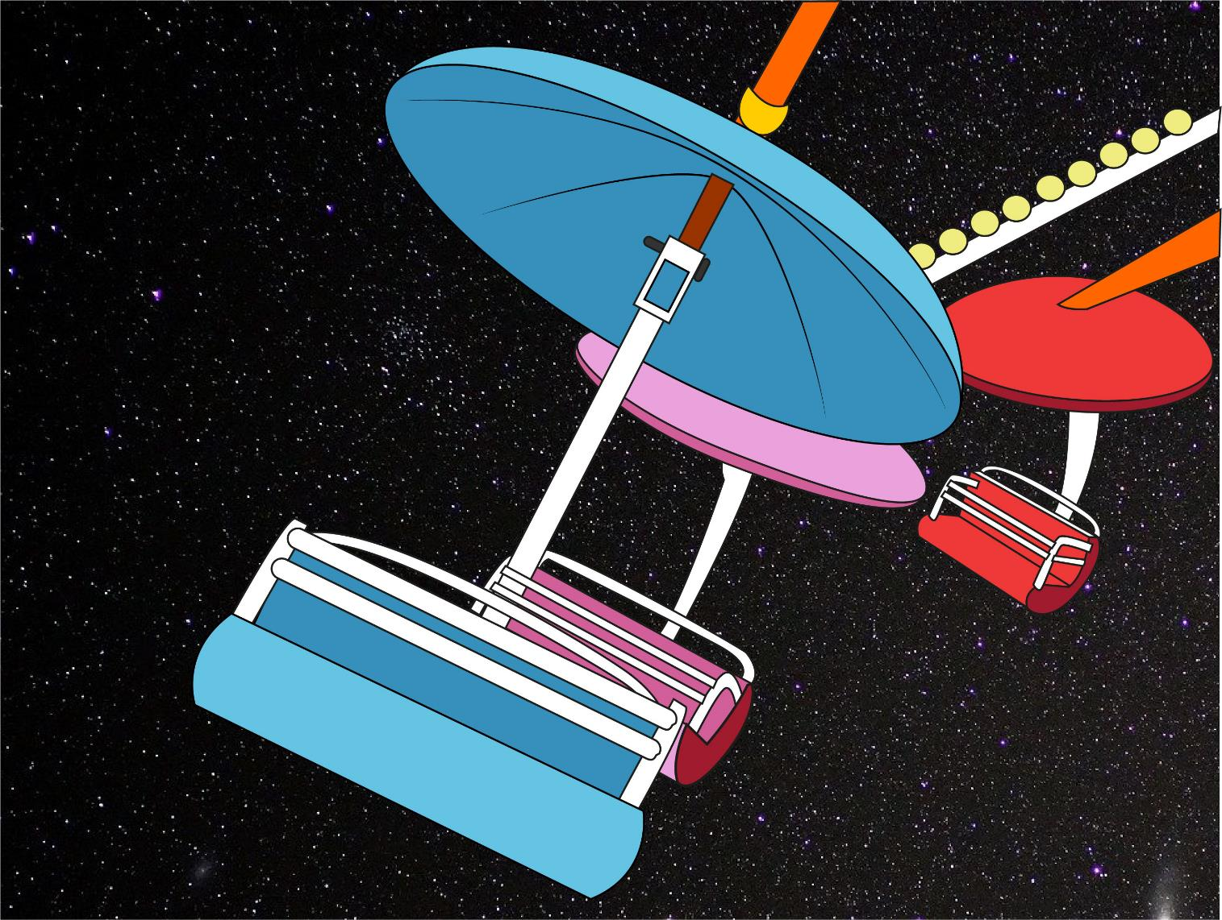
So, which ride do YOU measure up for?!
Did you beat YOUR personal best?

