Slide 1
Weather Experts
Block B: Meteorologists: Seasonal Weather Session 1
Enquiry question How is the weather different in each season?
Objectives
To make observations about the weather and discuss how this differs throughout different seasons.
To begin to understand how to record and measure the weather.

Slide 2
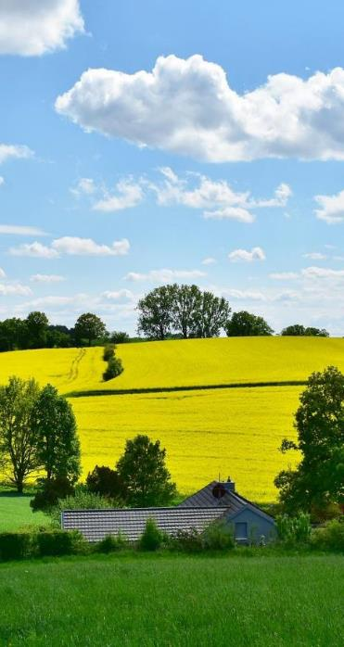
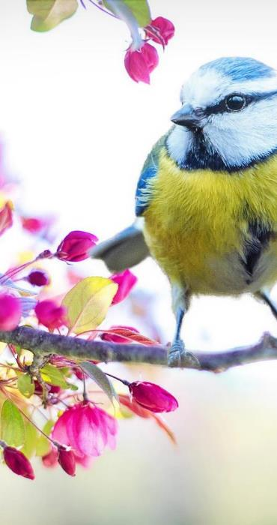
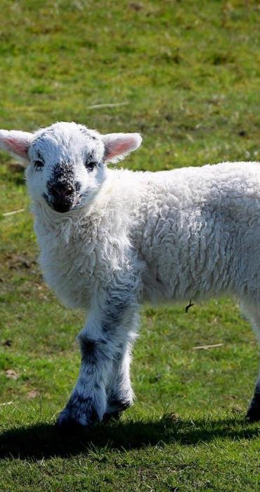
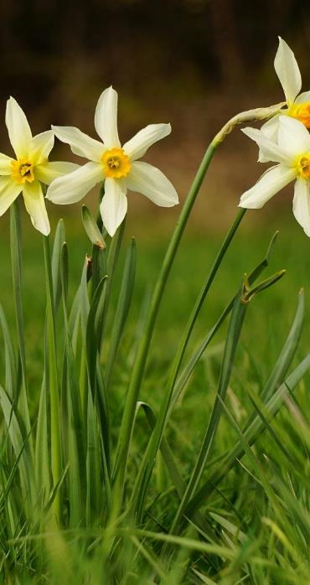
Which Season?

Slide 3
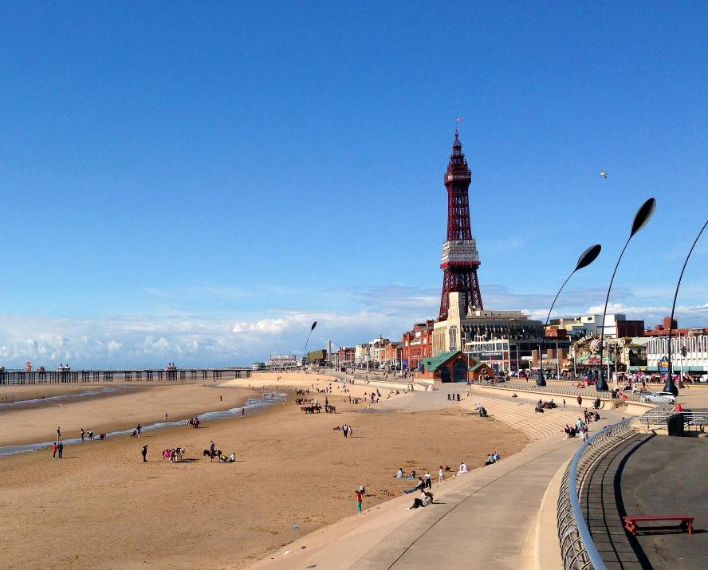
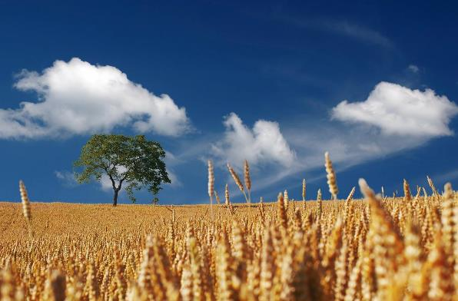
Which Season?

Slide 4
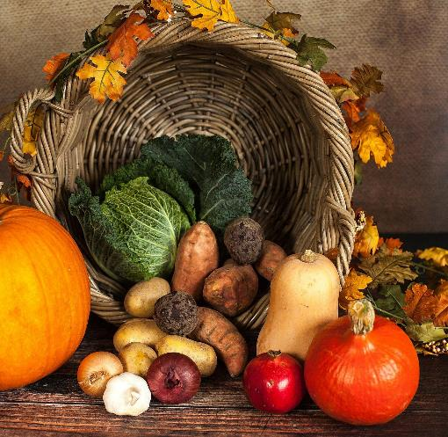
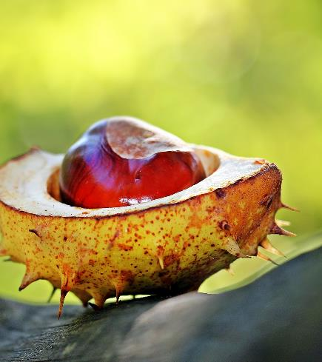
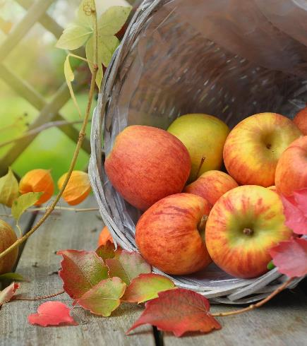
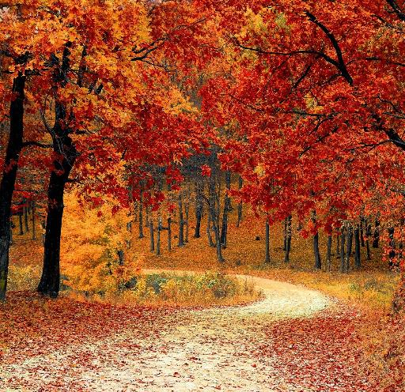
Which Season?

Slide 5
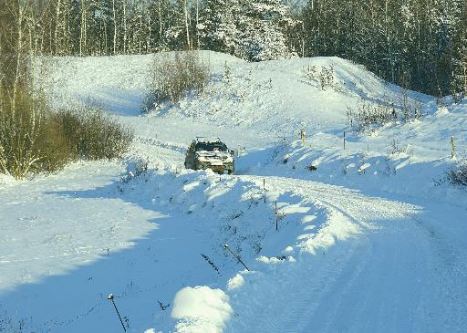
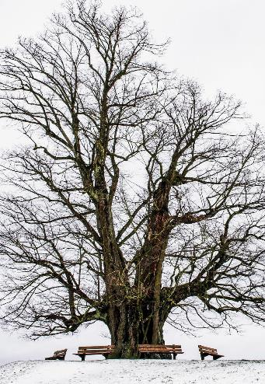
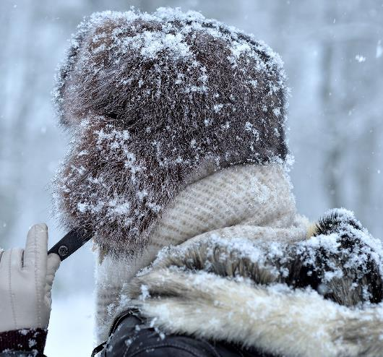
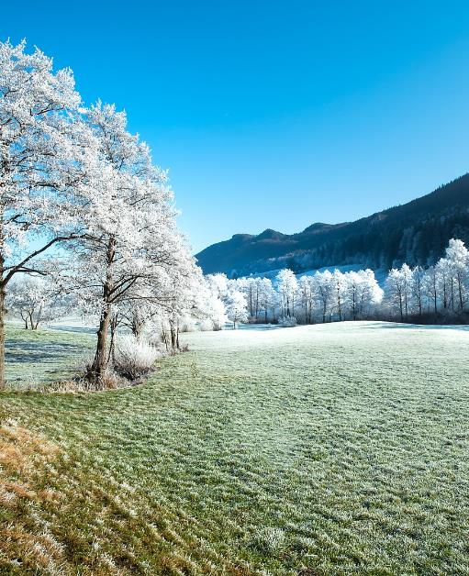
Which Season?

Slide 6
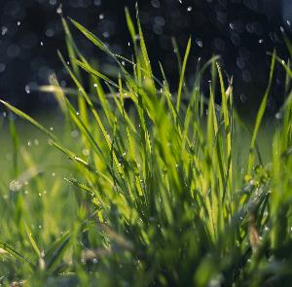
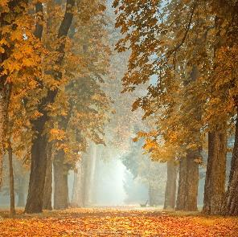
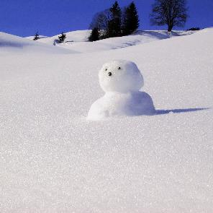
Seasonal Weather
What sort of weather have we been having?
Spring | Summer
Autumn | Winter
What season are we in now?

Slide 7
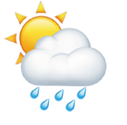
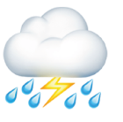
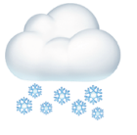
Seasons
Spring | Summer
Autumn | Winter

Slide 8
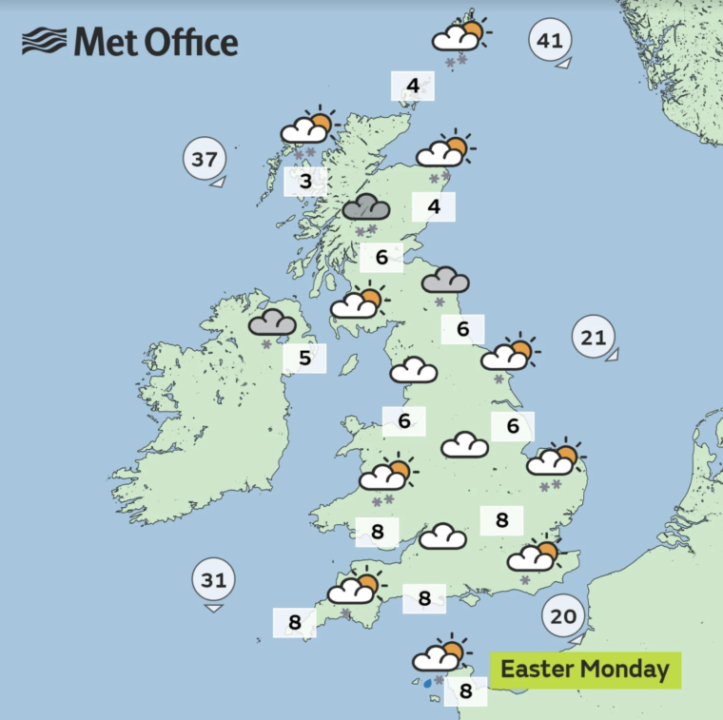
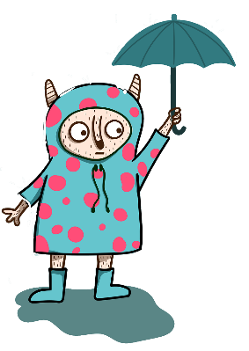
Weather Forecast
What can you tell me about the weather by reading this forecast?

Slide 9
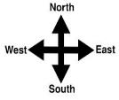
Weather Recording Chart
We are going to make our own weather chart to record the weather!
 | Wind direction | Wind strength | Clouds | Rainfall (cm) | Sunshine | Temperature
Monday (Day 1) | north | light breeze 2 |  | none | very sunny | hot
Tuesday (Day 2) | east | moderate breeze 4 |  | 3 cm | not sunny | cold
Wednesday (Day 3) | north | no wind 0 |  | none | sunny | warm
Thursday (Day 4) | south | light breeze 2 |  | 5 cm | not sunny | cold
Friday (Day 5) | south | light breeze 2 |  | 2 cm | not sunny | cold

