Slide 1
Systems of Measurement – Metric – Bingo Method
Students should choose nine answers from the grid and place them
randomly into a 3x3 square in their book.
You may want to pause your display and choose questions
according to difficulty during the game.
Depending on time, students could win with
a line, an X, or a ‘full house’ (all).

Slide 2
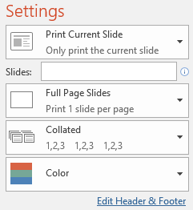
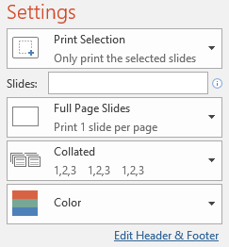
Printing
To print handouts from slides -
Select the slide from the left. Then click:
File > Print > ‘Print Current Slide’
To print multiple slides -
Click on a section title to highlight all those slides,
or press ‘Ctrl’ at the same time as selecting slides to
highlight more than one. Then click:
File > Print > ‘Print Selection’
To print double-sided handouts -
Highlight both slides before using ‘Print Selection’.
Choose ‘Print on Both Sides’ and ‘Flip on Short Edge’.

Slide 3
BINGO!
45 | 54 | 23
82 | 37 | 12
76 | 25 | 91
Systems of
Measurement

Slide 4
Choose your numbers…
1200 | 0.57 | 540 | 5.2
5.46 | 1250 | 18 | 230
2.5 | 2.4 | 3400 | 0.56
140 | 3200 | 0.35 | 68
Draw a 3x3 grid in your book.

Slide 5
1250
1.25 km = ______m
1 km = 1000m

Slide 6
0.56
56 cm = ______m
1 m = 100cm

Slide 7
3200
3.2 kg = ______g
1 kg = 1000g

Slide 8
5.2
52 mm = ______cm
1 cm = 10mm

Slide 9
1200
1.2 t = ______kg
1 t = 1000 kg

Slide 10
0.35
350 ml = ______l
1 l = 1000 ml

Slide 11
540
54 cl = ______ml
1 cl = 10 ml

Slide 12
2.5
250 cl = ______l
1 l = 100 cl

Slide 13
0.57
570 m = ______km
1 km = 1000m

Slide 14
230
2.3 m = ______cm
1 m = 100cm

Slide 15
5.46
5460 g = ______kg
1 kg = 1000g

Slide 16
18
1.8 cm = ______mm
1 cm = 10mm

Slide 17
2.4
2400 kg = ______t
1 t = 1000 kg

Slide 18
3400
3.4 l = ______ml
1 l = 1000 ml

Slide 19
68
680 ml = ______cl
1 cl = 10 ml

Slide 20
140
1.4 l = ______cl
1 l = 100 cl

Slide 22
Questions?
Comments?
Suggestions?
…or have you found a mistake!?
Any feedback would be appreciated ☺.
Please feel free to email:
tom@goteachmaths.co.uk

