Slide 1
Unit 3 Be a Data Expert

Slide 2
Lesson Objective
By the end of the lesson, learners will be able
to :
Analyse and identify the problems that can
be solved using data after collaborative
discussions and individual book questions
followed by formal format .

Slide 3
Key Vocabulary
decision: a choice about something

Slide 4
Big Question!
Based on collected data about toys, what is identified as the most popular toy of all time?

Slide 5
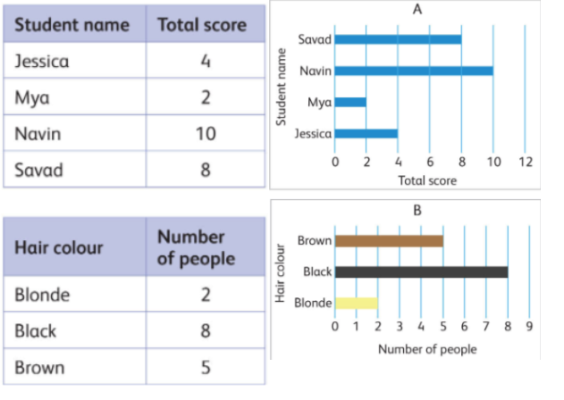
Collaborative Work (7 mins):
The teacher will organize the class into groups of four, display a shared picture on the board, and assign each group a specific printed question.

Slide 6
Collaborative Work:
Group 1: Identify which chart represents categorical data.
Group 2: Determine whether A and B are bar charts or pie charts.
Group 3: List other types of graphs or charts you know.
Group 4: Would you prefer to view this data as a table or a chart? Explain why.
The teacher will give the feedback to the students.

Slide 7
Main Activities
Corners Activity Strategy (10 mins):
The teacher will set up three corners in the classroom, labelling them as Home Problem, School Corner, and Business Corner. The class will be divided into three groups, each assigned to one of the corners. The learners will collaborate to discuss and work together to solve the provided problem on an A4 paper or sticky notes.
Teacher will provide the feedback.

Slide 8
Class Discussion Teacher Talk time (10 mins):
Teacher will discuss with learner that to
solve more problems, we need to make
sense of data. To do that we need to:
Collect data
Carefully look at the data
Find meaning in the data.
4. Decisions can be made when we
understand the meaning of data. Data can be used to
solve problems at home, school and in businesses.

Slide 9
Differentiation (7 mins):
Page 47 question 1
Page 47 question 2b
Page 47 question 2a

Slide 10
Homework
Homework - Page 47 question 2c.

Slide 11
Formal Formative test 2 (20 mins):

Slide 12
Exit Ticket (5 mins):
The learners will do page 47 question 2c.

Slide 13
Success Criteria (1 min):
I can identify and understand the problem.
I can collect data.
I can carefully look at the data.
I can find the meaning in the data.

