Slide 1
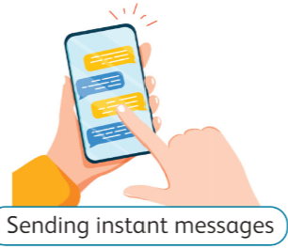
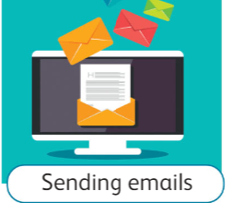
TASK 1
creating a poster using Microsoft Word to showcase different devices used for sharing information.
sharing information.
Smartphone can share it by:
Desktop can share it by:

Slide 2
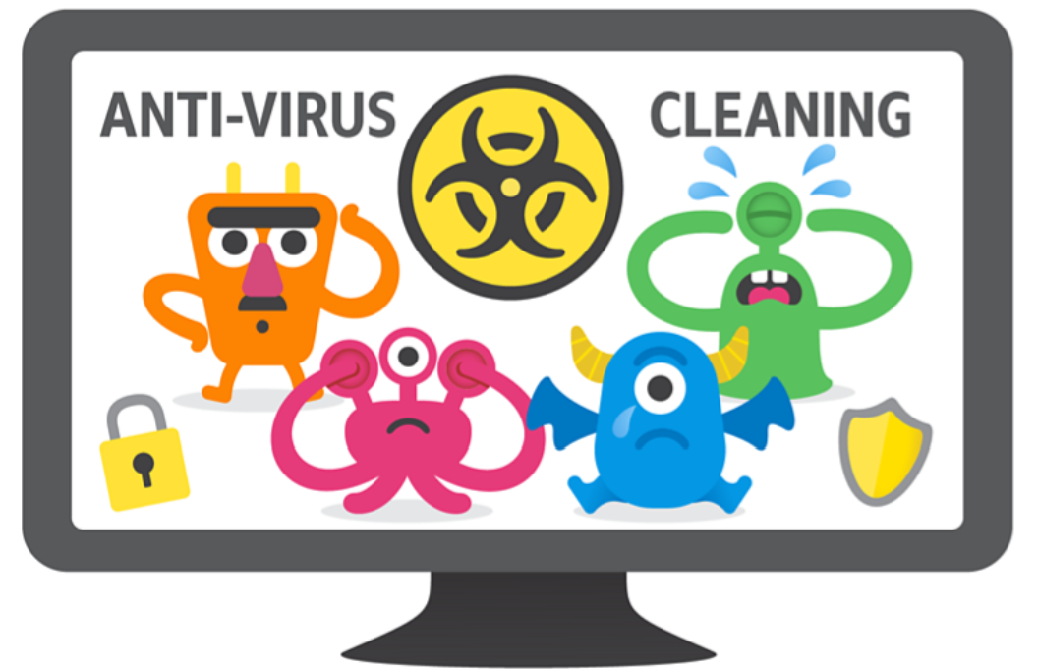
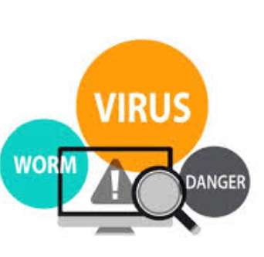
TASK 1
design posters that illustrate the dangers of malware and provide tips for protecting computers.
Malware
Malware is a bad program
To protect your computer from Malware :
1. Use anti-virus
2. Don’t open any link while you are online.

