Slide 1

Unit 9: connected and sharing
YR 2 CS T2 Wk 30 D2

Slide 2
Learning objective
By the end of this lesson, students will be able to analyze the risks of malware and identify different devices used for sharing information by doing the project.

Slide 3

Key Vocabulary

Slide 4
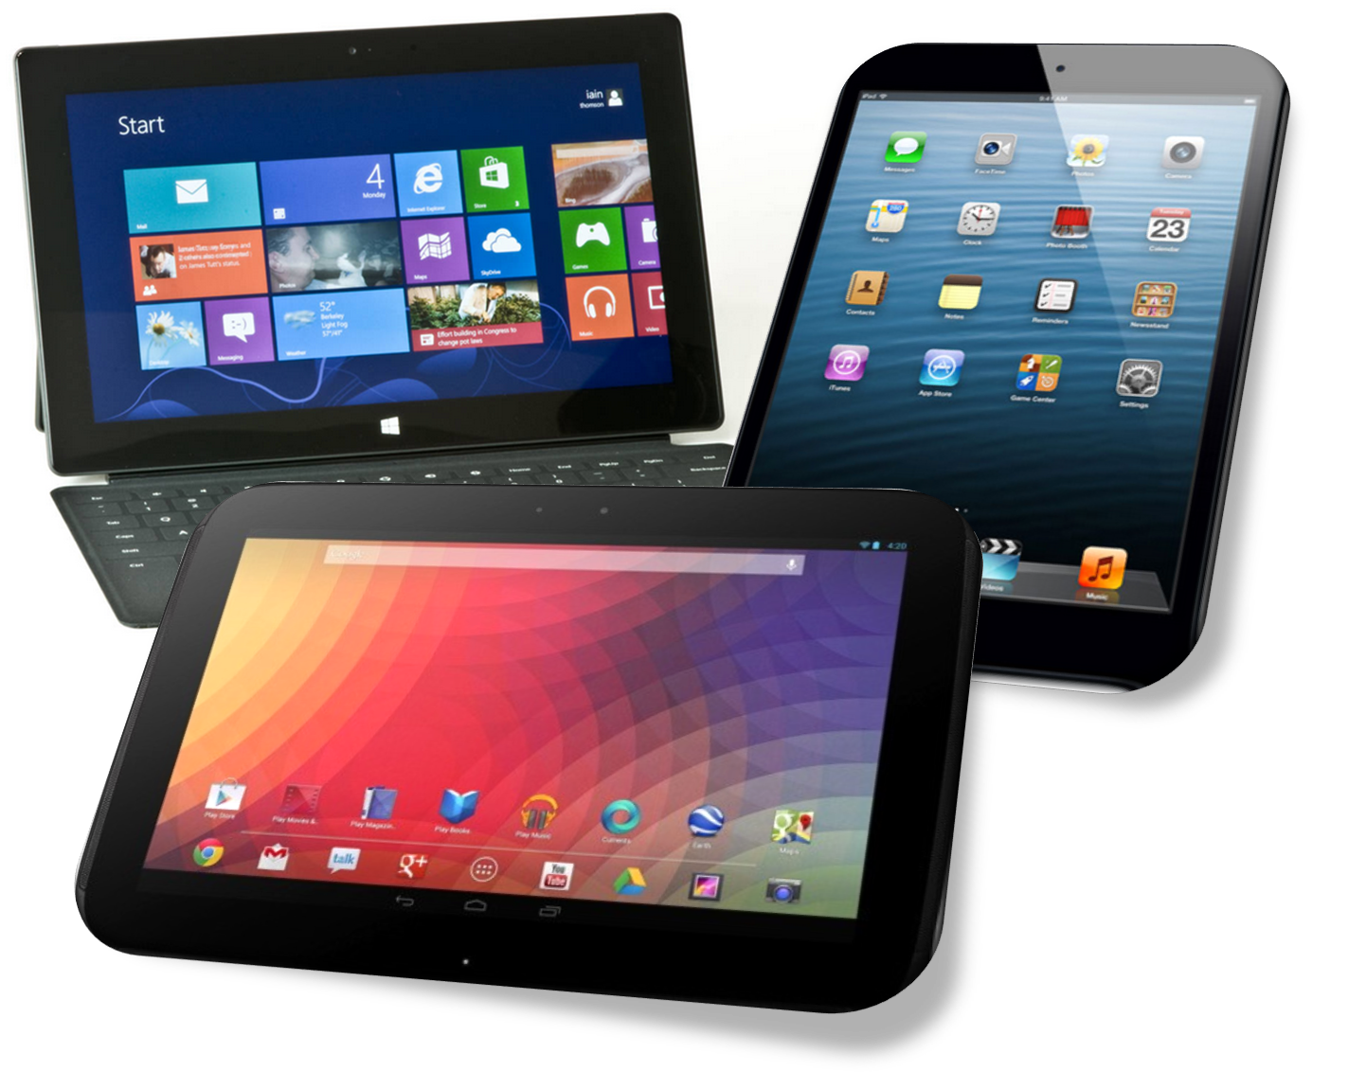
Hook Activity

Slide 5


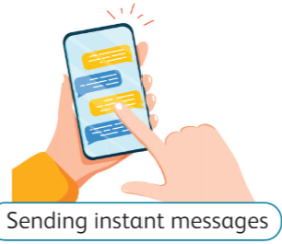
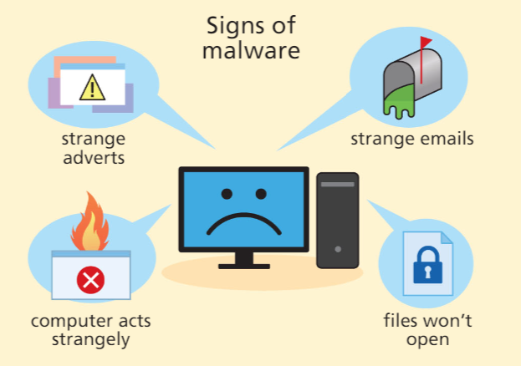
Main Activity
creating a poster using Microsoft Word to showcase different devices used for sharing information.
design posters that illustrate the dangers of malware and provide tips for protecting computers.

Slide 6
presentation.

