Slide 1
Revision Day 1
Objectives
To know addition facts for 10 and 20. use these facts to add three numbers.
Add/Subtract numbers bridging 10.
Add subtract using facts/ patterns.
Notes:
Before teaching, be aware that:
On Day 1 children will need 100-bead strings. You may prefer to use a real 100-bead bar.

Slide 2
Starters
Notes:
Choose starters that suit your class by dragging and dropping the relevant slide or slides below to the start of the teaching for each day.

Slide 3
Station 1: To know addition and subtraction facts for 10 and 20; To use these facts in adding three numbers.
17 + 5 + 3
17 3
Hint!
How could we find the answer?
17 + 3 = 20
20 + 5 = 25
When adding three numbers, if we can spot a bond to 10 or 20, it helps to find the total!

Slide 4
Station 1
Use 0-20 cards provided by the teacher.
Take one card, BUT your two cards together must total either 10 or 20.
Then take a third card and discuss what the total of all three cards is.
Record the addition on whiteboards.
Replace the cards face up.
epeat this at least seven times, so that you have 8 additions recorded.

Slide 5
Station 2: Add and subtract single digit numbers, not crossing 10s, using number facts & patterns.
85 + 3
75 + 3
95 + 3
5 + 3
45 + 3
65 + 3
15 + 3
35 + 3
55 + 3
25 + 3
15 and 3 is? Look at the 5 and 3!
45 and 3 more?
35 and 3 more?
55 and 3 more?
What is 25 and 3 more? Look at the 5 and 3!
65 and 3 more?
What is 5 and 3? We all know this!
As we know 5 + 3, we don’t need to count on.
85 and 3 more?
75 and 3 more?
95 and 3 more?
5 + 3 = 8
55 + 3 = 58
35 + 3 = 38
85 + 3 = 88
15 + 3 = 18
65 + 3 = 68
45 + 3 = 48
95 + 3 = 98
25 + 3 = 28
75 + 3 = 78

Slide 6
Station 2
Using facts and patterns to make your own addition and subtraction questions. For e.g.,
8 +2 = 10, 18 + 2 = 20, 28 + 2 = 30…
6 – 2 = 4. 16 – 2 = 14, 26 – 2 = 24…
Using the provided addition and subtraction cards, create your own addition and subtraction pattern.

Slide 7
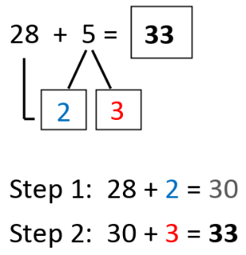
Station 3: Add a 1-digit number to a 2-digit number, bridging 10.
We are going to add 5 beads.
What do you notice?
What is the next multiple of 10 after 28?
Did you see the 2 beads being added to make 30? How many were added then?
We are going to add 5 beads.
What happened this time?
38 + 2 + 3 = 43
Notes:
Point out that 2 of the 5 beads completed a whole 10 and there are 3 more.
Explain that we call this strategy ‘Target the 10s’ or ‘T10’ for short, as we’re trying to land on a multiple of 10 to help us add the single-digit number. Show the steps in the addition.

Slide 8
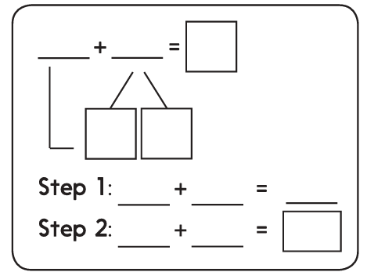
Station 3
Using template for bridging or t10 strategy, solve addition and subtraction problems using question cards.

Slide 9
Revision Worksheet 1

Slide 10
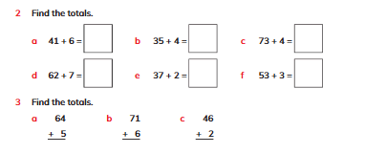
Learners’ Book pages
82, 83, 84, 85, 86, 87

Slide 11
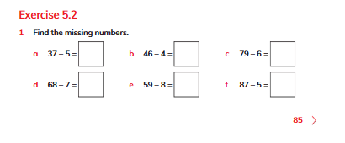

Slide 12
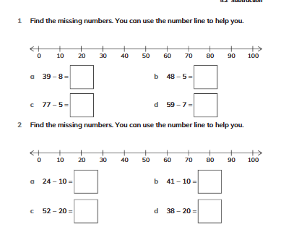
WorkBook pages
87,

Slide 13
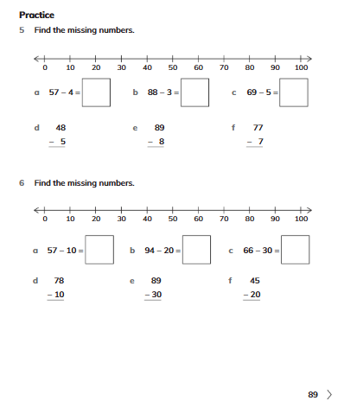

Slide 14
