Slide 1


Year 2 Starters
Autumn Term
Test G
Play through the slides, giving children as much time as you think they need to answer each question. Most questions have a written answer; sometimes children may show a number of fingers.
Answers are given at the end of the test.
This is not a class competition! Can children beat their own personal best each week?
Which ride do they get to enjoy at the end?

Slide 2
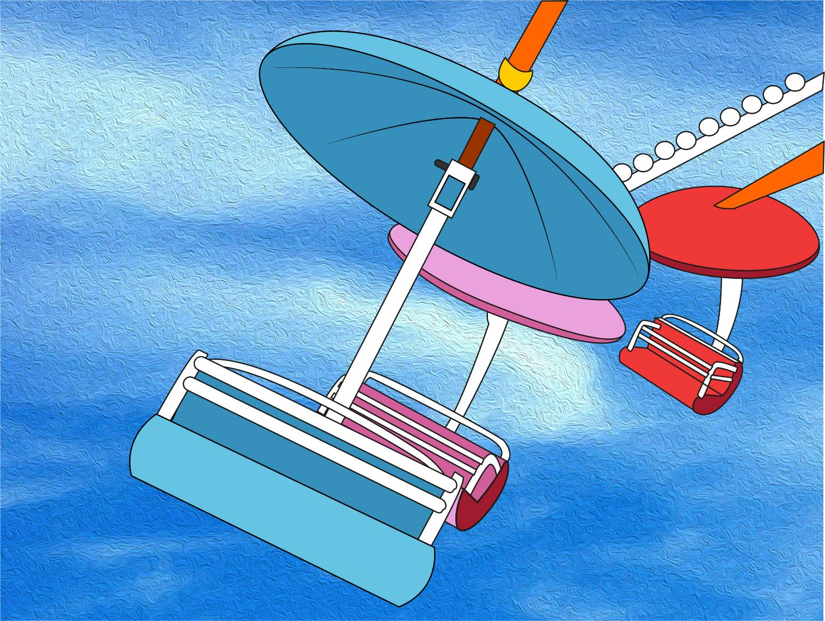
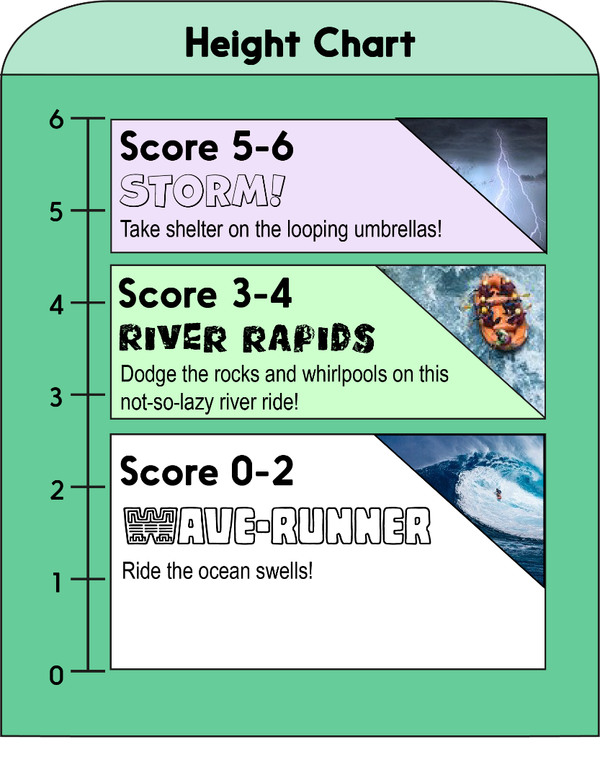


Score a mark on the chart for each correct answer on the test.
Which ride will you measure up for?!

Slide 3
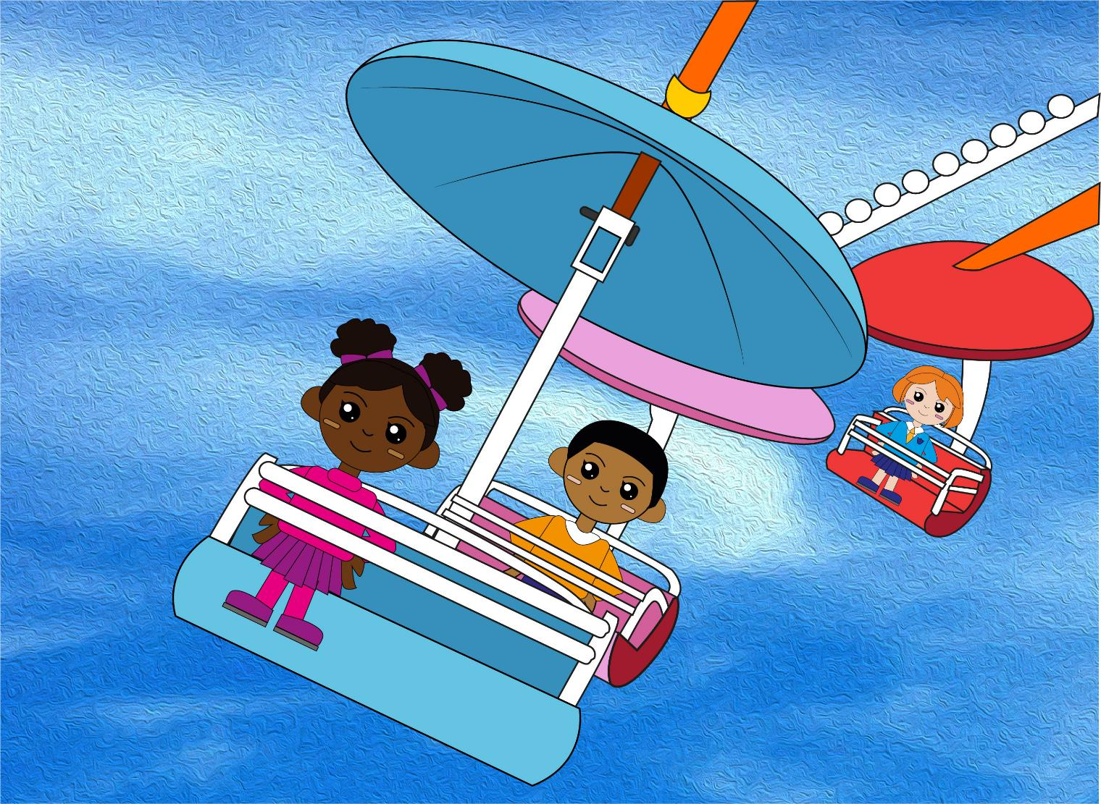

Question 1
What is the difference between 12 and 20?
Write your answer.

Slide 4
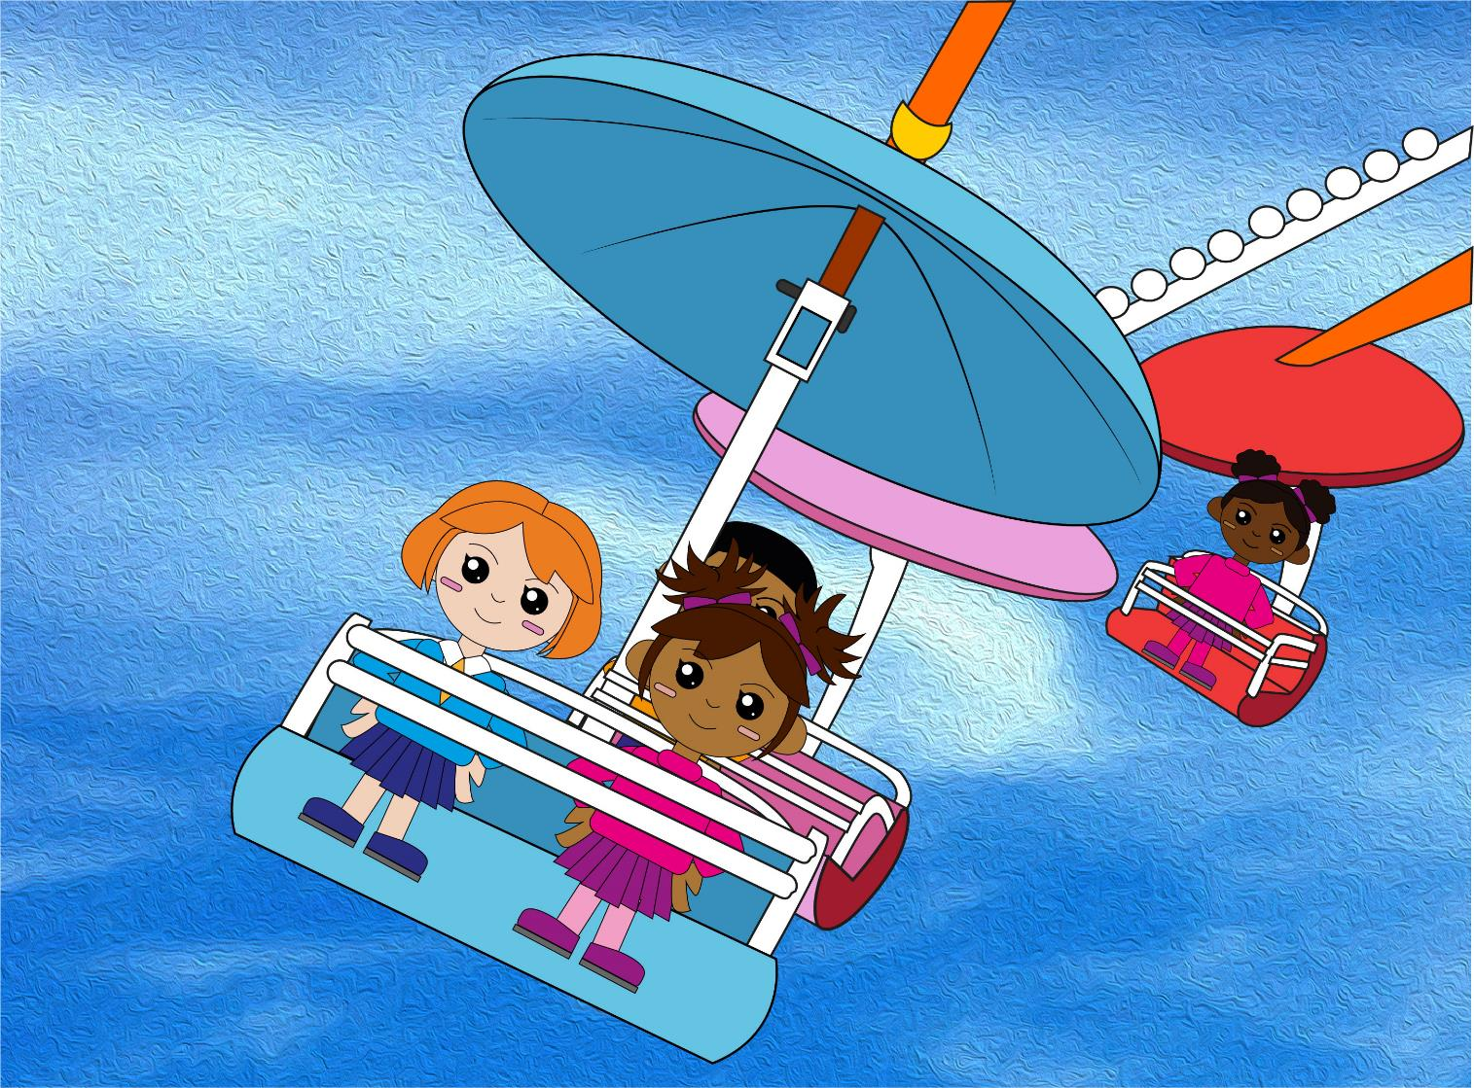
Question 2
What is the difference between 9 and 15?
text
Write your answer.

Slide 5
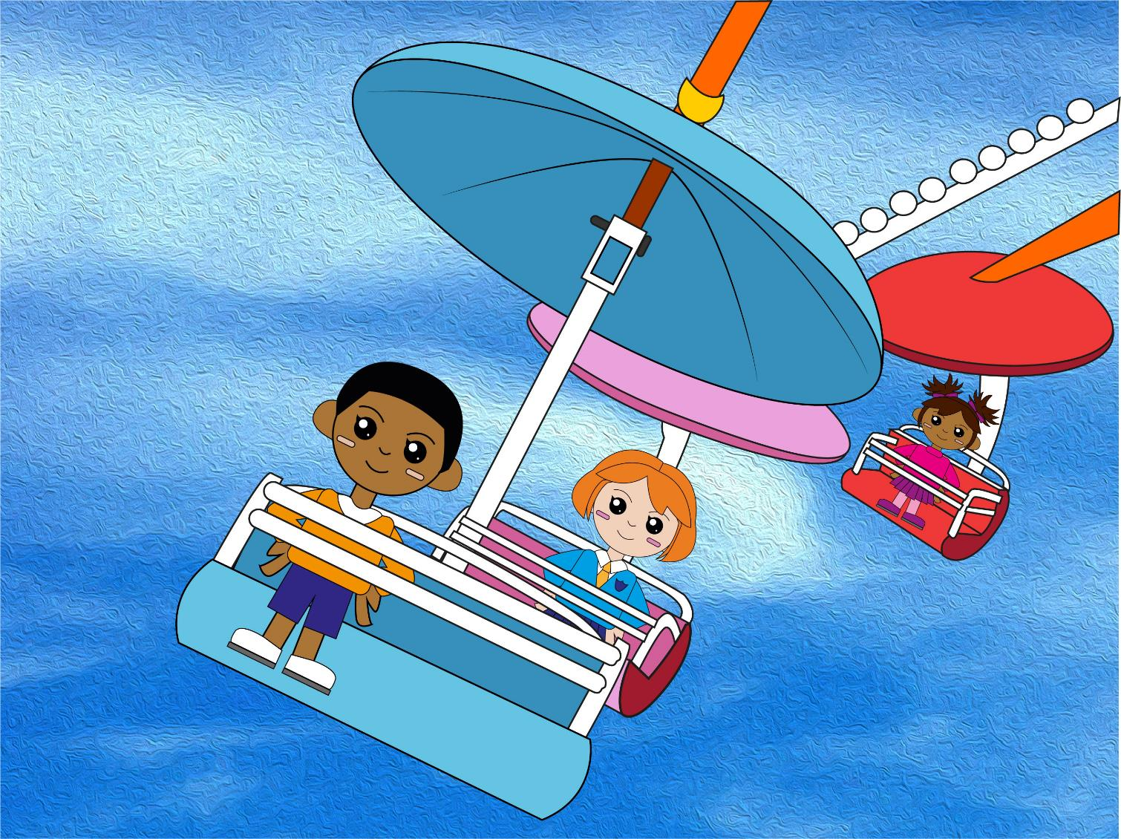
Question 3
Double 12 is?
Write your answer.

Slide 6
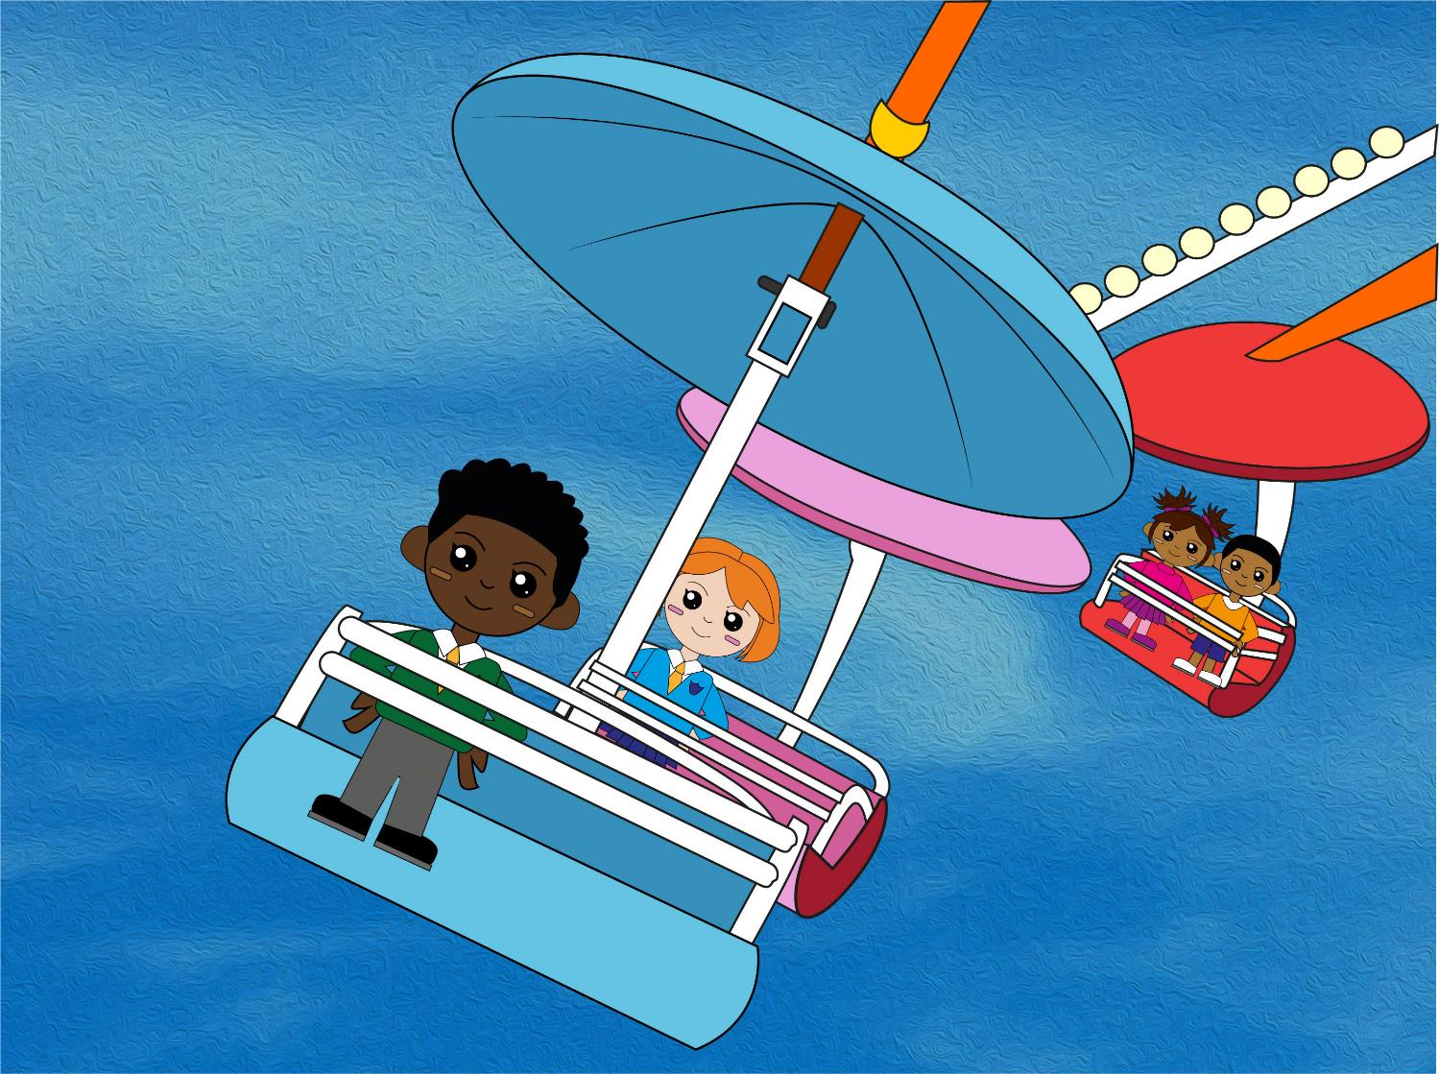
Question 4
Half of 18 is?
text
Write your answer.

Slide 7
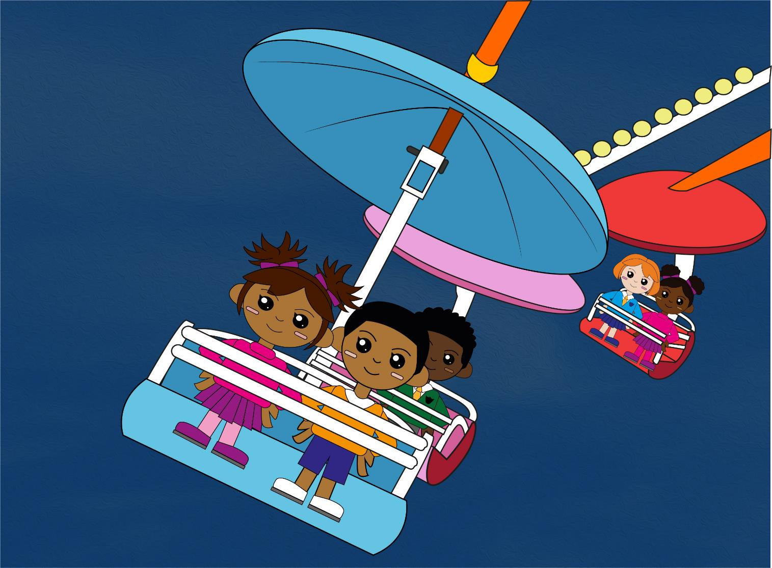
Question 5
4 x 3 = ?
Write your answer.

Slide 8
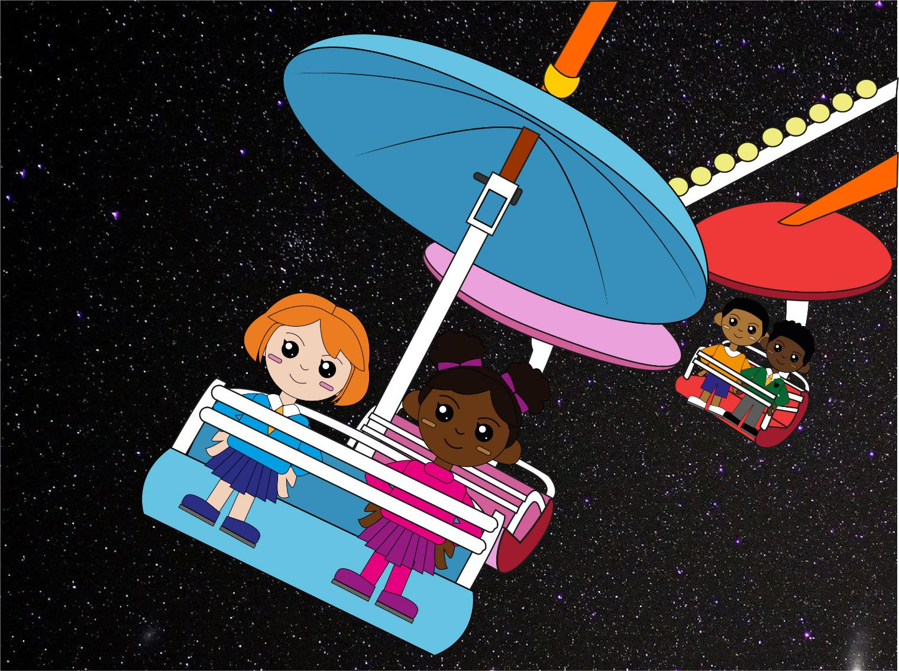
Question 6
6 x 3 = ?
Write your answer.

Slide 9

Q1
20 – 12 = 8
Q3
Double 12 is 24
Q2
15 – 9 = 6
Q4
Half of 18 is 9
Q5
4 x 3 = 12
Q6
6 x 3= 18
The answers!

Slide 10
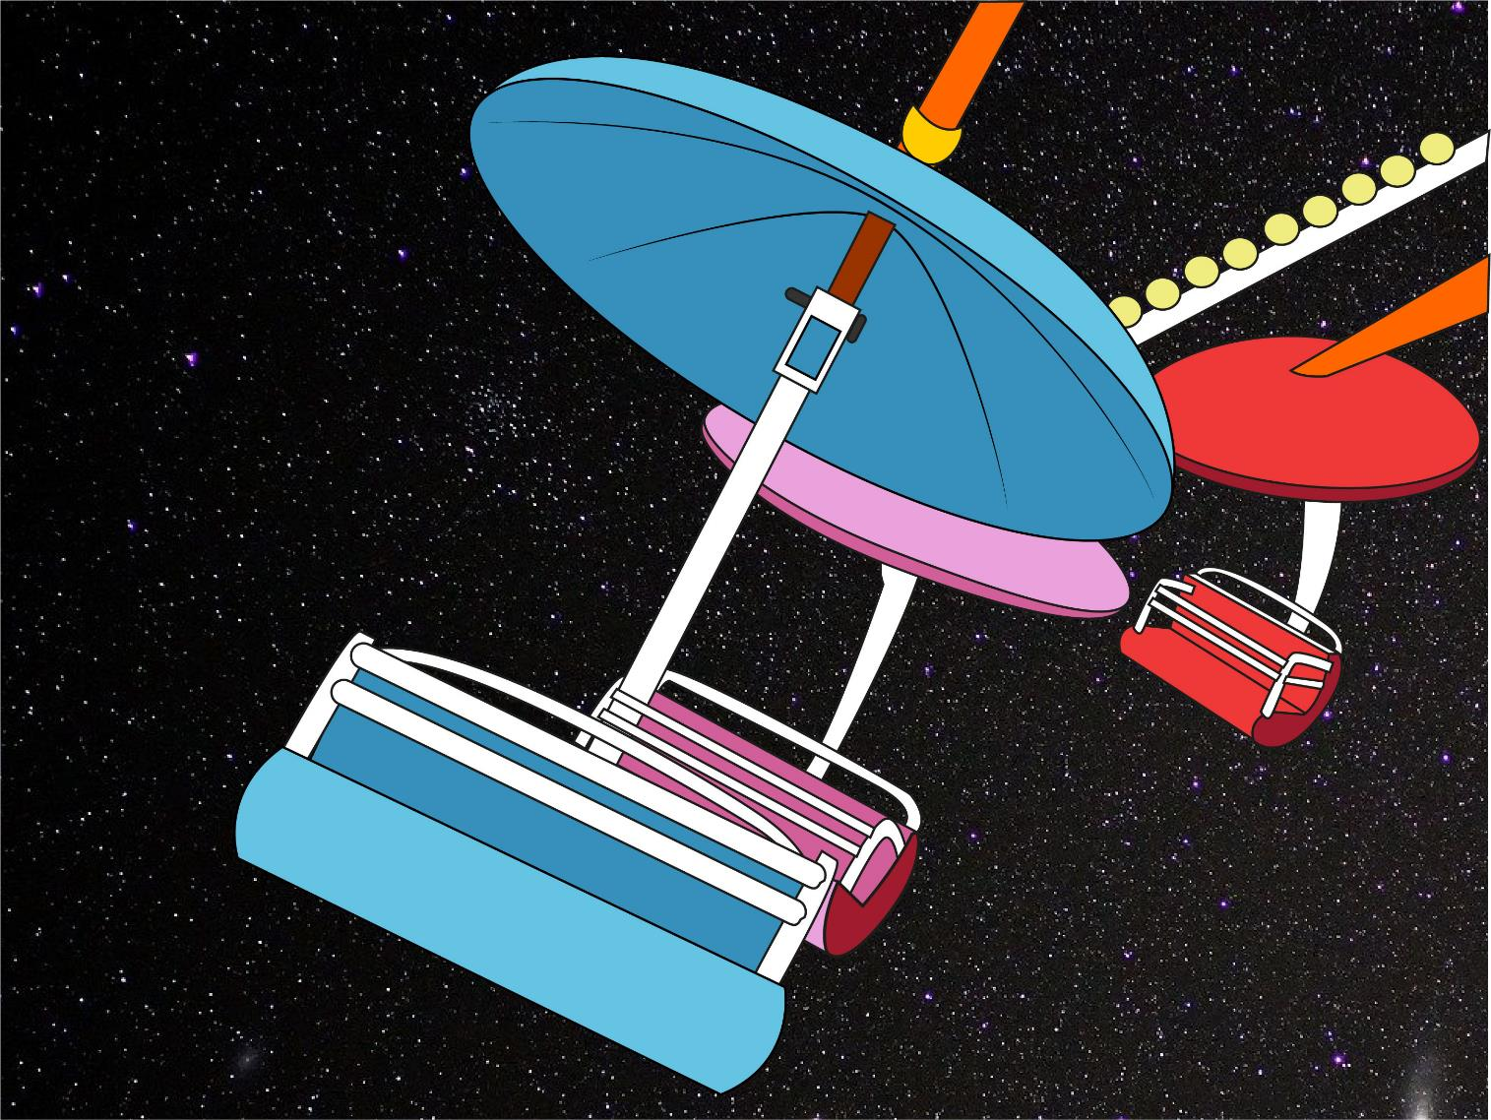
So, which ride do YOU measure up for?!
Did you beat YOUR personal best?

