Slide 1
PROJECT 2023-2024
TERM II CLASS 8

Slide 2
TOPIC
CREATE A WEBSITE SHOWING HOW THE QATAR AIMS TO ACHIEVE ANY ONE OF THE FOUR PILLARS OF QATAR VISION 2030

Slide 3
CREATE A WEBSITE USING THE BASIC FEATURES OF HTML .

Slide 4
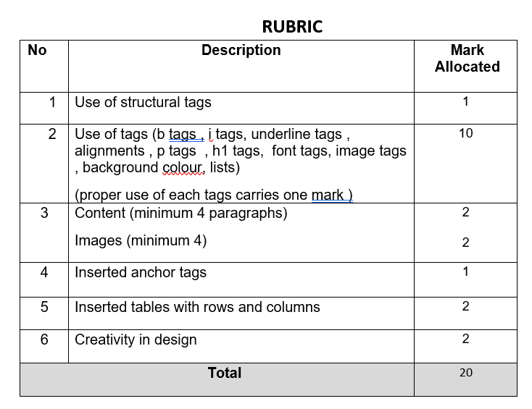

Slide 5
Reference websites for the topic:
https://www.gco.gov.qa/en/about-qatar/national-vision2030/
https://en.wikipedia.org/wiki/Qatar_National_Vision_2030
SUBMISSION DATE : April 05,2024

