Slide 1
More Addition and Subtraction
Add/subtract single digit numbers using facts and patterns
Objectives
Day 1
Add a 1-digit number to a 2-digit number, bridging 10.
Day 2
Add a 1-digit number to a 2-digit number, bridging 10.
Day 3
Subtract a 1-digit number from a 2-digit number, bridging 10.
Notes:
Before teaching, be aware that:
On Days 1 and 3 ideally you will need a real 100-bead bar. Alternatively use the slides.

Slide 2
More Addition and Subtraction
Add/subtract single digit numbers using facts and patterns
Objectives
Day 2
Add a 1-digit number to a 2-digit number, bridging 10.

Slide 3
Day 2:Add a 1-digit number to a 2-digit number, bridging 10.
These are special numbers – they match the ends of groups of 10 beads on the bead string.
+3
+3
37 + 6 =
43
What will happen when we add 6?
We will cross a red number.

Slide 4
Day 2:Add a 1-digit number to a 2-digit number, bridging 10.
45 + 8 =
53
+5
What will happen when we add 8?
+3
We will cross a red number.

Slide 5
Day 2:Add a 1-digit number to a 2-digit number, bridging 10.
22 + 5
27 + 5
38 + 4
33 + 4
76 + 5
43 + 5
35 + 7
23 + 6
Which will cross into next group of 10 beads, that is, go to the next line of the 1-100 grid? How do you know?
Don’t cross a 10s number
Cross a 10s number
22 + 5
33 + 4
27 + 5
38 + 4
43 + 5
23 + 6
76 + 5
35 + 7
Notes:
Test children’s ideas on the 1-100 grid.
Today would be a great day to use a problem-solving investigation – Pyramids – as the group activity, which you can find in this unit’s IN-DEPTH INVESTIGATION box on Hamilton’s website.
Alternatively, children can now go on to do differentiated GROUP ACTIVITIES. You can find Hamilton’s group activities in this unit’s TEACHING AND GROUP ACTIVITIES download.
WT/ARE/GD: Children sort and solve additions by bridging 10, using 1-100 number grids, beaded or landmarked lines.

Slide 6
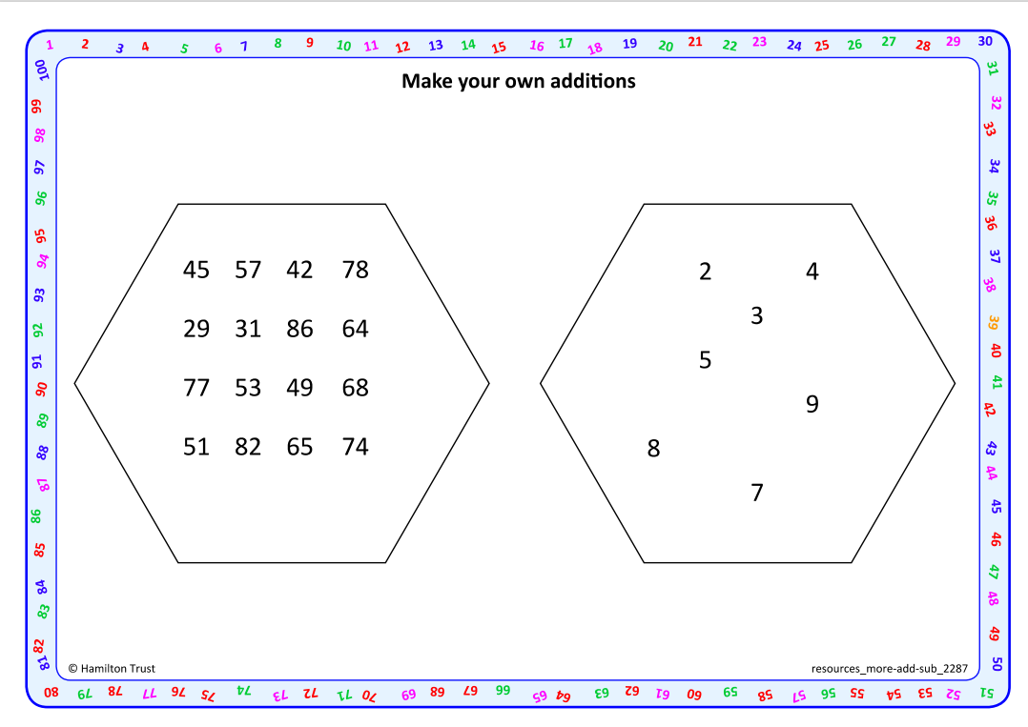
Task 1 – Pair/Group Work
Choose to use a beaded line or 1-100 grid with red multiples of 10 to help.
Work in pairs to choose a number from each set, recording them in an addition number sentence on ‘make your own addition activity sheet’
Now draw either Y for yes or N for no beside it. Write Y if you think that you WILL have to cross a ‘red’ number (multiple of 10). Write N if you think you will NOT have to cross a ‘red’ number.
Now add the 2 numbers, using the ‘T10’ recording strategy to keep track of how the 1-digit number is partitioned. Compare answers.
Choose another pair of numbers and repeat the process.

Slide 7
Task 2 – Independent Work
Challenge
Notes:
The Practice Sheet on this slide is suitable for most children.
Differentiated PRACTICE WORKSHEETS are available on Hamilton’s website in this unit’s PROCEDURAL FLUENCY box.
WT: Be a teacher! Sheet 1 – check two groups of additions.
ARE/GD: Be a teacher! Sheet 2 – check three groups of additions.

Slide 8
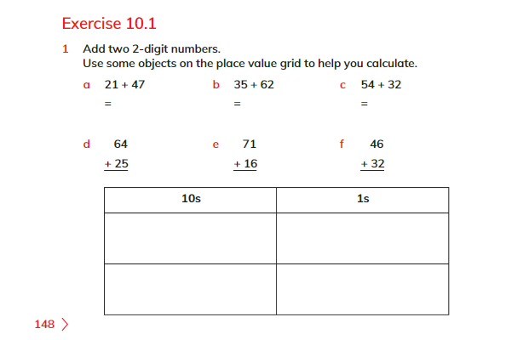
Plenary
Attempt Ex 10.1, Q1 on page 148 and peer check your answers.

Slide 9
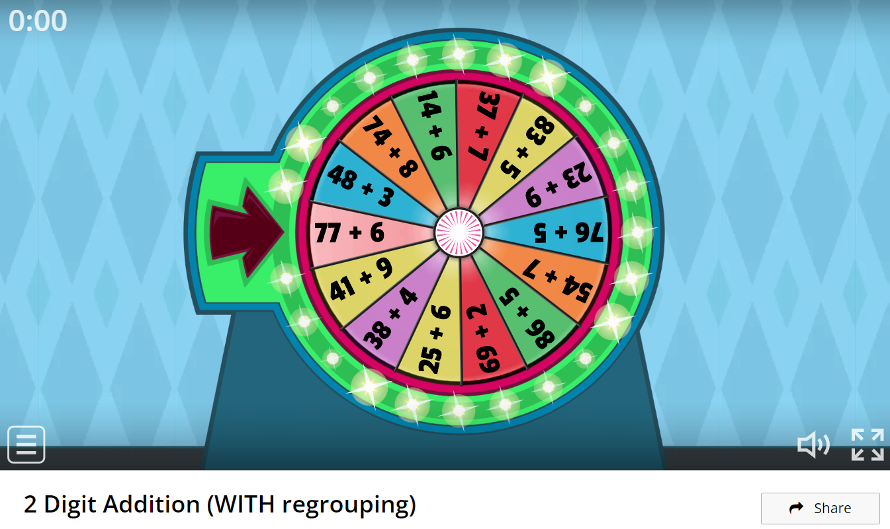
Homework
https://wordwall.net/resource/12026359/2-digit-addition-with-regrouping

