Slide 1
Year 2 Starters
Autumn Term
Test D
Play through the slides, giving children as much time as you think they need to answer each question. Most questions have a written answer; sometimes children may show a number of fingers.
Answers are given at the end of the test.
This is not a class competition! Can children beat their own personal best each week?
Which ride do they get to enjoy at the end?

Slide 2
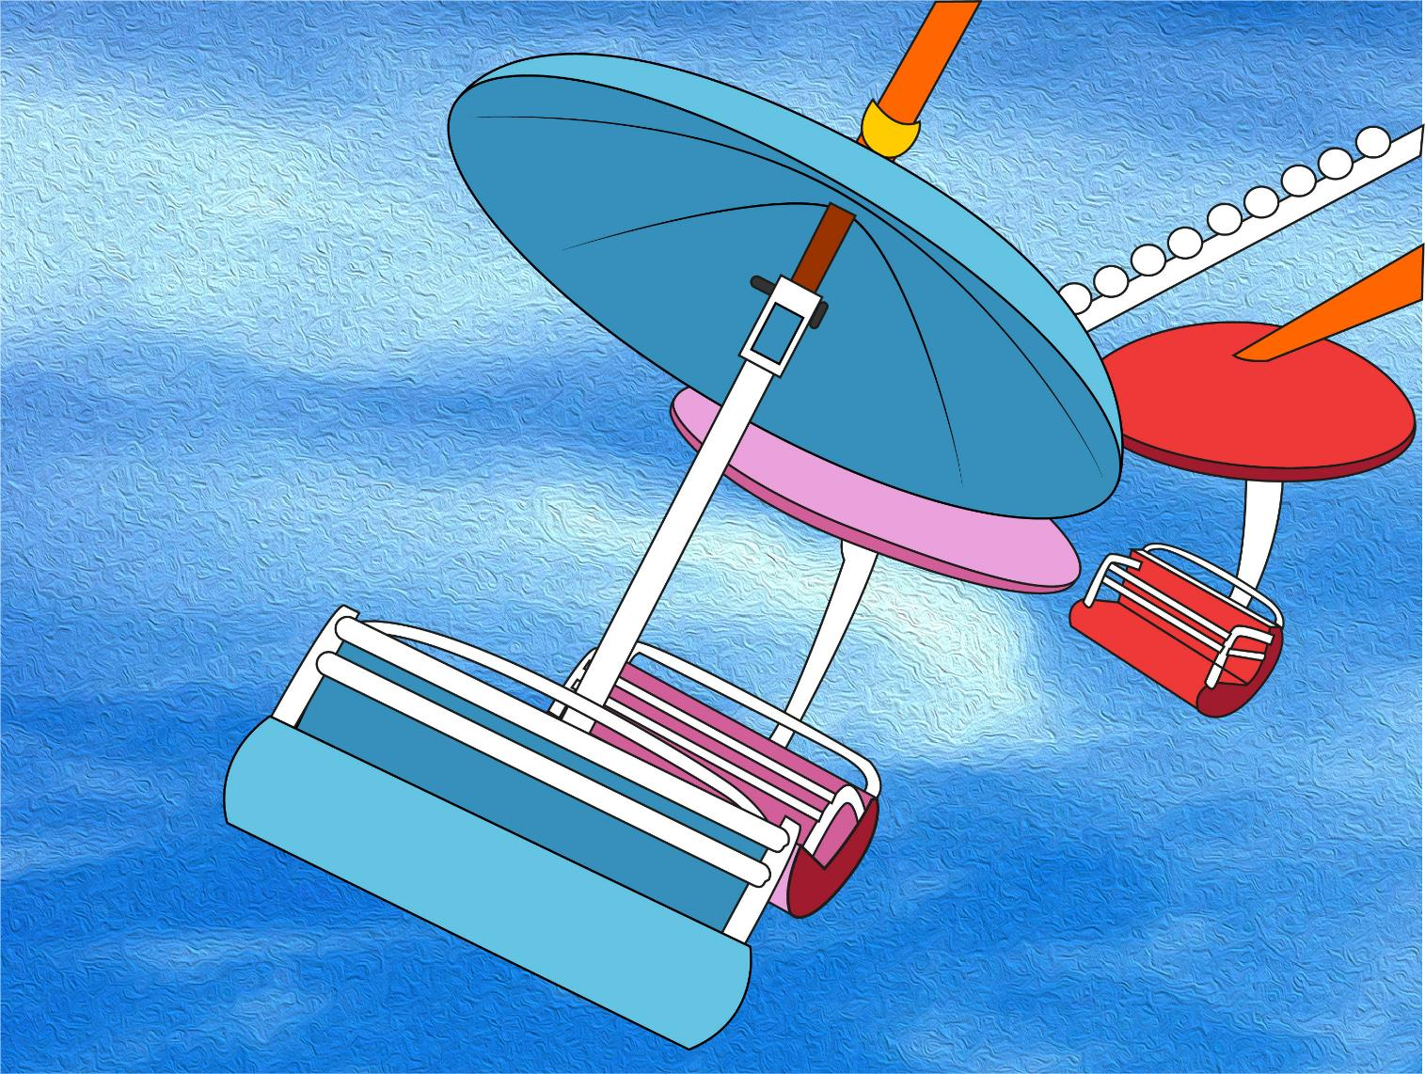
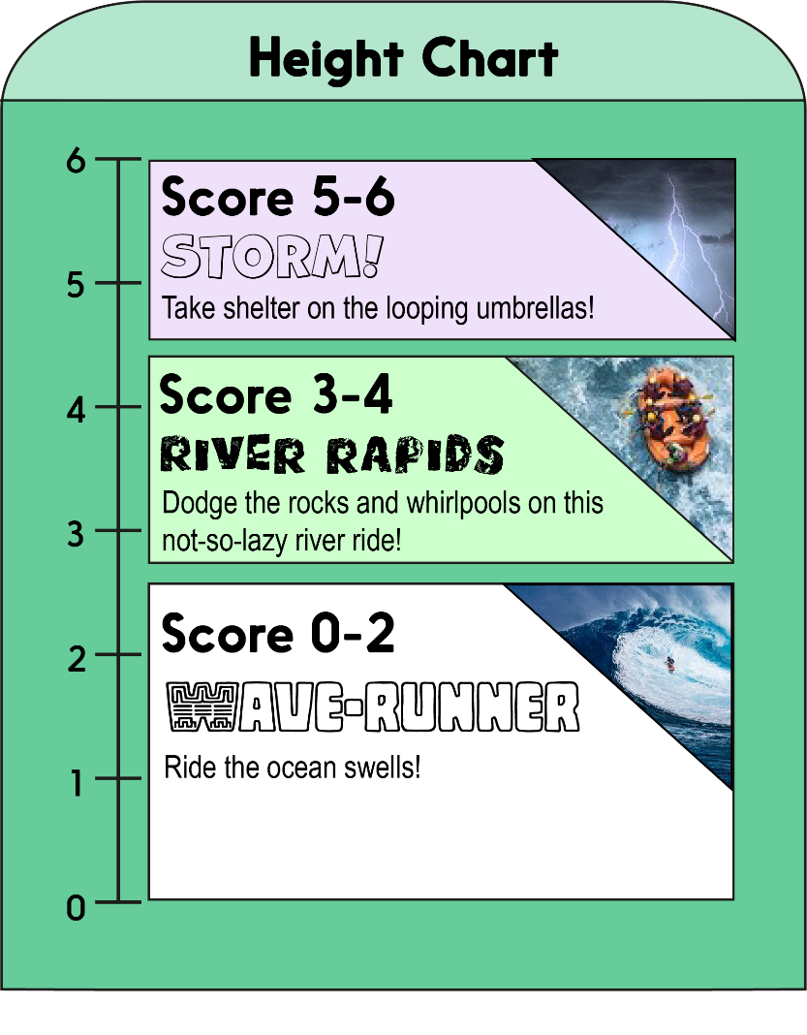
Score a mark on the chart for each correct answer on the test.
Which ride will you measure up for?!

Slide 3
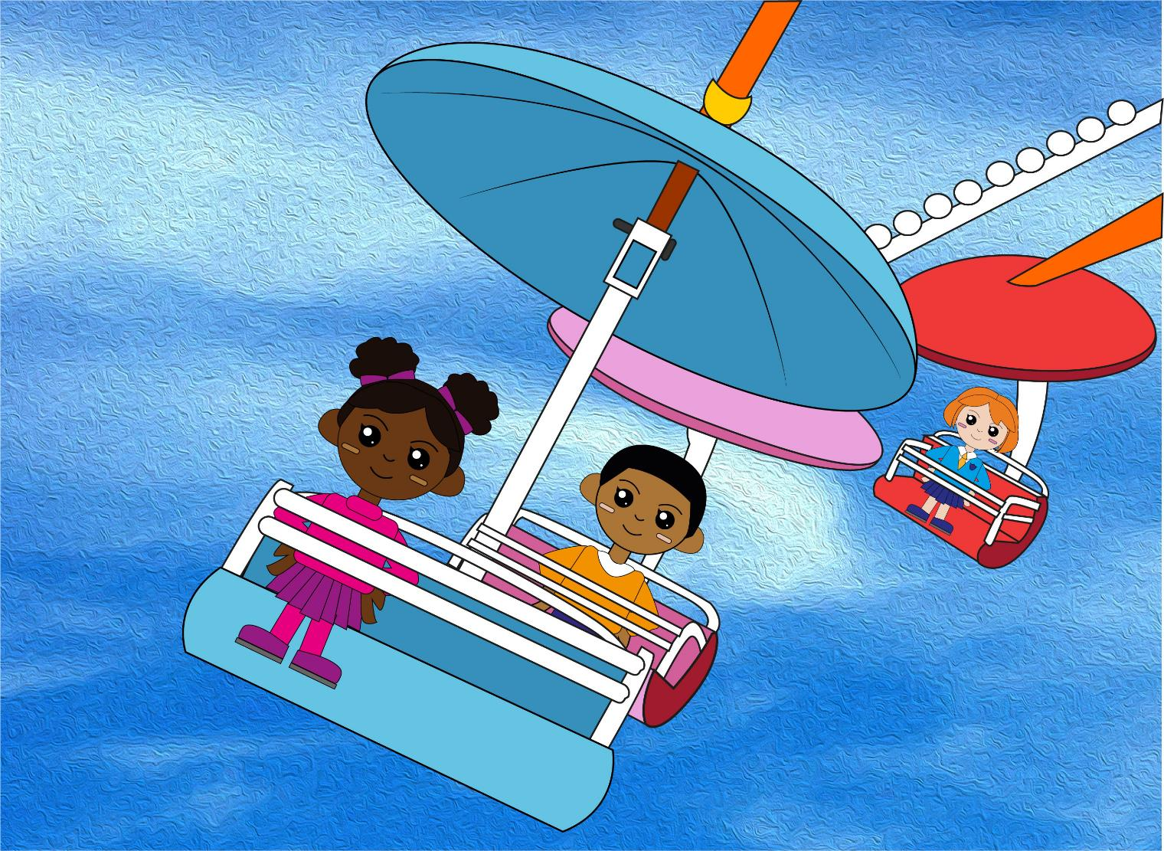
Question 1
20 – 4 = ?
Write the number sentence.

Slide 4
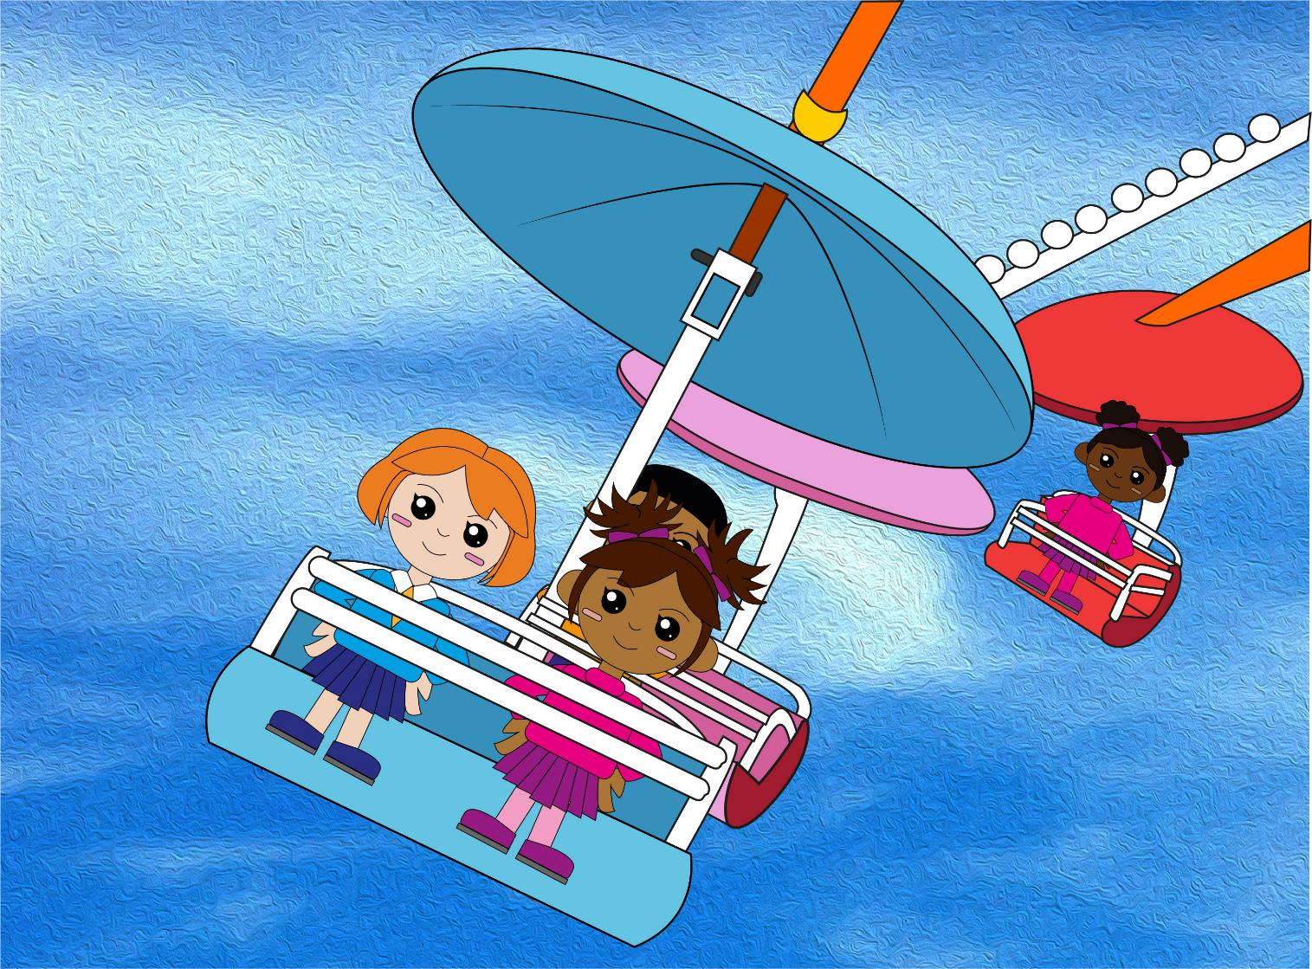
Question 2
18 – 3 = ?
text
Write the number sentence.

Slide 5
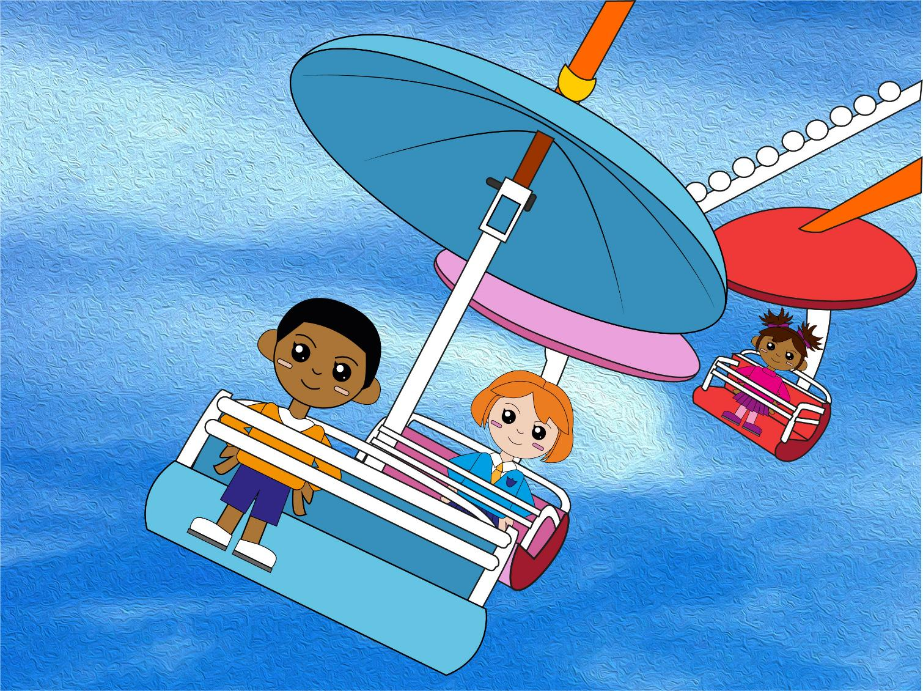
Question 3
19 – 6 = ?
text
Write the number sentence.

Slide 6
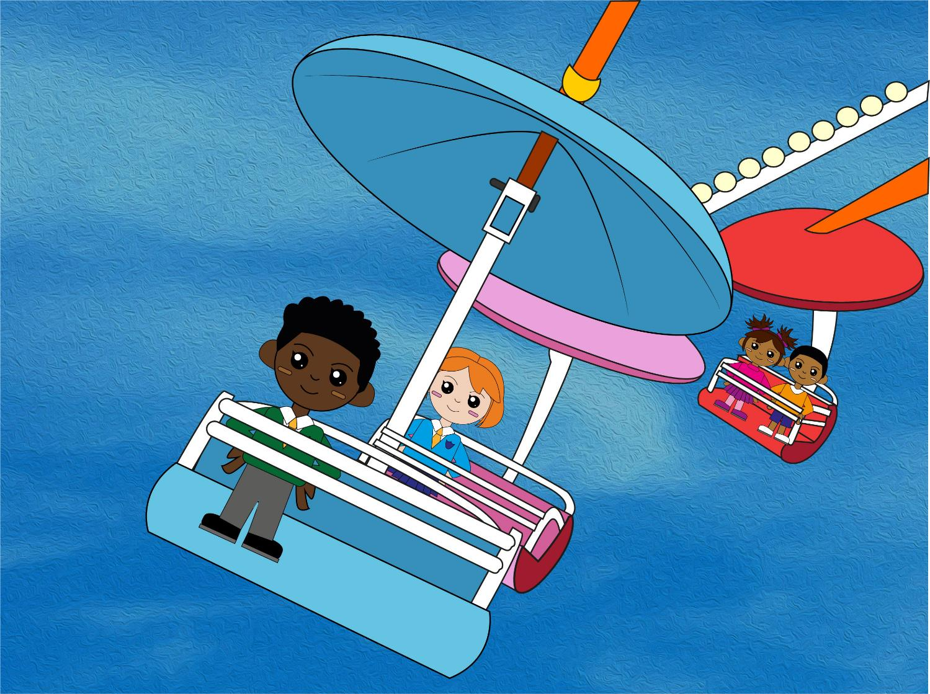
Question 4
8 + 3 = ?
So, 18 + 3 = ?
text
Write your two answers.

Slide 7
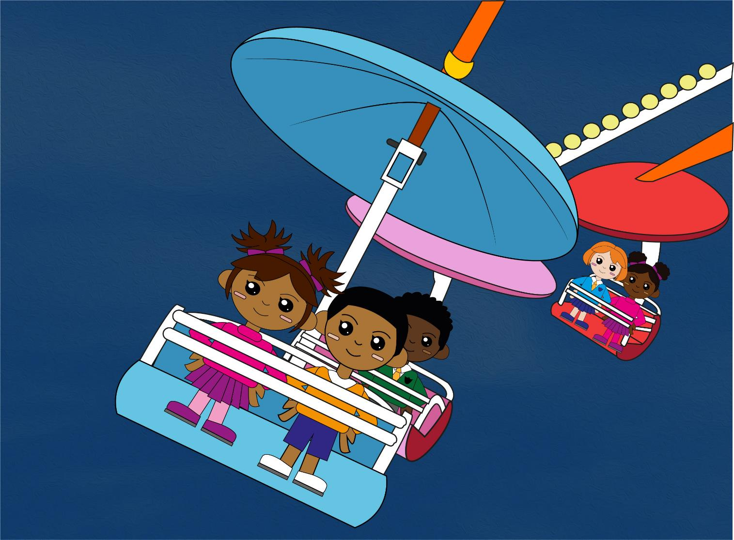
Question 5
7 + 5 = ?
So, 27 + 5 = ?
text
Write your two answers.

Slide 8
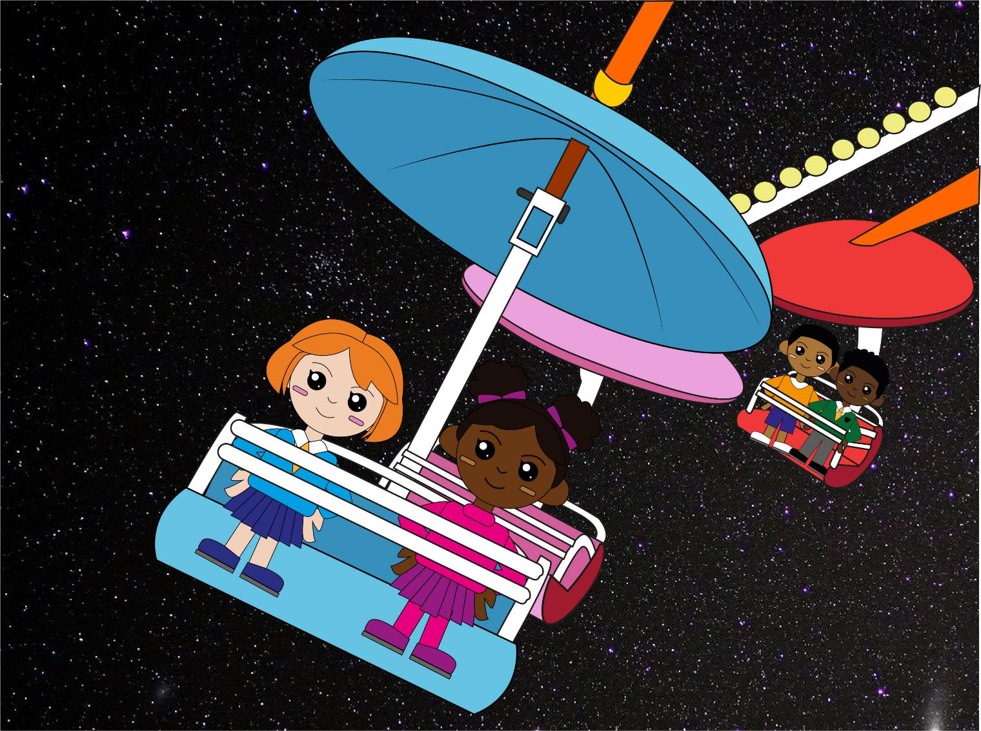
Question 6
9 + 5 = ?
So, 39 + 5 = ?
text
Write your two answers.

Slide 9
Q2
18 – 3 = 15
Q1
20 – 4 = 16
Q3
19 – 6 = 13
Q4
8 + 3 = 11
So, 18 + 3 = 21
Q5
7 + 5= 12
So, 27 + 5= 32
Q6
9 + 5= 14
So, 39 + 5 = 44
The answers!

Slide 10
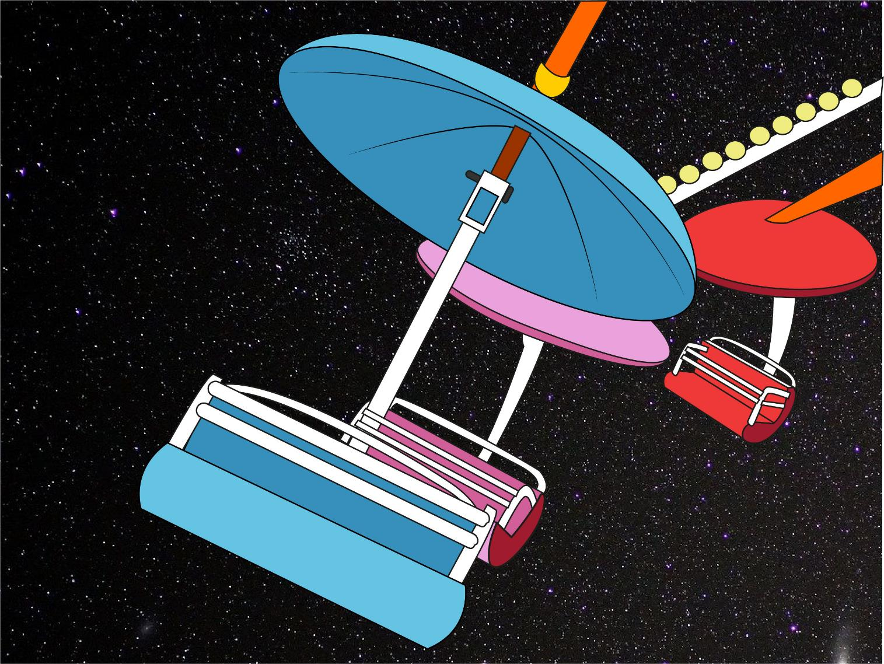
So, which ride do YOU measure up for?!
Did you beat YOUR personal best?

