Slide 1
BIOTECHNOLOGY

Slide 2
Key Terms
Biotechnology- using living organisms to carry out processes that makes substances useful to humans
Bacteria
Yeast
Genetic Modification- changing the genetic material of an organism by removing, changing or inserting individual genes

Slide 3
USING MICROORGANISMS
Bacteria and fungi are very small, and are easy to grow in a laboratory
No one minds what is done to bacteria and fungi
We all share the same kind of genetic material- DNA
They have plasmids for moving genes from one organism’s cells to another

Slide 4
YEAST
http://www.bbc.co.uk/schools/gcsebitesize/science/triple_ocr_gateway/beyond_the_microscope/understanding_microbes/revision/3/

Slide 5
Fermentation
Glucose Ethanol + Carbon Dioxide
Yeast: Saccharomyces cerevisiae

Slide 6
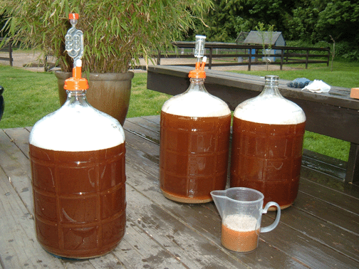
Making Alcoholic Drinks
https://wine.lovetoknow.com/wiki/Wine_Making
http://www.growbetterveggies.com/.a/6a00d8346ffdca53ef014e88da9a39970d-popup

Slide 7
Making Bread
Enzyme breaks down starch to sugar and are respired by the yeast.
http://www.thefreshloaf.com/lessons/myfirstsourdough

Slide 8
Making Biofuel
https://www.dw.com/en/biofuels-good-or-bad-for-the-environment/a-44354834

Slide 9
Making Use of Enzymes
Biological Washing Powder
Pectinase- used to extract fruit juices
Lactase
Lactose Glucose + Galactose

Slide 10
Fermenters
https://www.kinnek.com/product/asia-pacific-packaging-60-bbl-fermenters/

Slide 11
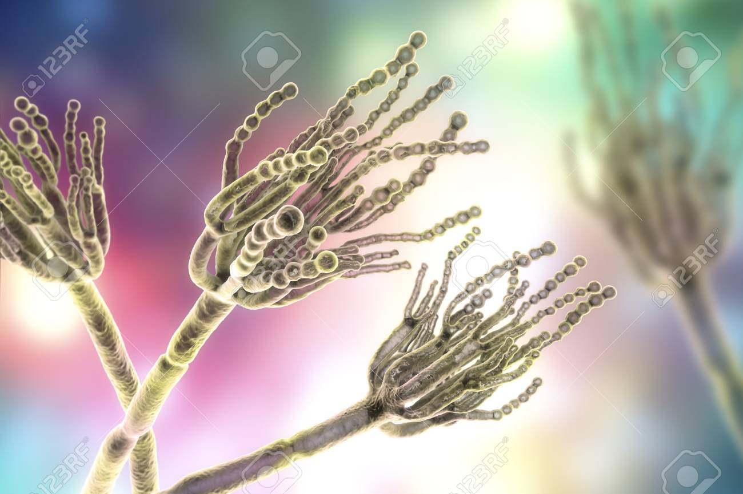
Penicillin
Made by growing the fungus Penicillium in a large fermenter
https://www.123rf.com/photo_89447209_stock-illustration-fungi-penicillium-which-cause-food-spoilage-and-are-used-for-production-of-the-first-antibiotic-peni.html

Slide 12
Fermenters
https://biology-igcse.weebly.com/use-of-microorganisms-to-manufacture-antibiotic-penicillin.html

Slide 13
Fermenters
Parts | Functions
water jacket | maintain temperature
paddlers/ stirrers | Stop solids from settling; gives uniform mixture
nutrient inlet | Supplies glucose/nutrients for growth
sensor/ data logger | Monitors temperature/pH
air supply | Supplies oxygen for respiration
outlet | Allows collection of the liquid containing penicillin after fermentation

Slide 14
Two problems if the fermenter is not sterile
Any bacteria or fungi that manage to get in would compete with the organisms on the culture, reducing the yield of product
The product would become contaminated with waste products or cells of the ‘foreign’ organism

Slide 15
SOURCES
IGCSE Combined Sciences Biology (Oxford Int. AQA Examinations)
Images from Google
Cambridge IGCSE Biology 3rd ed.
Biology for Cambridge IGCSE Coursebook 4th ed.

