Slide 1
Place Value and Fractions
Ordinal numbers, Place value
Properties of 2-digit numbers, Rounding
Objectives
Day 1
Use ordinal numbers in context up to 10th and beyond.
Day 2
Compare numbers using the symbols < and >.
Day 3
Round 2-digit numbers to nearest multiple of 10.
Day 4
Round 2-digit numbers to nearest multiple of 10.
Notes:
Before teaching, be aware that:
On Day 1 you will need a selection of age birthday cards (to include 1st, 2nd, 3rd, 6th, 9th; children will need mini-whiteboards and pens.
On Day 2 you will need 0-100 landmarked line (see resources), black card strips and fasteners to make <, and > signs, cubes, card, 0-9 cards.
On Day 3 you would be best-served by using a 0-100-bead bar and tags; children will need mini-whiteboards and pens.
On Day 4 you will need items for sale with price labels [17p, 25p, 32p, 49p, 55p, 63p, 74p, 86p and 99p], a 0-100 landmarked line (see resources).

Slide 2
Place Value and Fractions
Ordinal numbers, Place value
Properties of 2-digit numbers, Rounding
Starters
Day 1
1 more/1 less (pre-requisite skills)
Day 2
Order 2-digit numbers (pre-requisite skills)
Day 3
Place value (simmering skills)
Day 4
Rounding (simmering skills)
Notes:
Choose starters that suit your class by dragging and dropping the relevant slide or slides below to the start of the teaching for each day.

Slide 3
Place Value and Fractions
Ordinal numbers, Place value
Properties of 2-digit numbers, Rounding
Starter
1 more/1 less
Notes:
Pre-requisite skills – to use this starter, drag this slide to the start of Day 1
Ask children to write a number on their whiteboards between 10 and 50. Choose a child to stand up and show their number. Draw 3 boxes next to each other on IWB. Write that number in the middle box. Choose children to come up and write the number one more on the right side and the number that is one less on the left. Repeat with other numbers. As children get used to the activity, simply point at the boxes and have children call out/ show you with a number fan the numbers 1 more and 1 less

Slide 4
Place Value and Fractions
Ordinal numbers, Place value
Properties of 2-digit numbers, Rounding
Starter
Order 2-digit numbers
Notes:
Pre-requisite skills – to use this starter, drag this slide to the start of Day 2
Put children in groups of 4. They each write a 2-digit number on a whiteboard and then work together to put them in order from the smallest to largest. Show a 1-100 grid (see resources) for them to check. Repeat then ask 2 groups of 4 to combine and order all 8 on whiteboards.

Slide 5
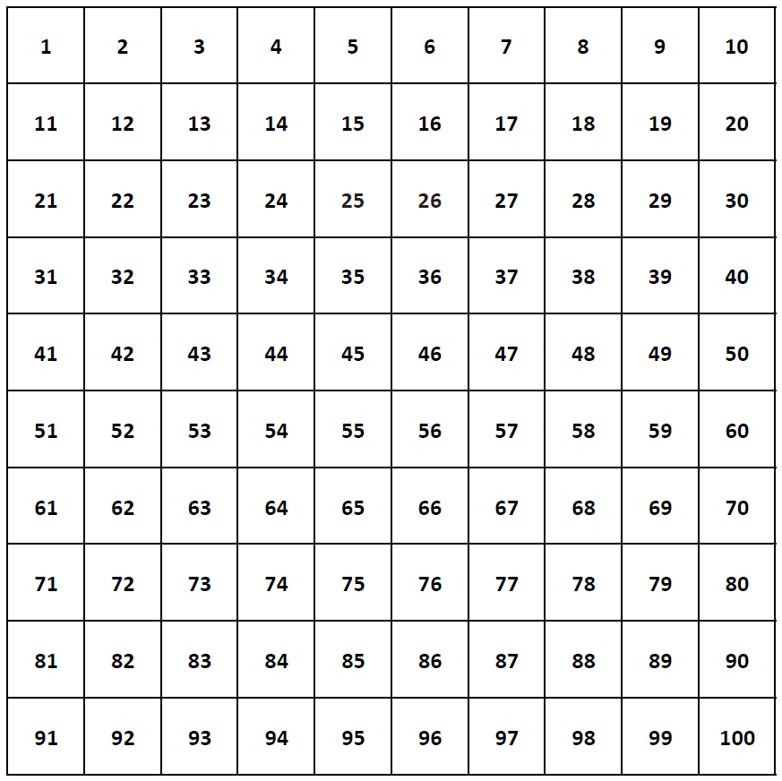
Notes:
Pre-requisite skills – to use this starter, drag this slide to the start of Day 2
Put children in groups of 4. They each write a 2-digit number on a whiteboard and then work together to put them in order from the smallest to largest. Show a 1-100 grid (see resources) for them to check. Repeat then ask 2 groups of 4 to combine and order all 8 on whiteboards.

Slide 6
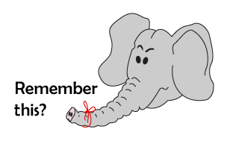
Place Value and Fractions
Ordinal numbers, Place value
Properties of 2-digit numbers, Rounding
Starter
Place value
Notes:
Simmering skills – to use this starter, drag this slide to the start of Day 3
Show children how to show 35 using hands. Close your hands, flash 10, three times, and then hold up 5 fingers. Hold up a 2-digit number, say 3, 2, 1. Children show the number. Repeat.

Slide 7
Place Value and Fractions
Ordinal numbers, Place value
Properties of 2-digit numbers, Rounding
Starter
Rounding
Notes:
Simmering skills – to use this starter, drag this slide to the start of Day 4
Use the hall or an outside space. Children stand holding numbers: 0, 10, 20… 100. Give other children a 1-100 card each. A group at a time, they stand between the correct multiples of 10, then move to the closest 10.

Slide 8
Day 2: Compare numbers using the symbols < and >.
35
51
83
0 10 20 30 40 50 60 70 80 90 100
Where is 51 on this line?
Is it closer to 50 or 60?
Where would 35 go on this line?
Imagine ten beads between 30 and 40.
Where would you put 83 on this line?
Nearer 80 or 90?
Closer to 80 or 85, which is halfway between 80 and 90?

Slide 9
Day 2: Compare numbers using the symbols < and >.
27
42
78
0 10 20 30 40 50 60 70 80 90 100
What about 78?
Show me where would 27 go on this line…
And where does 42 sit?

Slide 10
Day 2: Compare numbers using the symbols < and >.
Using your card strips and two towers of cubes, complete a demonstration to model
equals
greater than
less than.
Notes:
Make an equals sign by securing 2 strips of black paper with brass fasteners to a background piece of card. Explain:
The equals sign means that whatever is on each side must balance.
There is space for more cubes at this end than at the other, we call this a greater than sign: what’s on this side is greater than what is on the other side. Record 3 > 1.
The smaller number goes on the left this time, there’s less space here. Record 1 < 3.

Slide 11
Day 2: Compare numbers using the symbols < and >.
38
83
0 10 20 30 40 50 60 70 80 90 100
What 2-digit numbers can we make with these cards?
Which number is bigger?
8
3
Write an inequality to show this, using < or >.
38 < 83
83 > 38

Slide 12
Day 2: Compare numbers using the symbols < and >.
17
71
0 10 20 30 40 50 60 70 80 90 100
What 2-digit numbers can we make with these cards?
Which number is bigger?
1
Write an inequality to show this, using < or >.
7
17 < 71
71 > 17

Slide 13
Day 2: Compare numbers using the symbols < and >.
56
65
0 10 20 30 40 50 60 70 80 90 100
What 2-digit numbers can we make with these cards?
Which number is bigger?
6
5
Write an inequality to show this, using < or >.
56 < 65
65 > 56
Notes:
Children can now go on to do differentiated GROUP ACTIVITIES. You can find Hamilton’s group activities in this unit’s TEACHING AND GROUP ACTIVITIES download.
WT: Using beaded and landmarked lines, children record inequalities between two 2-digit numbers, using symbols for inequalities.
ARE: Using a landmarked line, pick 2-digit numbers to complete inequalities, using symbols for inequalities.
GD: As ARE and mark number sentences on the ‘Inequalities’ sheet (see resources).

Slide 14
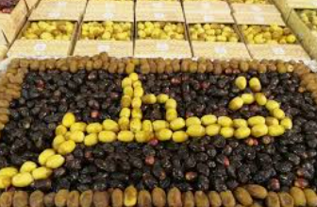
QNID
Khalas, Shishi, Barhi, Khudri, Safawiare some of the kinds of dates grown in Qatar.
Basket A: Khudri Dates – 15
Basket B: Safawi Dates – 12
Which basket has more dates?
Is 15 more than or less than 12?
Write the correct symbol (>, <, =) between the numbers.

Slide 15
Task 1 – Pair/Group Work
• Work with a partner.
• Shuffle a pack of cards with numbers 1 to 9.
• Pick 2 cards from the pack.
• Use the cards to make two different two-digit numbers.
Example: If you pick 5 and 4, you can make 54 and 45.
• Mark both numbers on a 0-100 number line.
• Write the comparison:
Example: 54 > 45 and 45 < 54.
• One child picks 2 number cards (1-9) and shows them to everyone.
• Work together to make two numbers using the digits.
Example: If the cards are 3 and 5, the numbers are 35 and 53.
• Find the biggest number.
• Mark both numbers on a 0-100 beaded line.
• Write the comparison:
Example: 53 > 35 and 35 < 53.
• Repeat with new numbers.

Slide 16
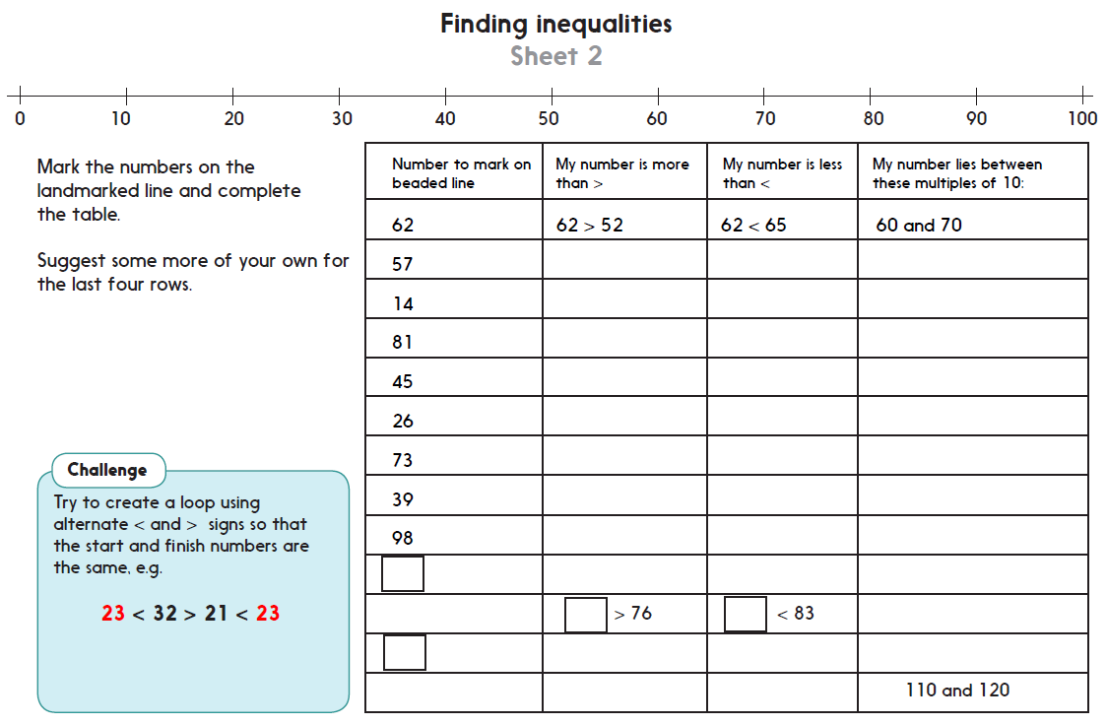
Task 2 – Independent Work
Challenge
Notes:
The Practice Sheet on this slide is suitable for most children.
Differentiated PRACTICE WORKSHEETS are available on Hamilton’s website in this unit’s PROCEDURAL FLUENCY box.
WT: Complete a table showing inequalities. Use a beaded line to model position of numbers (Sheet 1).
ARE/ GD: Complete a table showing inequalities. Use a landmarked line to model position of numbers. Complete a ‘loop’ challenge (Sheet 2).

Slide 17
Plenary
.
A child to pick 2 digit cards 1-9 and show them to the group.
Which numbers can we make by using these 2 digits? (e.g. 35 and 53.)
Which is the largest number?
Mark these 2 numbers on the line.
How can we show that 53 is bigger than 35? Write 53 > 35.

Slide 18
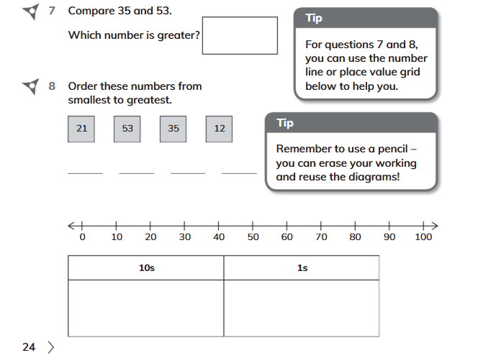
Homework
Q7 and Q8 on page 24, workbook

