Slide 1


Year 2 Starters
Autumn Term
Test H
Play through the slides, giving children as much time as you think they need to answer each question. Most questions have a written answer; sometimes children may show a number of fingers.
Answers are given at the end of the test.
This is not a class competition! Can children beat their own personal best each week?
Which ride do they get to enjoy at the end?

Slide 2
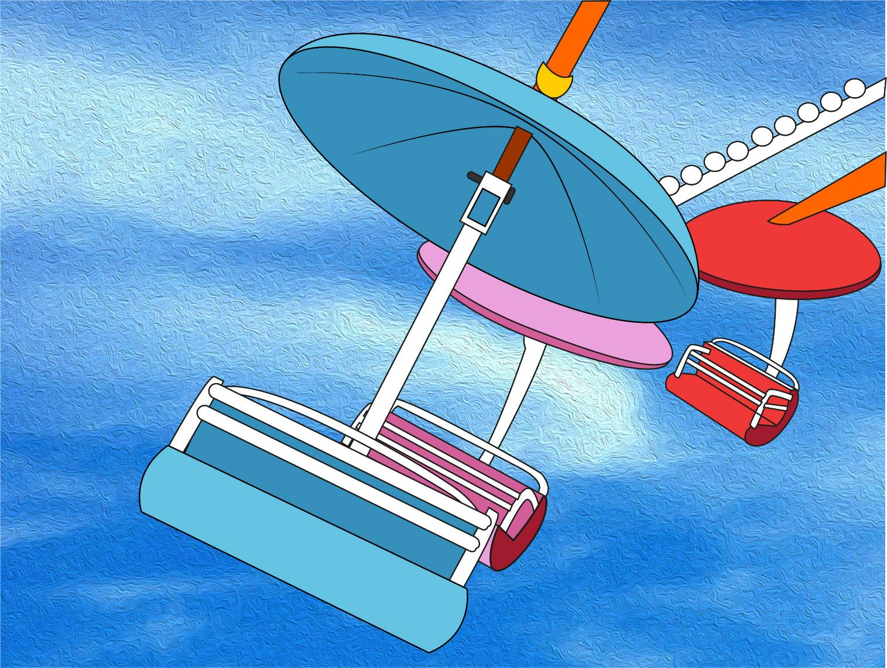
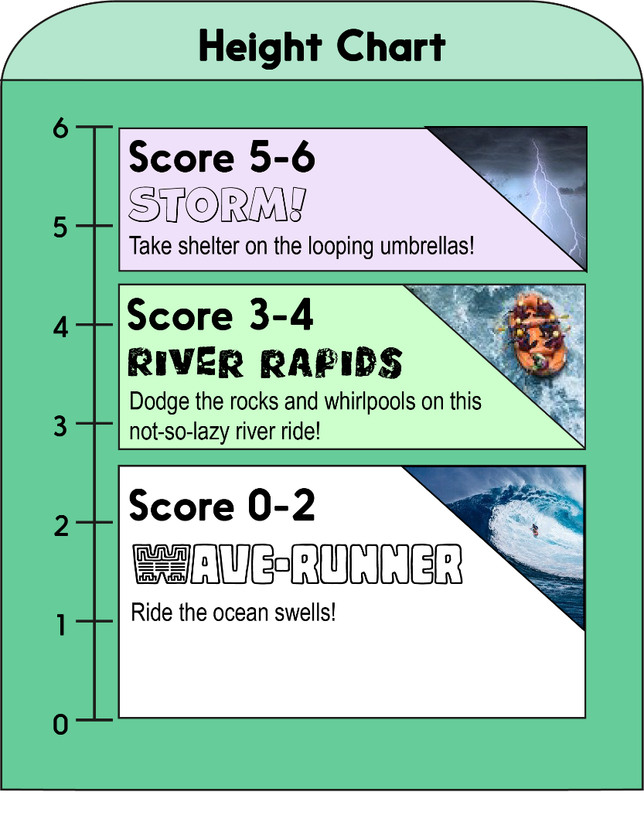


Score a mark on the chart for each correct answer on the test.
Which ride will you measure up for?!

Slide 3
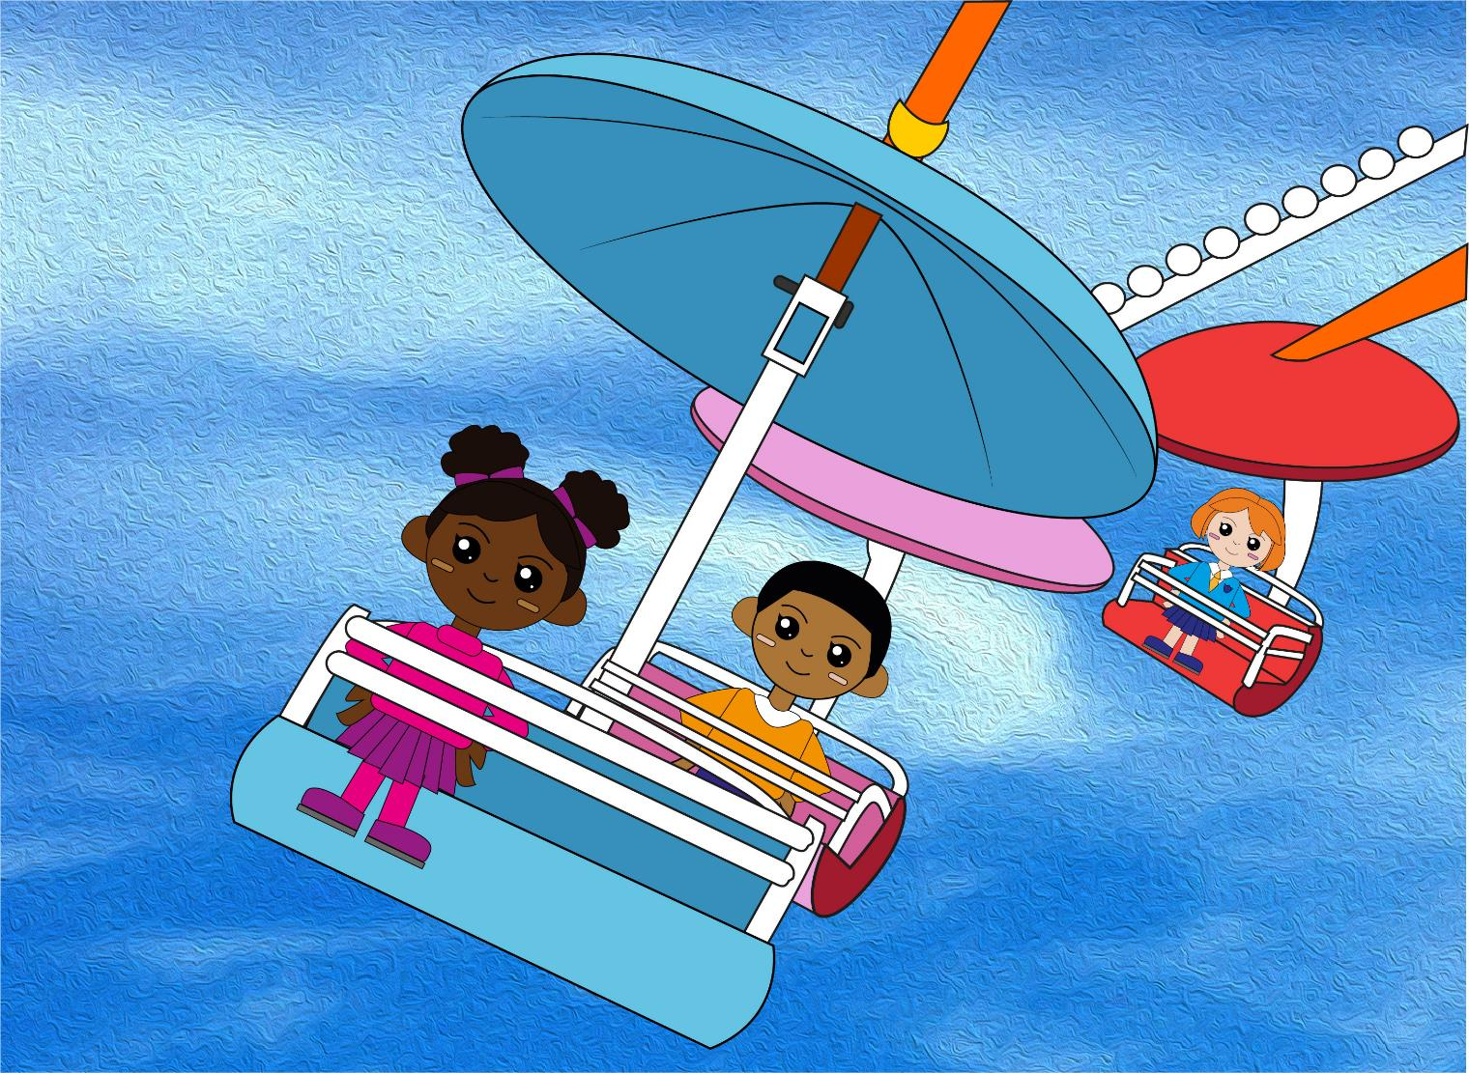

Question 1
51 + = 60
Write your answer as a number sentence.

Slide 4
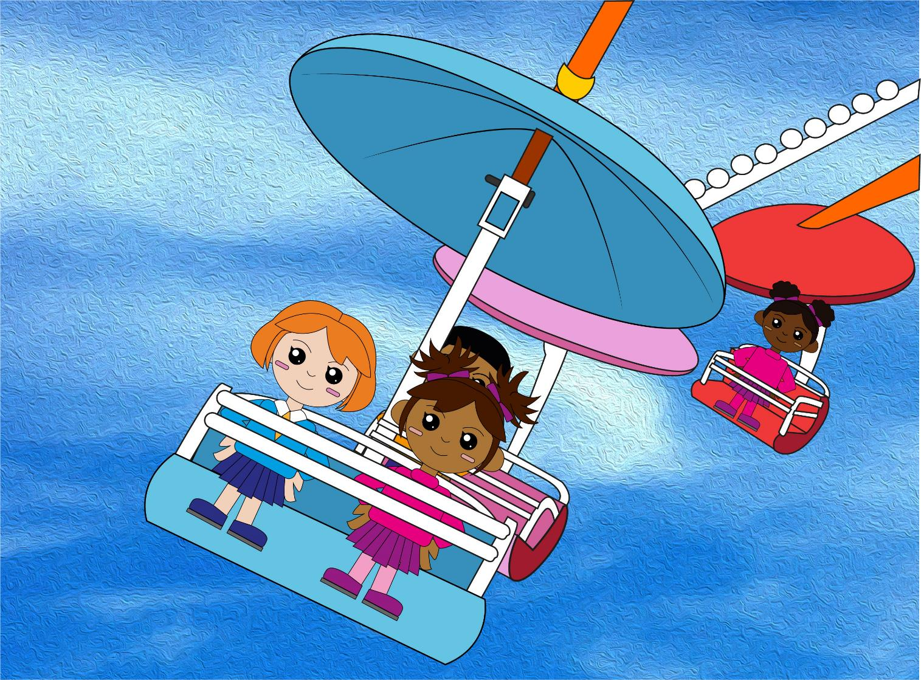
Question 2
92 + = 100
Write your answer as a number sentence.

Slide 5
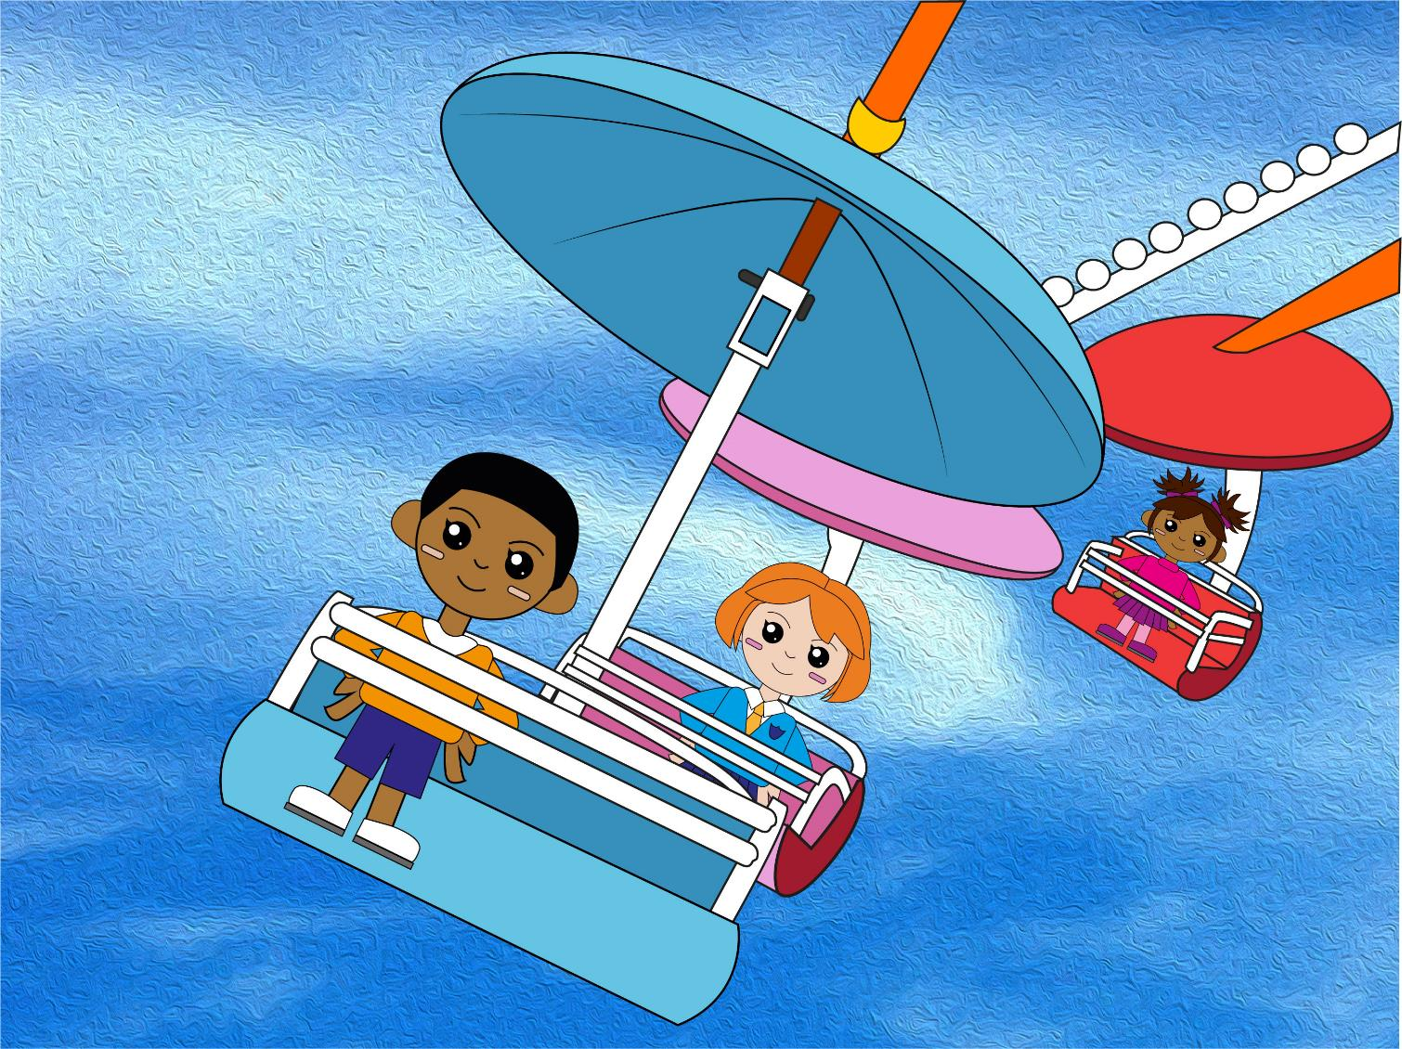
Question 3
11 – 3 = ?
So, 21 – 3 = ?
text
Write your two answers.

Slide 6
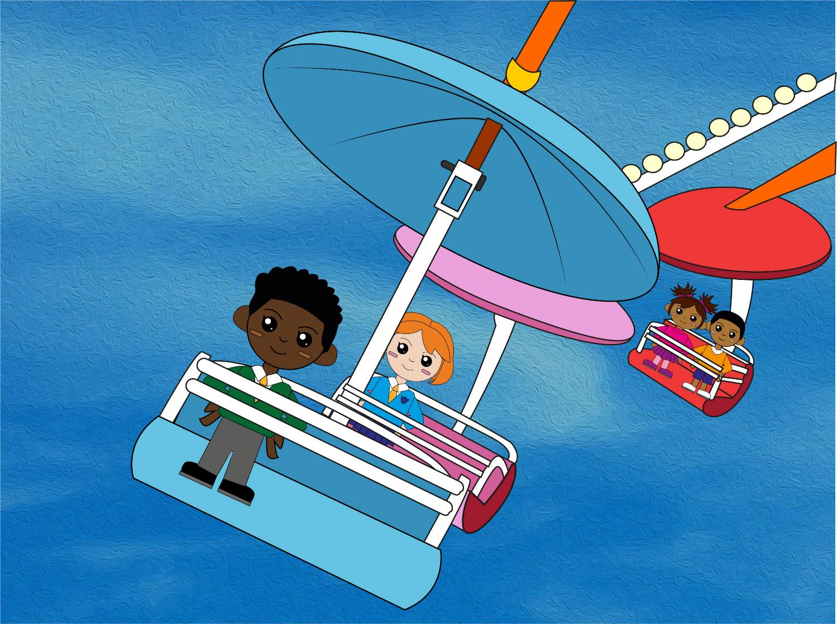
Question 4
12 – 5 = ?
So, 32 – 5 = ?
text
Write your two answers.

Slide 7
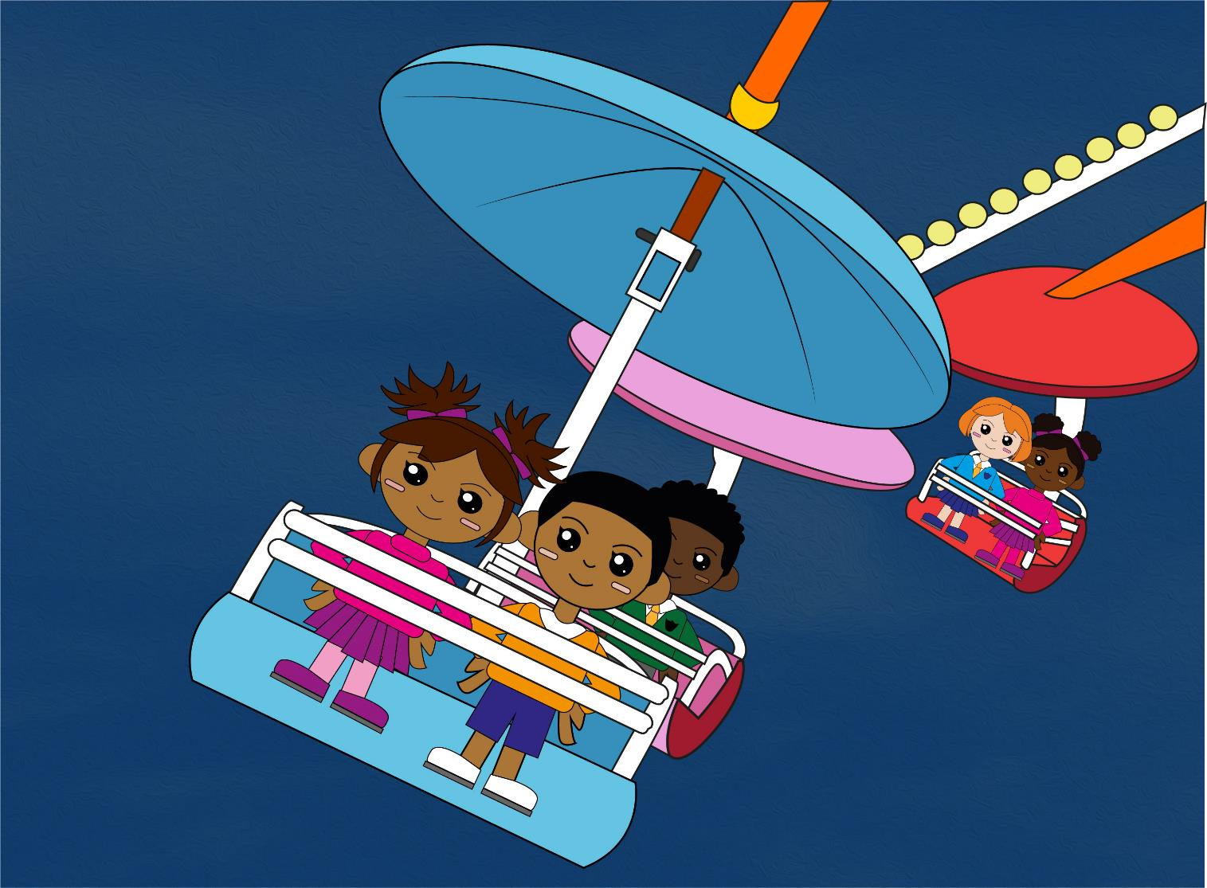
Question 5
Double 18 is ?
text
Write your answer.

Slide 8
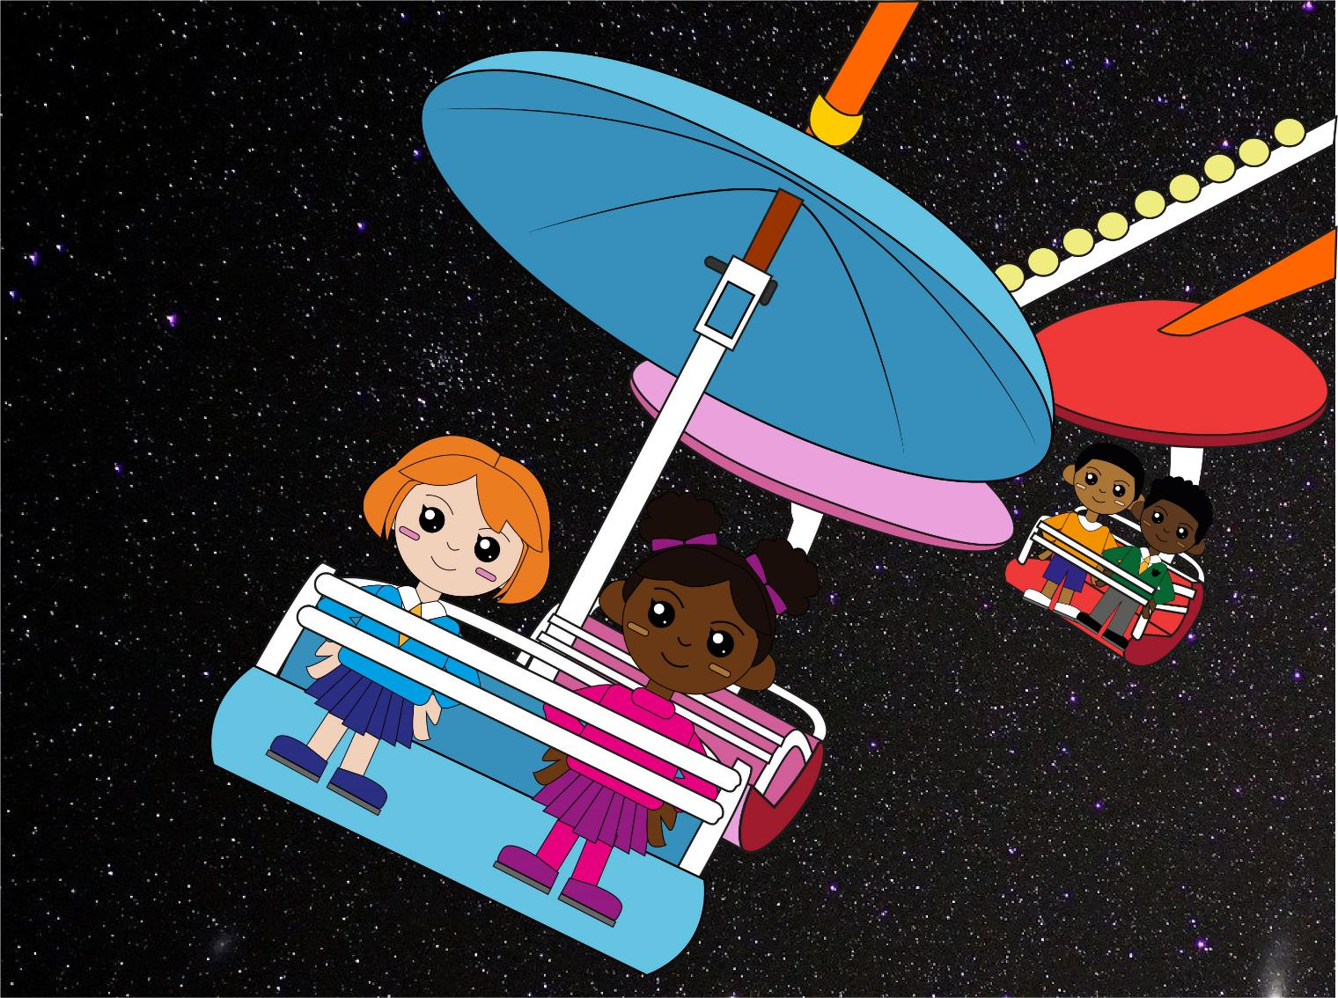
Question 6
Half of 28 is ?
text
Write your answer.

Slide 9

Q1
51 + 9 = 60
Q2
92 + 8 = 100
Q3
11 – 3 = 8
So, 21 – 3 = 18
Q4
12 – 5 = 7
So, 32 – 5 = 27
Q5
Double 18 is 36
Q6
Half of 28 is 14
The answers!

Slide 10
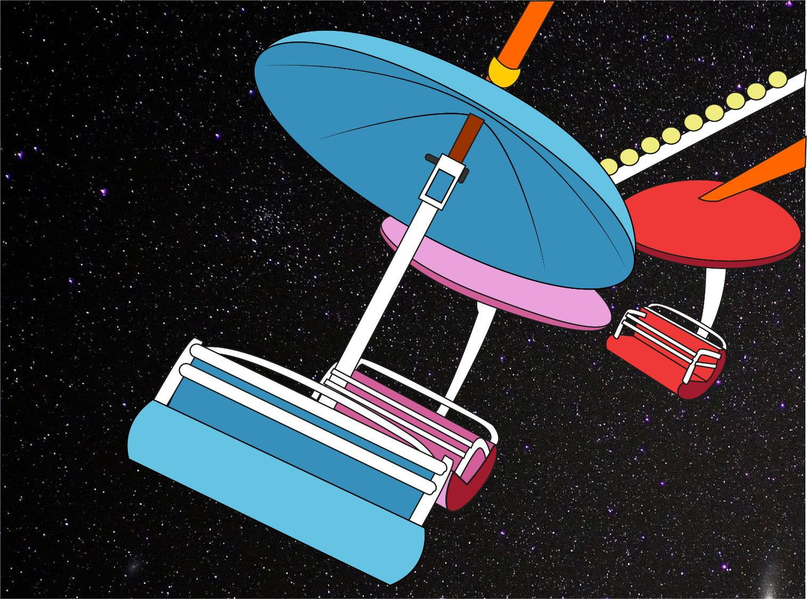
So, which ride do YOU measure up for?!
Did you beat YOUR personal best?

