Slide 1
Revision: Unit 3-Be a data expert Unit 4-Be a designer Unit 5: Networks are everywhere

Slide 2
Lesson Objective
Identify services available on the network.
Recognize the advantage and disadvantages of a network
Demonstrate the advantage and disadvantages of a network
Identifying the different ways of representing data
Analyse the problems that can be solved using data
Record discrete and categorical data

Slide 3
Key Vocabulary
Decision: a choice about something
Numerical: made of number
Categorical Data: information that can be sorted into categories or groups.
Discrete Data: information that can only take specific values and cannot be divided into smaller parts.
Multifunction: does more than one thing
Interactive smartboard: a whiteboard connected to a computer and a projector
E-reader: a device that lets you read electronic books.
Smart device: an electronic device that is connected to other devices via the internet decision: a choice about something.
Repetitive: doing the same thing repeatedly

Slide 4
Big Question
Why do you think computer networks are important in our everyday lives?
Can you give an example of how people use computer networks to share information or communicate with each other?

Slide 5
Hook Activity – Pair Activity (10 mins)
Each person will make a list of different tasks in sticky notes they often perform simultaneously in their daily life.
Once they have their list, pair up with their partner.
Each pair will then share and discuss examples of multitasking and consider how they compare to a computer's ability to run multiple programs at the same time.

Slide 6
Group Activity 1 (10 mins):
Decision
Numerical
Categorical Data
Discrete Data
Multifunction
Interactive smartboard
E-reader
Smart device
Repetitive

Slide 7
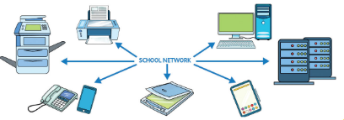
Group Activity 2 (20 mins):
List the devices connected on the school network in colored sheet.
What are the services provided by network?
List the advantages and disadvantages of network.

Slide 8
Extension Task:
Annay has a greenhouse that contains light sensors, water sensors and temperature sensors. He often takes pictures using the camera on his smartphone to show how the plants are growing. He saves these pictures on the phone.
Annay hands his smartphone to his mum to show her the pictures. but the phone is locked and requires a passcode to open it. He uses the fingerprint reader to unlock the phone or his mum to see the pictures.
List one example from each category of hardware.
Input | Output | Storage

Slide 9
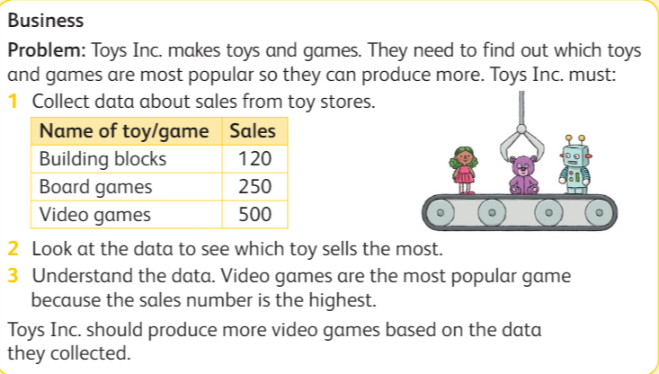
Exit Ticket
Write the answer on sticky note:

