Slide 1
PHYSICS – MAGNETIC FIELDS

Slide 2
LEARNING OBJECTIVES
Core •Describe the forces between magnets, and between magnets and magnetic materials • Give an account of induced magnetism • Distinguish between magnetic and non-magnetic materials • Describe methods of magnetisation, to include stroking with a magnet, use of d.c. in a coil and hammering in a magnetic field • Draw the pattern of magnetic field lines around a bar magnet • Describe an experiment to identify the pattern of magnetic field lines, including the direction • Distinguish between the magnetic properties of soft iron and steel • Distinguish between the design and use of permanent magnets and electromagnets | Supplement Explain that magnetic forces are due to interactions between magnetic fields • Describe methods of demagnetisation, to include hammering, heating and use of a.c. in a coil

Slide 3
Magnetic fields

Slide 4
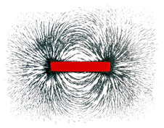
Magnetic fields
Iron filings sprinkled around a magnet
Magnetic field lines around the magnet

Slide 5
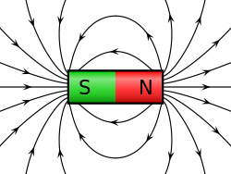
Magnetic fields
Iron filings sprinkled around a magnet
Field lines run from the north pole (N) to the south pole (S). The magnetic field is strongest where the field lines are closer together.
Magnetic field lines around the magnet

Slide 6
Magnetic fields
Using a plotting compass to find the field lines.
N
S

Slide 7
Magnetic fields
Using a plotting compass to find the field lines.
N
S

Slide 8
Magnetic fields
Using a plotting compass to find the field lines.
N
S

Slide 9
Magnetic fields
Using a plotting compass to find the field lines.
N
S

Slide 10
Magnetic fields
Using a plotting compass to find the field lines.
N
S

Slide 11
Magnetic fields
Using a plotting compass to find the field lines.
N
S

Slide 12
Magnetic fields
Using a plotting compass to find the field lines.
.
.
.
.
N
S

Slide 13
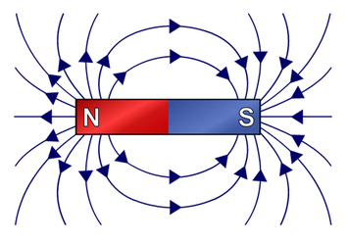
Magnetic fields
Using a plotting compass to find the field lines.
http://www.physbot.co.uk/magnetic-fields-and-induction.html

Slide 14
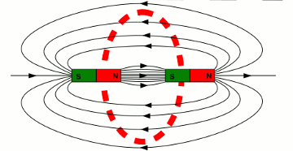
Magnetic fields
Interactions between magentic fields
When unlike poles are placed near each other, their magnetic fields combine to produce a single field of almost uniform strength.
http://www.homofaciens.de/technics-magnetic-field-energy_en_navion.htm

Slide 15
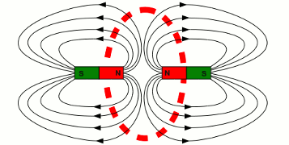
Magnetic fields
Interactions between magentic fields
Neutral point
When unlike poles are placed near each other, their magnetic fields combine to produce a single field of almost uniform strength.
When like poles are placed near each other, their magnetic fields cancel each other, and there is a neutral point where the combined field strength is zero.
http://www.homofaciens.de/technics-magnetic-field-energy_en_navion.htm

Slide 16
The Earth’s magnetic field
The Earth’s magnetic field is like that around a very large, but very weak, bar magnet.

Slide 17
The Earth’s magnetic field
The Earth’s magnetic field is like that around a very large, but very weak, bar magnet.
A compass ‘north’ end points north. But a north pole is always attracted to a south pole, so the Earth’s magnetic south pole must actually be in the north.

Slide 18
The Earth’s magnetic field
The Earth’s magnetic field is like that around a very large, but very weak, bar magnet.
A compass ‘north’ end points north. But a north pole is always attracted to a south pole, so the Earth’s magnetic south pole must actually be in the north.
The Earth’s magnetic north is actually over 1200km away from the true geographic north pole.

Slide 19
The Earth’s magnetic field
Over a period of time the Earth’s magnetic pole will ‘flip’.
The Earth’s magnetic field is like that around a very large, but very weak, bar magnet.
A compass ‘north’ end points north. But a north pole is always attracted to a south pole, so the Earth’s magnetic south pole must actually be in the north.
The Earth’s magnetic north is actually over 1200km away from the true geographic north pole.

Slide 20
The Earth’s magnetic field
Over a period of time the Earth’s magnetic pole will ‘flip’.
The Earth’s magnetic field is like that around a very large, but very weak, bar magnet.
A compass ‘north’ end points north. But a north pole is always attracted to a south pole, so the Earth’s magnetic south pole must actually be in the north.
The Earth’s magnetic north is actually over 1200km away from the true geographic north pole.
In the last 10 million years, there have been, on average, 4 or 5 ‘flips’ per million years.

Slide 21
Electromagnets
Distinguish between the design and use of permanent magnets and electromagnets

Slide 22
Electromagnets
Distinguish between the design and use of permanent magnets and electromagnets
Unlike bar magnets, which are permanent magnets, the magnetism of electromagnets can be turned on and off.

Slide 23
Electromagnets
Distinguish between the design and use of permanent magnets and electromagnets
Unlike bar magnets, which are permanent magnets, the magnetism of electromagnets can be turned on and off.
Permanent magnet uses:
Needles of compasses.
Fridge door seals, holding the doors closed.
Loudspeakers and microphones.

Slide 24
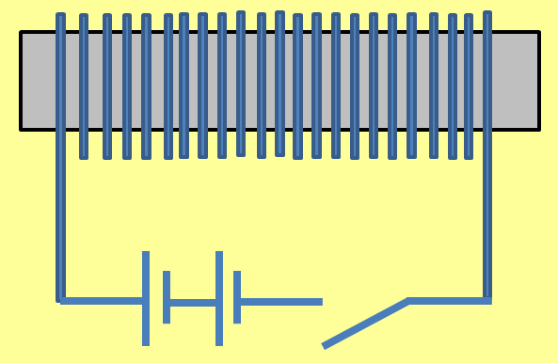
Electromagnets
Distinguish between the design and use of permanent magnets and electromagnets
switch
battery
Unlike bar magnets, which are permanent magnets, the magnetism of electromagnets can be turned on and off.
coil
Soft iron core
Permanent magnet uses:
Needles of compasses.
Fridge door seals, holding the doors closed.
Loudspeakers and microphones.
When a current flows through the coil it produces a magnetic field. This field is temporary and is lost when the current is switched off.

Slide 25
Electromagnets
Distinguish between the design and use of permanent magnets and electromagnets
switch
battery
Unlike bar magnets, which are permanent magnets, the magnetism of electromagnets can be turned on and off.
coil
Soft iron core
Permanent magnet uses:
Needles of compasses.
Fridge door seals, holding the doors closed.
Loudspeakers and microphones.
When a current flows through the coil it produces a magnetic field. This field is temporary and is lost when the current is switched off.
Strength increased by:
Increasing the current
Increasing number of turns

Slide 26
Electromagnets
Distinguish between the design and use of permanent magnets and electromagnets
switch
battery
Unlike bar magnets, which are permanent magnets, the magnetism of electromagnets can be turned on and off.
coil
Soft iron core
Permanent magnet uses:
Needles of compasses.
Fridge door seals, holding the doors closed.
Loudspeakers and microphones.
When a current flows through the coil it produces a magnetic field. This field is temporary and is lost when the current is switched off.
Strength increased by:
Increasing the current
Increasing number of turns
Uses: scrapyard electromagnets, circuit breakers, relays, electric bells.

Slide 27
LEARNING OBJECTIVES
Core •Describe the forces between magnets, and between magnets and magnetic materials • Give an account of induced magnetism • Distinguish between magnetic and non-magnetic materials • Describe methods of magnetisation, to include stroking with a magnet, use of d.c. in a coil and hammering in a magnetic field • Draw the pattern of magnetic field lines around a bar magnet • Describe an experiment to identify the pattern of magnetic field lines, including the direction • Distinguish between the magnetic properties of soft iron and steel • Distinguish between the design and use of permanent magnets and electromagnets | Supplement Explain that magnetic forces are due to interactions between magnetic fields • Describe methods of demagnetisation, to include hammering, heating and use of a.c. in a coil

Slide 28
PHYSICS – MAGNETIC FIELDS

