Slide 1
MITOSIS AND MEIOSIS

Slide 2
Reproduction
The process that make more of the same kind of organism

Slide 3
Asexual Reproduction
a process resulting in the production of genetically identical offspring from one parent

Slide 4
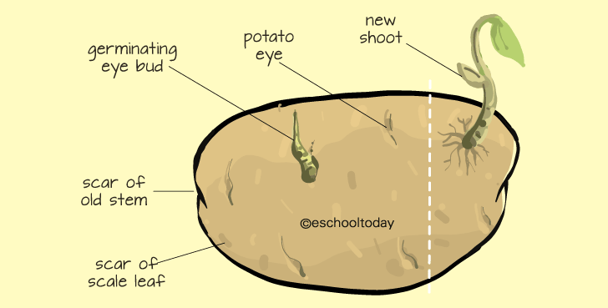
Tubers

Slide 5
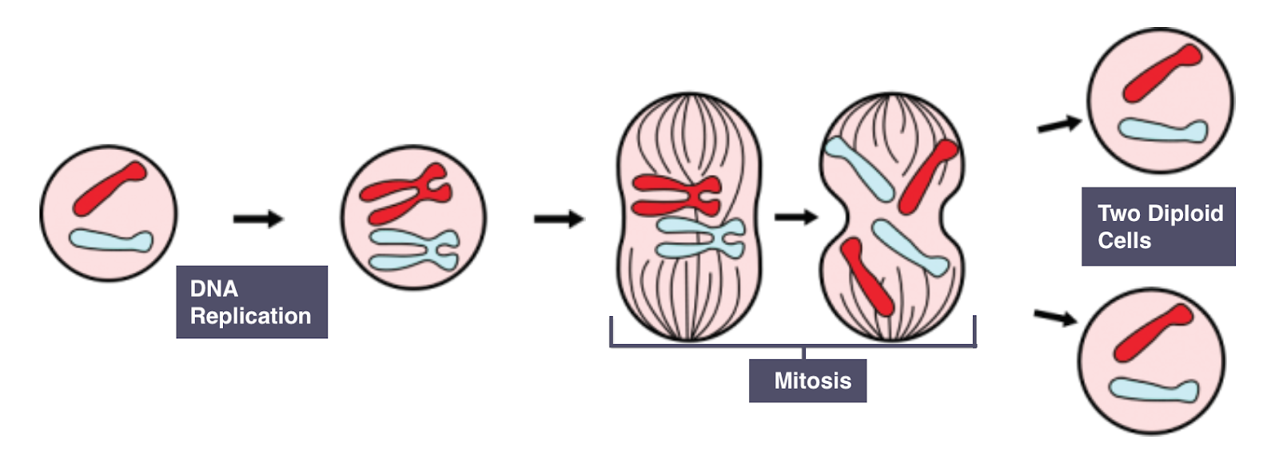
Mitosis
Nuclear division giving rise to genetically identical cells

Slide 6
Sexual Reproduction
a process involving the fusion of the nuclei of two gametes to form a zygote and the production of offspring that are genetically different from each other

Slide 7
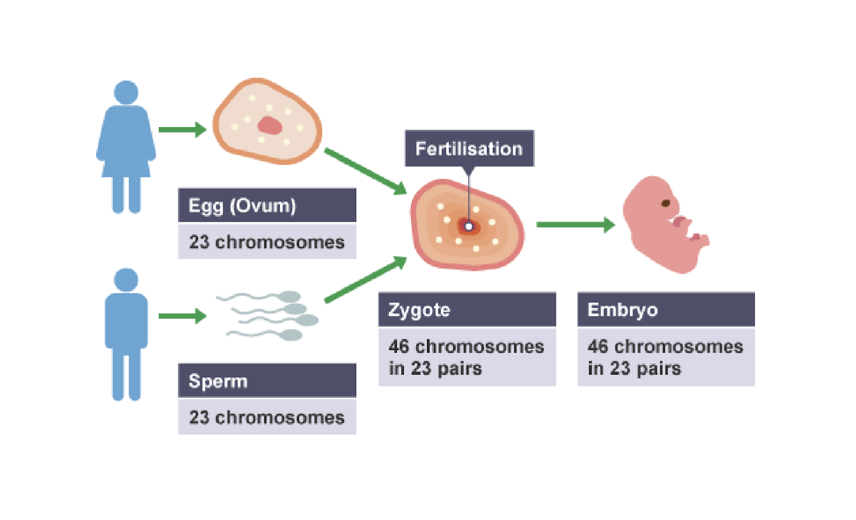
Chromosome numbers in sexual reproduction

Slide 8
Meiosis
A nuclear division giving rise to cells that are genetically different
Reduction division in which the chromosome number is halved from diploid to haploid, resulting in genetically different cells

Slide 9
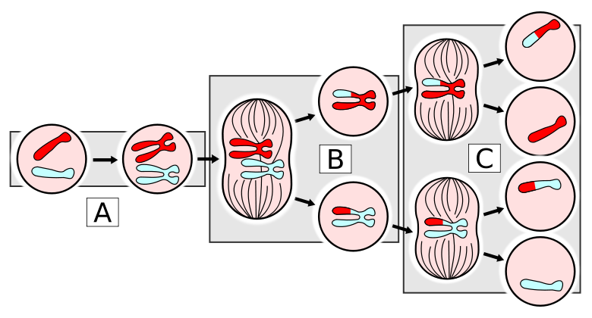
Meiosis

Slide 10
MITOSIS VS MEIOSIS

Slide 11
Sources:
Cambridge IGCSE Biology Coursebook 3rd ed.
Images from Google
http://eschooltoday.com/science/asexual-reproduction/what-is-a-stem-tuber-in-vegetative-propagation.html
https://courses.lumenlearning.com/boundless-biology/chapter/asexual-reproduction/
http://eschooltoday.com/science/asexual-reproduction/what-is-a-bulb-in-vegetative-propagation.html
https://hemantmore.org.in/foundation/science/biology/reproduction-plants-artificial-methods/422/
http://igcse-biology-notes.blogspot.com/2017/06/324-understand-that-mitosis-occurs.html
http://igbiologyy.blogspot.com/2014/03/cell-division-mitosis-and-meiosis.html
http://www.eschooltoday.com/science/pollination/types-of-pollination.html

