Slide 1
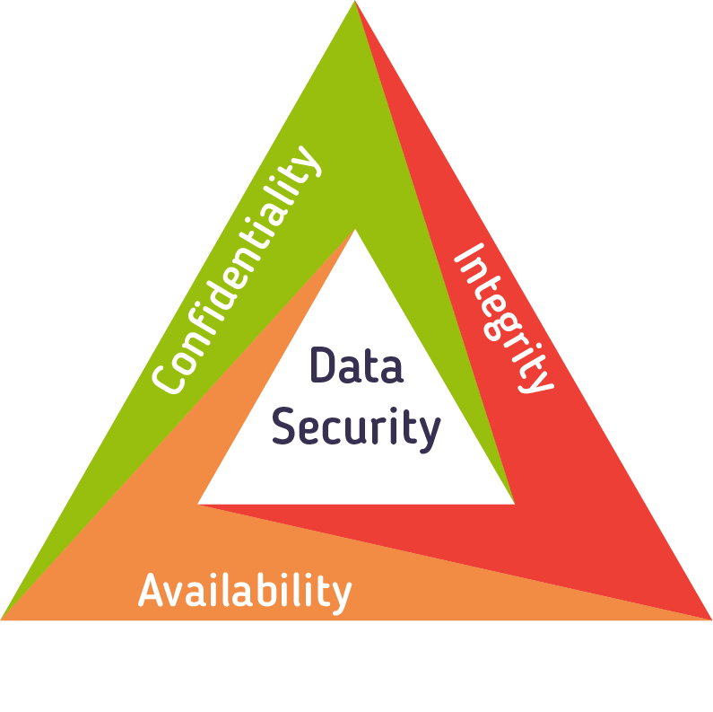
Unit9- Keep data safe
Year 6 Week 21 Day 1

Slide 2
Learning objective
By the end of the lessons students will be to identify and explain the need to keep data secure during transmission after completing the task and class discussion.

Slide 3
Key Vocabulary
Network traffic, Hacker, Websites, E-commerce

Slide 4
Big Question
What do you think can happen if the data shared is not transferred securely to the intended receiver?
What do you think secure data transmission means?

Slide 5
Hook Activity – Group (10 mins)
10 mins- Visual Aid
Engage learners in to watch a video on the need to keep data secure during transmission. In between the video the teacher will pause and ask randomly the students to answer the following big questions.
1.What do you think can happen if the data shared is not transferred securely to the intended receiver?
2.What do you think secure data transmission means?
.
https://www.youtube.com/watch?v=sdpxddDzXfE

Slide 6
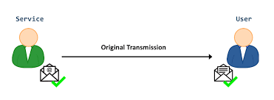
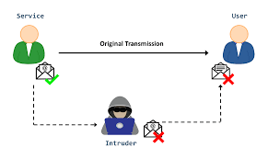
Main Activity Discussion–
15 mins-Class discussion
5mins-
Students will discuss with their peer and identify the differences between the two images. They will explain to the class what they have observed.
Teacher will randomly select the students to answers and jot it down their responses on the smart board.
Meanwhile others can note it down their answers in the sticky note.
10 mins-
Teacher will lead the discussion with their given answers by asking the any one student to Read a loud each different threats from the learners book (and in between teacher will explain the main key vocabulary.
30 mins- Group Activity Rotational Learning Station

Slide 7
Main Activity Discussion–
6-7 mins-Learning Station 1- Identifying the threats
Students will be grouped into 5 in each and complete the task.
Teacher will cut out the scenarios and students will identify the name of the threats and stick with sticky notes.
Note- Attached as Scenarios
6-7 mins- Learning Station 2- Match the vocabularies.
Students will be grouped into 5 in each and complete the task.
Students will cut and paste the key vocabularies with their meanings.
Note- Attached as Vocabularies
8 mins- Learning Station 3-Quiz Technology Station
Students will be grouped into 5 in each and complete the task.
https://wordwall.net/play/65510/688/132
15 mins -Learning station 4-Teacher lead station
Complete the worksheet independtly.LA will complete with the help of teacher support.
Note-Attached as Worksheet 2.

Slide 8
Enrichment task
Enrichment task
Write the answers in the barcoded sheet.

Slide 9
Plenary
5 mins- Just a min
Summaries the lesson. Meanwhile the others will write down the challenging part they faced in the lesson in the attached sheet.

Slide 10
Homework
Read and revise the unit and create a poster on MS Word for the different threats and share with the teacher via ClassDojo.

